Slide 1
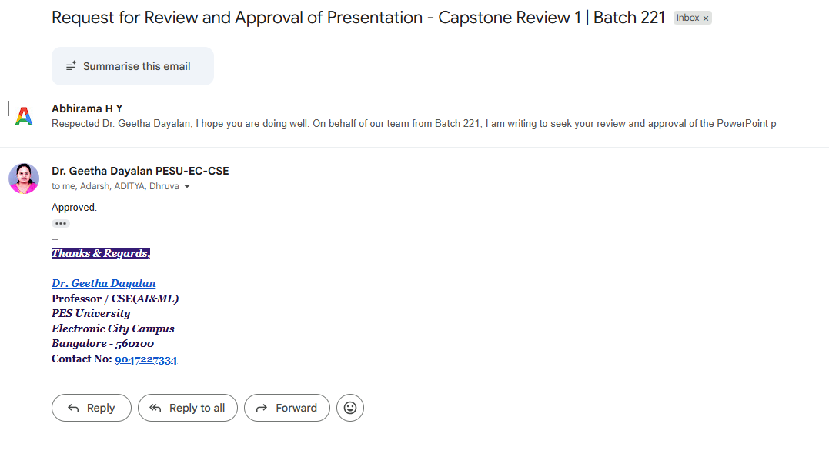

Slide 2
UE24CS320A – Capstone Project Approval
Phase-I · Review-1 · Problem Statement Approval
Project Title
Trust-Aware Agentic AI for Autonomous Cyber Incident Response and Resilient Recovery
Project ID :
221
Project Guide :
Dr. Geetha Dayalan
Project Team :
Abhirama H Y – PES2UG24CS023
Adarsh Prakash – PES2UG24CS027
Dhruva G Hegde – PES2UG24CS671
Aditya B Jambagi – PES2UG24CS030
Notes:
Introduce the team and guide, then the project title. 15 minutes presentation plus 5 minutes Q&A.

Slide 3
Outline
Problem Statement
Background Work and Research Gap
Our Approach
1
2
3
Scope and Feasibility Study
Challenges and Mitigation
Applications and Use Cases
4
5
6
Expected Deliverables
Project Timeline
References
7
8
9
Notes:
Nine parts in the order of the slides.

Slide 4
MOTIVATION : M&S · Ransomware 2025
Who is M&S?
A UK retailer with ~64,000 staff and 1,400+ stores: food, clothing and home goods.
What was the attack?
A 2025 ransomware attack that encrypted its servers and stole customer data.
Why does M&S need IT?
Payments, online orders and stock run on IT. Without it, shelves go empty.
2+ months reported dwell time [14]
46 days online orders halted [15]
£136M direct incident cost [13]
What happened
Why choosing the recovery point is hard
Apr 2025: ransomware encrypted M&S servers; online orders stopped [14][15].
Attackers got in by tricking staff at a third-party IT contractor [13].
They reportedly stole the Active Directory (login) database in February [14].
The attacker was inside for weeks, so recent backups may already be tainted.
Login data was stolen: every password is suspect, so identity comes first.
Recovery ran for months, one service at a time, with outside experts [14][15].
M&S took months to recover. Our aim: find the trustworthy recovery point by evidence.
Sources: [13] Sky News, 5 Nov 2025 · [14] BleepingComputer, Apr 2025 · [15] TechRadar, 2025
Notes:
M&S 2025: Scattered Spider/DragonForce ransomware. Attackers reportedly tricked a third-party IT contractor, and stole the Active Directory database (NTDS.dit) in February, about two months before encrypting servers on 24 April. Online orders were halted for 46 days and click-and-collect returned after nearly four months. Direct cost about GBP 136M (about GBP 100M insured); M&S had earlier estimated a GBP 300M profit hit. M&S has not published its recovery-point decisions, so we use it to show why the decision is hard: a long attacker dwell time means recent backups may be tainted, stolen login data means identity must be recovered and trusted first, and recovery is staged over months.

Slide 5
Problem Statement
1
The Threat
2
The Problem
3
Our Solution
Hackers lock or wipe a company’s datas or assets (ransomware).
Many systems are hit before anyone understands what is going on.
After detection of the attack, to recover from it, the team restores from different available backups.
But which assets and backups are still trustworthy and clean?
Choosing by hand is slow, and also wrong choice of backup brings the attacker back.
An AI system that gives
- every backup a trust score
- plans a safe recovery
- runs the critical steps only after human approval.
- Minimizes the recovery point selection time (MTTR)
Key questions after an attack: What is still safe to trust and restore from?
How fast can we choose the right backup?
How much data will we lose if we pick an older backup?
Which backup loses the least data and is still trusted?
Backup = a saved copy of data or systems. Recovery = getting systems working again after an attack. Trust score = a number showing how safe a backup is to use.
Notes:
Prevention sometimes fails. After compromise the hard question is what is still trustworthy. Today this is manual and static; we make trust the central decision variable.

Slide 6
Background Work
1
Existing Approaches & Recovery Workflow
2
Why This Problem Matters
Standards & SOAR:
94%
Attackers tried to damage or affect the backups that organizations use to recover their data.
NIST guides [1][2] and fixed playbooks [11] support response and recovery. – static and time consuming.
Traditional workflow:
57%
More than half of the attacks on backups were successful, making it difficult for organizations to recover safely.
Detect and contain → restore the latest (assumed-clean) backup → manual/fixed-playbook recovery → plan the recovery.
Success is often measured by time (MTTR) [7][9][11].
34%
Many organizations took more than a month to recover their systems and return to normal after a ransomware attack.
AI agents:
LLM/RL agents plan response actions [6]–[8], [12], but do not assess backup trust or reason the clean recovery. We add evidence-based trust scoring and safer recovery-point selection.
Source: Sophos, State of Ransomware 2024 [3]
Notes:
Background: existing solutions, the traditional recovery process, and why the problem matters (Sophos 2024: 94% / 57% / 34%).

Slide 7
Research Gap
Research gap | What exists today | What is missing | Found in
1 Recovery decisions are fragmented | Response agents [6]–[8], threat intel [12] and backup recovery [10] are studied separately. | One loop: evidence → trust → priorities → restore. | [6]–[8], [10], [12]
2 Recovery-point trust is not measurable | Guidance: choose by evidence, not recency [1][9]; backups are only protected [10]. | A graded trust score with an UNCERTAIN state, updated as evidence changes. | [1], [9], [10]
3 Speed is measured, safety is not | Agents report up to 22–23% faster recovery [7][8]. | Proof that the restored system is clean; safety metrics. | [7], [8], [9]
4 Hallucination is reduced, not blocked | The chance of a bad AI plan is bounded [7]; playbooks are fixed [11]. | A rule-based policy gate that blocks unsafe actions, with human approval. | [7], [11]
5 Service dependencies are ignored | Storage recovery protects data, not restore order [10]; [9] flags “dependency blindness”. | Restore in dependency order (e.g. identity first), from trusted backups. | [9], [10]
Our contribution: a unified loop that scores recovery trust, enforces policy and orders services.
Notes:
Five unique gaps merged from twelve candidates. [7] up to 22% shorter recovery, bounded hallucination probability; [8] up to 23% faster recovery; [9] backup over-trust, dependency blindness, asset-centric metrics; [11] playbooks differ by organisation.

Slide 8
Our Approach
INPUT
WHAT HAPPENS IN BETWEEN
OUTPUT
Alerts and logs
Threat intelligence (CTI)
Attack timeline
Service dependency map
Backup details
1 Understand the attack. Find what was hit, and when.
2 Score trust. Each backup gets a 0–1 score.
3 Check policy. Reject unsafe backups and actions.
4 Plan. Restore in order, from trusted backups.
5 Execute and verify. Re-score on new evidence.
Trust state per backup
Ranked recovery plan
Decision report with reasons
TRUSTED: use
UNCERTAIN: review
UNTRUSTED: exclude
Hard rules (e.g. confirmed malware) override the score.
EVALUATION
Recovery time (MTTR)
Correct-backup selection
Contaminated-recovery rate
Unsafe-action rate
SAFETY
Policy gate
Human approval
Post-recovery check
Notes:
One-slide approach. Input, process, output; an illustrative example output showing why the attack happened, the plan chosen and why others were rejected; the three trust states; and the evaluation metrics and safety measures. Example values are illustrative, not experimental results.

Slide 9
Example Scenario
1 Company XYZ
E-commerce firm, ~500 staff
Identity, app, database, website; daily backups
2 Cyberattack
21:40 Stolen VPN login
22:17 Backup server reached
22:25 Ransomware detected
3 Current situation
Servers encrypted or wiped; backups also touched
Which backup is safe?
INPUT TO OUR ENGINE
1 Alerts and logs: suspicious VPN login, ransomware at 22:25
2 Threat intelligence: malicious IP, known ransomware indicators
3 Attack timeline: access 21:40, backup server 22:17, ransomware 22:25
4 Dependency map: Identity → Application → Database → Website
5 Backup details: recovery points, integrity check, scan result
OUR ENGINE PROCESSING
1 Understand the attack: correlate logs, CTI and timeline
2 Calculate trust score (RTS): score 0–1 and trust state per backup
3 Check policy: reject unsafe backups; apply hard rules
4 Plan recovery: pick trusted backups, order by dependencies
5 Execute and verify: human approval, restore, re-score on new evidence
TRUSTED: RP-B 0.86, clean, pre-attack
UNCERTAIN: RP-E, integrity data missing
UNTRUSTED: RP-A, RP-D (contaminated)
Final outcome: restore from RP-B (RP = recovery point) with human approval, identity first, then servers.

Slide 10
Scope
In scope: what the system does
Real-world setting
Out of scope
Assess trust of assets, evidence and recovery points
Rank recovery points; exclude unsafe ones
Plan restoration in dependency order
Enforce policy; human approval for high-impact steps
Validate the restored state and explain decisions
Enterprise IT: identity, servers, databases, file shares
Ransomware and multi-stage intrusions with backups
Used by SOC and backup teams as decision support
Tested first in a controlled lab
New attack-detection engines
Live production deployment
OT / ICS and physical-safety recovery
Ransom negotiation and legal handling
Extended scope (if time permits): forensics, root-cause analysis and hardening recommendations.
Notes:
Core scope, real-world setting and exclusions; forensics and hardening are an extension.

Slide 11
Feasibility
1
Technical feasibility
2
Economic feasibility
3
Operational feasibility
Uses proven tools: LLM agents, threat-intel standards [4][5], malware scanners. Runs on lab VMs.
Free, open-source tools and a few lab VMs. Far cheaper than a failed recovery, e.g. £136M direct cost at M&S [13].
Helps humans decide; does not change live systems [1][2].
4
Legal and ethical feasibility
5
Data feasibility
6
Schedule feasibility
Only simulated attacks in an isolated lab; no real data. Humans approve big actions.
We create our own lab dataset of attacks with known clean and infected backups, plus public threat data [4][5].
Three phases with clear deliverables; each part can be tested alone.
Notes:
Six feasibility lenses: technical, economic, operational, legal and ethical, data, schedule.

Slide 12
Challenges and Mitigation
Challenge | What it means | How we address it
Dataset availability | No public data has clean and infected backups. | Build our own lab dataset: simulate attacks and take backups before and after.
Turning raw data into a trust score | Logs and scan results are not ready-made scores. | Fixed rules convert each clue into the parameters of the trust score (RTS). Missing evidence is marked UNCERTAIN.
Changing or unreliable evidence | New evidence keeps arriving; some is incomplete or tampered with. | Re-score on new evidence, track its source, and confirm with a second source.
Restore order | A clean backup is useless if what it depends on is not restored first. | Plan the recovery in dependency order.
Safety vs. automation | Full automation can take unsafe actions. | Rule-based policy gate plus human approval for big actions.
Notes:
Six challenges, including the dataset and the conversion of raw inputs into RTS scores.

Slide 13






Applications and Use Cases
Ransomware recovery
SOC and response teams
Backup and DR platforms
Pick a clean backup so the attacker does not come back.
Clear, ranked recovery plans to help analysts decide.
A trust-scoring layer that picks clean backups before restoring.
Critical services
Managed security providers
Audit and Explainability
Hospitals, banks, retailers like M&S: restore logins and key services first.
One consistent, auditable recovery method for many clients.
Decision reports serve as proof in reviews and practice drills.
Notes:
Real-world uses of trust-aware recovery.

Slide 14
Expected Deliverables
Phase-I deliverables
Phase-II deliverables
Phase-III deliverables
Finalized problem statement and scope
Literature survey and research-gap analysis
Research objectives and question
Architecture and TCRP design
RTS definition and trust states
Lab environment and attack scenarios
Telemetry and CTI correlation
Labelled clean vs. contaminated dataset
RTS parameter extraction from raw evidence
RTS calibration and recovery-point ranking
Policy gate with human approval
Dependency-aware restoration
Post-recovery validation and re-scoring
Explainable decision report
Final evaluation, prototype, report and demo
Notes:
Deliverables by phase.

Slide 15
Project Timeline
Task / Stage
Capstone Phase-I
Capstone Phase-II
Capstone Phase-III
1
2
3
4
5
6
7
8
9
10
11
12
13
14
15
16
17
18
Literature survey and research-gap analysis
Problem definition and scope
Architecture, TCRP and dependency-graph design
RTS definition and trust states
Lab setup and attack scenarios
Telemetry and CTI correlation
Dataset preparation and RTS parameter extraction
RTS calibration and recovery-point ranking
Policy gate and human approval
Dependency-aware planning and restoration
Validation, re-scoring and decision report
Final evaluation and integration testing
Documentation, final report and demo
Notes:
Gantt chart over eighteen numbered slots, six per phase, with overlapping tasks the way real work proceeds. Phase-I covers literature, problem definition, design and the trust score definition. Phase-II covers lab setup, CTI correlation, dataset and parameter extraction, calibration and ranking. Phase-III covers policy gate, planning and restoration, validation and report, final evaluation, and documentation and demo. No calendar months are shown.

Slide 16
References
Standards, reports and frameworks
[1] M. Bartock et al., “Guide for Cybersecurity Event Recovery,” NIST SP 800-184, 2016.
[2] NIST, “Incident Response Recommendations and Considerations for Cybersecurity Risk Management,” SP 800-61 Rev. 3, 2025.
[3] Sophos, “The State of Ransomware 2024,” 2024.
[4] MITRE, “ATT&CK: Adversarial Tactics, Techniques, and Common Knowledge,” attack.mitre.org.
[5] OASIS, “STIX Version 2.1” and “TAXII Version 2.1,” 2021.
Research papers
[6] X. Lin et al., “IRCopilot: Automated Incident Response with Large Language Models,” arXiv:2505.20945, 2025.
[7] K. Hammar et al., “Incident Response Planning Using a Lightweight Large Language Model with Reduced Hallucination,” arXiv:2508.05188, 2025.
[8] Y. Gao, K. Hammar, T. Li, “In-Context Autonomous Network Incident Response,” arXiv:2602.13156, 2026.
[9] C. Y. Chiu, “From Backup Restoration to Minimum Viable Factory Recovery,” arXiv:2605.16167, 2026.
Research papers (continued)
[10] K. Higuchi and R. Kobayashi, “Time-Scale Reconfiguration for Ransomware Mitigation by Delaying Encryption Progress,” IEEE Access, 2026. doi:10.1109/ACCESS.2026.3692203.
[11] D. Schlette et al., “Do You Play It by the Books? A Study on Incident Response Playbooks and Influencing Factors,” IEEE S&P, 2024. doi:10.1109/SP54263.2024.00060.
[12] “Advancing Autonomous Incident Response: Leveraging LLMs and Cyber Threat Intelligence,” IEEE GLOBECOM, 2025. doi:10.1109/GLOBECOM59602.2025.11432623.
Real-world incident sources
[13] S. Taaffe-Maguire, “M&S reveals cost of cyber attack as profit almost wiped out,” Sky News, Nov. 5, 2025.
[14] L. Abrams, “Marks and Spencer breach linked to Scattered Spider ransomware attack,” BleepingComputer, Apr. 2025.
[15] “Marks and Spencer click and collect is back at last,” TechRadar, 2025.
DRIVE LINK : LINK
Notes:
Non-arXiv sources first (standards, industry report, frameworks), then the research papers. [13], [14] and [15] support the real-world incident slide. Reference numbers on all slides refer to this list.

Slide 17
Thank You
Trust-Aware Agentic AI for Autonomous Cyber Incident Response and Resilient Recovery
Notes:
Invite questions.

