Slide 1
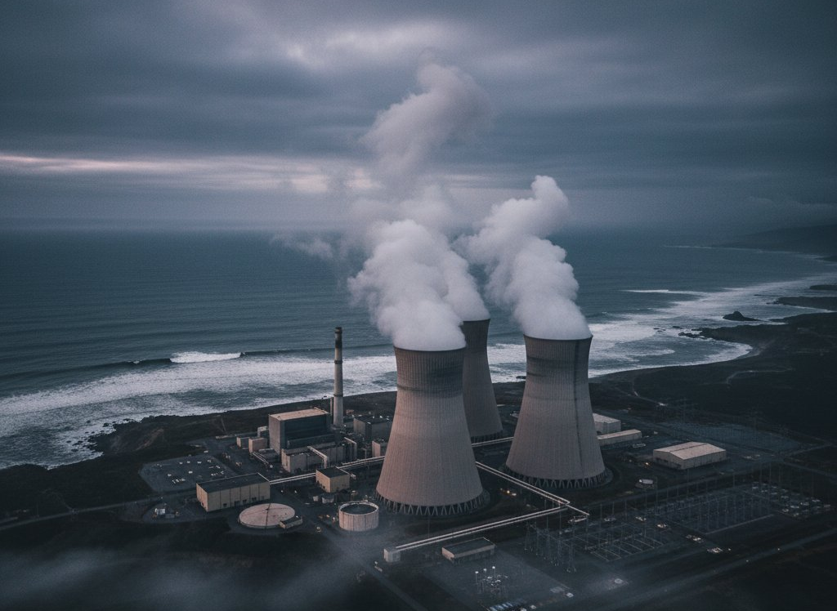
INES LEVEL 7
Fukushima Daiichi
Nuclear Disaster
March 11, 2011 · Japan
A 15 m tsunami overwhelmed all safety systems, triggering meltdown.
Earthquake
Tsunami Height
9.0
~15
Mw
m
Magnitude
Design basis: 5.7 m
INES Rating
Reactor Cores
7
3
/ 7
melted
Maximum Level
Within 72 hours
01
Notes:
On March 11, 2011, a magnitude 9.0 earthquake — the most powerful ever recorded in Japan — struck off the eastern coast of Honshu. What followed was a 15-meter tsunami that overwhelmed every safety barrier at the Fukushima Daiichi nuclear plant, disabling 12 of 13 backup generators and cutting all cooling to three operating reactors. Within 72 hours, all three reactor cores had melted. The accident was rated Level 7 on the International Nuclear Event Scale — the maximum possible level, shared only with Chernobyl.

Slide 2
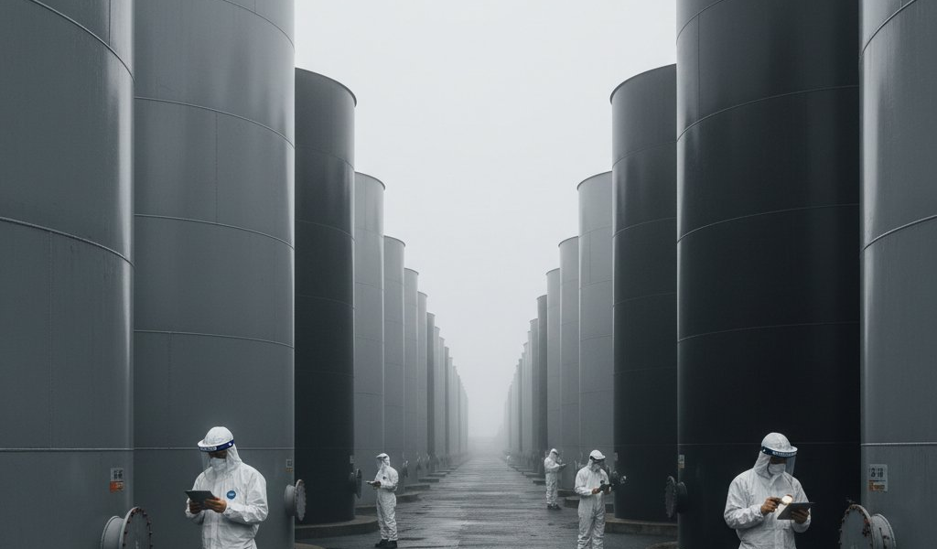
Impact, Cleanup & Global Legacy
2011 — ONGOING DECOMMISSION (EST. 2041–2051)
RECOVERY TIMELINE
Mar
Dec
2012
2021
2023
2041–
2011
2011
2051
Accident &
Cold Shutdown
NRA Est.
Unit 3 Fuel
ALPS Water
Full
Evacuation
Achieved
New Regulator
Pool Cleared
Release Begins
Decommission
HUMAN IMPACT
CLEANUP STATUS
100,000+
People evacuated from their homes
2,313
Disaster-related evacuee deaths
0
deaths
From direct radiation exposure
1.25M
Tonnes contaminated water stored
GLOBAL LEGACY
Contaminated water storage at Fukushima Daiichi site
Germany phased out all nuclear power by 2023
Decommissioning: 30–40 Year Project
Japan NRA established; new safety standards enacted
Est. $200 billion cost · Target: 2041–2051
IAEA global post-Fukushima safety review worldwide
Fuel debris retrieval remains greatest challenge
Source: World Nuclear Association · IAEA · TEPCO
02
Notes:
The Fukushima disaster displaced over 100,000 people and caused 2,313 stress-related deaths among evacuees — though remarkably, zero people died from direct radiation exposure. Japan is still managing the aftermath: roughly 1.25 million tonnes of treated water have accumulated on site, and in August 2023 Japan controversially began releasing filtered water into the Pacific Ocean. The full decommissioning of the four damaged reactors — an estimated 200 billion dollar project — is not expected to be complete until between 2041 and 2051. The accident reshaped global nuclear policy: Germany shut down its last reactor in 2023, Japan created an independent nuclear regulator, and the IAEA launched worldwide safety reviews. The cleanup at Fukushima continues, serving as a permanent reminder of the gap between what safety standards promised and what the ocean delivered.

