Slide 1



SMART INDIA HACKATHON 2026
  Problem Statement ID - •SIH26056
  Problem Statement Title - Development of a Real-time Airfare Price Index for India through Automated Web Scraping of Airline and Online Travel Aggregator Portals for Augmentation of the Consumer Price Index (CPI)
  Theme- Smart Automation
  •PS Category- Software
  TeamID -
  Team Name- SAPNAK

Slide 2

SAPNAK
IDEA TITLE
Challenges Faced
Proposed Solution
Product Uniqueness
• Manual & Static: Current CPI collection relies on slow offline spot-checks, capturing only a limited snapshot of airfare.
• Dynamic Volatility: With 90%+ of tickets sold online, algorithmic pricing can drive 200–400% price swings within a day.
• Macroeconomic Blindspots: Missed intra-day fare surges create gaps in CPI measurement and can distort true inflation signals.
• Aviation Specifics: Demand, seat scarcity, and advance-booking windows change fares faster than conventional NSO collection cycles can capture.
CPI relies on slow manual collection. Our real-time data-driven pipeline corrects this.
Extraction Engine : Python scrapers capture quotes (T+1 to T+45).
Cleaning Pipeline: Normalizes data and isolates base fares.
Composite Index : Computes daily weighted APIx
Crowdsourcing : Rewards receipt uploads to bypass blocks.
Dual Dashboards:B2G analytics and freemium B2C portal.
  T+45 Advance Window: Captures fare dynamics from T+1 to T+45.
  Anti-Bot Shield: Combines ethical scraping + crowd verification for resilient data collection.
  Base Fare Isolation: Strips taxes, UDF & fees to reveal the core airfare movement.
  Laspeyres + DGCA Weighting: Passenger-weighted indexing reflects real route importance.
  Self-Sustaining Loop: Gamified receipts → continuous ground truth → better data.
  CPI Augmentation: Built for direct MoSPI/RBI integration.
Why We Stand Out
  Manual & Slow?→ Automated Nodes Capture : thousands of daily data points.
  200-400% Volatility?→ Real-Time Track : Pipelines capture dynamic surges instantly.
  Layout & Captchas?→ Crowdsourcing :User feedback loop bypasses scraper friction.
  Distorted Metrics?→ Base Isolation : Ensures government tracks true economic changes.
  Opaque Pricing?→ Transparent B2C : Freemium dashboards democratize fare data.
@SIH Idea submission-Template
2
2

Slide 3
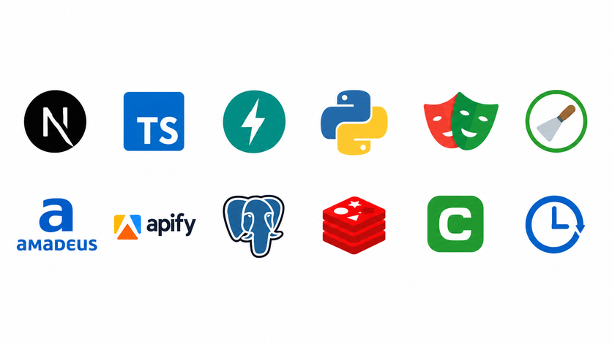
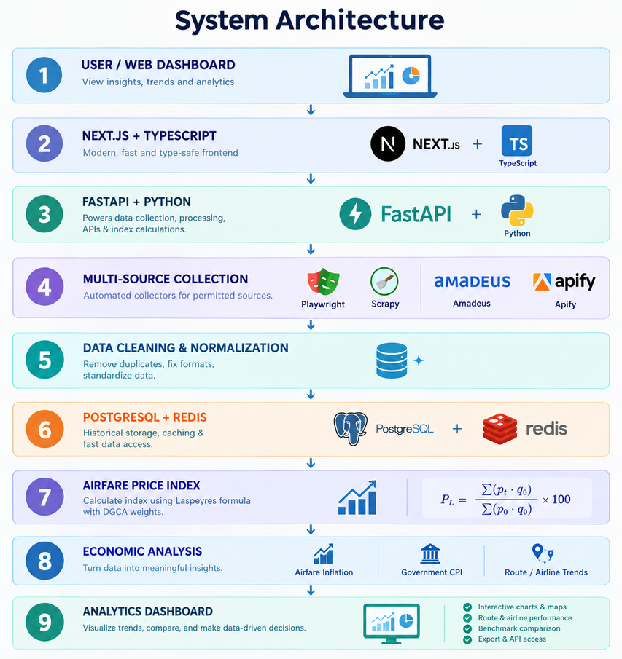
TECHNICAL APPROACH
SAPNAK
TECH STACK
architecture diagram
Live Airfare Intelligence
  Real-Time Fare Collection: Collects fares from permitted airline, OTA, Amadeus & Google Flights sources.
  India-Wide Search: Supports route and travel-date searches across Indian airports.
  Multi-Source Comparison: Compares fares by airline, route, source and stops.
  Availability Monitoring: Tracks available, limited, sold-out and blocked results.
  Live + Historical Data: Preserves timestamped fares for trend analysis.
  Economic Intelligence: Converts fares into APIx and compares airfare inflation with CPI.
  Next.js + TypeScript: Responsive dashboard for search, trends & insights.
  FastAPI + Python: Powers data collection, processing, APIs & index calculations.
  Playwright / Scrapy: Automated collectors for permitted sources.
  Amadeus + Apify: Structured airfare data integration.
  PostgreSQL + Redis: Historical storage, caching & fast data access.
  Celery / APScheduler: Handles scheduled and background scraping.
3

Slide 4
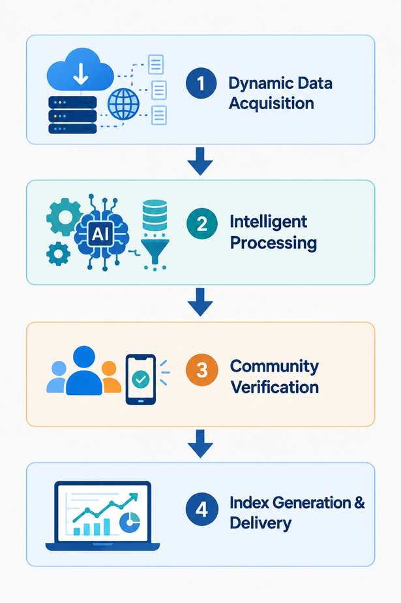
FEASIBILITY AND VIABILITY
SAPNAK
Technical Feasibility
Data PipeLine FLow
Economic Viability
  Automated Data Gathering : Captures live fares from airline & OTA sources.
  Smart Data Cleaning : Normalizes fares and isolates base prices.
  Built for Scale : Handles high-frequency fare data.
  Community Verification : Uses receipts for ground-truth validation.
  DemoCollector Fallback : Synthetic fares keep the system running when live scraping fails.
  Cost-Effective : Built with open-source tools and public data.
  Asset-Light Model : Eliminates expensive licenses by strictly leveraging public booking channels.
  Self-Sustaining Loop : Gamified B2C rewards incentivize a continuous supply of verified data.
  Multi-Tier Monetization : Freemium consumer tier paired with premium B2G/B2B analytics dashboards.
  Base Fare Isolation: Separates base fare, taxes, UDF and convenience fees .
  Targeted Integration : B2G dashboard purpose-built to plug directly into RBI & NSO pipelines.
  Execution-Ready Team : In-house expertise spans Python scrapers, ML pipelines, and Next.js dashboards.
REAL DATA
SCALABLE
VALIDATED
DEPLOYABLE
DGCA + MoSPI
Daily
Automated
30-Day
Benchmark
API +Dashboard
NSO/RBI Ready
4

Slide 5
IMPACT AND BENEFITS
SAPNAK
Target Impact
Strategic Alignment
Business Model
Future & Scale
Macro Authorities: Delivers high-frequency airfare metrics to MoSPI/RBI to eliminate static CPI lag.
Aviation Consumers: Democratizes fare transparency, shielding travelers from dynamic surge gouging.
Economic Research: Establishes an open, auditable benchmark dataset for aviation market dynamics.
Viksit Bharat & DPI:
Advances India's Data Governance by modernizing national stats via automated pipelines.
UN SDG 8: Strengthens monetary policy stability through accurate real-time price indexation.
UN SDG 9 & 12: Upgrades legacy infrastructure with AI while driving market consumption transparency.
  Monetary Calibration: Quantifies true transport inflation by applying the official 8.59% CPI Transport weight to real-time fare data.
  Inflation Gap Tracking: Real-time visibility into whether air travel is inflating faster than general headline CPI.
  High-Frequency Signal: Eliminates the 30–45 day reporting lag for central bank policy meetings.
Multi-Modal Index : Expanding scraper pipelines beyond aviation to capture premium rail and buses.
Nowcasting Engine : Integrating ML time-series models to predict transport inflation ahead of stats.
Regional Expansion : Scaling distributed ingestion to cover major South Asian and cross-border corridors.
@SIH Idea submission-Template
2
5

Slide 6
RESEARCH AND REFERENCES
SAPNAK
REFERENCES
  Reference & Research Sources
  MoSPI eSankhyiki (CPI Data): https://esankhyiki.mospi.gov.in/
  DGCA (Air Traffic & Fare Data): https://www.dgca.gov.in/
  RBI (Inflation & Monetary Policy): https://www.rbi.org.in/
  UN Sustainable Development Goals (SDGs): https://www.un.org/sustainabledevelopment/
  NSO/MoSPI: CPI Compilation Manual & Methodology Notes
  Index Construction: Laspeyres, Tornqvist & Divisia CPI research
  Global Benchmarks: US BLS Airline Fare CPI & EU HICP Air Transport
  Ethical Scraping: RFC 9309 (robots.txt), Scrapy & Playwright documentation
Research Datasets
  https://www.kaggle.com/datasets/yashdharme36/airfare-ml-predicting-flight-fares
  https://github.com/Vonter/india-aviation-traffic
2
6

