Slide 1
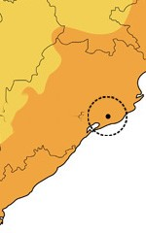
Bhubaneswar

Slide 2
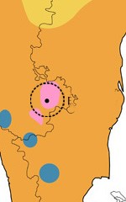
Bengaluru

Slide 3
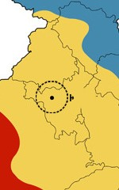
Hisar

Slide 4
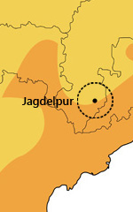
Jagdalpur

Slide 5

Kolkata

Slide 6
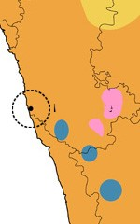
Mangaluru

Slide 7
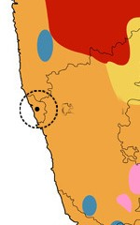
Panaji

Slide 8
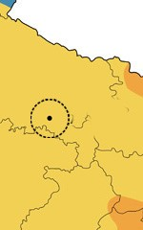
Prayagraj

Slide 9

Visakhapatnam

Slide 10
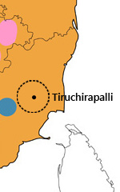
Tiruchirappalli

Slide 11
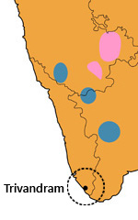
Thiruvananthapuram

Slide 12
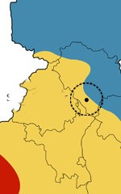
Sundar Nagar

Slide 13
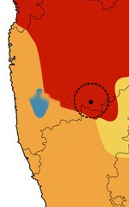
Solapur

Slide 14
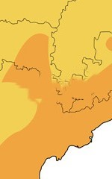
Raipur

