Slide 1
PROJECT PRESENTATION
CareerLens
AI Career Recommendation Platform
Personalized, explainable career guidance for engineering students
Node.js | Express | SQLite | CareerIQ Web Interface

Slide 2
PROBLEM AND OBJECTIVES
Problem Statement
Students struggle to choose the right career
Lack of personalized guidance and industry awareness
Unaware of required skills; cannot see which skills they have or lack
Guidance is generic, with no clear learning path to job-ready
CareerLens | AI Career Recommendation Platform
2

Slide 3
PROBLEM AND OBJECTIVES
Objectives
Collect education, branch, year, skills, interests and goal
Recommend top three careers with a weighted, explainable model
Show match %, confidence level and reasons
Identify existing and missing skills
Provide roadmap, projects and internship checklist
Store every assessment and report analytics
CareerLens | AI Career Recommendation Platform
3

Slide 4
EXISTING VS PROPOSED
Comparison
Feature | Traditional Guidance | CareerLens
Personalization | General advice | Skills, interests, branch, education, goal
Explanation | Rarely given | Reasons listed for every match
Skill-gap analysis | Not available | Existing and missing skills shown
Learning path | Not structured | Eight-step roadmap per career
Record keeping | Manual | Saved in SQLite database
CareerLens | AI Career Recommendation Platform
4

Slide 5
ARCHITECTURE AND MODULES
System Architecture
Presentation Layer
frontend/index.html: profile form, dashboard, recommendations, roadmap
▼
Application Layer
backend/server.js: Express routes, validation, CORS, logging
▼
Logic Layer
recommendationEngine.js and careerData.js: scoring, skill gap
▼
Data Layer
database.js: SQLite assessments table and analytics
CareerLens | AI Career Recommendation Platform
5

Slide 6
ARCHITECTURE AND MODULES
Modules
Student Profile: collects and stores profile details
Dashboard: readiness, skills, streak, matches
Recommendation Engine: scores 11 careers, returns top 3
Skill Gap Analysis: existing vs missing skills, coverage %
Roadmap and Opportunities: learning path, internships, projects
Database and Analytics: saves and analyzes assessments
CareerLens | AI Career Recommendation Platform
6

Slide 7
RECOMMENDATION ALGORITHM
Scoring Model
CareerLens | AI Career Recommendation Platform
7

Slide 8
RECOMMENDATION ALGORITHM
Algorithm Steps
Normalize text; split skills and interests into unique lists
Exact full-string matching: "C" never matches "C++"
Convert each score to a percentage, capped at 99%
Sort by score, then alphabetically for stable order
Confidence: high 70%+, medium 50-69%, low below 50%
Return top three with reasons, skill gaps, roadmap and projects
CareerLens | AI Career Recommendation Platform
8

Slide 9
DATABASE, API AND TECHNOLOGIES
Database Design
SQLite via built-in node:sqlite module
careerlens.db is created automatically
Table "assessments" stores every submission
Fields: student details, skills, interests, goal
Top career, match %, confidence, full result JSON, timestamp
CareerLens | AI Career Recommendation Platform
9

Slide 10
DATABASE, API AND TECHNOLOGIES
REST API Endpoints
Method | Endpoint | Purpose
GET | /api/health | Health check
GET | /api/careers | List all supported careers
POST | /api/recommend | Validate profile, recommend, save (400 if invalid)
GET | /api/assessment/:id | Retrieve saved assessment (404 if missing)
GET | /api/analytics | Totals, top careers, branches, average score
CareerLens | AI Career Recommendation Platform
10

Slide 11
DATABASE, API AND TECHNOLOGIES
Technologies Used
Frontend: HTML5, CSS3, JavaScript, localStorage
Backend: Node.js 22.5+, Express 4, CORS
Database: SQLite (node:sqlite)
Testing: tests.js (unit), e2eTests.js (end-to-end)
Browsers: Chrome, Firefox, Edge, Safari
CareerLens | AI Career Recommendation Platform
11

Slide 12
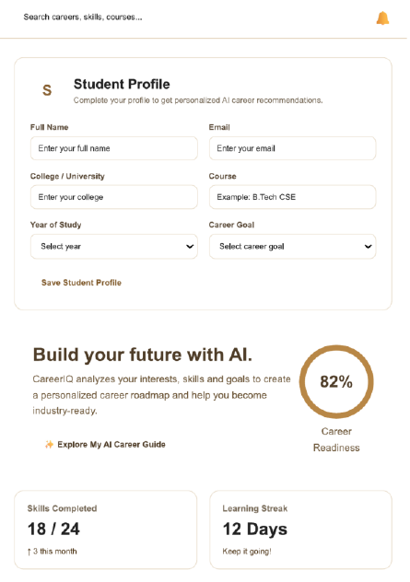
OUTPUT, TESTING AND RESULTS
CareerIQ: Profile and Readiness
Student Profile form with all required fields
82% career readiness indicator
Skills Completed: 18 / 24
Learning Streak: 12 days
Profile saved in the browser (localStorage)
CareerLens | AI Career Recommendation Platform
12

Slide 13
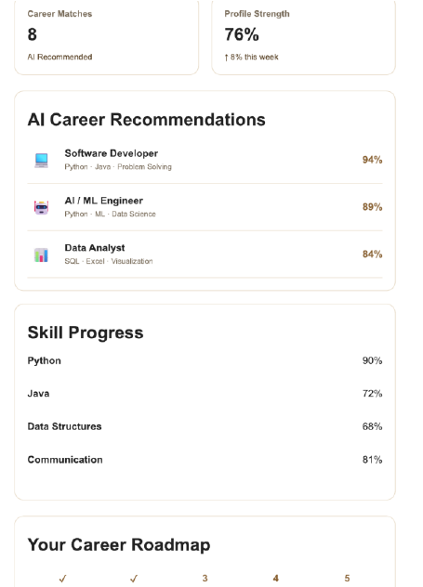
OUTPUT, TESTING AND RESULTS
CareerIQ: Recommendations
Career Matches and Profile Strength cards
Software Developer 94%
AI / ML Engineer 89%
Data Analyst 84%
Skill Progress bars and career roadmap
CareerLens | AI Career Recommendation Platform
13

Slide 14
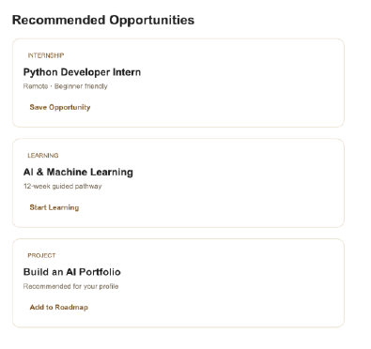
OUTPUT, TESTING AND RESULTS
CareerIQ: Opportunities
Python Developer Intern: remote, beginner friendly
AI and Machine Learning: 12-week guided pathway
Build an AI Portfolio: project for your profile
Save Opportunity, Start Learning, Add to Roadmap
CareerLens | AI Career Recommendation Platform
14

Slide 15
OUTPUT, TESTING AND RESULTS
Test Scenarios
Test Scenario | Result
CSE + Python, C++ + AI | AI Engineer (83%): Pass
CSE + Python, SQL + Data Science | Data Scientist (95%): Pass
ECE + Verilog + VLSI | VLSI Engineer: Pass
Repeated run, unknown interest, "C" vs "C++" | Deterministic and safe: Pass
CareerLens | AI Career Recommendation Platform
15

Slide 16
CONCLUSION AND FUTURE SCOPE
Conclusion
Combines interests, skills, branch, education and goal
Ranked recommendations with clear reasons, skill gaps and roadmap
Eleven careers, five REST endpoints and an SQLite database working
17 of 17 automated tests passed
Meets the goal of personalized, data-driven guidance
CareerLens | AI Career Recommendation Platform
16

Slide 17
CONCLUSION AND FUTURE SCOPE
Future Scope
Integration: connect CareerIQ to /api/recommend
Authentication: user accounts and assessment history
Richer engine: more careers and goal weighting
Analytics: charts from /api/analytics
CareerLens | AI Career Recommendation Platform
17

Slide 18
Thank You

