Slide 1

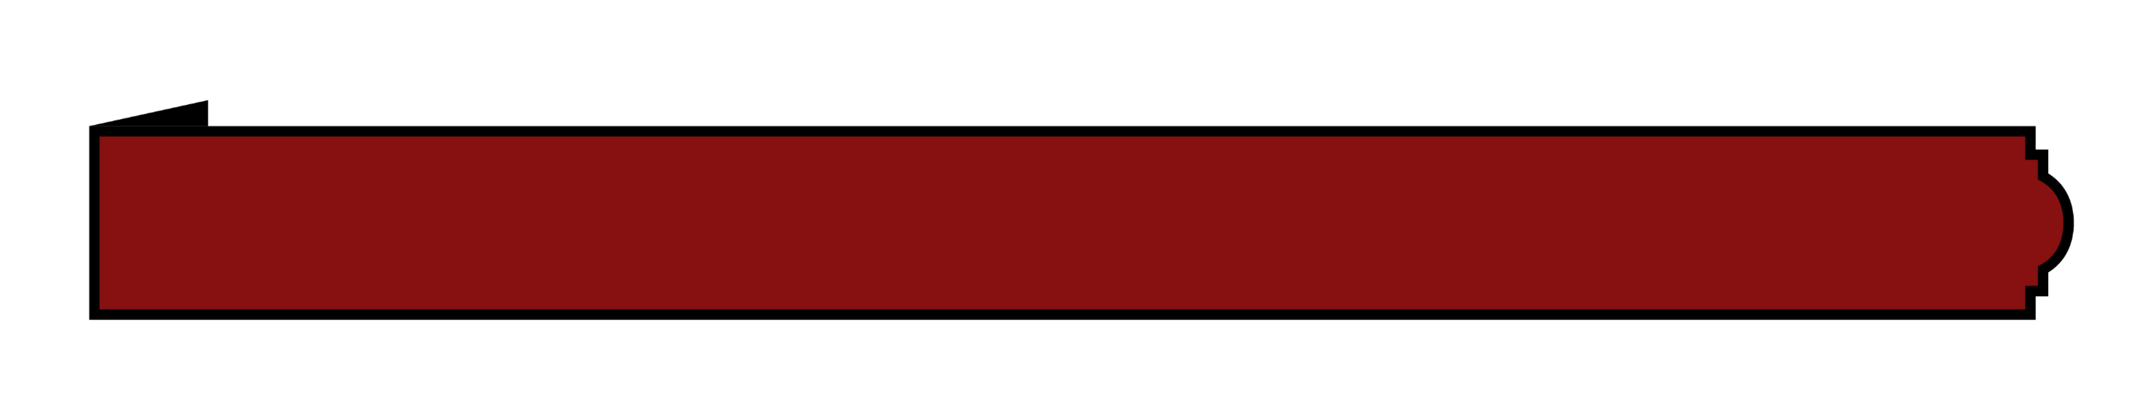
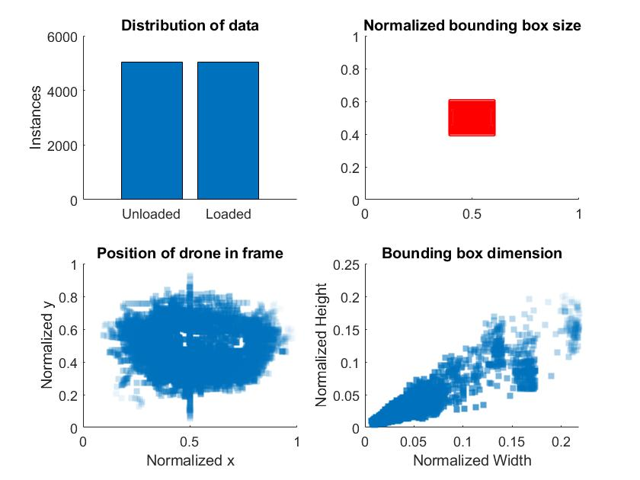
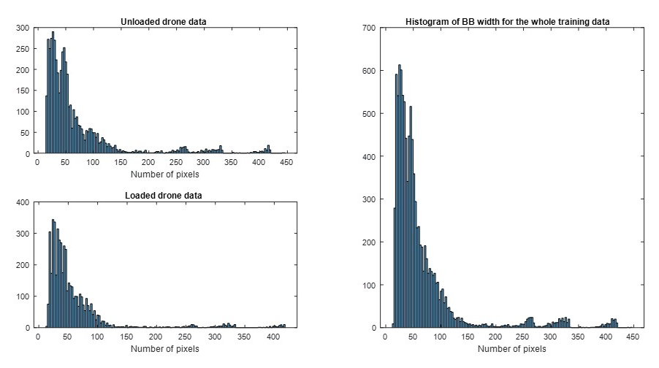
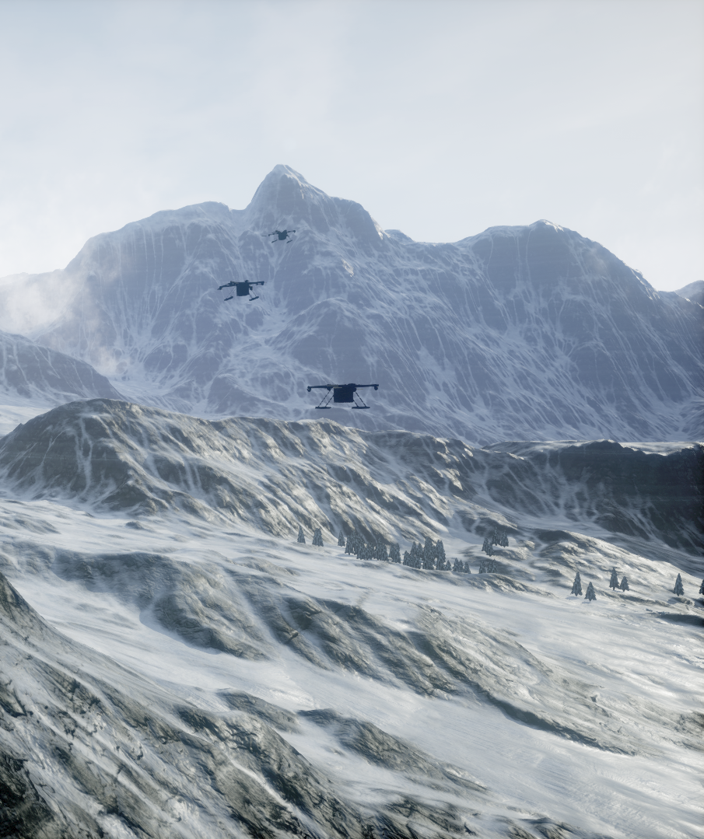
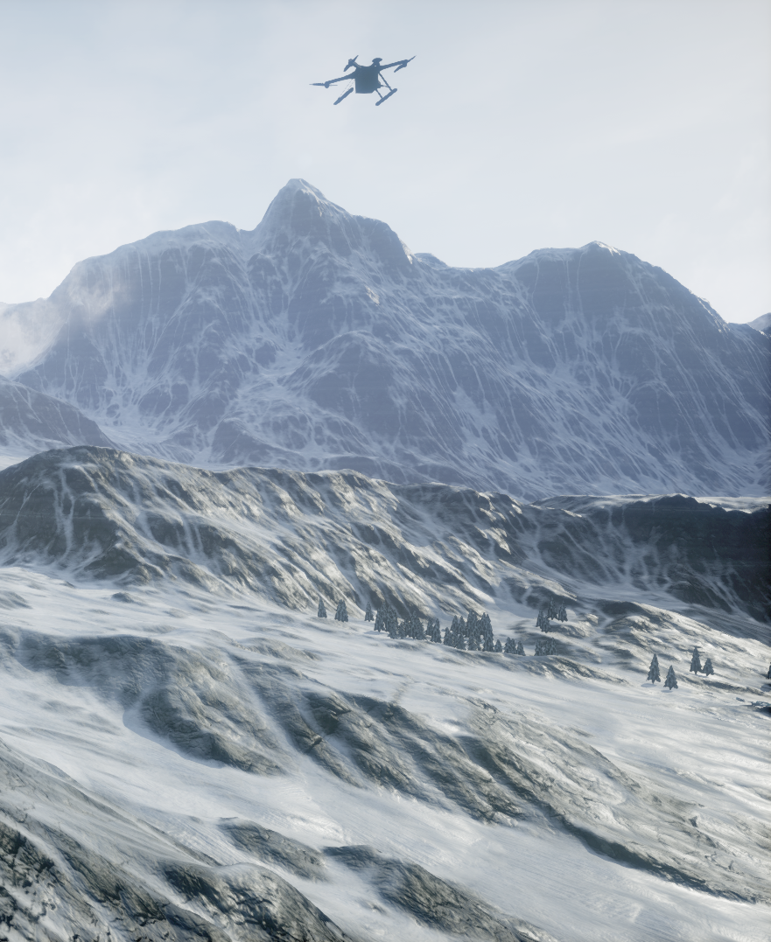
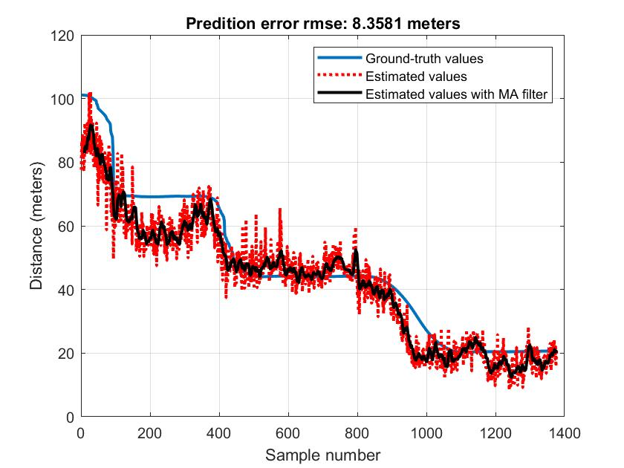

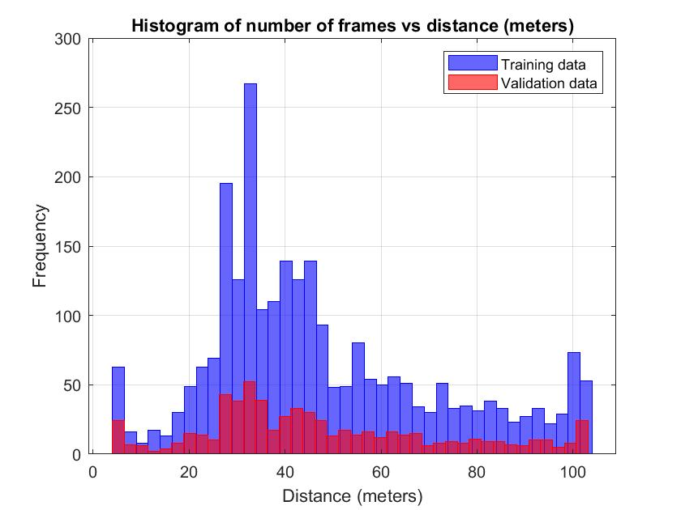
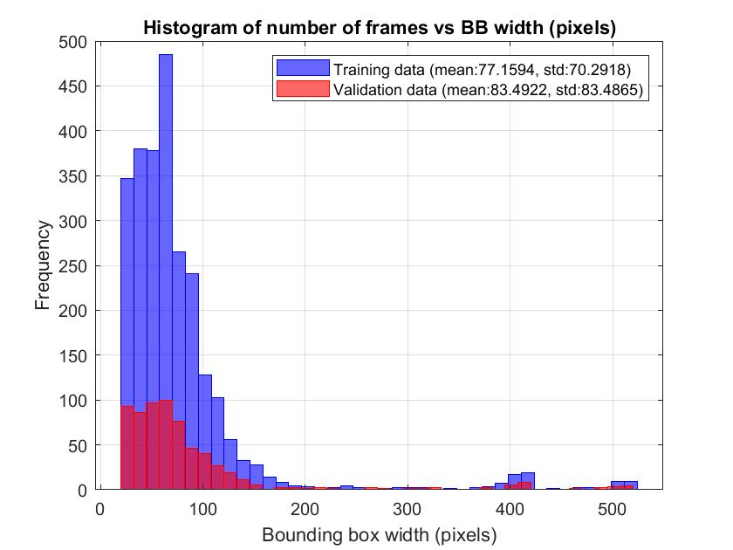

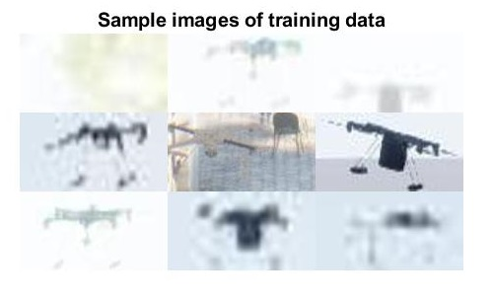
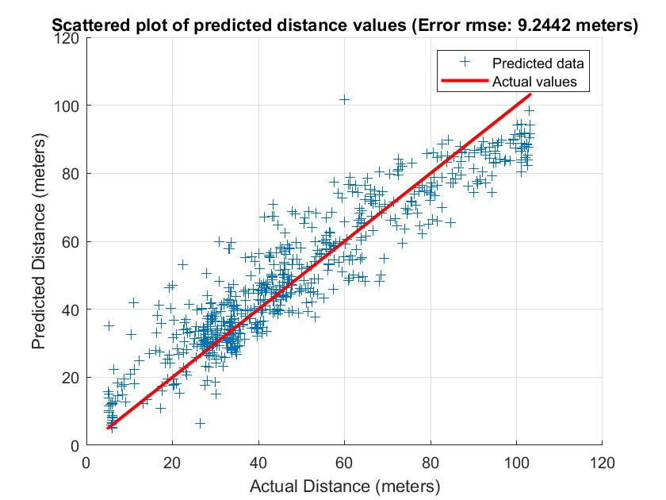
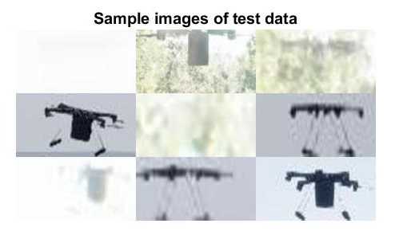
Air-to-Air Simulated Drone Dataset for AI-powered Problems
Hamid Azad¹, Varun Mehta², Fardad dadboud¹, Miodrag Bolic¹, Iraj Mantegh²
¹ School of Electrical Engineering and Computer Science, University of Ottawa, Ottawa, Canada
² Aerospace Research Centre, National Research Council Canada, Ottawa, Canada
Introducing the multi-view Air-to-Air Simulated Drone Dataset (A2A-SDD) using AirSim©
Diverse scenarios where one or two drones are pursued by one to three monitoring drones
Five types of drones, such as DJI models and a generic quadrotor model
Recorded videos in various weather conditions and environments, and both loaded and unloaded drones
Extensive annotations, including object detection and XYZ coordinates
Promising performance of trained networks on practical data
Potential applications in training deep learning-based models for counter-UAV measures such as localization and payload detection in single- and multi-view cases
Dataset specifications
Five types of drones: DJI Phantom, Inspire, Mavic, FPV, and a generic drone model (referred here as the Quadrotor)
Chasing one or two coming drones by one to three monitoring drones (multi-view scenario)
Various environments such as Blocks, Landscape Mountains, and City Park
Different weather conditions including sunny, rainy, and snowy cases.
Various payload conditions, including unloaded drones, drones with attached loads, drones with hanging loads, and payloads with different colors and shapes.
Provided information in the dataset
The XYZ coordinates of all the observer drones and the target drones
Bounding box information for each drone in every individual frame
Timestamps to synchronize recorded videos by different cameras
Flags indicating the detection status of a specific drone in each frame, as well as whether the drone is loaded or unloaded
Figure: Multi-view recorded videos using two cameras
Drone payload detection
Classification of drones into two distinct categories: loaded and unloaded
ResNet classifiers
ResNet-50 and ResNet-101 architectures
Simulation result (sample case)
Stochastic gradient descent optimizer is employed with an initial learning rate of 0.03.
25 epochs and the batch size of 64
70%, 15%, and 15% of training, validation, and testing
Accuracy of 97% and 99% for ResNet-50 and ResNet-101, respectively
ABSTRACT
SIMULATED DATASET
CONSIDERED PROBLEMS
Payload detection
Uncrewed Aerial Vehicles (UAVs) have seen a significant rise in their applications across various fields
Their widespread use raises concerns about safety and security, which results in a growing need for countermeasures
Two primary categories of sensors emerge in the realm of counter-UAV measures :
Ground-based (limitations concerning coverage, especially over long distances).
Deploying observer drones in close proximity to target drones for enhanced defense coverage. Vision-based sensors offer an affordable and adaptable solution for such scenarios.
The potential of deep learning to address counter-UAV problems
Requirement of a substantial volume of data for effective training. Simulations provide a controlled environment for data generation.
INTRODUCTION
EXPERIMENTAL TEST
Testing on real-world recorded data
Captured videos of a quadrotor at distances from 20 to around 100 meters from the camera (ground-truth value was recorded using GPS sensor)
Mounted camera on a hovering drone (air-to-air setup)
A box of size 7.8915 cm³ as payload
Classification accuracy of 88% and 92% for the unloaded drone and 87% and 89% for the loaded case for the ResNet-50 and 101.
3D localization (distance/azimuth/elevation) of the drone using 2D image
Deep learning-based distance regressor
Simple pinhole model for azimuth/elevation angle estimation
CNN distance regression
Consists of 4 convolutional layers plus a fully-connected one as the last layer.
Simulation results
Stochastic gradient descent optimizer
Initial learning rate of 10⁻⁵, trained for 10 epochs
80% and 20% of data for each training and validation.
CONSIDERED PROBLEMS
Presented a simulated multi-view air-to-air drone dataset
Two distinct features: multi-view perspective and the inclusion of location information for all cameras and drones
Promising performance on experimental data
Potential for solving real-world drone-related challenges using optical sensors
CONCLUSION
LOCALIZATION
Some of previous works:
Zheng et al. (2021) – Air-to-Air Det-Fly UAV dataset
Consists of 13271 images of a flying DJI Mavic acquired by DJI M210 platform with XT2 camera (single view – no location information)
Li et al. (2021) - U2U-D&TD Dataset for UAV Detection and Tracking
Comprises 50 video sequences with up to 8 UAVs per frame, recorded outdoors (single view – no location information)
Walter et al. (2020) – MIDGARD dataset
Around 7600 frames of aerial view in both indoor and outdoor environment
Rozantsev et al. (2016) - Detection of Small UAVs and Aircraft
Included 4000 frames capturing drones in various lighting and weather conditions (single view – no location information)
MIDGARD is the only dataset that includes location information, but none of the datasets provides multi-view records
LITERATURE REVIEW
Supported by the Canadian Safety and Security Program
Partial funding is provided from the NSERC Discovery Grant RGPIN-2020-04417
Complementary support has also been provided by National Research Council Canada through Artificial Intelligence for Logistics and Integrated Aerial Mobility programs.
[1] Y. Zheng, Zh. Chen, D. Lv, Zh. Li, Zh. Lan, and Sh. Zhao, “Air-to-air visual detection of micro- UAVs: An experimental evaluation of deep learning,” IEEE Robotics and Automation Letters, 6(2):1020–1027, 2021.
[2] J. Li, D. H. Ye, M. Kolsch, J. P. Wachs, and C. A. Bouman, “Fast and robust UAV to UAV detection and tracking from video,” IEEE Transactions on Emerging Topics in Computing, vol. 10, no. 3, pp. 1519–1531, 2021.
[3] V. Walter, M. Vrba, and M. Saska, “On training datasets for machine learning-based visual relative localization of micro-scale UAVs,” In 2020 IEEE International Conference on Robotics and Automation (ICRA), pages 10674–10680. IEEE, 2020.
[4] A. Rozantsev, V. Lepetit, and P. Fua, “Detecting flying objects using a single moving camera,” IEEE transactions on pattern analysis and machine intelligence, vol. 39, no. 5, pp. 879–892, 2016

