Slide 1
Introducción a la web semántica
Entender el contexto de la información, la semántica
La representación del conocimiento es esencial
Poder nombrar las cosas
RDF : Resource Description Framework
URI (identificador) dbpedia.org/resource/Pluto
:Pluto rdf:type dbo:Planet
Subject → Property → Object

Slide 2
Cómo nombrar las cosas
URI: Universal Resource Identifier (Identificador Universal) Un recurso en cualquier objeto
Triángulo semiótico: relación de concepto con símbolo, con le objeto
Conocer el nombre de algo te da poder sobre el objeto.
Torre Eiffel, http://dbpedia.org/page/Eiffel_Tower
Vs http://dbpedia.org/data/Eiffel_Tower
La representación define la presentación

Slide 3
Representación de conocimiento
Hecho: Plutón fue descubierto en 1930
Reto: representar el mismo conocimiento
Sujeto: Plutón; Predicado: fue descubierto; objeto: 1930
Solución: grafo dirigido, RDF Triple
Plutón
Fue descubierto en
1930
Notes:
http://dbpedia.org/ontology/discovered
http://dbpedia.org/ontology/discoverer
Expresar conocimiento con triplets

Slide 4
Notación N-Triples / Turtle (prefijos)
<http://dbpedia.org/resource/Pluto> <http://dbpedia.org/ontology/discovered> “1930” .
@prefix dbo: http://dbpedia.org/ontology/
@base <http://dpedia.org/resource/>
<Pluto> dbo:discovered “1930”
<Pluto> dbo:discoverer <Clyde_Tombaugh>

Slide 5
RDFS
Esquema
http://dbpedia.org/ontology/Planet
https://dbpedia.org/sparql

Slide 6
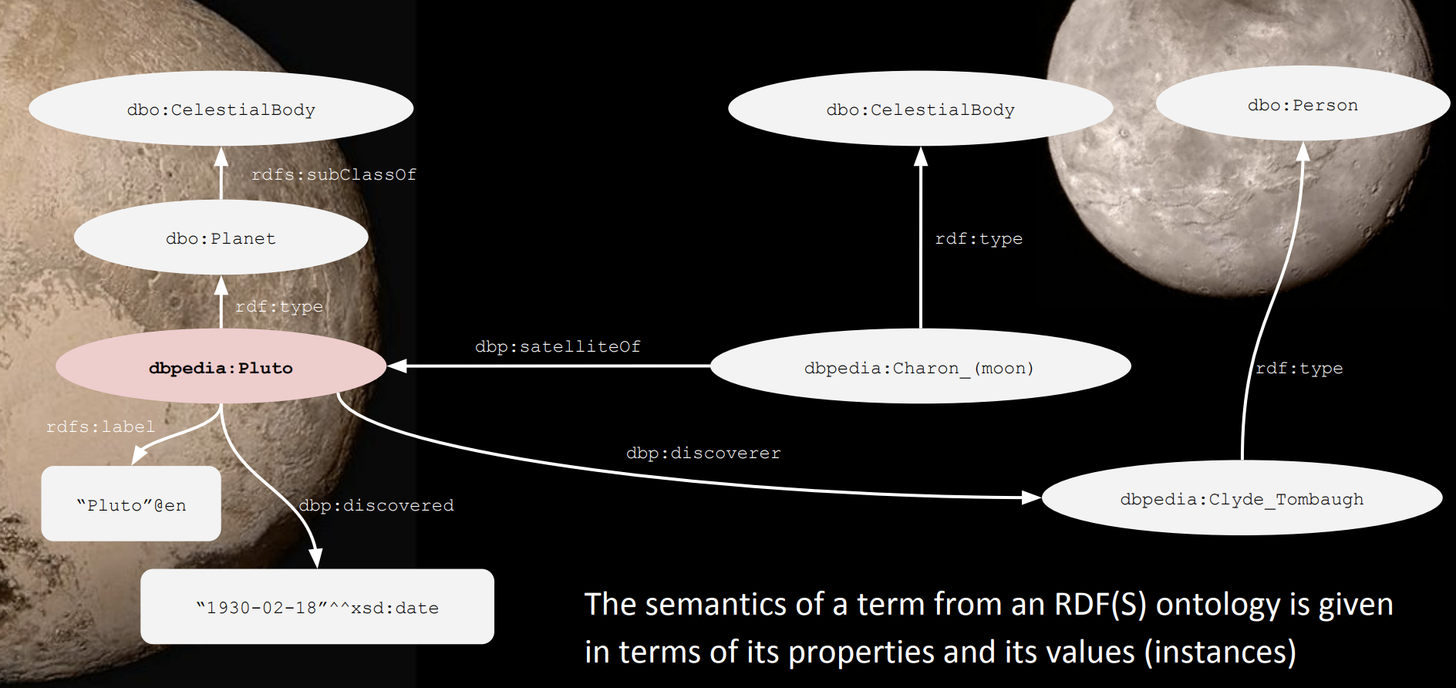
Inferencias con RDFS
¿Hay conocimiento escondido?

Slide 7
Consulta simple
PREFIX rdf: <http://www.w3.org/1999/02/22-rdf-syntax-ns#>
PREFIX dbo: <http://dbpedia.org/ontology/>
SELECT ?author ?work
WHERE {
?author rdf:type dbo:Writer ;
dbo:notableWork ?work .
} LIMIT 100

Slide 8
Traer diferentes elementos
PREFIX rdf: <http://www.w3.org/1999/02/22-rdf-syntax-ns#>
PREFIX rdfs: <http://www.w3.org/2000/01/rdf-schema#>
PREFIX dbo: <http://dbpedia.org/ontology/>
PREFIX dbp: <http://dbpedia.org/property/>
SELECT ?author ?work ?date
FROM <http://dbpedia.org/>
WHERE {
?author rdf:type dbo:Writer .
?author dbo:notableWork ?work .
?work dbp:releaseDate ?date
} ORDER BY ?date
LIMIT 100

Slide 9
Contando
PREFIX rdf: <http://www.w3.org/1999/02/22-rdf-syntax-ns#>
PREFIX dbo: <http://dbpedia.org/ontology/>
SELECT COUNT(?author) AS ?num
FROM <http://dbpedia.org/>
WHERE {
?author rdf:type dbo:Writer .
}

Slide 10
Distinct
PREFIX rdf: <http://www.w3.org/1999/02/22-rdf-syntax-ns#>
PREFIX dbo: <http://dbpedia.org/ontology/>
SELECT COUNT(DISTINCT(?author)) AS ?num
FROM <http://dbpedia.org/>
WHERE {
?author rdf:type dbo:Writer ;
dbo:notableWork ?work .
}

Slide 11
SPARQL - Consultas
Inspirado en SQL, obtener subgrafos, agregaciones, joins, explorar, transformar, inferencia.
Variables → ?
Instruccion “SELECT”
Resultado es una table
AND → .

Slide 12

Consulta
Nombre y título de trabajos notablesm, ordenados con límite
PREFIX : <http://dbpedia.org/resource/>
PREFIX rdf: <http://www.w3.org/1999/02/22-rdf-syntax-ns#>
PREFIX rdfs: <http://www.w3.org/2000/01/rdf-schema#>
PREFIX dbo: <http://dbpedia.org/ontology/>
SELECT ?author_name ?title
FROM <http://dbpedia.org/>
WHERE {
?author rdf:type dbo:Writer .
?author rdfs:label ?author_name .
?author dbo:notableWork ?work .
?work rdfs:label ?title .
}
ORDER BY ASC (?author_name)
LIMIT 100

Slide 13
FILTER
PREFIX : <http://dbpedia.org/resource/>
PREFIX rdf: <http://www.w3.org/1999/02/22-rdf-syntax-ns#>
PREFIX rdfs: <http://www.w3.org/2000/01/rdf-schema#>
PREFIX dbo: <http://dbpedia.org/ontology/>
SELECT ?author_name ?title ?pages
FROM <http://dbpedia.org/>
WHERE {
?author rdf:type dbo:Writer .
?author rdfs:label ?author_name
FILTER (LANG(?author_name)="en").
?author dbo:notableWork ?work .
?work dbo:numberOfPages ?pages
FILTER (?pages > 500) .
?work rdfs:label ?title .
FILTER (LANG(?title)="en").
} LIMIT 100

Slide 14
PREFIX : <http://dbpedia.org/resource/> PREFIX rdf: <http://www.w3.org/1999/02/22-rdf-syntax-ns#> PREFIX rdfs: <http://www.w3.org/2000/01/rdf-schema#> PREFIX dbo: <http://dbpedia.org/ontology/> SELECT COUNT(?title) FROM <http://dbpedia.org/> WHERE { ?author rdf:type dbo:Writer . ?author rdfs:label ?author_name FILTER (LANG(?author_name)="en"). ?author dbo:notableWork ?work . ?work dbo:numberOfPages ?pages FILTER (?pages > 500) . ?work rdfs:label ?title . FILTER (LANG(?title)="en"). } LIMIT 100

Slide 15
Expresiones regulares
PREFIX : <http://dbpedia.org/resource/>
PREFIX rdf: <http://www.w3.org/1999/02/22-rdf-syntax-ns#>
PREFIX rdfs: <http://www.w3.org/2000/01/rdf-schema#>
PREFIX dbo: <http://dbpedia.org/ontology/>
SELECT ?author_name ?title
FROM <http://dbpedia.org/>
WHERE {
?author rdf:type dbo:Writer .
?author rdfs:label ?author_name
FILTER (LANG(?author_name)="en").
?author dbo:notableWork ?work .
?work rdfs:label ?title .
FILTER (LANG(?title)="en")
FILTER REGEX (?title, "love", "i").
} LIMIT 100
Notes:
http://regexone.com

Slide 16
PREFIX : <http://dbpedia.org/resource/>
PREFIX rdf: <http://www.w3.org/1999/02/22-rdf-syntax-ns#>
PREFIX rdfs: <http://www.w3.org/2000/01/rdf-schema#>
PREFIX dbo: <http://dbpedia.org/ontology/>
SELECT ?author_name ?en_title ?de_title
FROM <http://dbpedia.org/>
WHERE {
?author rdf:type dbo:Writer .
?author rdfs:label ?author_name
FILTER (LANG(?author_name)="en").
?author dbo:notableWork ?work .
?work rdfs:label ?en_title .
FILTER (LANG(?en_title)="en") .
OPTIONAL {?work rdfs:label ?de_title
FILTER (LANG(?de_title)="de") .
}
} LIMIT 100

Slide 17
PREFIX : <http://dbpedia.org/resource/>
PREFIX rdf: <http://www.w3.org/1999/02/22-rdf-syntax-ns#>
PREFIX rdfs: <http://www.w3.org/2000/01/rdf-schema#>
PREFIX dbo: <http://dbpedia.org/ontology/>
SELECT ?author
FROM <http://dbpedia.org/>
WHERE {
?author rdf:type dbo:Writer .
OPTIONAL {?author dbo:notableWork ?work . }
FILTER (!BOUND(?work)) .
} LIMIT 100

Slide 18
Elementos opcionales
PREFIX : <http://dbpedia.org/resource/>
PREFIX rdf: <http://www.w3.org/1999/02/22-rdf-syntax-ns#>
PREFIX rdfs: <http://www.w3.org/2000/01/rdf-schema#>
PREFIX dbo: <http://dbpedia.org/ontology/>
SELECT ?author_name ?en_title ?de_title
FROM <http://dbpedia.org/>
WHERE {
?author rdf:type dbo:Writer .
?author rdfs:label ?author_name
FILTER (LANG(?author_name)="en").
?author dbo:notableWork ?work .
?work rdfs:label ?en_title .
FILTER (LANG(?en_title)="en") .
OPTIONAL {?work rdfs:label ?de_title
FILTER (LANG(?de_title)="de") .
}
} LIMIT 100

Slide 19
FILTER Not
PREFIX : <http://dbpedia.org/resource/>
PREFIX rdf: <http://www.w3.org/1999/02/22-rdf-syntax-ns#>
PREFIX rdfs: <http://www.w3.org/2000/01/rdf-schema#>
PREFIX dbo: <http://dbpedia.org/ontology/>
SELECT ?author
FROM <http://dbpedia.org/>
WHERE {
?author rdf:type dbo:Writer .
OPTIONAL {?author dbo:notableWork ?work . }
FILTER (!BOUND(?work)) .
} LIMIT 100

Slide 20
Ordenando
PREFIX rdf: <http://www.w3.org/1999/02/22-rdf-syntax-ns#>
PREFIX rdfs: <http://www.w3.org/2000/01/rdf-schema#>
PREFIX dbo: <http://dbpedia.org/ontology/>
PREFIX dbp: <http://dbpedia.org/property/>
PREFIX xsd: <http://www.w3.org/2001/XMLSchema#>
SELECT ?author ?work xsd:integer(?date) AS ?year
FROM <http://dbpedia.org/>
WHERE {
?author rdf:type dbo:Writer .
?author dbo:notableWork ?work .
?work dbp:releaseDate ?date
} ORDER BY DESC(?year)
LIMIT 100

Slide 21
Transformando
PREFIX rdf: <http://www.w3.org/1999/02/22-rdf-syntax-ns#>
PREFIX rdfs: <http://www.w3.org/2000/01/rdf-schema#>
PREFIX dbo: <http://dbpedia.org/ontology/>
PREFIX dbp: <http://dbpedia.org/property/>
PREFIX xsd: <http://www.w3.org/2001/XMLSchema#>
SELECT ?author ?work SUBSTR((REPLACE(STR(?date),"[^0-9]", "")), 1, 4) AS ?year
FROM <http://dbpedia.org/>
WHERE {
?author rdf:type dbo:Writer .
?author dbo:notableWork ?work .
?work dbp:releaseDate ?date
FILTER REGEX (?date, "[0-9]{4}") .
} ORDER BY DESC(?year)
LIMIT 100

Slide 22
Agregados
PREFIX rdf: <http://www.w3.org/1999/02/22-rdf-syntax-ns#>
PREFIX dbo: <http://dbpedia.org/ontology/>
SELECT ?author COUNT(?work) AS ?num_works
FROM <http://dbpedia.org/>
WHERE {
?author rdf:type dbo:Writer ;
dbo:notableWork ?work .
} GROUP BY ?author
ORDER BY DESC (?num_works)

Slide 23
PREFIX dbo: <http://dbpedia.org/resource/Batman>
PREFIX dbr: <http://dbpedia.org/resource/Justice_League> PREFIX rdf: <http://www.w3.org/1999/02/22-rdf-syntax-ns#>
SELECT count(?Integrante) WHERE {
?Aliados dbp:alliances ?res ;
rdfs:label ?Integrante .
FILTER(?res =<http://dbpedia.org/resource/Justice_League>)
FILTER (LANG(?Integrante)="en"). }

Slide 24
PREFIX dbo: <http://dbpedia.org/resource/Batman>
PREFIX dbr: <http://dbpedia.org/resource/Justice_League> PREFIX rdf: <http://www.w3.org/1999/02/22-rdf-syntax-ns#>
SELECT distinct (?Integrante) WHERE {
?Aliados dbp:alliances ?res ;
rdfs:label ?Integrante .
FILTER(?res =<http://dbpedia.org/resource/Justice_League>)
FILTER (LANG(?Integrante)="en"). }

Slide 25
PREFIX : <http://dbpedia.org/resource/>
PREFIX rdf: <http://www.w3.org/1999/02/22-rdf-syntax-ns#> PREFIX rdfs: <http://www.w3.org/2000/01/rdf-schema#> PREFIX dbo: <http://dbpedia.org/ontology/>
SELECT count(distinct ?res) as ?Series,count(*) as ?Temporadas from <http://dbpedia.org/page/Netflix/>
WHERE {
?Net dbp:mainCharTeam ?res. }

Slide 26
SELECT ?predicate (COUNT(*)AS ?frequency)
WHERE {
?subject ?predicate ?obDEject }
GROUP BY ?predicate ORDER BY DESC(?frequency)

Slide 27
PREFIX : <http://dbpedia.org/resource/>
PREFIX rdf: <http://www.w3.org/1999/02/22-rdf-syntax-ns#>
PREFIX rdfs: <http://www.w3.org/2000/01/rdf-schema#>
PREFIX dbo: <http://dbpedia.org/ontology/> SELECT ?stadium_name
FROM <http://dbpedia.org/>
WHERE {
?stadium rdf:type dbo:SportsTeam .
?stadium rdfs:label ?stadium_name . }
ORDER BY ASC (?stadium_name) LIMIT 100

