Slide 1

My experience with IMAS
Alexei Pankin
IMAS working group February 16, 2021
Notes:
<number>

Slide 2
Integrated Modelling & Analysis Suite (IMAS)
Is developed to support plasma operation and research on the ITER tokamak experiment
Allows collaboration development, model coupling, and data exchange
Centerpiece of IMAS infrastructure is a standardized generic data model that represents simulated and experimental data with identical structures
Includes set of tools to access data and design integrated modeling workflows
F. Imbeauxet al, NF, 2015
M. Romanelli, 3rd IAEA TM on Fusion Data Processing, Validation and Analysis (2019)
Notes:
<number>

Slide 3
^{ITER Physics Data Model (PDM)}
Is standardized data model in IMAS
Ensures that input and output of physics components is saved in a standard way
Physics components, once interfaced to the data model, can be coupled into an Integrated Modelling workflow
Includes set of tools to access data and design integrated modeling workflows
Data model consists of data dictionary and data model (list of expressions to link between nodes of generic data dictionary and methods for accession data for a particular experiment)
https://sharepoint.iter.org/departments/POP/CM/IMDesign/Data%20Model/CI/imas-3.30.0/html_documentation.html
F. Imbeauxet al, NF, 2015
Notes:
<number>

Slide 4
^{Interface Data Structure (IDS)}
Is an entry point of the data dictionary such as full description of tokamak subsystems (diagnostic, heating, equilibrium, etc)
Is also a part of data dictionary
May contain time-dependent and time-independent information. For example, it might include diagnostic data and diagnostic description at the same time
F. Imbeauxet al, NF, 2015
Notes:
<number>

Slide 5
Access Layer/Universal Access Layer (UAL)
Implements an access to data dictionary
Has application programming interfaces (APIs) for Fortran, C++, Python, Java and Matlab
Writes data files on disk and features also a memory cache mechanism for fast data transfer between workflow components
Support MDSPlus, HDF and other backends
F. Imbeauxet al, NF, 2015
Notes:
<number>

Slide 6
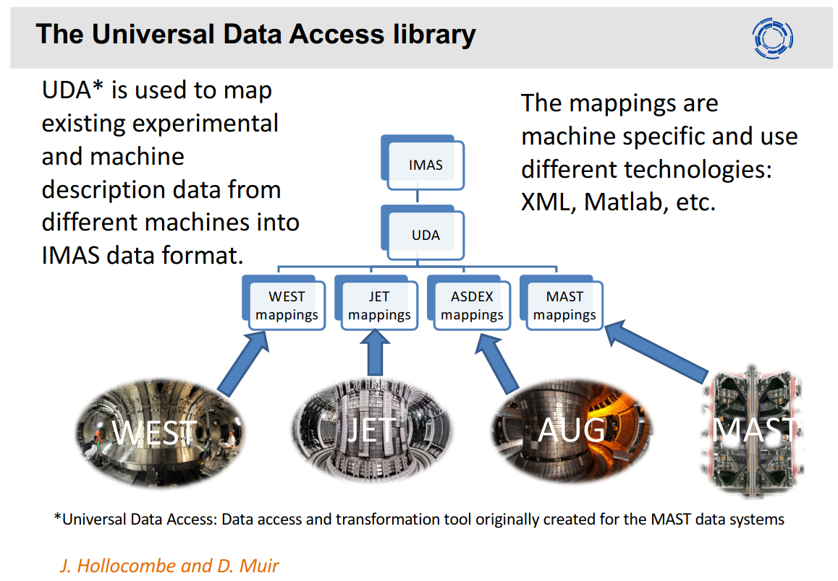
M. Romanelli, 3rd IAEA TM on Fusion Data Processing (2019)

Slide 7
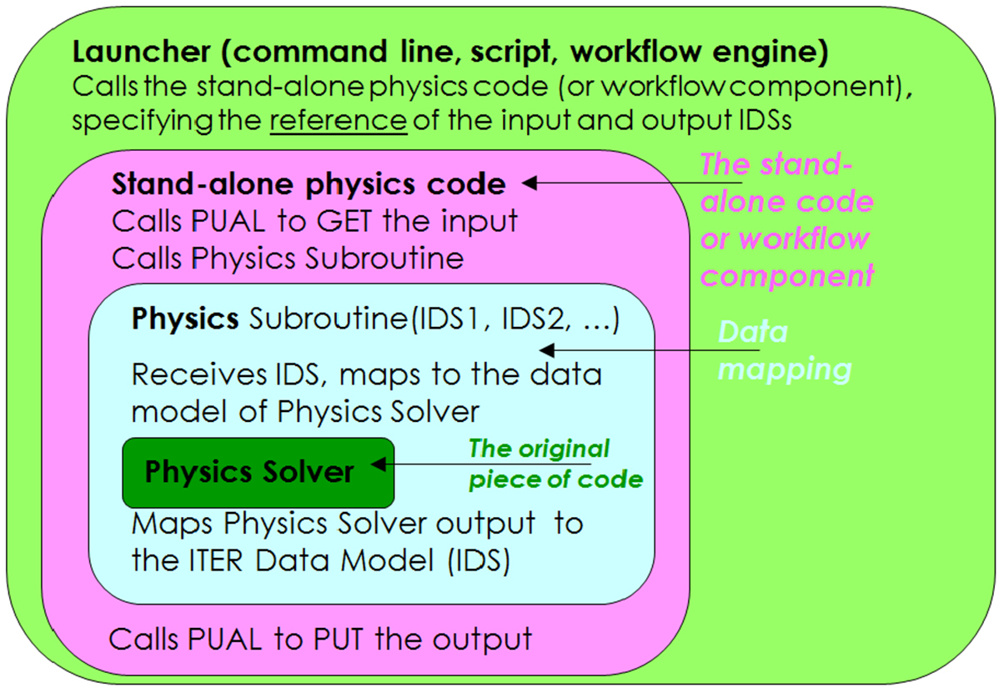
Data exchange for a physics solver
Layered structure in IMAS to enable the execution of a physics solver utilizes Physics User Access Language (PUAL)
F. Imbeauxet al, NF, 2015
Notes:
<number>

Slide 8
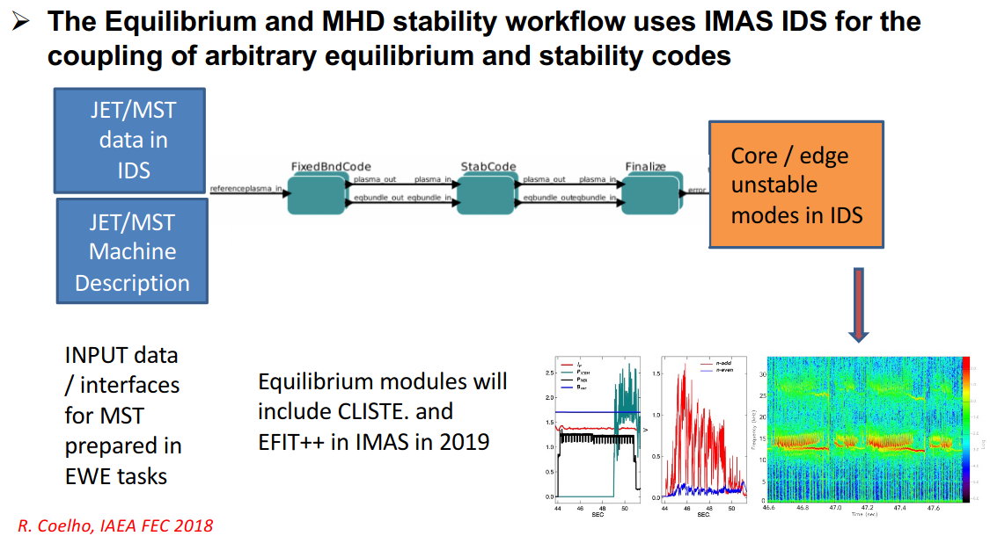
Code Development for Integrated Modelling (WPCD)
Several workflows have been developed and tested
The Equilibrium and MHD stability workflow
The European Transport Simulator (ETS)
The edge turbulence with synthetic diagnostic workflow
M. Romanelli, 3rd IAEA TM on Fusion Data Processing (2019)
Notes:
<number>

Slide 9
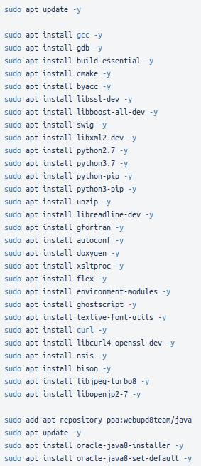
Compiling of IMAS on a Linux workstation
https://git.iter.org/projects/IMAS/repos/access-layer/browse
Data Dictionnary https://git.iter.org/scm/imas/data-dictionary.git
MDSplus backend https://github.com/MDSplus/mdsplus
HDF5 backend (compiled with latest release)
UDA backend https://git.iter.org/scm/imas/uda.git
PostgreSQL https://github.com/postgres/postgres.git
NetCDF
C++ Interface https://github.com/blitzpp/blitz
Notes:
<number>

Slide 10
Compiling of IMAS on IRIS at GA
/fusion/projects/codes/imas/pankin/software/AL.3_30
export PATH=/fusion/projects/codes/imas/pankin/software/bin:~/.local/bin:$PATH
module unload python/2.7
module load python/3
module unload mdsplus hdf5/1.8.14-pgf13.2 mpich/pgf pgf/13.2 gcc-4.7.2
module unload gcc-4.9.2 mpich/3.2-gcc4.9.2 fftw/3.3.6-mpich3.2-gcc4.9.2 hdf5/1.8.19-mpich3.2-gcc4.9.2
module unload netcdf/4.4.1-mpich3.2-gcc4.9.2
module load env/gcc9.2
module unload matlab
module load matlab/2019b
export SOFT_PATH=/fusion/projects/codes/imas/pankin/software
export PATH=$SOFT_PATH/cmake/bin:$SOFT_PATH/hdf5-1.8.19-sersh/bin:$PATH
export HDF5_DIR=$SOFT_PATH/hdf5-1.8.19-sersh
export HDF5ROOT=$HDF5_DIR
export JAVA_HOME=$SOFT_PATH/jdk-15.0.2
export MDSPLUS_DIR=$SOFT_PATH/mdsplus
export MATLABPATH=/fusion/projects/codes/imas/pankin/IMAS/AL/matlabinterface
export LD_LIBRARY_PATH=/fusion/usc/opt/MATLAB/R2019a/bin/glnxa64:$LD_LIBRARY_PATH
export LD_LIBRARY_PATH=/fusion/usc/opt/gcc/gcc-9.2.0/lib64:$LD_LIBRARY_PATH
export MATLAB_ROOT=/fusion/usc/opt/MATLAB/R2019b
export MATLAB=$MATLAB_ROOT
export IMAS_VERSION=3.30.0
export IMAS_PREFIX=$SOFT_PATH/AL.3_30
export PYTHONPATH=$SOFT_PATH/AL.3_30/python/lib:$SOFT_PATH/AL.3_30/python/lib.linux-x86_64-3.8:$PYTHONPATH
export LD_LIBRARY_PATH=$SOFT_PATH/uda-2.3.1/lib:$SOFT_PATH/AL.3_30/lib:$MDSPLUS_DIR/lib:$LD_LIBRARY_PATH
export PATH=$MDSPLUS_DIR/bin:$PATH
. /fusion/projects/codes/imas/pankin/IMAS/AL/lin_setenv.sh
. /fusion/projects/codes/imas/pankin/IMAS/AL/set_ual.sh
Notes:
<number>

Slide 11
Compiling of IMAS on IRIS at GA
/fusion/projects/codes/imas/pankin/software/AL.3_30
import omas, imas
ods = omas.ODS()
s = ods['wall.description_2d.0.limiter']
s['type.description'] = 'first wall'
s['type.name'] = 'first_wall'
s['type.index'] = 0
# set values of xarray and zarray
s['unit.0.outline.r'] = [0,1,2,3,4]
s['unit.0.outline.z'] = [0,1,2,3,4]
omas.save_omas_imas(ods, user='pankin', machine='d3d', imas_version='3.30.0', pulse=174819, run=1, new=True);
#
shot = 174819
run_in = 0
input_user = 'pankin'
input_database = 'd3d'
time_slice = 3.02
input = imas.ids(shot, run_in)
#input.setBackend(10)
ods2=omas.load_omas_imas(user=input_user, machine='d3d', imas_version='3.30.0', pulse=shot, run=run_in);
omas.save_omas_imas(ods2, user='pankin', machine='d3d', imas_version='3.30.0', pulse=174819, run=8, new=True);
Notes:
<number>

Slide 12
^{Fortran Interface}
Based on presentation of M. Schneider at IMAS Training camp 2020 (IDM_2M82)
program wrapper
use ids_schemas
use ids_routines
implicit none
type(ids_equilibrium):: equi_in, equi_out
character(len=200):: user,machine
integer:: idx
! DEFINE LOCAL DATABASE
call getenv('USER',user)
machine = 'iter'
! OPEN INPUT DATAFILE FROM OFFICIAL ITER DB
call imas_open_env('ids' ,131024,1,idx, &
'public','iter','3')
call ids_get(idx,'equilibrium',equi_in)
call imas_close(idx)
! EXECUTE PHYSICS CODE
call physics_i(equi_in,equi_out)
! EXPORT RESULTS TO LOCAL DATABASE
call imas_create_env('ids',131024,2,0,0,idx, &
trim(user),trim(machine),'3')
call ids_put(idx, 'equilibrium' ,equi_out)
call imas_close(idx)
end program wrapper
subroutine physics_i(equi_in, equi_out)
use ids_schemas
use ids_routines
implicit none
type(ids_equilibrium), intent(in):: equi_in
type(ids_equilibrium), intent(out):: equi_out
double precision:: rmaj_in, rmaj_out
! MAP YOUR INPUT
rmaj_in = equi_in%time_slice(1)%boundary%geometric_axis%r
! MODIFY PLASMA MAJOR RADIUS
write(*,'(a31,f7.3)') 'Initial major radius =', rmaj_in
rmaj_out = r_maj_in * 1.5
write(*,'(a31,f7.3)') 'Final major radius =', rmaj_out
! MAP YOUR OUTPUT
equi_out%time_slice(1)%boundary%geometric_axis%r = rmaj_out
end subroutine physics_i
Notes:
<number>

