Slide 1



Privacy-preserving Cox proportional hazards from vertically partitioned data
Florian van Daalen
CARRIER

Slide 2
Outline
CARRIER
Federated Learning
Cox Proportional Hazard model
Existing Solution: Verticox
Verticox: Privacy Concern
Proposed solution
Status & Future work
CARRIER

Slide 3














CARRIER
Coronary ARtery disease: Risk estimations and Interventions for prevention and EaRly detection
Hospitals
GPs
CBS
No need to share individual level data!
CARRIER

Slide 4
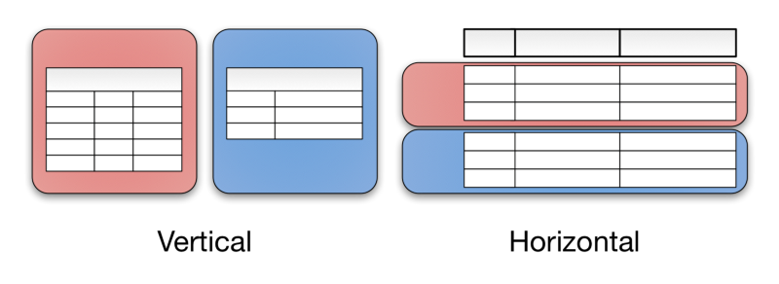
Federated Learning
Horizontal v.s. Vertical split
Different solutions
Vertical is (generally) more complex
CARRIER

Slide 5
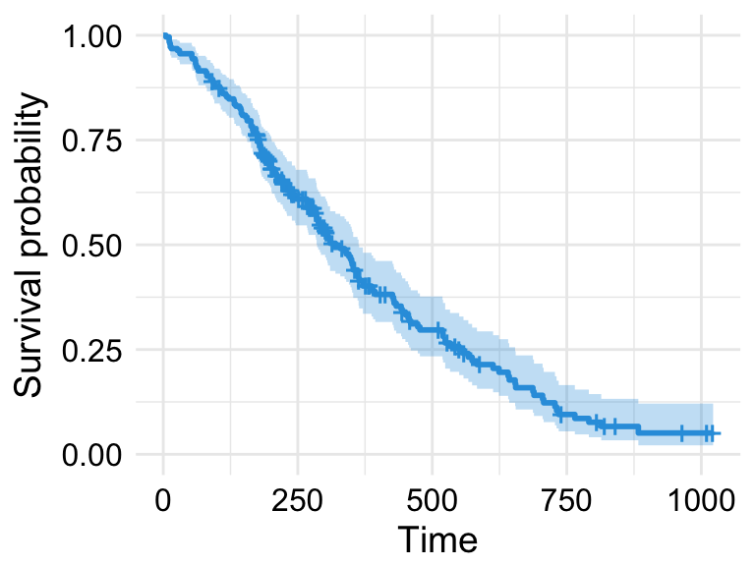
Cox Proportional Hazard
Model prediction probability of survival until a given time t, for a given individual based on predictors
CARRIER

Slide 6
Existing Solution: Verticox¹
First vertical implementation of Cox Hazard models
Utilizes an ADMM-based, two-step loop
Guaranteed convergence
Final model is comparable to centrally trained model
¹Dai et al. VERTICOX: Vertically Distributed Cox Proportional Hazards Model Using the Alternating Direction Method of Multipliers
CARRIER

Slide 7


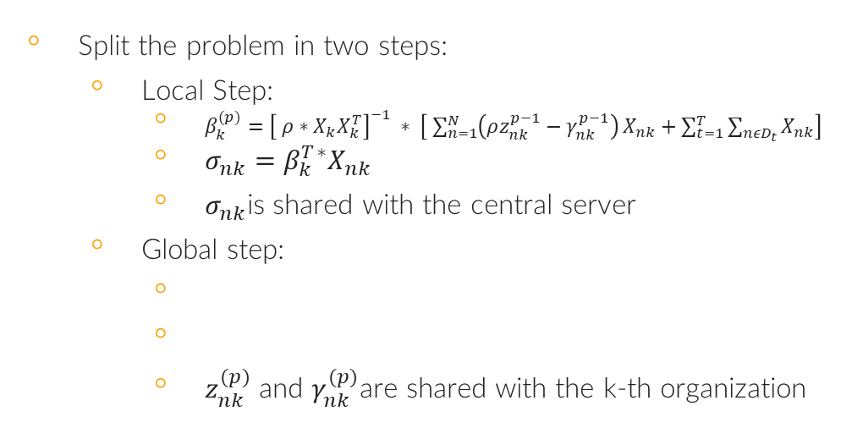
Existing Solution: Verticox
Split the problem in two steps:
Local Step:
$β_{k}^{(p)}={\left[ ρ∗X_{k}X_{k}^{T}\right]}^{−1} ∗ \left[ \sum_{n=1}^{N}{\left(ρz_{nk}^{p−1}−γ_{nk}^{p−1}\right)}X_{nk}+\sum_{t=1}^{T}{\sum_{nεD_{t}}{X_{nk}}}\right]$
$σ_{nk}=$ $β_{k}^{T}$*$X_{nk}$
$σ_{nk}$is shared with the central server
Global step:
$z_{nk}^{(p)}$ and $γ_{nk}^{(p)}$are shared with the k-th organization
CARRIER
Notes:
Sigma is hazard ratio

Slide 8
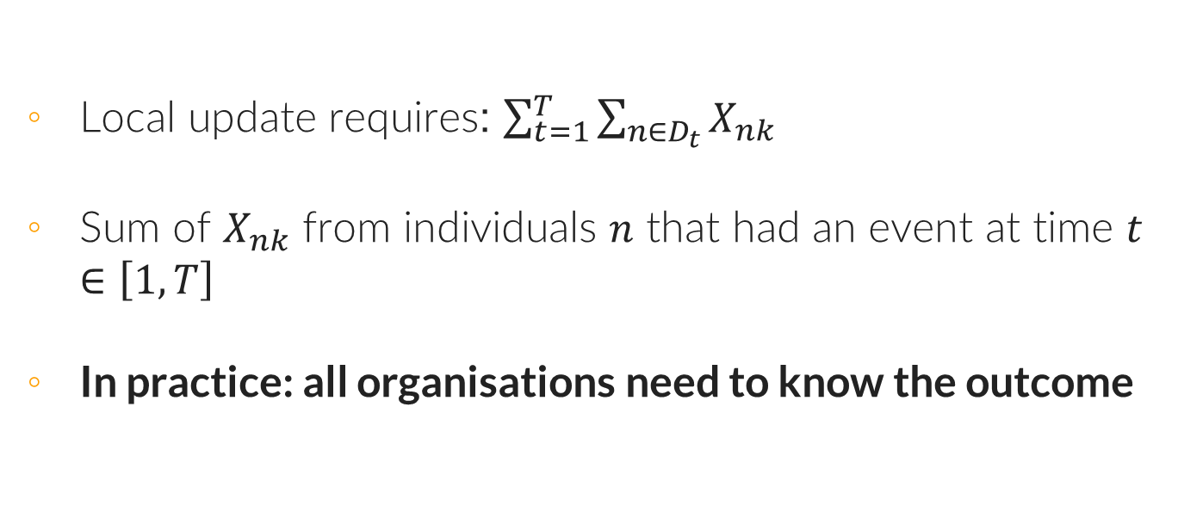
Verticox: Privacy Concern
Local update requires: $\sum_{t=1}^{T}{\sum_{n∈D_{t}}{X_{nk} }}$
Sum of $X_{nk}$ from individuals $n$ that had an event at time $t$ $∈\left[1,T\right]$
In practice: all organisations need to know the outcome
CARRIER

Slide 9
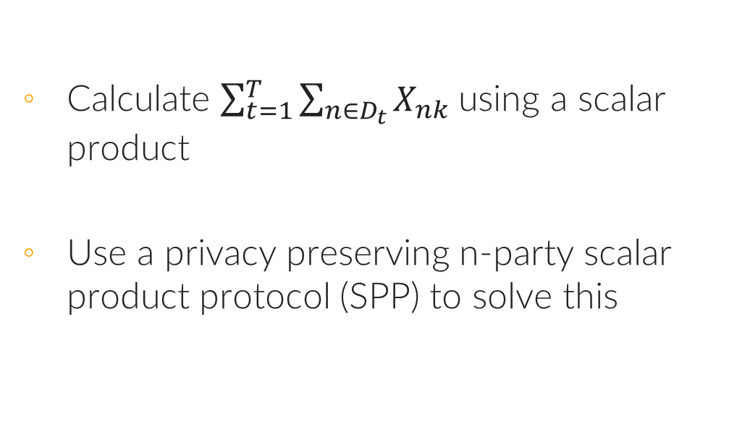
Proposed solution:
Calculate $\sum_{t=1}^{T}{\sum_{n∈D_{t}}{X_{nk}}}$using a scalar product
Use a privacy preserving n-party scalar product protocol (SPP) to solve this
CARRIER

Slide 10
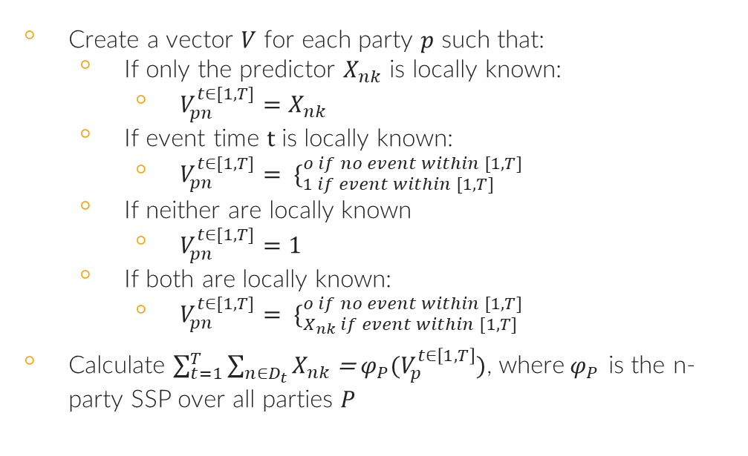
Translation into n-party scalar product
Create a vector $V$ for each party $p$ such that:
If only the predictor $X_{nk}$ is locally known:
$V_{pn}^{t∈[1,T]}=X_{nk}$
If event time $t$ is locally known:
$V_{pn}^{t∈[1,T]}= \{_{1 if event within [1,T]}^{o if no event within [1,T]}$
If neither are locally known
$V_{pn}^{t∈[1,T]}=1$
If both are locally known:
$V_{pn}^{t∈[1,T]}= \{_{X_{nk} if event within [1,T]}^{o if no event within [1,T]}$
Calculate $\sum_{t=1}^{T}{\sum_{n∈D_{t}}{X_{nk}}}$ = $φ_{P}(V_{p}^{t∈\left[1,T\right]})$, where$φ_{P}$ is the n-party SSP over all parties $P$
CARRIER

Slide 11
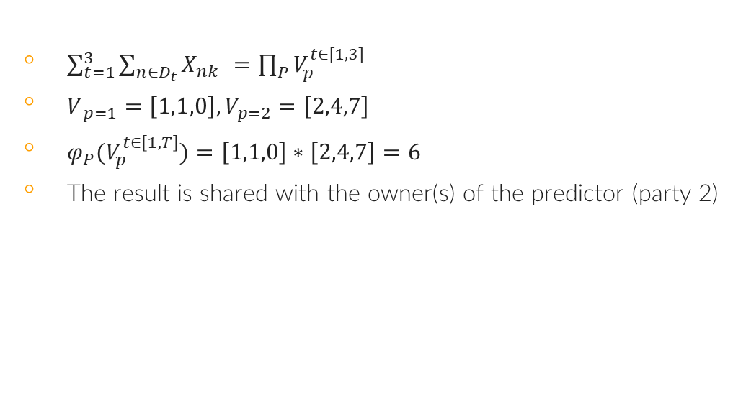
2-party Example
$\sum_{t=1}^{3}{\sum_{n∈D_{t}}{X_{nk} }=\prod_{P}{V_{p}^{t∈[1,3]}}}$
$V_{ p=1}=\left[1,1,0\right], V_{p=2}=\left[2,4,7\right]$
$φ_{P}(V_{p}^{t∈\left[1,T\right]})=\left[1,1,0\right]∗\left[2,4,7\right]=6$
The result is shared with the owner(s) of the predictor (party 2)
Party 1
Party 2
ID | T
1 | 1
2 | 1
3 | 10
ID | X
1 | 2
2 | 4
3 | 7
CARRIER

Slide 12
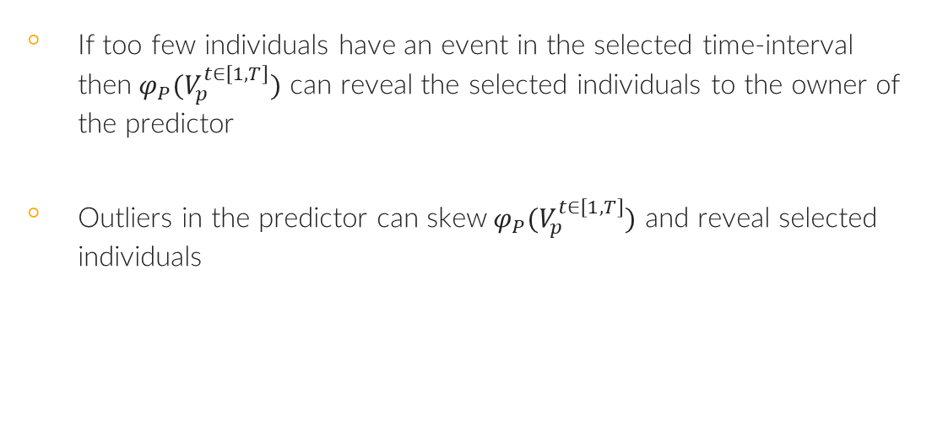
Remaining Privacy Concerns
If too few individuals have an event in the selected time-interval then${ φ}_{P}(V_{p}^{t∈\left[1,T\right]})$ can reveal the selected individuals to the owner of the predictor
Outliers in the predictor can skew${ φ}_{P}(V_{p}^{t∈\left[1,T\right]})$ and reveal selected individuals
CARRIER

Slide 13
Current status
Done:
Implemented original Verticox Protocol into Vantage6
In progress:
Incorporate the adaptation
ToDo:
Determine if verticox can deal with a hybrid enviroment
If not: split local update into several privacy preserving protocols
Validate solution
Measure running time
CARRIER

Slide 14
Any questions?
CARRIER

Slide 15
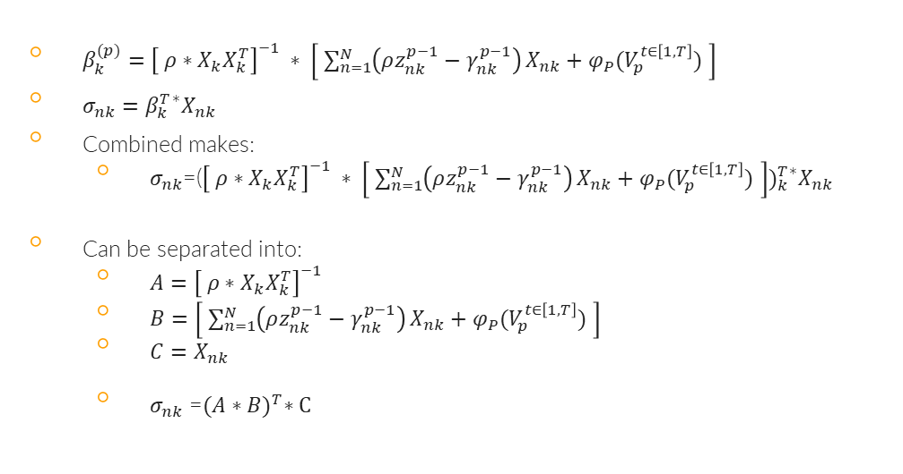
Hybridizing the local update
$β_{k}^{(p)}={\left[ ρ∗X_{k}X_{k}^{T}\right]}^{−1} ∗ \left[ \sum_{n=1}^{N}{\left(ρz_{nk}^{p−1}−γ_{nk}^{p−1}\right)}X_{nk}+φ_{P}(V_{p}^{t∈\left[1,T\right]}) \right]$
$σ_{nk}=$ $β_{k}^{T}$*$X_{nk}$
Combined makes:
$σ_{nk}$=(${{\left[ ρ∗X_{k}X_{k}^{T}\right]}^{−1} ∗ \left[ \sum_{n=1}^{N}{\left(ρz_{nk}^{p−1}−γ_{nk}^{p−1}\right)}X_{nk}+φ_{P}(V_{p}^{t∈\left[1,T\right]}) \right])}_{k}^{T}$*$X_{nk}$
Can be separated into:
$A={\left[ ρ∗X_{k}X_{k}^{T}\right]}^{−1}$
$B=\left[ \sum_{n=1}^{N}{\left(ρz_{nk}^{p−1}−γ_{nk}^{p−1}\right)}X_{nk}+φ_{P}(V_{p}^{t∈\left[1,T\right]}) \right]$
${C=X}_{nk}$
$σ_{nk}$ =${(A∗B)}^{T}∗C$

Slide 16
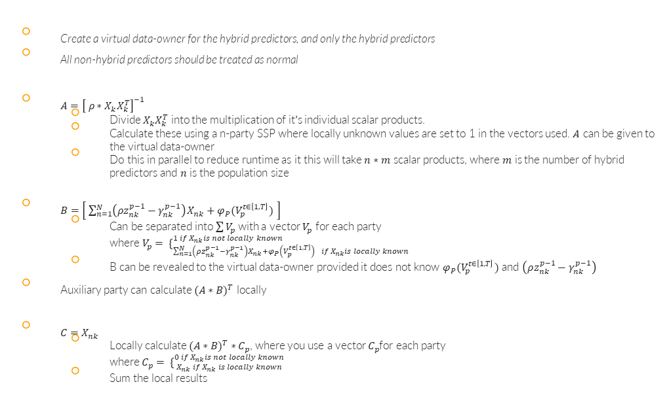
Hybridizing the local update
Create a virtual data-owner for the hybrid predictors, and only the hybrid predictors
All non-hybrid predictors should be treated as normal
$A={\left[ ρ∗X_{k}X_{k}^{T}\right]}^{−1}$
Divide $X_{k}X_{k}^{T}$ into the multiplication of it’s individual scalar products.
Calculate these using a n-party SSP where locally unknown values are set to 1 in the vectors used. $A$ can be given to the virtual data-owner
Do this in parallel to reduce runtime as it this will take $n∗m$ scalar products, where $m$ is the number of hybrid predictors and $n$ is the population size
$B=\left[ \sum_{n=1}^{N}{\left(ρz_{nk}^{p−1}−γ_{nk}^{p−1}\right)}X_{nk}+φ_{P}(V_{p}^{t∈\left[1,T\right]}) \right]$
Can be separated into $\sum{V_{p}}$ with a vector $V_{p}$ for each party where$V_{p}= \{_{\sum_{n=1}^{N}{\left(ρz_{nk}^{p−1}−γ_{nk}^{p−1}\right)}X_{nk}+φ_{P}\left(V_{p}^{t∈\left[1,T\right]}\right) if{ X}_{nk}is locally known}^{1 if{ X}_{nk}is not locally known}$
B can be revealed to the virtual data-owner provided it does not know $φ_{P}(V_{p}^{t∈\left[1,T\right]})$and $\left(ρz_{nk}^{p−1}−γ_{nk}^{p−1}\right)$
Auxiliary party can calculate ${(A∗B)}^{T}$ locally
${C=X}_{nk}$
Locally calculate ${(A∗B)}^{T} ∗C_{p}$, where you use a vector $C_{p}$for each party where $C_{p}= \{_{{ X}_{nk} if{ X}_{nk} is locally known}^{0 if{ X}_{nk}is not locally known}$
Sum the local results

