Slide 1

Behavior Tree in YARP
Current status and future work

Slide 2
CARVE project
This work originated from CARVE project.
The goal was to achieve formal verification of code execution by mean of behavior trees

Slide 3

The big picture
Groot GUI
Runtime
display
BT Engine
Receives signals for
Monitoring via YARP ports
Generates
Reads from
Glue Code
Monitors
BlackBoard
BT
description
Coordinates modules
via YARP ports
YARP exec
YARP exec
YARP exec
YARP execs

Slide 4
Behavior Tree cycle
The engine periodically scans all the behavior tree and will return to the root node with a final result.
Each node can return a single value from the list
Running / Success / Failure
(N.d.a. Originally it was only Success / Failure)

Slide 5
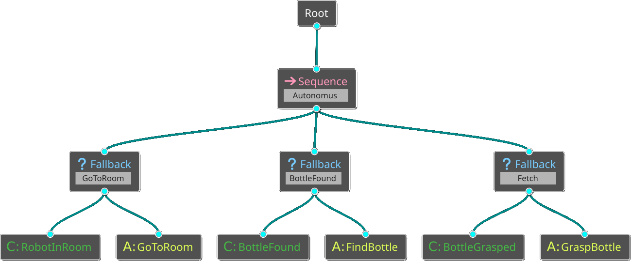
Behavor Tree in Robotics
Tick
Tick
Tick

Slide 6
Behavor Tree in Robotics
Tick
Tick
Tick
Tick
Failure

Slide 7
Behavor Tree in Robotics
Tick
Running
Tick
Running
Tick
Running
Tick
Failure

Slide 8
Behavor Tree in Robotics
Tick
Tick
Tick
Success
Tick
Success
Tick
Tick
Failure

Slide 9
Behavor Tree in Robotics
Tick
Running
Tick
Tick
Running
Success
Tick
Success
Tick
Running
Tick
Failure
Failure
Tick

Slide 10
Behavor Tree in Robotics
Tick
Running
Tick
Tick
Running
Success
Tick
Tick
Running
Success
Failure
Tick

Slide 11
Behavor Tree in Robotics
Tick
Running
Tick
Tick
Tick
Success
Success
Running
Tick
Tick
Tick
Running
Success
Success
Tick
Failure

Slide 12
Behavor Tree in Robotics
Tick
Tick
Tick
Failure

Slide 13
Behavor Tree in Robotics
Tick
Running
Tick
Halt
Halt
Running
Tick
Running
Halt
Halt
Tick
Failure

Slide 14
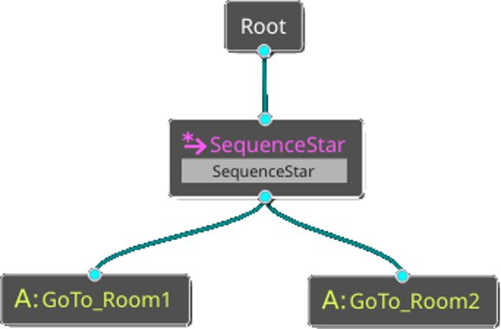
Star (*) Nodes
SequenceStar and FallbackStar are nodes with memory.
This means that once they get a result (Success/Failure, i.e. not Running) from the leaf node, they won't tick it anymore.
NOTE!!!!
In BehaviorTree_CPP library the naming convention is different:
- Sequence -> SequenceStar
- ReactiveSequence -> Sequence

Slide 15
Implementing leaf nodes
All the conditions and actions require to run some code in order to compute the return value.
The routine can be directly embeeded inside the leaf node itself and loaded by the BT engine by subclassing the provided "ConditionNode" or "ActionNode" classes.
Custom Code

Slide 16
Implementing leaf nodes
This was not good for CARVE for different reasons:
1) The purpose of the project was to better inspect the inside of the custom code and try to verify some property on the whole system: BT + custom code.
This implementation completely hides the code whitin the "ActionNode" class.
Custom Code

Slide 17
Implementing leaf nodes
This was not good for CARVE for different reasons:
2) The engine needs to compile / link the code of the leaves, creating a sort of circular dependency:
The leaf require the Action definition in order to subclass, and the engine requires the class in odrer to link against it.
Each time a new Action is created or modified, the engine requires recompilation.
Custom Code

Slide 18
Implementing leaf nodes
This was not good for CARVE for different reasons:
3) Not easy to integrate already existing code.
Navigation and manipulation stack in YARP are widespread across many executables (on different machines) and can't directly included in a single class.
Custom Code

Slide 19
Connecting BT with existing executables
To connect existing code with BT engine, a glue code is required.
Glue code
Glue code
Glue code
translation
Exec
<GoTo>
Exec
<Find>
Exec
<Grasp>
action implementation

Slide 20
BT nei confronti di una singola azione | Glue code | Singolo eseguibile nei confronti del chiamante
Solo 2 comandi possibili Tick / Halt | Cosa chiamo? | Una pletora di possibili chiamate a funzione
Tick e Halt NON hanno parametri | Dove recupero I parametri? | Ogni chiamata ha quasi sempre dei prarametri custom
Chiamare Tick periodicamente sulla stessa azione, anche durante l'esecuzione della stessa (running) , è safe e normale | Il primo tick ha un significato diverso dai successivi | Ad ogni chiamata, tendenzialmente, la routine riparte da capo. Una nuova chiamata durante l'esecuzione della stessa non è safe e può causare undefined behaviour
Un'azione è un'unità singola, atomica | Contiene una parte logica/deliberativa esso stesso | Ad un tick corrispondono più cose da fare, che possono cambiare con l'evolversi dell'azione.
Le azioni terminano sempre con Successo o Fallimento | Cosa ritorno? | Il valore di ritorno (se c'è) della singola chiamata RPC non rispecchia il Successo / Fallimento dell'azione (*1)
L’implementazione dell’azione è in grado di conoscere autonomamente il risultato dall’azione che esegue. Il risultato Success/Failure di una azione/condizione è, per il BT, un input esterno | Dove recupero lo status? | Per conoscere il successo / fallimento dell'azione (in senso BT) può essere necessario fare più chiamate e non una sola (*1)
Distingue tra Successo e Fallimento nella missione, ma non tra Fallimento ed Errore di esecuzione | Gestione errori e map logico dei valori di ritorno | Non distingue tra Successo o Fallimento ma tra Errore o Non-Errore (*2)

Slide 21
BT nei confronti di una singola azione | Glue code | Singolo eseguibile nei confronti del chiamante
Il Tick deve durare 'poco' | Adattare le tempistiche | La chiamata può prendersi tutto il tempo che gli serve prima di ritornare
Ha un clock periodico | Adattare le tempistiche | Dipende dall'implementazione, ma in generale non è sincrono col chiamante

Slide 22
Glue code's job
Remap Tick / Halt
Remap Return values
Handle parameters
Asynchronous actions

Slide 23
Usual YARPish paradigm
The RPC client/server pattern has been used to propagate the Tick/Halt command from the engine to the action's glue code.
BT engine
Leaf node implementation
Custom code
Tick
YARP
Tick Client
YARP RPC
YARP
Tick Server
Tick
Tick function implementation

Slide 24
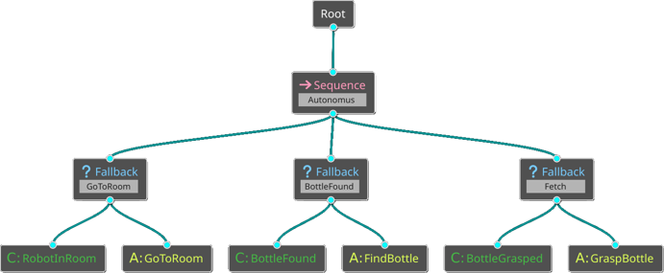
YARP
Tick Client
YARP RPC
GoTo implementation
YARP
Tick Server
Tick
User code

Slide 25
YARP
Tick Client
YARP RPC
thrift
GoTo implementation
Existing executable
YARP
Tick Server
Tick
Nav Client
Navigation Server

Slide 26
Thrift interface
ReturnStatus request_tick (1:ActionID target, 2: Params params = {});
ReturnStatus request_halt (1:ActionID target, 2: Params params = {});
ReturnStatus request_status (1:ActionID target);
bool request_initialize ();
bool request_terminate ();

Slide 27
Thrift interface
The ActionID is a small structure useful to uniquely identify the client requesting the action, so that the server can safely handle multiple clients at the same time.
struct ActionID {
1: string target;
2: string resources;
3: i32 action_ID;
}
target: this identifies the main target the action is referred to; e.g the location to reach.
resources: this identifies which resources the action will need to use; e.g. left or right arm.
action_ID: an ID number which is required to be unique for each Behaviour Tree for each node. In case the same action node is repeated more than once, each instance needs to have a different ID. (see later)

Slide 28
Synch/Asynchronous actions
Synchronous actions: the computation time of request_tick user function is negligible with respect to Behavior Tree period. In this case the Tick can return only Success/Failure (no Running).
Asynchronous actions: the computation time of request_tick user function takes a lot of time, e.g. navigation. In this case, the TickServer can spawn a thread for the Tick execution and return Running.
skill.configure_TickServer("/TickServer", "Test 1", true);
Note: if more actions are running in parallel, the server will handle it automatically, the user implementation does not require any addictional work.

Slide 29
Handle parameters
To handle the parameters required by the actual implementation to work correctly, a mapping has been introduced by mean of a shared blackboard.
Each node can have a single (optional) parameter called 'target' which is used as a key to retrieve other data from a shared blackboard.
The parameters will then propagated to the TickServer to be processed.
At the startup the blackboard can read a .ini file to initialize the data.

Slide 30
YARP
Tick Client
Shared blackboard
YARP RPC
YARP RPC
GoTo implementation
YARP
Tick Server
Tick
User code

Slide 31
Targets
Many actions are called like:
GoTo_Kitchen Grasp_Bottle Find_Bottle ecc...
The part in red is the name of the action itself, while the part in blue indicates the main target it referres to.
For example, in case a BT has the leaves GoTo_Kitchen and GoTo_Kitchen they indicates due different actionsm but at implementation level they'll act onto the same executable, with a different target.

Slide 32
Targets
If we think to the target as a primary parameter, it can be used to retrieve other associated paramters.
Es:
The navigation target Kitchen has a numeric value <x, y, theta>
The associated parameters are configurations of the navigation module, like
enable/disable obstacle avoidance, maximum speed and so on.
Those parameters may differ for different targets, so they depend on it

Slide 33
Glue Code / Tick Server (Skill)
Halt
The glue code will usually perform a few steps, mainly devided into two groups.
Startup:
Set max speed;
Set start navigation;
Check completion:
Compare robot position with desired one
Wait for Tick
Tick
Startup
Halt_Done
Routine_Done
Either Success or Failure
Startup_Done
Tick
Check
completion
Halt
Halting
Routine_Done
Either Success or Failure
Wait to return result

Slide 34
Blackboard interface
struct Data { }
(
yarp.name = "yarp::os::Property"
yarp.includefile="yarp/os/Property.h"
)
service BlackBoardWrapper
{
Data getData(1: string target)
bool setData(1: string target, 2: Data datum)
void clearData(1: string target)
void clearAll()
void resetData()
list<string> listTarget()
}

Slide 35
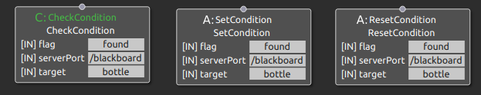
Blackboard Tick handler
The blackboard is also Tickable: it'll return success if a certain condition is True and Failure if it is false.
CheckCondition checks if the parameter <found> for target <Bottle> is true
SetCondition will set the parameter <found> for target <Bottle> to true
ResetCondition will set the parameter <found> for target <Bottle> to false

Slide 36
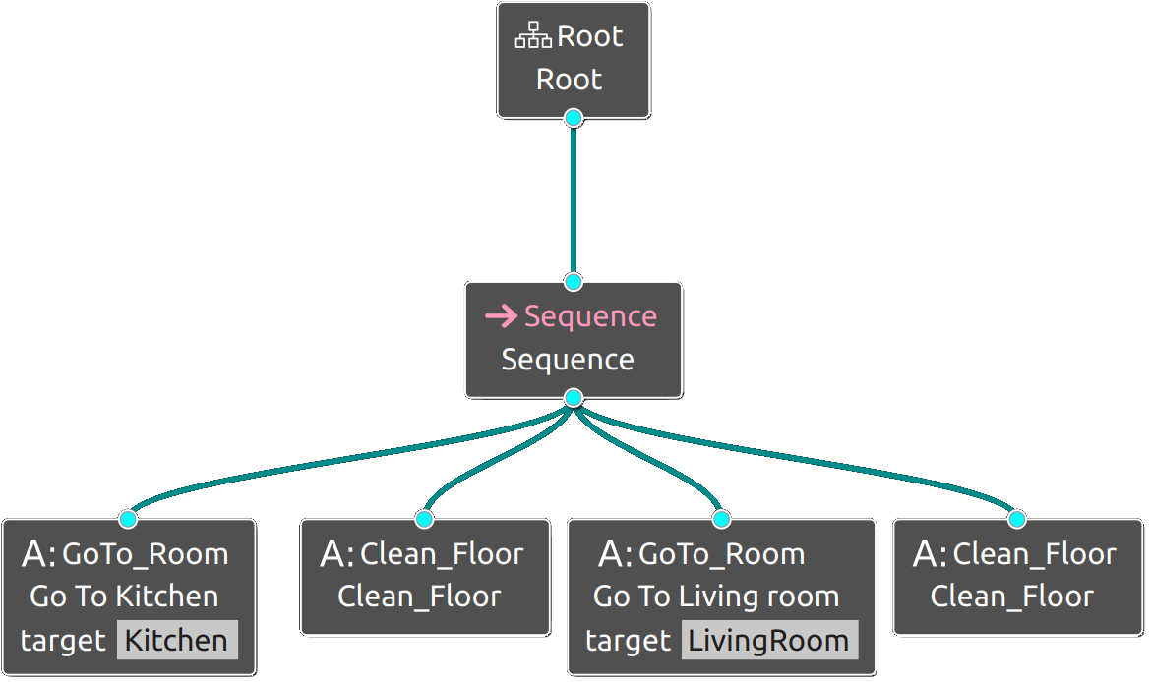
Multiple Targets
struct ActionID {
1: string target;
2: string resources;
3: i32 action_ID;
}
Target = livingRoom
Target = Kitchen
GoTo implementation
YARP
Tick Server
Tick
User code

Slide 37
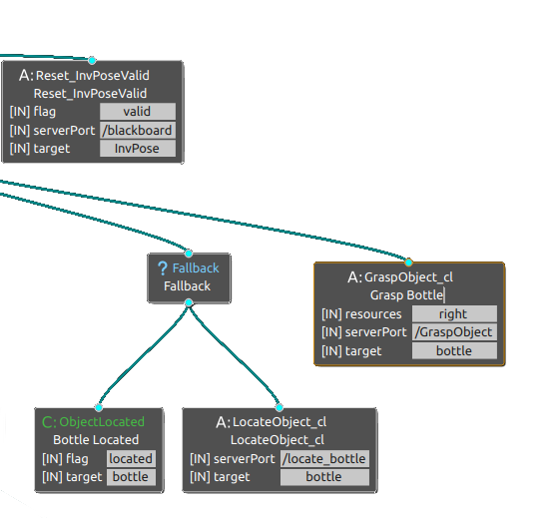
Resource usage description
struct ActionID {
1: string target;
2: string resources;
3: i32 action_ID;
}
A special field has been reserved into leaves desription for resources.
Right now it is a string parameter, with no special handling, but they are read from BT description XML file and propagated to the TickServer via the Action_ID sctucture.
This example shows that the grasp action shall be performed with right arm. By changing right with left from the Groot GUI, we can easily change how the robot will perform the action.

Slide 38
Reusage of leaves
struct ActionID {
1: string target;
2: string resources;
3: i32 action_ID;
}
Halt
Tick
ID = 4
ID = 2
GoTo implementation
YARP
Tick Server
Tick
User code

Slide 39
Skills
To generalize the interaction between any deliberative level (regardless of type) and any implementation level (from different robots / producers) RobMoSys comes up with the concept of skill.
The skill fills the gap between the two levels and specify how to use a specific robot functionality.
The roles of a skill are configuration and coordination.

Slide 40
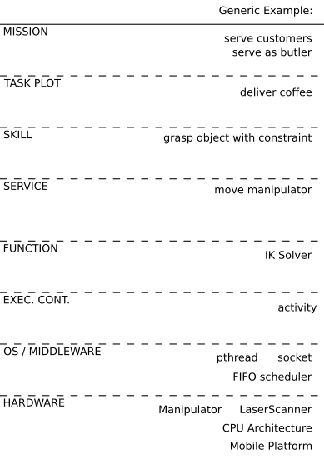
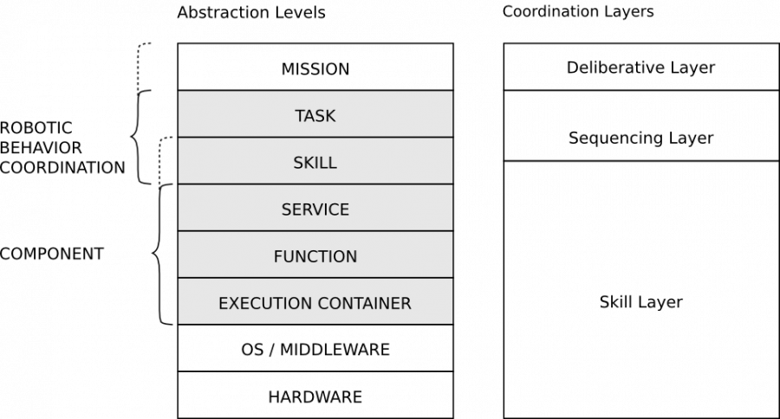
Deliberative Level (Mission & Task) | Coordination Level (Skill) | Implementation Level (Service & Function) | Robot Level (Service & Function)
Behaviour Tree | BT Glue code | RF modules | robot
State Machine | SM Glue code | RF modules | robot
User Scripts / Code | User Scripts / Code (same) | RF modules | robot

Slide 41
'BT Skills'
Halt
The glue code will usually perform a few steps, mainly devided into two groups.
Startup:
Set max speed -> RobotGoTo
Set start navigation -> NavigServer
Check completion:
Check robot's position -> localizServer
Wait for Tick
Tick
Startup
Halt_Done
Routine_Done
Either Success or Failure
Startup_Done
Tick
Check
completion
Halt
Halting
Routine_Done
Either Success or Failure
Wait to return result

Slide 42
CARVE / RobMoSys naming convetion
Deliberative level
Navigation
Skill
Vision
Skill
Manipulation
Skill
Coordination level
Exec
<GoTo>
Exec
<Find>
Exec
<Grasp>
Implementation level

Slide 43
CARVE setup
Behavior Tree
RPC
RPC
RPC
Navigation
Skill
Vision
Skill
Manipulation
Skill
Skills
RPC
RPC
RPC
Existing executables
Environment

Slide 44
Monitor
The monitors are utilities to verify the skills are working correctly.
Right now they perform a high level check and simply verify the skills will succesfully terminate its job within a certain amoungh of time.
They do so by making sure the Tick is correctly propagated from the BT to the environment via the skill, and way back to the BT.

Slide 45
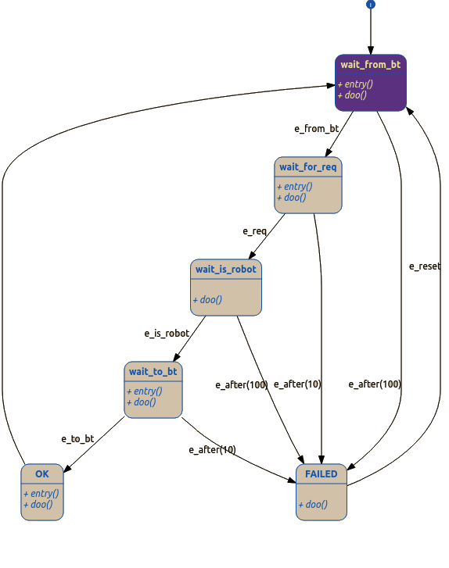
Basic monitoring - theory
1) Tick
e_from_bt
4) Result
e_to_bt
Monitors
Navigation
Skill
2) Action
e_req
3) Reply
e_reply
Env

Slide 46
Basic monitoring - implementation
Monitors
2) Action
4) Result
1) Tick
3) Reply
User application (BT engine)
Leaf node implementation
YARP RPC
Tick
User code
Tick
YARP
Tick Client
YARP
Tick Server
Tick function implementation

Slide 47
The engine
Dependency:
The Behavior Tree engine is based on the library BehaviorTree.CPP , which has a optional dependency the ZeroMQ library used to communicate with the Groot GUI.

Slide 48
The engine
It uses a custom XML format as Behavior Tree description. The syntax is described in the BehaviorTree.CPP documentation page. Example:
<BehaviorTree ID="BehaviorTree">
<Fallback name="Bottle Found">
<Condition name="Bottle Found" ID="CheckCondition" serverPort="/blackboard" flag="found" target="bottle"/>
<Action name="Find Bottle" ID="GoToLocation_cl" serverPort="/navigation_module" target="findBottle"/>
</Fallback>
</BehaviorTree>
<TreeNodesModel>
<Condition ID="CheckCondition">
<input_port name="flag"> Boolean condition to be checked on target. </input_port>
<input_port name="serverPort"> Name of the YARP port to connect to. </input_port>
<input_port name="target"> Name of the target to test. </input_port>
</Condition>
<Action ID="ComputePose_cl">
<input_port name="resources"> List of resources required by this action, if any.</input_port>
<input_port name="serverPort"> Name of the YARP port to connect to. </input_port>
<input_port name="target" default="InvPose"> Pose to compute </input_port>
</Action>
</TreeNodesModel>

Slide 49
The engine
Create a new leaf
class BtCppClient : public BT::ActionNodeBase, // inherit from BehaviorTree_cpp library
{
// It is mandatory to define this static method, from behavior tree CPP library
static BT::PortsList providedPorts()
{
return { BT::InputPort("target", "Name of the target this action is referring to, if any."),
BT::InputPort("resources", "List of resources required by this action, if any."),
BT::InputPort("serverPort", "YARP Port Name to connect to.")
};
}
}

