Slide 1
Maruti Suzuki India Limited
Pitchbook | Investment Opportunity
Prepared by: [Your Name/Firm]
Date: July 2025

Slide 2
Executive Summary
India’s leading passenger vehicle manufacturer with ~42% market share
Strong FY25 performance: ₹1.45 lakh Cr revenue, ₹13.9k Cr PAT
Growing export presence and upcoming EV strategy (eVX model)
Solid balance sheet with over ₹38k Cr cash reserves
Valuation suggests room for upside with DCF-implied value at ₹13,000+

Slide 3
Company Overview
Founded in 1981 as JV between Maruti Udyog and Suzuki Japan
Manufactures compact cars, sedans, UVs, vans, and upcoming EVs
Production capacity: ~2 million units/year across multiple plants
Large dealership and service network spanning rural & urban India
Parent company Suzuki Motor Corp holds majority stake

Slide 4
Industry Analysis
Indian PV industry CAGR ~6% (FY20–25); shifting towards UVs & EVs
EV penetration in India <3%, offering long-term growth potential
PLI scheme and FAME II policy favoring local EV & battery manufacturing
Competitors: Tata Motors (EV leader), Hyundai, M&M, Toyota
Maruti well-positioned via hybrid rollout and eVX SUV (FY26)

Slide 5
Financials Overview (FY25)
Net Sales: ₹1,451,152 Mn (+7.5% YoY)
Operating EBIT: ₹146,259 Mn (+9.3% YoY)
PBT: ₹191,832 Mn | PAT: ₹139,552 Mn (+5.6% YoY)
Sales Volume: 2.23 million units (+4.6% YoY)
Operating Margin: 10.1% | PAT Margin: 9.6%

Slide 6
Valuation Summary
Relative Valuation: P/E ~34x | EV/EBITDA ~23x
Peers: Tata Motors, M&M, Hyundai, Toyota
DCF-Based Value: ₹12,800–₹13,500/share
Implied Upside: ~15–20% over current market price
Key drivers: EV launch, rural growth, cost efficiency

Slide 7
SWOT Analysis
Strengths: Brand equity, dealer network, rural penetration, cost leadership
Weaknesses: Late EV entry, thin SUV portfolio vs. peers
Opportunities: EV growth, export expansion, hybrid product demand
Threats: Competitive pricing, commodity inflation, regulatory risks

Slide 8
Key Risks
EV disruption from Tata/Hyundai before Maruti’s EV rollout
Cost pressures from raw materials and chip shortages
Consumer shift towards premium/SUV segment
Delays in Kharkhoda plant scaling or EV delivery
Regulatory tightening on ICE vehicle emissions

Slide 9
Conclusion & Investment Case
Maruti Suzuki is a stable, cash-rich industry leader
FY25 results reinforce revenue and margin momentum
Valuation attractive with visible upside from hybrid/EV plans
Growth potential in exports and rural demand
Strong candidate for long-term portfolio inclusion

Slide 10
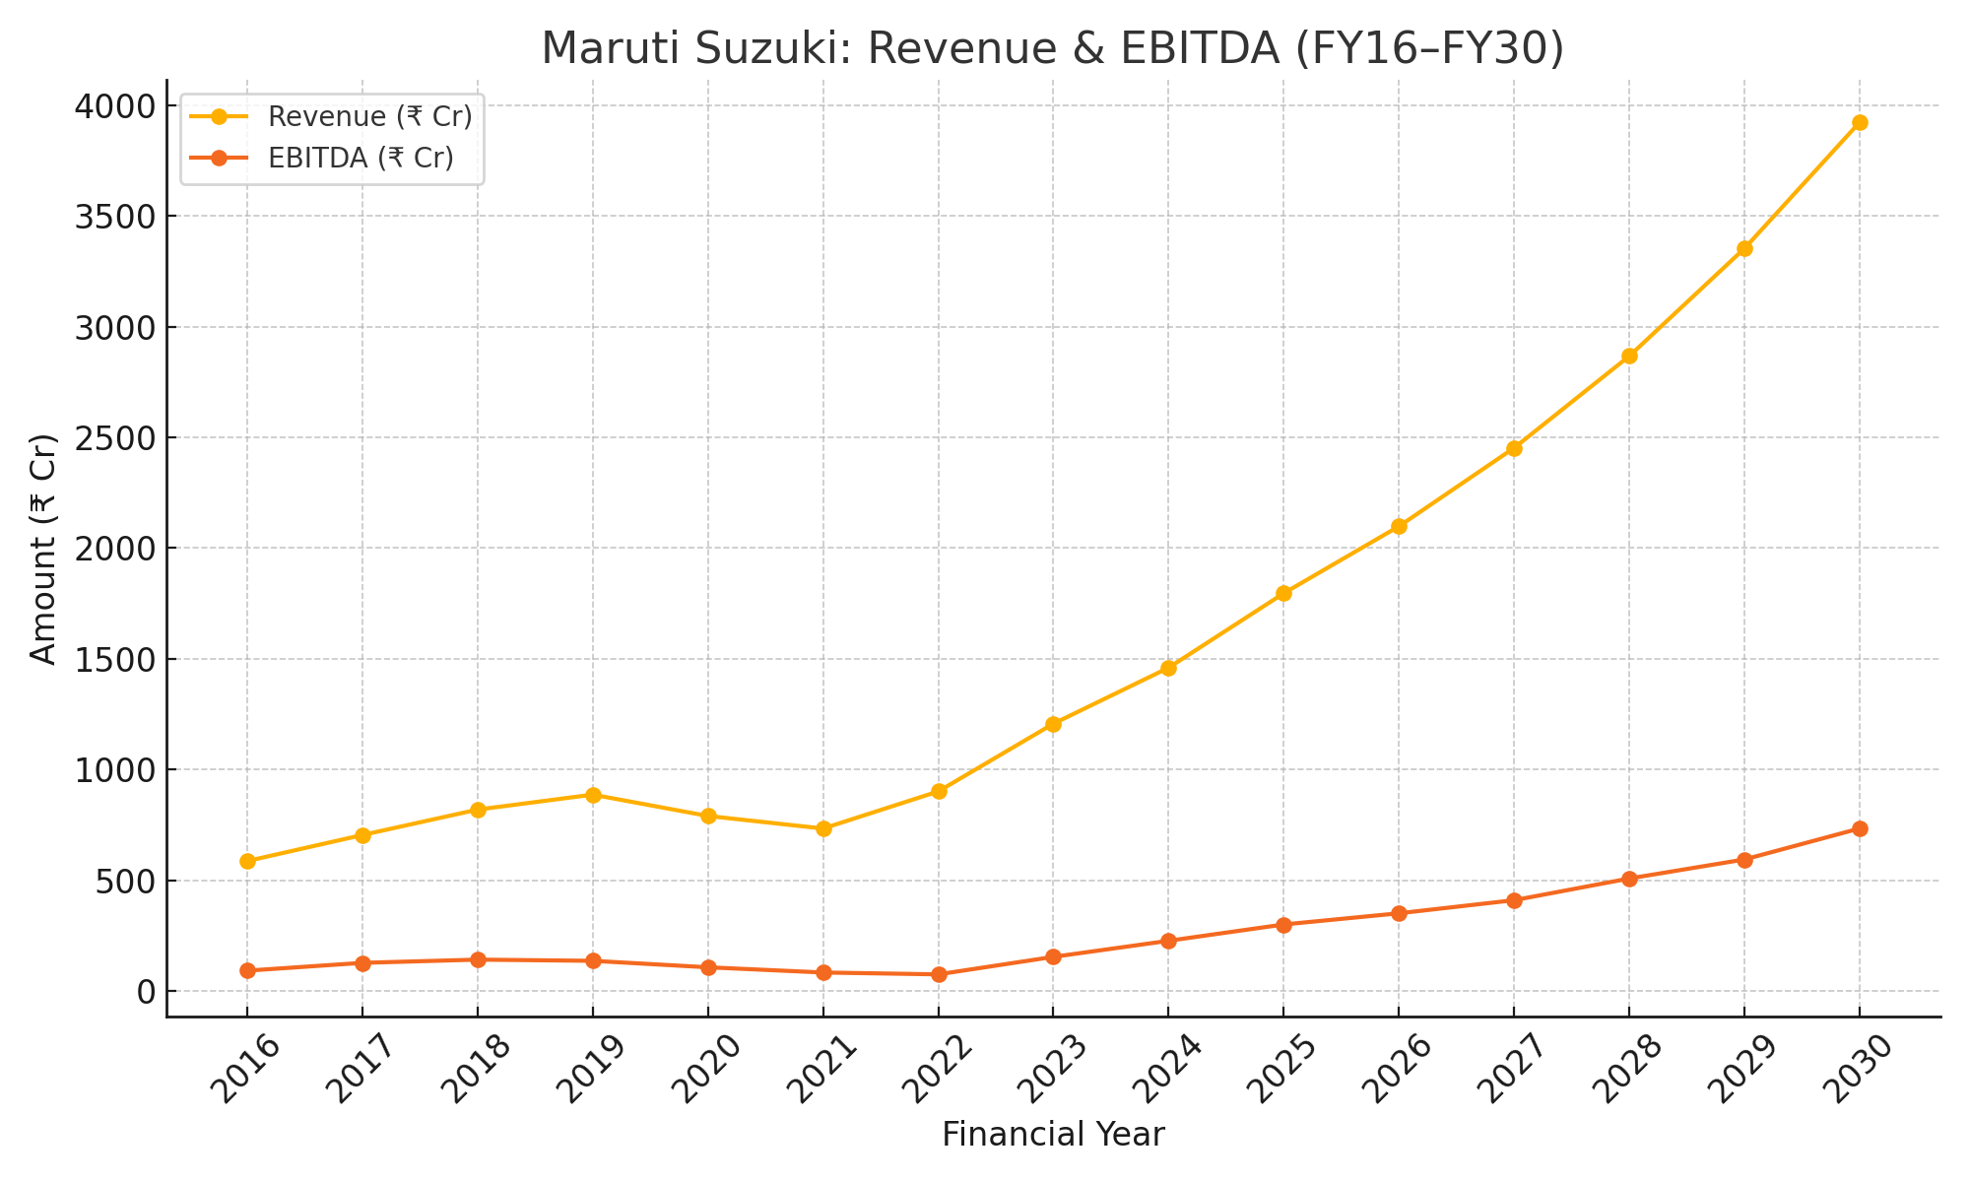
Revenue & EBITDA Trend (FY16–FY30)

Slide 11
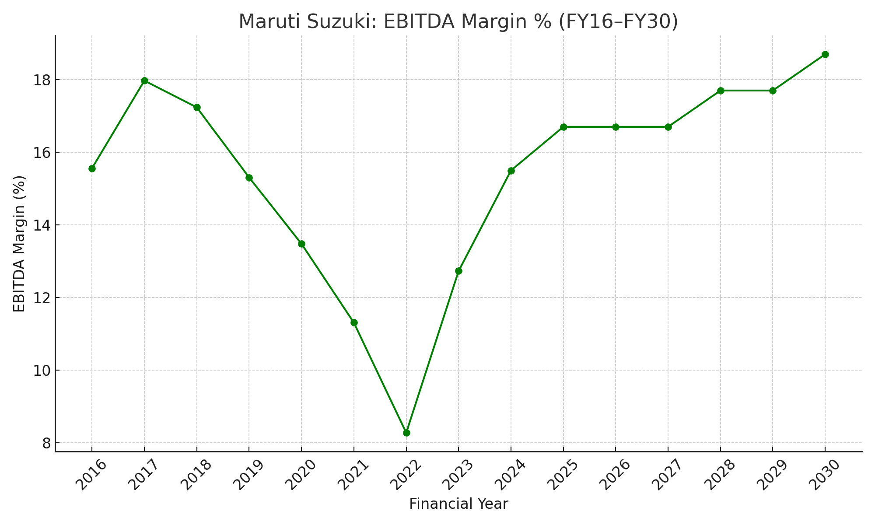
EBITDA Margin % (FY16–FY30)

