Slide 1

Reflective Writing

Slide 2
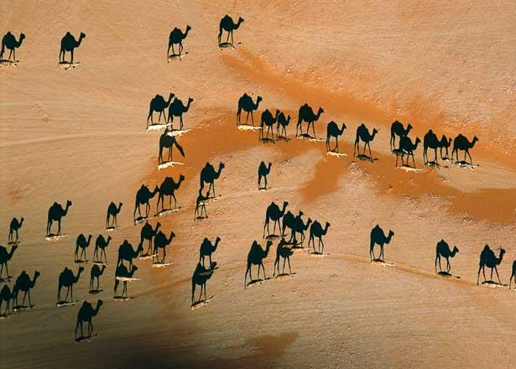

Slide 3


Slide 4
By the end of this session you should:
be able to know what reflective writing is;
be able to effectively write reflective documents.

Slide 5
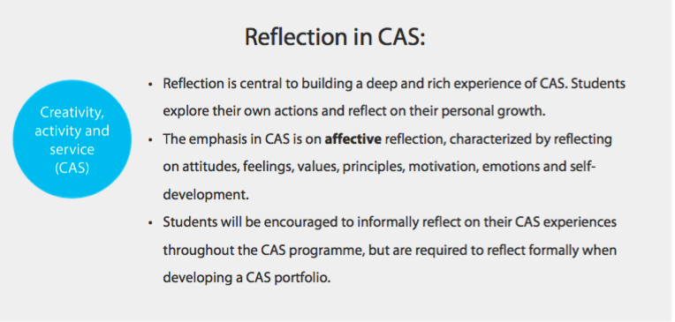

Slide 6
CAS Learning Outcomes
Identify own strengths and develop areas for growth
Demonstrate that challenges have been undertaken, developing new skills in the process.
Demonstrate how to initiate and plan a CAS experience
Show commitment to and perseverance in CAS experiences
Demonstrate the skills and recognize the benefits of working collaboratively
Demonstrate engagement with issues of global significance
Recognize and consider the ethics of choices and actions

Slide 7
What is reflective writing?
Looking back at something (event, idea or object)
Analysing the event or idea
Thinking carefully about what the event or idea means for you and your ongoing progress

Slide 8
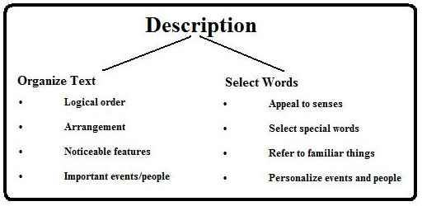
1. Description / Record
What happened, what did you find interesting?
What is being examined?
Keep it short!
Pictures
For descriptions of events - use past tense

Slide 9

2. Interpret / Reflect
What is important / interesting / useful / relevant about the experience (C, A or S)?
How do you feel about it?
How is it similar to and different from other experiences?

Slide 10

3. Connect
How did you meet the CAS Learning Objectives?
How can it be explained with an academic theory or through something you learned in class?
How is it similar to and different from other experiences?

Slide 11

4. Challenges / Action Plans
What have I learned from this?
What does this mean for my future?
Further ideas?

Slide 12
Reflection Summary
an exploration and an explanation of events – not just a description
practise standing back from oneself when writing
practise reflecting writing on the same event /incident through different people’s viewpoints and disciplines
select just the most significant parts of the event or idea on which you are reflecting
‘reflect forward’ to the future as well as ‘reflecting back’

Slide 13
Key Date - 2nd of October
Upload on MB:
CAS plan for 17/18
the goal / plan setting documents for each club (you can fill it in together in one of the first club meetings)
the Summary of CAS doc.

Slide 14
Summary of CAS
Creativity Experiences 332
Activity Experiences
Service Experiences
Project
Face to Face Engagements
Connections to Curriculum
1.Identify own strengths and develop areas for growth
2.Demonstrate that challenges have been undertaken, developing new skills in the process.
3.Demonstrate how to initiate and plan a CAS experience
4.Show commitment to and perseverance in CAS experiences
5.Demonstrate the skills and recognize the benefits of working collaboratively
6.Demonstrate engagement with issues of global significance
7.Recognize and consider the ethics of choices and actions
Portfolio

Slide 15
References
Watton, P, Collings, J, Moon, J.( 2001, April) Reflecting Writing – Guiding Notes for Students
Hampton, M, Reflective writing: a basic introduction, University of Portsmouth

