Slide 1
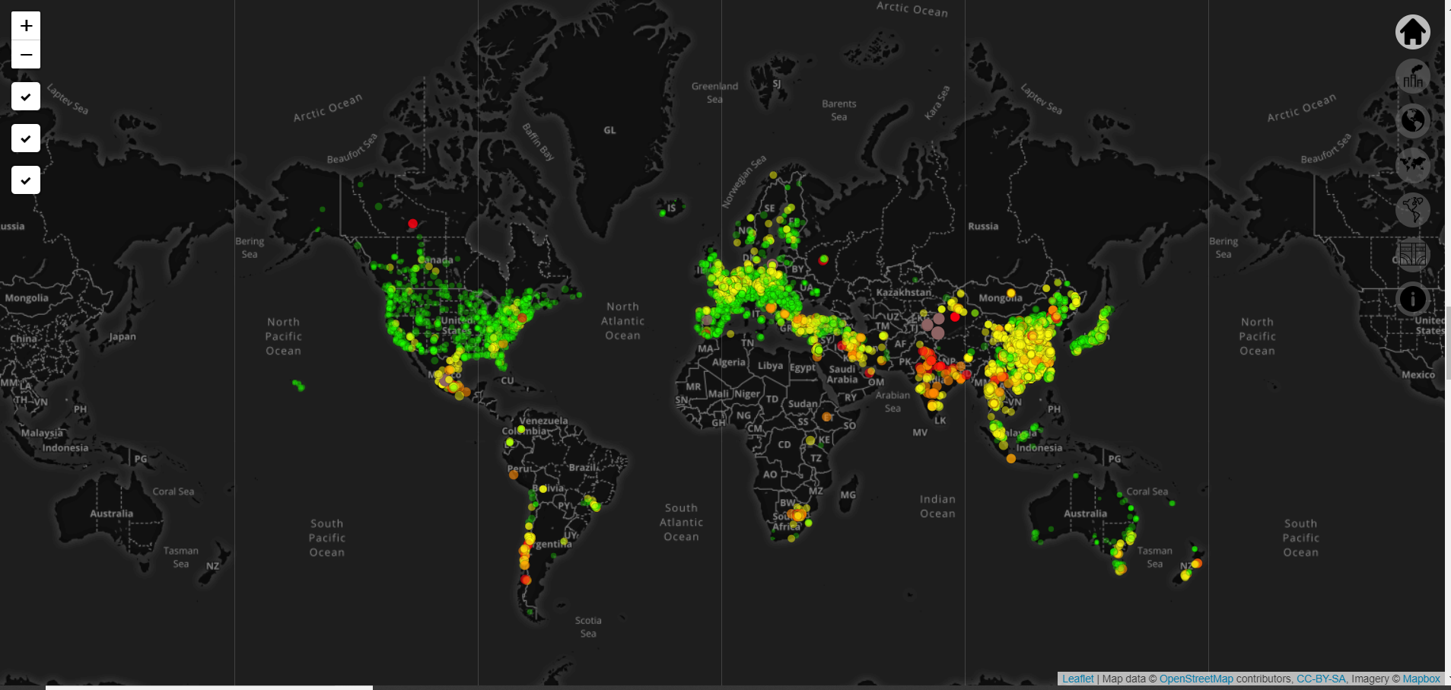
Invisible Cities – Air Quality
Group 3

Slide 2
Project Objectives
Why Air Quality?
Important invisible process affecting public health in a city
Providing direct and informative measures of air pollution to the public
Objectives of the visualisations
Visualise a invisible process
Account for differences in scales
Account for differences across space and time
Notes:
Objectives of the visualisation: Primarily to visualise an invisible process. Space-time (live API data)

Slide 3




Global (3D)
Global (2D)
Region-Level
(animation)
Street-Level (2.5D)
Notes:
Different challenges associated with each level

Slide 4
Presentation Overview
Part 1 – Global
Perspective of air pollution at a global scale
Overview of technical specifications of the project
Part 2 – Regional Level
Perspective on air quality over time
Overview of data source, collection and pre-processing
Part 3 – Street
Perspective of air pollution on the street of city
Overview of overall design of the project
Part 4 – Story
Overall story and user-interaction of the project
Finally – Recap, Challenges & Solutions
Notes:
Technical: technology based challenges (static, interactive, etc). Street level: where air pollution directly interacts with a city

Slide 5
Overall Design
Website
Slides
Navigators
Transition pages (smooth the styling)
Reducing Scale
Visualisations
Allow for both positive exploring and negative viewing
Animations, interactivity, static and non-static
Exploring has options
Information
Data dissemination (animation, interactivity, static, sliders, buttons)
Text
Notes:
Data as a tool for dissemination

Slide 6
Overall Story
User Experience
Sequential story telling
Memorable and topical
Integrating data
Including insight at every level
Different time scales tell a different story

Slide 7
Challenges & Solutions
Challenges
Data
Software
Data:
Projecting the data onto a globe
Copernicus
24 hour data
Software:
Unity
Solutions:
Visualising street level air pollution

Slide 8
Data Sources
The World Air Quality Index Project – https://aqicn.org/api/
London Atmospheric Emissions Inventory (LAEI) Concentration Data - https://data.london.gov.uk/dataset/laei-2008-concentration-maps?resource=159b2b40-d881-4ee5-88e2-09cbf0e1c012
Air pollution deaths – https://ourworldindata.org/air-pollution

Slide 9
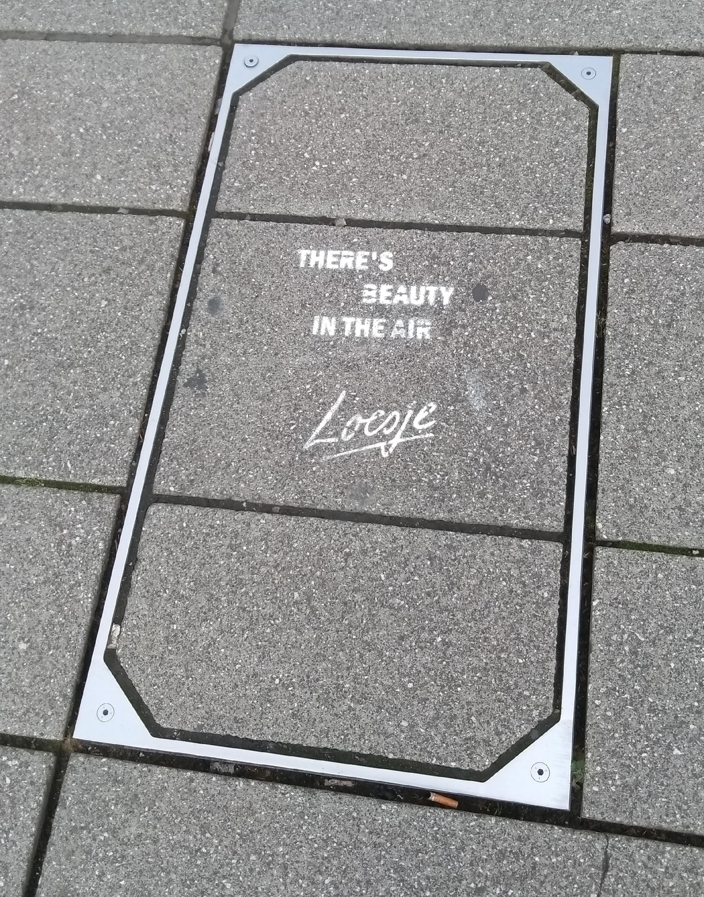
Question time!

