Slide 1
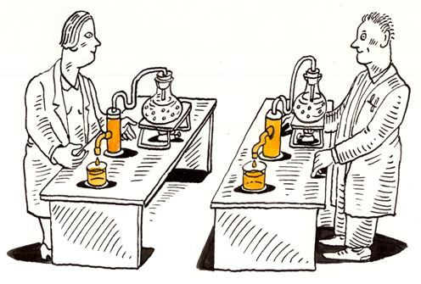
Reproducible Science
A Primer on Workflows to Support Research
Nelson Roque, PhD

