Slide 1
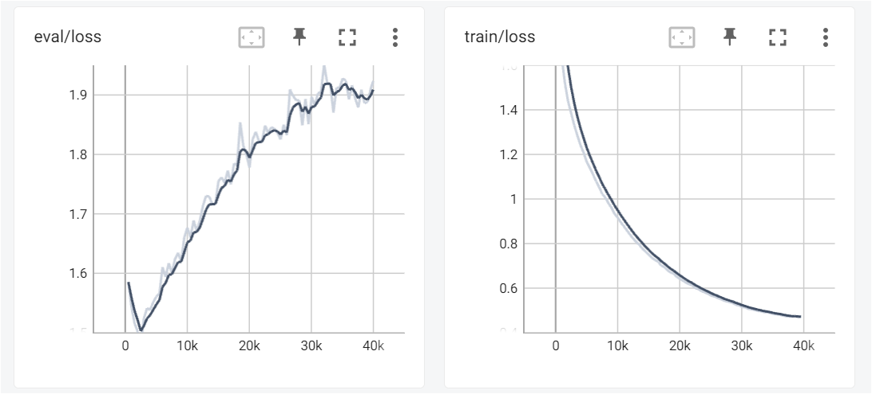
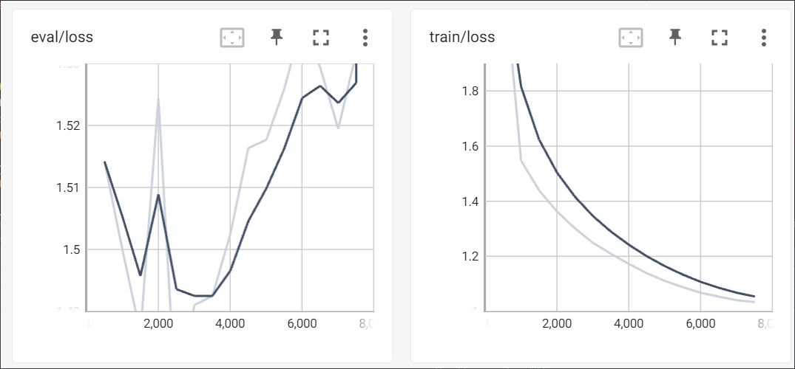
BERT-Base-Cased
Single Model
MoE

Slide 2
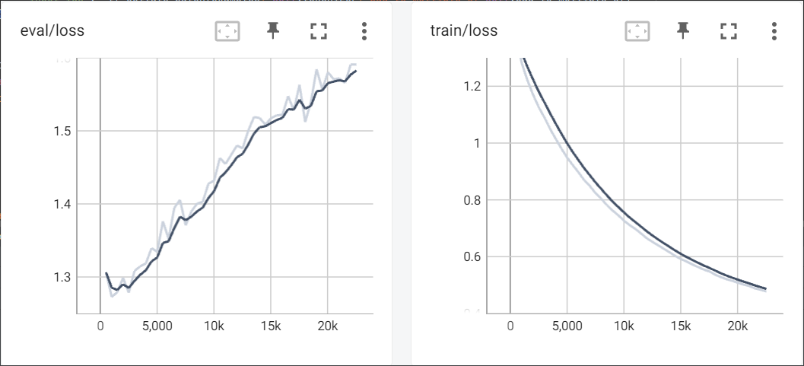
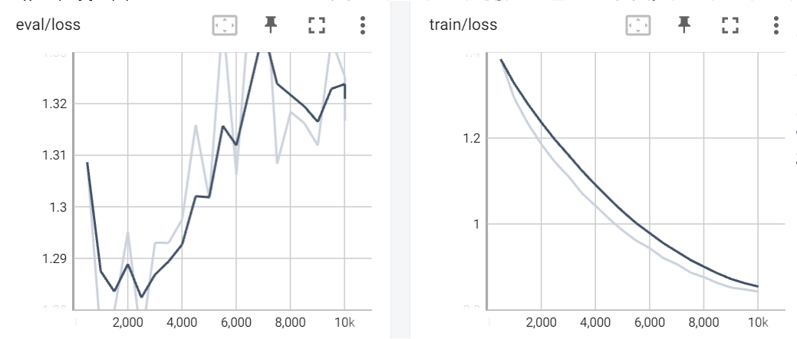
Roberta-Base
Single Model
MoE

Slide 3
Roberta-Base
Single Model
MoE

Slide 4
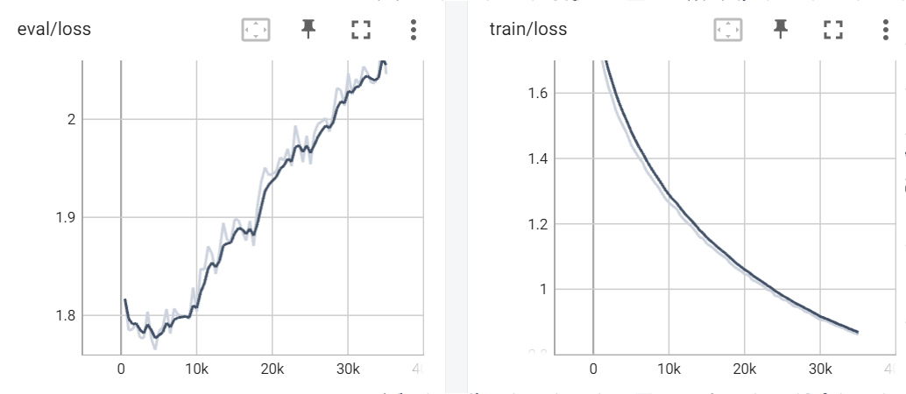
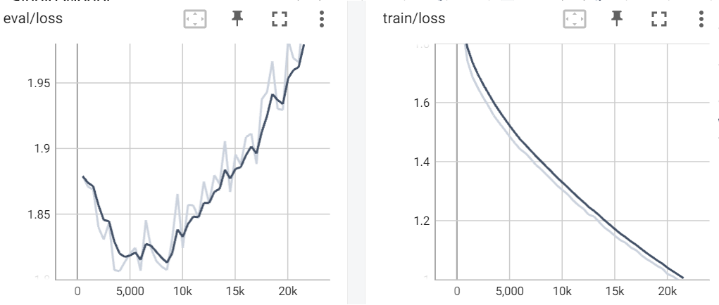
Albert
Single Model
MoE

