Slide 1
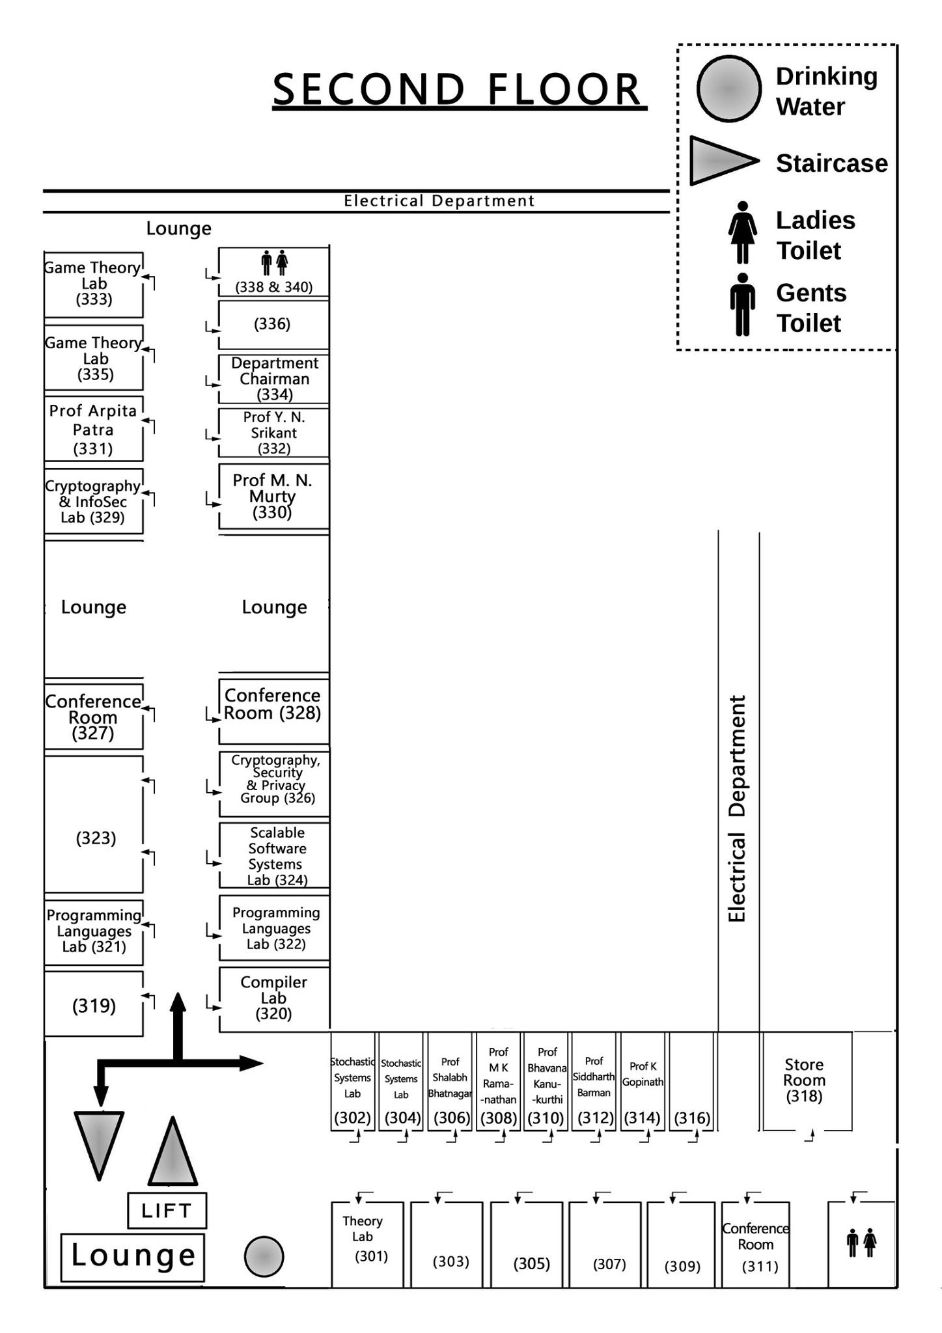
Computer Architecture and Systems Lab
Room 319
Room 314
319
314
Maps Not Drawn to Scale

Slide 2
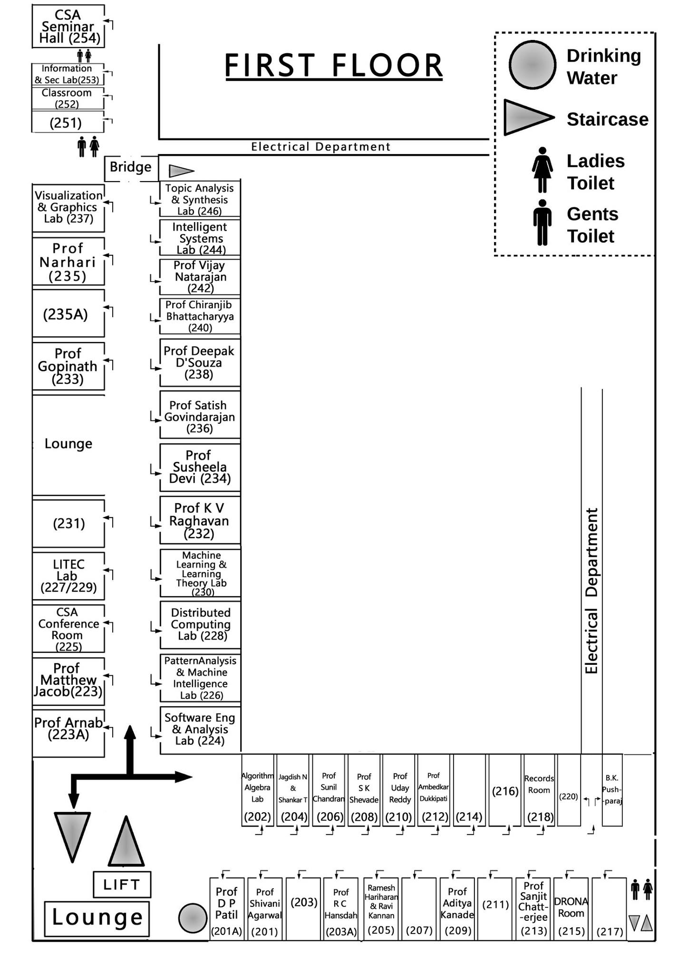
Professor K. Gopinath’s
Office
Room 223
223
309
314
Maps Not Drawn to Scale

