Slide 1

Concept Drift Detection in Social Media Streams
Informed ageing naive Bayes + an error-based ADWIN detector,
live on Kafka, Spark, InfluxDB and Grafana
Streaming Data Analytics (IOE413) · Semester 7 · Team 18
BY
2023BCS0102 – BICHU DEVNARAYAN
2023BCD0005 – ALBIN JOHN
2023BCS0068 – SARTHAK
2023BCD0024 – ASWIN PARAMESH
Notes:
[12 s, Bichu] Hello, we are Team 18: Bichu Devnarayan, Albin John, Sarthak and Aswin Paramesh. Our project is concept drift detection in social media streams.

Slide 2
Introduction and Problem Statement
Tweets arrive as a fast, never-ending stream; topics, words and opinions keep changing: concept drift
A sentiment model trained once quietly loses accuracy
Virtual drift: new words or topics, P(X) changes
Real drift: same words, new meaning, P(y | X) changes
Problem: the base paper's detector watches only the words, so it cannot see a change in meaning
Goal: catch both kinds, early, in a live streaming pipeline
Virtual drift
work / school tweets → music / movie tweets
the words change, the meaning does not
Real drift
"so sick" was negative, now means positive
the words stay, the meaning changes
Only real drift necessarily hurts a classifier.
Notes:
[22 s, Bichu] Tweets arrive as a fast, never-ending stream, and topics, words and opinions keep changing: concept drift. Some drift only changes the words, like a switch from work tweets to music tweets. Real drift changes the meaning: the same words now signal a different sentiment, and a model trained once quietly loses accuracy.

Slide 3
Literature Review
[1] Iosifidis, Oelschlager, Ntoutsi (2017): informed ageing naive Bayes on Sentiment140; a vocabulary detector tunes how fast the model forgets
Our baseline: we reproduce the model, the detector and all 5 forgetting strategies
[2] Costa, Silva, Antunes, Ribeiro (ICMLA 2014): sudden, gradual and recurring drift simulated by re-timestamping real tweets
Our method for controlled drift scenarios with known drift points
[3] Bechini et al. (IEEE Access 2021): real-world events cause drift in a Twitter stance stream; adaptive models recover
Our motivation: drift on social media is event-driven and real
Gap: the baseline watches only the input words, reacts once per 24k-tweet window, and was never run on a live streaming stack
Notes:
[18 s, Bichu] We built on three papers. Iosifidis and colleagues adapt a naive Bayes classifier when a word-based detector signals change; that is our baseline. Costa and colleagues show how to simulate drift with real tweets, and Bechini and colleagues show that real events cause it. The gap: the baseline only watches the words.

Slide 4
System Architecture
Ingest
Sentiment140 → parquet
pandas, pyarrow
Producer
confluent-kafka 2.15
Kafka 3.9.1 (KRaft)
topic tweets, 1 partition
Process
Spark executors
read Kafka, parse JSON, tokenize
Spark driver: foreachBatch
predict, then learn, tweet by tweet
Models
Baseline
ageing naive Bayes + vocabulary detector
Enhanced
baseline + ADWIN on the errors (River)
Serve
InfluxDB 2.7
per-model + pipeline metrics, drift events
Grafana 11.5.2
live dashboard + drift markers
Kafka, Kafka UI, Spark master + worker, InfluxDB and Grafana run in Docker Compose; one Python package (core/) holds the models for both the live and the offline runner.
Notes:
[22 s, Albin] Here is the pipeline. A Python producer replays Sentiment140's 1.6 million tweets, in time order, into Kafka. Spark Structured Streaming tokenizes each micro-batch, and the driver runs the baseline and our enhanced model side by side. Metrics and drift events go to InfluxDB and Grafana, all in Docker.

Slide 5
Baseline: Informed Ageing Naive Bayes
Multinomial naive Bayes whose counts fade with age:
weight of a word in a class ∝ count × e^(−λ · hours since last seen)
Vocabulary detector, every w tweets, per class:
overlap of the latest window's words with the previous window's
alarm if it leaves mean ± 1.8 standard deviations
On an alarm: forget faster (raise λ) or rebuild the model; 5 strategies from the paper
Details we had to fix
Time measured in hours: per tweet, the model forgot everything within ~100 tweets
Compare with the previous window, not all words so far: otherwise the score drifts down and the detector fires constantly
Mean / deviation over 20 checks instead of 10: removes false alarms
Notes:
[20 s, Albin] The baseline is an ageing naive Bayes: old word counts fade with time. Every few thousand tweets a detector compares the words of recent tweets with the previous window, and when they change, the model forgets faster or is rebuilt. We had to fix two details the paper leaves open.

Slide 6
Enhancement: ADWIN on the Errors
Predict the tweet
Every tweet is tested before it is learned, so the error comes for free
Sees changes in meaning even when the words stay the same
Checks every tweet, not once per 24k-tweet window
Learn its label
Error: right = 0, wrong = 1
Fusion mode | Model reacts when
vocab only | the word detector fires (= baseline)
ADWIN only | ADWIN fires
OR (main) | either detector fires
AND | both fire within one window
ADWIN (River, δ = 0.01)
alarm if the error rate rises
Rebuild on the tweets after the change
only the new concept
Notes:
[22 s, Albin] Our enhancement watches the model's own mistakes. Every tweet is predicted before it is learned, so each one gives a free right-or-wrong signal. ADWIN raises an alarm when the error rate rises, and the model is rebuilt on the tweets after the change. The OR mode, which combines both detectors, is our main model.

Slide 7
Data and Drift Scenarios
Stream | What changes | Size
DS1: Sentiment140 | real data, sorted by time; all tweets negative from #1,324,775 | 1.6M tweets
DS2: volatile variant | positive share swings 68 / 27 / 70 / 17 / 56 / 28 / 0 % | 1.07M tweets
Sudden / gradual / recurring | topic switch: work / school ↔ music / movies | 80k × 5 seeds
Prior shift | 50 % → 10 % positive | 80k × 5 seeds
Label flip | every label inverts at 40k; the words stay the same | 80k × 5 seeds
Label flip (topic) | only work / school labels invert | 80k × 5 seeds
Scenarios use real tweets re-timestamped as in Costa et al. [2]; every stream has a file of its true drift points.
Metrics: accuracy, macro precision / recall / F1, detection delay, false alarms, missed drifts, recovery time, throughput, latency, memory
Notes:
[15 s, Sarthak] We test on the real stream, the paper's more volatile variant, and six controlled scenarios with known drift points, each with five random seeds. The key one is the label flip: at tweet 40,000 every label inverts while the words stay the same.

Slide 8
Implementation: Tools and Versions
Tool | Version | Role
Apache Kafka (KRaft) + confluent-kafka | 3.9.1 + 2.15.1 | ordered, replayable tweet stream
Apache Spark Structured Streaming | 3.5.3 | parse, tokenize, run both models
River | 0.26.1 / 0.22.0 in Spark | ADWIN drift detector
InfluxDB + Grafana OSS | 2.7 + 11.5.2 | metrics store, live dashboard
Docker + Compose | 28.3.2 + 2.39.1 | runs all six services
Python, pandas, pyarrow | 3.12.4, 3.0.6, 25.0.1 | data preparation, offline runner
scikit-learn, pytest | 1.9.1, 9.1.1 | reference model, 46 unit tests
Exact pins: requirements.txt, docker/spark/Dockerfile, docker-compose.yml (see the README).
Notes:
[10 s, Sarthak] These are the tools and their versions. The Python packages are pinned in the requirements file, and the Spark image is built from our Dockerfile.

Slide 9
Live Demo
1
Six services up in Docker
2
Spark consumer: baseline + enhanced
3
Producer replays the label-flip stream
4
Grafana: the flip, ADWIN's alarm, recovery
5
Offline runner: one command, full metrics
Pipeline: Kafka → Spark Structured Streaming → InfluxDB → Grafana, on real tweets.
Notes:
[5 s, Albin] Now let us show the pipeline running end to end.

Slide 10
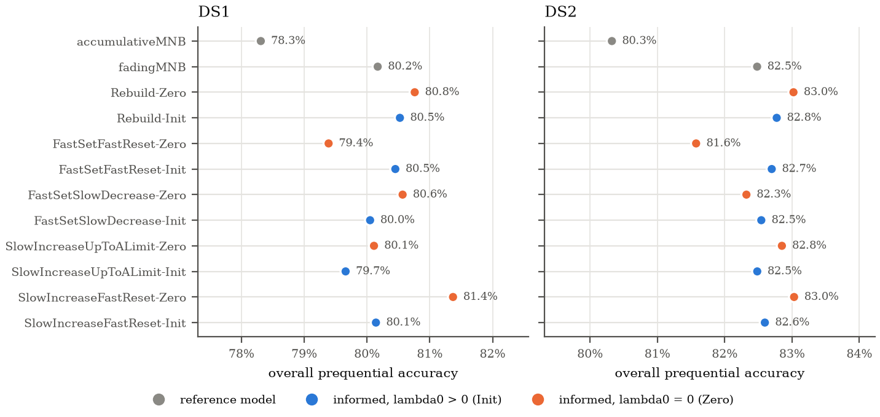
Results: Baseline Reproduction
Same ordering as the paper on both streams
Never forgetting is worst: 78.3 % / 80.3 %
Informed adaptation best: up to 81.4 % / 83.0 %
After DS1's change point: 93–99.9 % vs 77 %
Difference: forgetting only on alarms (Zero) beats constant forgetting (Init)
Overall accuracy of all baseline strategies (Table 1 parameters of [1]).
Notes:
[15 s, Sarthak] First, the baseline reproduces the paper: the model that never forgets is worst, fixed forgetting helps, and informed adaptation is best on both streams. One difference: in our runs, forgetting only on detected change beats constant forgetting.

Slide 11
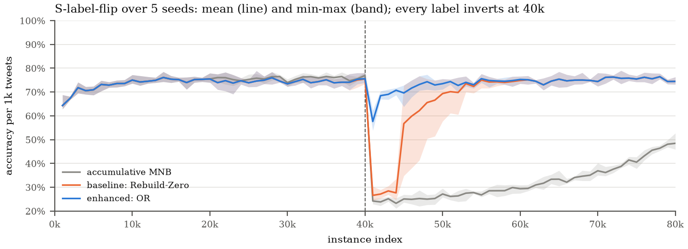
Results: The Label Flip
 | Detection delay | Recovery to 95 % | Accuracy (5 seeds)
Baseline (word detector) | 3,999 tweets | 8,204 tweets | 71.0 ± 1.0 %
Enhanced (OR) | 39 tweets | 3,183 tweets | 73.8 ± 0.3 %
Notes:
[18 s, Sarthak] On the label flip, the word detector waits a full window, about four thousand tweets, while accuracy sits near twenty-five percent. ADWIN fires after thirty-nine tweets, recovery is two and a half times faster, and accuracy rises from seventy-one to almost seventy-four percent.

Slide 12
Results: All Streams and Real Data
Metric | Baseline | Enhanced
Topic-only flip: drifts detected | 3 / 5 | 5 / 5
DS1 accuracy | 80.8 % | 81.3–81.7 %
DS1 change point: delay | 19,224 | 704
DS2 accuracy | 83.0 % | 83.7–84.1 %
Drifts detected (all 47) | 36 | 39
False alarms (all runs) | 70 | 102
≥ baseline accuracy | – | 28 of 32 runs
ADWIN catches meaning drift; the word detector catches topic and prior shifts
OR keeps both: never more than 0.04 points below the baseline
Extra false alarms come mostly from the word detector; a rebuild makes them cheap
Topic and prior shifts barely change accuracy for any model
Notes:
[20 s, Aswin] ADWIN also catches a flip limited to one topic, which the baseline misses in two of five runs. On real data, accuracy improves on both streams, and Sentiment140's change point is caught after seven hundred tweets instead of nineteen thousand. The price is more false alarms, mostly from the word detector.

Slide 13
Performance
Metric | Result
Throughput, 1k-tweet batches | 2,000 tweets/s
Latency at 2,000 tweets/s | 0.42 s median, 0.76 s p95
Throughput, 5k-tweet batches | 5,593 tweets/s
Model time per 1k tweets | 22.6 ms → 32.9 ms
ADWIN update | < 1 µs
Offline runner | 37–46k tweets/s
Unit tests | 46 passing
Live accuracy = offline accuracy (72 % vs 74 % on the label flip)
The bottleneck is Spark's ~170 ms per micro-batch, not the models
ADWIN adds ~10 ms per 1,000 tweets
Spark driver memory: 200–330 MB
Notes:
[12 s, Aswin] The cost is small. In our benchmark the pipeline kept up with two thousand tweets per second, and ADWIN adds only about ten milliseconds per thousand tweets.

Slide 14
Limitations and Future Work
Limitations
Future work
Labels come from emoticons and are noisy
Controlled drifts are synthetic; topics defined by keywords
Real streams list only designed drift points: false alarms are upper bounds
Model state lives on the Spark driver
Naive Bayes cannot learn a topic-only flip (~64 % ceiling)
A context-aware classifier for topic-specific meaning changes
Drift-specific reactions, e.g. re-weight the class prior on a prior shift
Keyed state so Spark can partition the model
Recent, event-driven Twitter / X data
Notes:
[12 s, Aswin] Limitations: the labels come from emoticons, the controlled drifts are synthetic, and the model runs on the Spark driver. Next, we would try a context-aware classifier and recent, event-driven data.

Slide 15
Conclusion
Reproduced the paper's informed ageing naive Bayes on Sentiment140
Its word-based detector misses or delays drift that changes meaning
ADWIN on the errors detects it ~100× sooner and recovers 2.6× faster
Accuracy improves on both real streams, at ~10 ms per 1,000 tweets
Runs end to end on Kafka, Spark Structured Streaming, InfluxDB and Grafana
Watch the errors, not only the words.
Notes:
[12 s, Aswin] To conclude: watch the errors, not only the words. Combining both detectors catches meaning drift about a hundred times sooner and improves accuracy, at almost no cost, in a real streaming pipeline.

Slide 16
References
[1] V. Iosifidis, A. Oelschlager and E. Ntoutsi, “Sentiment classification over opinionated data streams through informed model adaptation,” in Proc. TPDL, Springer LNCS, 2017.
[2] J. Costa, C. Silva, M. Antunes and B. Ribeiro, “Concept drift awareness in Twitter streams,” in Proc. 13th ICMLA, IEEE, 2014.
[3] A. Bechini, A. Bondielli, P. Ducange, F. Marcelloni and A. Renda, “Addressing event-driven concept drift in Twitter stream: a stance detection application,” IEEE Access, vol. 9, 2021.
[4] A. Bifet and R. Gavaldà, “Learning from time-changing data with adaptive windowing,” in Proc. SIAM SDM, 2007.
[5] S. Wagner, M. Zimmermann, E. Ntoutsi and M. Spiliopoulou, “Ageing-based multinomial naive Bayes classifiers over opinionated data streams,” in Proc. ECML PKDD, 2015.
[6] A. Go, R. Bhayani and L. Huang, “Twitter sentiment classification using distant supervision,” Stanford CS224N report, 2009.
[7] J. Montiel et al., “River: machine learning for streaming data in Python,” JMLR, vol. 22, 2021.
[8] M. Armbrust et al., “Structured Streaming: a declarative API for real-time applications in Apache Spark,” in Proc. ACM SIGMOD, 2018.
Notes:
[3 s, Aswin] These are our references.

Slide 17
Thank You
Questions are welcome
github.com/CASPER0022/Drift-Aware-Sentiment-Stream
Notes:
[4 s, Aswin] Thank you.

