Slide 1
PROJECT REVIEW • NLP
Malayalam Named Entity
Recognition using IndicBERTv2
A fine-tuned Transformer + CRF sequence-tagging system that identifies People, Organizations, Locations, Dates and Cardinal values in raw Malayalam text — served through a Gradio web app and a FastAPI microservice.
PER
ORG
LOC
DATE
CARDINAL
ai4bharat/IndicBERTv2-MLM-only + CRF Decoder + Inverse Class Weighting
Semester 7 • NLP Project

Slide 2
FOUNDATION
Dataset & Challenges
02
Dataset Composition
Core Challenge: Malayalam Agglutination
716,652
3,618
Malayalam words fuse multiple morphemes into one token (e.g. തിരുവനന്തപുരത്ത് → ‘Thiruvananthapuram + locative’). A subword tokenizer therefore splits one word into several WordPiece units, breaking the 1:1 word↔label mapping.
Training sentences
Validation sentences
974
7
Held-out test sentences
IOB2 tag classes
Our Solution: Subword-Aware Masking
• Fast tokenizer word_ids(): map each subword back to its source word
• First subword of a word receives the real IOB2 label
• Remaining subwords get label −100, excluded from the loss automatically by PyTorch
• Result: clean gradient signal even though input/label lengths differ
• Tag scheme: O, B-PER/I-PER, B-ORG/I-ORG, B-LOC/I-LOC (IOB2)
• Class imbalance: the ‘O’ tag covers ~71% of tokens — addressed with inverse class weighting (Slide 3)
• Train subset: 50,000 sentences sampled for fast convergence on available GPU (RTX-class, fp16)
Malayalam NER using IndicBERTv2 | Project Review
2

Slide 3
HOW IT WORKS
Methodology & Architecture
03
Pipeline
Malayalam
Raw Text
IndicBERTv2 /
MuRIL Encoder
Linear
Classifier Head
CRF
Decoder
IOB2 Tag
Sequence
Backbone: ai4bharat/IndicBERTv2-MLM-only (config-swappable for google/muril-base-cased) — torchcrf CRF layer learns valid tag-transition constraints
Why a CRF head?
Handling Class Imbalance & Training
• Plain softmax tags each token independently — can output illegal sequences like I-PER right after O
• CRF models transition scores between tags and decodes the globally-best label path with Viterbi
• Result: structurally valid IOB2 sequences, especially for multi-word entities (e.g. പിണറായി വിജയൻ)
• Inverse class weighting: loss weight ∝ 1/frequency, normalized — forces the model to pay attention to rare PER/ORG/LOC tags, not just ‘O’
• fp16 mixed precision on CUDA, AdamW, lr 3e-5, batch 32, 3 epochs, max_len 128
• Hybrid rule overlay: regex post-processor adds DATE & CARDINAL spans (months, numeric patterns) with zero extra training
Malayalam NER using IndicBERTv2 | Project Review
3

Slide 4
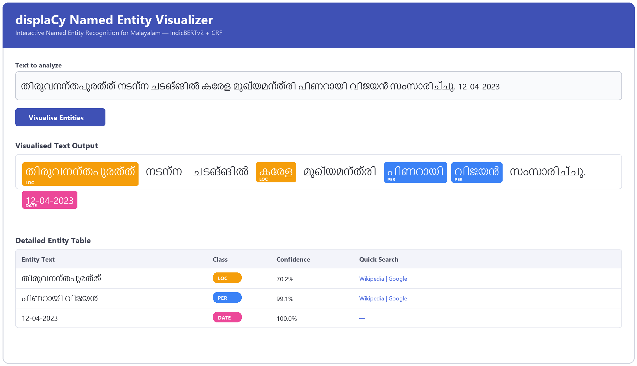
SEE IT IN ACTION
Live Demo — Gradio Web App
04
What to highlight live
• Color-coded highlighting for PER / ORG / LOC / DATE / CARDINAL, with per-token confidence
• Clickable links auto-generated to Malayalam Wikipedia & Google Search for each entity
• Live bar charts of entity-class distribution per query
• Batch tab: upload a .txt file → aggregate entity frequencies → download CSV report
• Entity filter toggles to show/hide specific tag classes on demand
Mockup rendered from actual model output on a real test sentence (predict.py).
Malayalam NER using IndicBERTv2 | Project Review
4

Slide 5
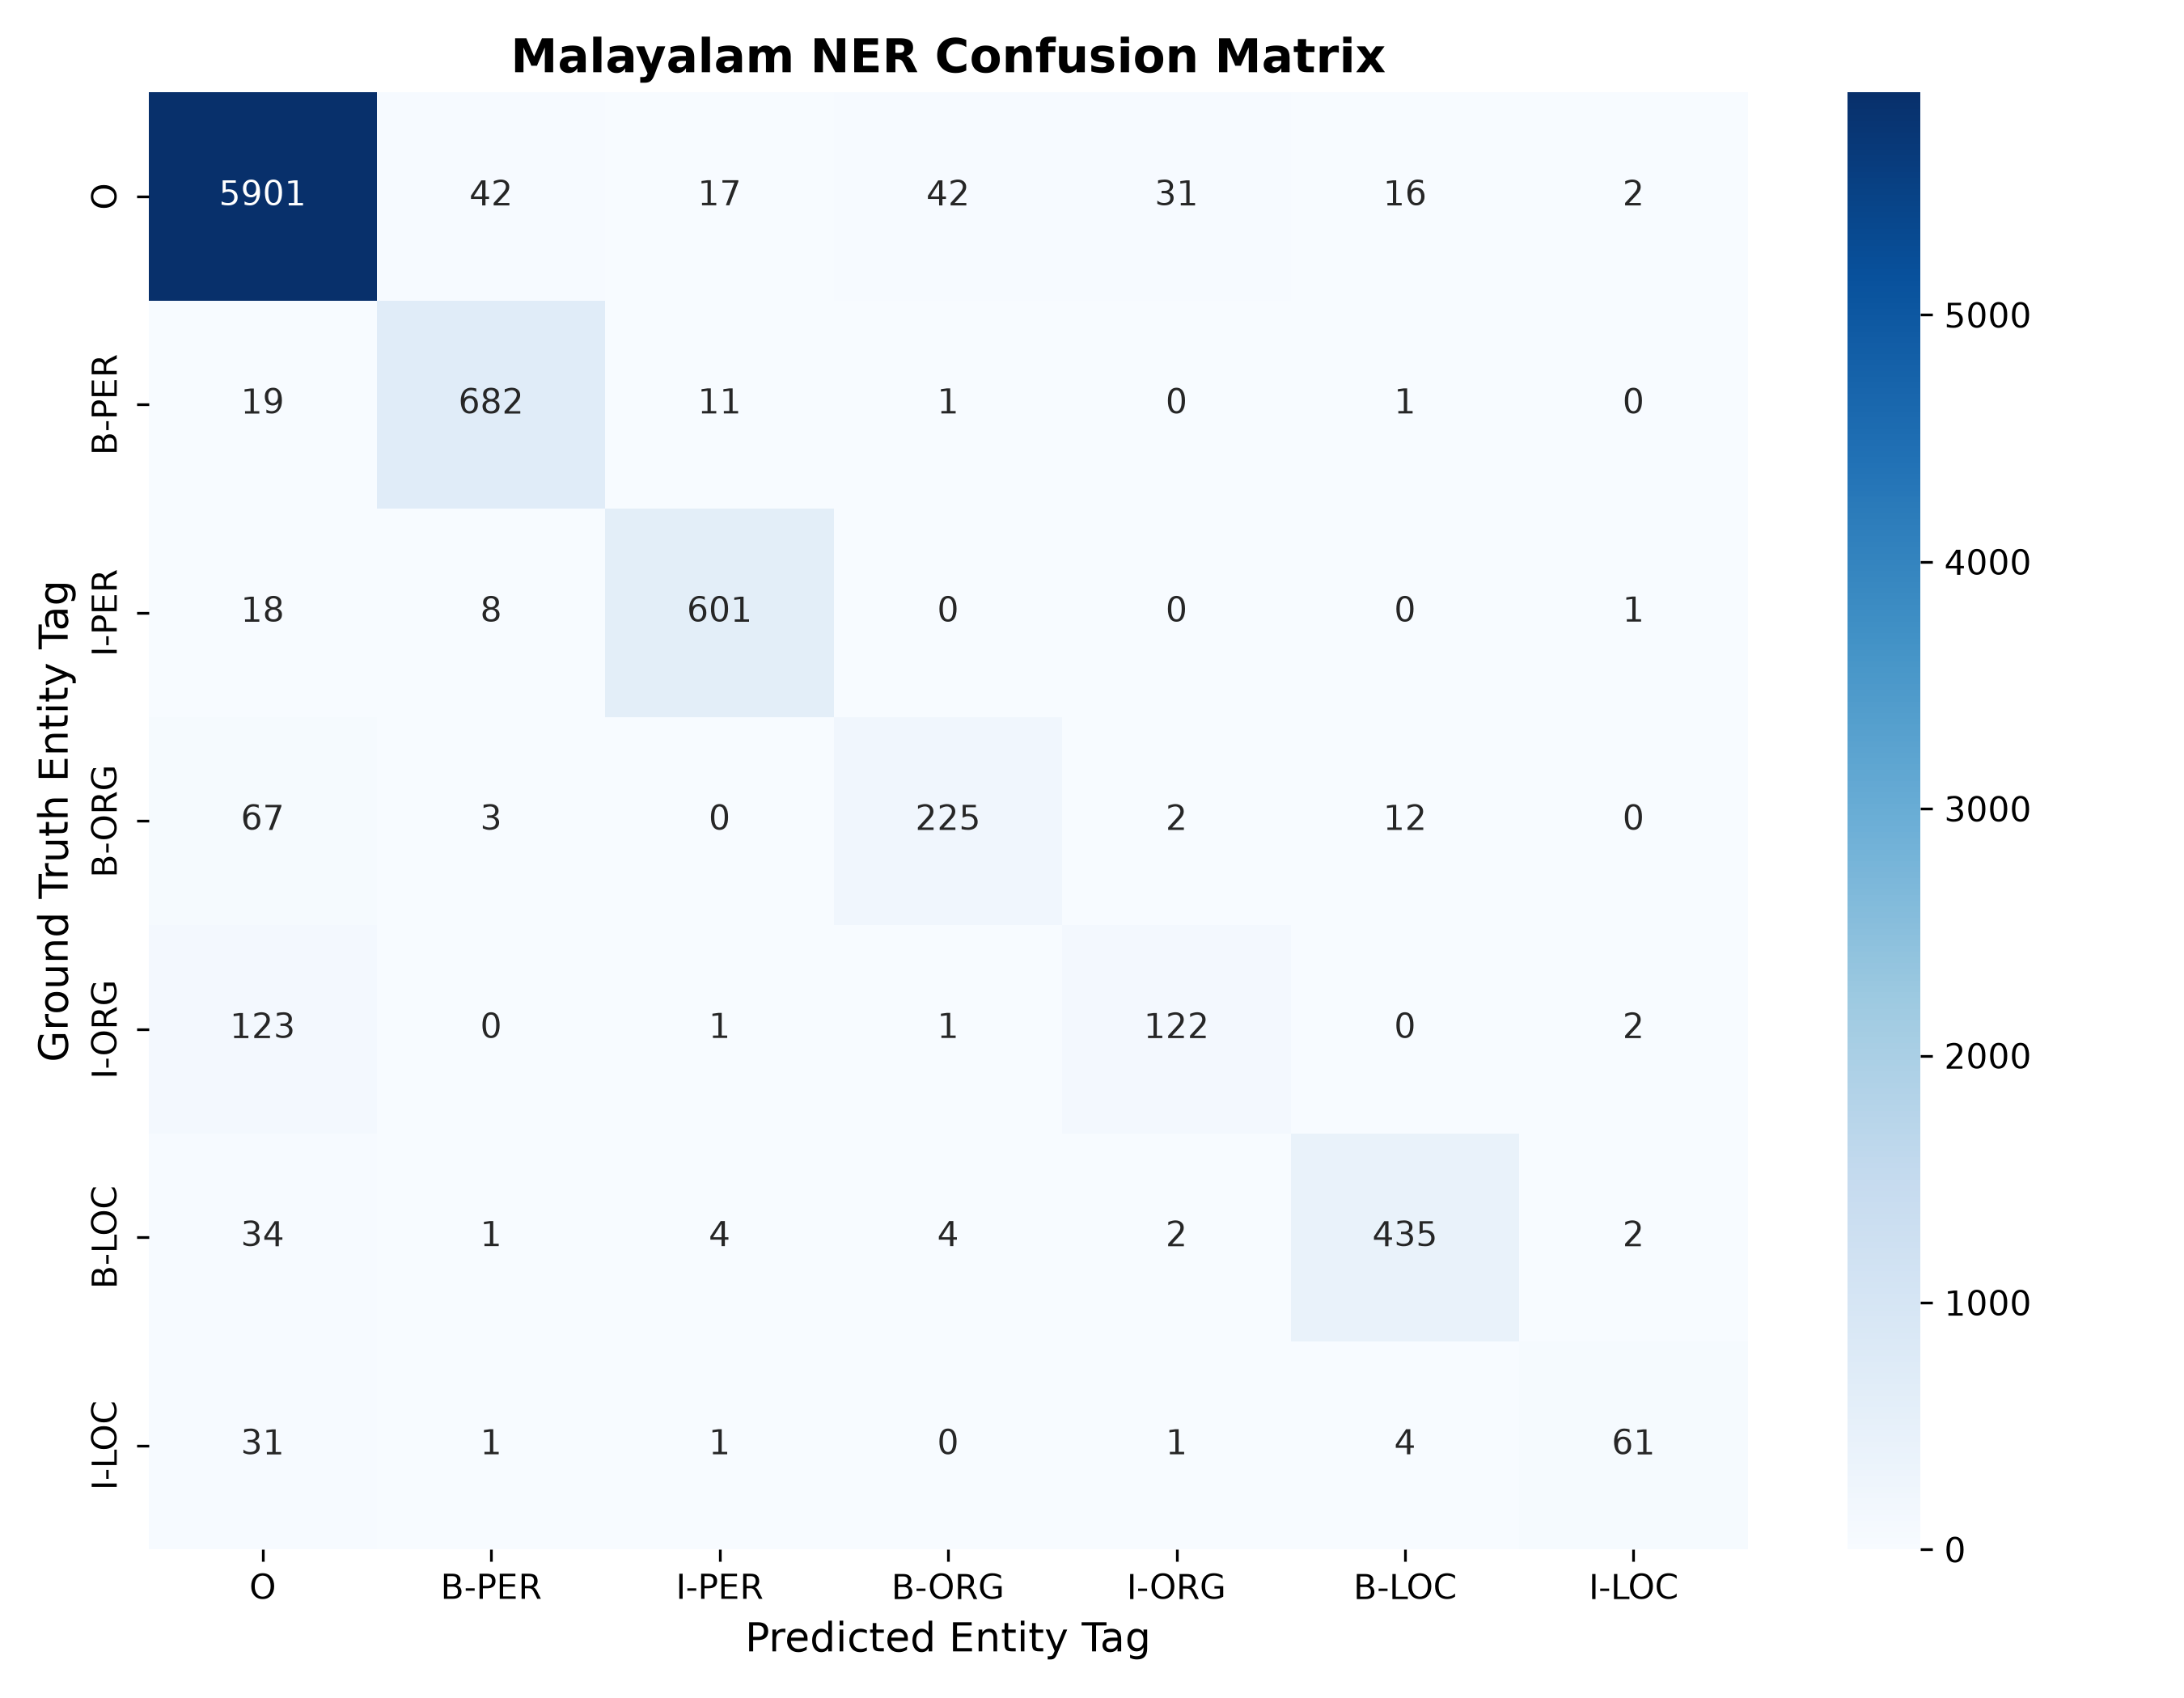
RESULTS
Performance & Evaluation
05
Confusion Matrix — Test Set (974 sentences)
Token-Level Metrics (from confusion matrix)
94.1%
81.9%
8,532
Overall token accuracy
Macro-F1 (entity tags)
Test tokens evaluated
Per-class F1 score
B-PER
I-PER
B-LOC
94.0%
95.2%
91.6%
I-LOC
B-ORG
I-ORG
73.1%
77.3%
60.0%
Insight: PER and LOC entities are detected reliably (F1 > 0.90 on B- tags). ORG is the weakest class — especially I-ORG (60.0% F1) — because multi-word organization names are longer, rarer, and more easily confused with the dominant ‘O’ tag. This is the clearest target for future fine-tuning.
Note: figures computed at token level from evaluate.py's confusion matrix; strict entity-span seqeval report available via the same script.
Malayalam NER using IndicBERTv2 | Project Review
5

Slide 6
PRODUCTIONIZING
System Integration — FastAPI Backend
06
Why a separate API layer?
Completed enhancements so far
• Decouples model inference from the Gradio UI — any client (web, mobile, another service) can call the same model
• server.py exposes a single POST /predict endpoint via FastAPI + Uvicorn (ASGI)
• Pydantic request validation (TextRequest schema) and structured HTTPException error handling
• Response returns both word-level tags and grouped entity spans as JSON
• Wikipedia / Google links auto-generated for every PER, ORG, LOC hit — turns raw tags into actionable lookups
• Batch file processor for .txt uploads with aggregated entity-frequency CSV export
• Entity distribution charts (Gradio BarPlot) for both single-sentence and batch views
• FastAPI microservice (server.py) exposing /predict as a production-ready REST endpoint
• CRF + inverse-weighted training pipeline, fully reproducible via train.py / evaluate.py
POST /predict
{ "text": "തിരുവനന്തപുരത്ത് ... പിണറായി വിജയൻ ..." }
{ "entities": [
{"text": "പിണറായി വിജയൻ", "type": "PER", "confidence": 0.99},
{"text": "തിരുവനന്തപുരത്ത്", "type": "LOC", "confidence": 0.70}
] }
Malayalam NER using IndicBERTv2 | Project Review
6

Slide 7
WHAT'S NEXT
Future Scope
07
01
02
03
PDF / DOCX Document Highlighter
Entity Co-occurrence Network Graph
ONNX CPU Optimization
Extend the batch tab to accept real-world document formats. Extract raw text, run the existing model, and render a highlighted HTML/markdown view — useful for legal docs, news archives, reports.
Detect entities that appear together in the same sentence (e.g. പിണറായി വിജയൻ [PER] + തിരുവനന്തപുരത്ത് [LOC]) and render a relation map using networkx — no retraining needed.
Export the fine-tuned PyTorch model to ONNX and benchmark ONNX Runtime vs. native PyTorch on CPU — targets low-latency, low-memory deployment without a GPU.
All three are training-free extensions of the current model — they build on what already works rather than requiring a new fine-tuning cycle.
Malayalam NER using IndicBERTv2 | Project Review
7

