Slide 1
CSE413 SPEECH & NLP • MINOR PROJECT • FINAL EVALUATION
Malayalam Named Entity Recognition
with Fine-Tuned IndicBERTv2 + CRF
We fine-tune an Indic Transformer to find people, organizations and places in raw Malayalam text, and show that a CRF output layer beats the base paper's softmax head by 12 F1 points.
PER
ORG
LOC
DATE
CARDINAL
Albin John (2023BCD0005) • Adnan Soni (2023BCD0017) • Aswin Paramesh S S (2023BCD0024)
Department of CSE, Indian Institute of Information Technology Kottayam
October 2026
Notes:
Good morning. We are Albin, Adnan and Aswin. Our project is Named Entity Recognition for Malayalam. In one line: we fine-tuned IndicBERTv2, a Transformer pre-trained on Indian languages, and added a CRF output layer. On the human-annotated Naamapadam test set this reaches 84.25 strict entity F1, 12 points above the softmax approach of our base paper. We also deployed it as a web app and a REST API.

Slide 2
PROBLEM
What is Named Entity Recognition?
02
NER finds the names in a sentence and labels their type: person (PER), organization (ORG), location (LOC).
തിരുവനന്തപുരത്ത്
നടന്ന
ചടങ്ങിൽ
കേരള
മുഖ്യമന്ത്രി
പിണറായി
വിജയൻ
സംസാരിച്ചു
B-LOC
O
O
B-LOC
O
B-PER
I-PER
O
“At a function held in Thiruvananthapuram, Kerala Chief Minister Pinarayi Vijayan spoke.” — real output of our model
Sequence labelling with IOB2 tags
Why it matters
• B-X first word of an entity of type X
• I-X later word inside the same entity
• O not part of any name
• 7 tags: O, B/I-PER, B/I-ORG, B/I-LOC
• Rule: I-X may only follow B-X or I-X
• First step of information extraction, search and question answering
• Indexing Malayalam news by people and places; knowledge graphs
• Redacting names in legal / government documents
• ~35 million Malayalam speakers, very few NLP tools
Malayalam NER using IndicBERTv2 + CRF | Final Evaluation
2
Notes:
NER means finding proper names and their type. We treat it as sequence labelling: one tag per word. IOB2: B marks the first word of a name, I the following words, O everything else. Three types gives seven tags. Key rule for later: an I tag must follow a B or I of the same type. Here the model correctly tags the agglutinated city name as LOC and groups Pinarayi Vijayan as one person.

Slide 3
MOTIVATION
Why Malayalam NER is hard
03
No capital letters
Agglutination
English NER leans on “Apple” vs “apple”. Malayalam script has no case, so the strongest cue is missing.
Case markers fuse onto names, so one place has many forms:
തിരുവനന്തപുരം
Thiruvananthapuram
തിരുവനന്തപുരത്ത്
in Thiruvananthapuram
തിരുവനന്തപുരത്തേക്ക്
to Thiruvananthapuram
Ambiguity
Low resource
Names are often common words, and ORG names start with places: Kochi Metro Rail Limited, Kerala Blasters (ORG, not LOC).
Earlier systems trained on a few hundred hand-labelled sentences. Naamapadam (2023) changed this.
Malayalam NER using IndicBERTv2 + CRF | Final Evaluation
3
Notes:
Four challenges. No capitalization. Agglutination: the same city appears in many surface forms, so a word-level vocabulary fails; we handle this with subword tokenization. Ambiguity: organizations often start with a place name, which is our biggest error source later. And low resource: until Naamapadam there was very little labelled data.

Slide 4
LITERATURE
Base paper and the gaps we address
04
Bharathi Mohan et al., “Fine-Tuned BERT Based Multilingual Model for NER in Native Indian Languages”, IEEE EASCT 2023. mBERT + softmax on WikiAnn (Tamil, Malayalam, Marathi, Bengali).
Their Malayalam results
Gap in the base paper | Our response
Each token tagged independently → invalid sequences (O → I-ORG) | CRF output layer; we count invalid transitions
Subword ↔ label alignment never described | Explicit first-subword alignment, −100 masking
Metric unclear; Marathi ORG F1 (88.8) above both P and R | Strict entity-level seqeval + confusion matrices
WikiAnn: auto-labelled title fragments | Naamapadam: human-annotated test set
mBERT: Malayalam is a tiny share | IndicBERTv2, built for Indic languages
Entity | P | R | F1
LOC | 79.8 | 91.26 | 85.50
ORG | 81.3 | 76.5 | 78.8
PER | 86.2 | 84.4 | 85.3
Overall | 82.1 | 82.1 | 82.2
Other work: Fuzzy SVM (Lakshmi 2016) 88.1 F1 on 500 private sentences; IndicNER 81.67 on Naamapadam; m-BERT (Gopalakrishnan 2025) 96.45 on an unreleased set.
Malayalam NER using IndicBERTv2 + CRF | Final Evaluation
4
Notes:
Our base paper fine-tunes multilingual BERT with a softmax layer, reaching 82.2 F1 for Malayalam on WikiAnn. We found four gaps. It tags each token independently, so invalid sequences are possible. It never explains subword alignment. The metric is unclear and some numbers are inconsistent: Marathi ORG F1 is higher than both its precision and recall, which is impossible for a harmonic mean. And WikiAnn is automatically labelled. The right column is what we did about each.

Slide 5
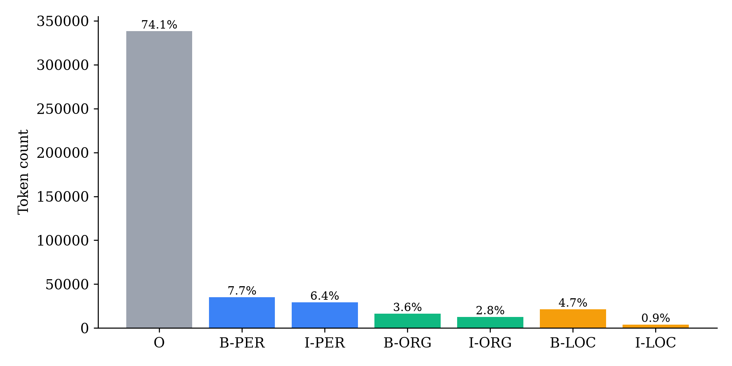
DATA
Dataset: Naamapadam (Malayalam)
05
• AI4Bharat, ACL 2023: largest public Indic NER corpus, 11 languages
• Train/val: English NER tags projected onto Malayalam translations (large, a bit noisy)
• Test: manually annotated by humans → trustworthy benchmark
• We used the first 50,000 of 716,652 training sentences (6 GB GPU budget)
Split | Sentences | PER | ORG | LOC
Train (used) | 50,000 | 35,057 | 16,265 | 21,333
Validation | 3,618 | 2,569 | 1,182 | 1,610
Test | 965* | 714 | 309 | 482
74% of words are O; I-LOC is only 0.9% because most Malayalam place names are one agglutinated word. This imbalance is why the baseline uses class weights, and why I-LOC / I-ORG are hardest.
* 974 rows, 9 empty/malformed rows dropped. Avg. 9 words per sentence.
Malayalam NER using IndicBERTv2 + CRF | Final Evaluation
5
Notes:
We use Naamapadam. Its training labels are projected from English, so they are noisy, but the test set is human annotated, so our test score is reliable. Because of compute, we trained on the first fifty thousand sentences. The chart shows heavy imbalance: three quarters of words are O, and I-LOC is under one percent.

Slide 6
METHOD
System architecture
06
Raw text
Malayalam sentence
Word split
regex, keeps glyph clusters
WordPiece
250k vocab · 1.56 subwords/word
IndicBERTv2
12 layers · 768-d · 278M
Linear 768→7
emission scores
CRF + Viterbi
best valid tag path
Spans + rules
PER/ORG/LOC + DATE/CARD.
Encoder: ai4bharat/IndicBERTv2-MLM-only
Two output heads, same encoder
• BERT-base: 12 Transformer layers, 12 attention heads, 768-dim vectors
• Pre-trained with masked language modelling on IndicCorp v2 (23 Indic languages + English)
• Self-attention lets each subword see the whole sentence, incl. its own case suffix
• All layers fine-tuned; backbone switchable to MuRIL / mBERT in config.py
Baseline (base-paper style)
Softmax per word, argmax. Inverse-frequency class-weighted cross-entropy.
Proposed (our extension)
Linear-chain CRF: learns a 7×7 tag-transition matrix and decodes the whole sentence with Viterbi. Unweighted sequence NLL loss.
Malayalam NER using IndicBERTv2 + CRF | Final Evaluation
6
Notes:
End to end: split text into words, WordPiece tokenizer, IndicBERTv2 encoder, a linear layer that gives seven scores per position, then either softmax or CRF. Finally we group tags into entity spans and, for the demo only, add DATE and CARDINAL with regex rules. Everything is identical between the two models except the output head and its loss.

Slide 7
METHOD
Handling agglutination: subword label alignment
07
The tokenizer splits words into subwords, so words and labels no longer line up 1:1. Rule: the first subword of each word gets the word's tag; continuation subwords and special tokens get −100 (ignored by the loss).
Subword | [CLS] | കോൺഗ്രസ് | സംസ്ഥാന | അധ്യക്ഷൻ | ജി | പരമേശ്വര | ഉപമുഖ്യമന്ത്രി | ##യാകും | . | [SEP]
word_id | None | 0 | 1 | 2 | 3 | 4 | 5 | 5 | 6 | None
Label | −100 | B-ORG | O | O | B-PER | I-PER | O | −100 | O | −100
Real tokenizer output for test sentence 0: 7 words → exactly 7 supervised positions (verified in test_dataset.py and notebook 01).
Why first-subword?
Why not a morphological analyser?
• One prediction per word → train and evaluate at word level
• Long words aren't over-counted in the loss
• Attention still lets the first piece “see” its suffix
• Gold tags are on surface words anyway
• Case suffix is useful context (locative → place)
• Analyser errors would compound; subwords are free
Malayalam NER using IndicBERTv2 + CRF | Final Evaluation
7
Notes:
This slide is how we deal with agglutination without a morphological analyser. The tokenizer splits ‘will become deputy chief minister’ into two pieces. Only the first piece carries the label; the second gets minus one hundred, which PyTorch ignores. Same for CLS, SEP and padding. Average fertility is 1.56 subwords per word, so about a third of positions are masked. The base paper never specified this step.

Slide 8
METHOD
Why a CRF? Tagging the sentence jointly
08
Softmax picks each tag on its own
CRF + Viterbi picks the best whole path
പിണറായി
വിജയൻ
സംസാരിച്ചു
പിണറായി
വിജയൻ
സംസാരിച്ചു
O
I-PER
O
B-PER
I-PER
O
✗ O → I-PER is an invalid sequence. Under strict scoring the name is lost.
✓ Strong I-PER on word 2 only pays off if word 1 is B-PER.
How it works
Cost
score(x, y) = Σ emission(i, yᵢ) + Σ transition(yᵢ₋₁, yᵢ)
Emissions come from BERT + linear layer; transitions are a learned 7×7 matrix.
Training: maximise log p(gold path) using the forward algorithm.
Prediction: Viterbi dynamic programming, O(n·K²) instead of Kⁿ paths.
Transitions never seen in training (O → I-ORG) get large negative scores.
+63
parameters (7×7 transitions + start + end)
~7–20%
slower inference (6.2 s vs 5.8 s for the full test set on GPU)
Malayalam NER using IndicBERTv2 + CRF | Final Evaluation
8
Notes:
This is the key idea. The softmax head decides every word separately, so it can output O followed by I-PER, which is invalid and scores zero under strict matching. The CRF adds a learned transition score for every pair of tags and scores whole sequences. Viterbi finds the best path efficiently. In this example the CRF fixes word one to B-PER, because a strong I-PER on word two only makes sense after a B-PER. It costs only 63 extra parameters and a few percent more inference time.

Slide 9
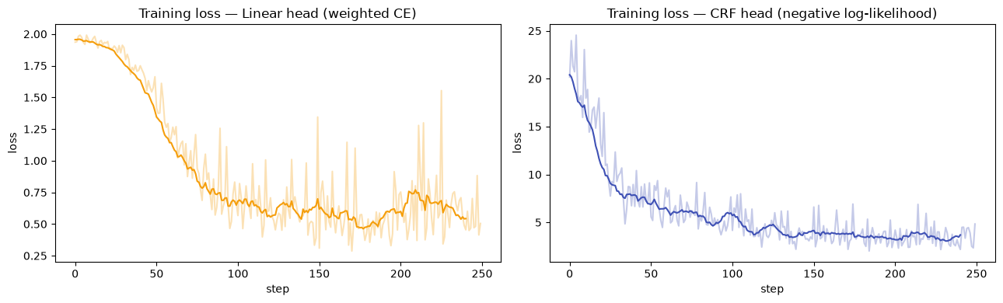
EXPERIMENT
Training setup (identical for both heads)
09
Setting | Value
Optimizer | AdamW, weight decay 0.01
Learning rate | 3e-5
Schedule | 10% warm-up + cosine decay
Batch / epochs | 32 / 3
Max length | 128 subwords
Precision | FP16 mixed (GradScaler)
Training data | 50,000 sentences
Model selection | best validation entity F1
Hardware | RTX 3050 6 GB laptop GPU
Training loss in the demo run of notebook 02 (8k sentences, 1 epoch). Left: weighted cross-entropy. Right: CRF negative log-likelihood (per sentence, so larger values).
Demo run (1 epoch) | Val P | Val R | Val F1
Softmax head | 0.464 | 0.686 | 0.553
CRF head | 0.671 | 0.653 | 0.662
Same pattern as the final results appears early: softmax has high recall but low precision; the CRF is balanced.
Malayalam NER using IndicBERTv2 + CRF | Final Evaluation
9
Notes:
Standard BERT fine-tuning recipe, the same for both heads so the comparison is fair. Warm-up protects the pre-trained weights while the new head is random. FP16 lets batch 32 fit in our 6 GB GPU. The curves are from the short demo run in notebook 02; both losses drop quickly and flatten. The CRF loss is larger only because it is per sentence, not per word.

Slide 10
RESULTS
Results on the human-annotated test set
10
84.25
+12.0
94.08%
98 → 20
strict entity F1 (CRF)
F1 over softmax baseline
token accuracy
invalid tag transitions
Entity | Support | Softmax P | Softmax R | Softmax F1 | CRF P | CRF R | CRF F1 | Δ F1
PER | 714 | 78.99 | 91.60 | 84.82 | 88.72 | 92.58 | 90.61 | +5.8
LOC | 482 | 68.52 | 79.46 | 73.58 | 86.60 | 84.44 | 85.50 | +11.9
ORG | 309 | 37.63 | 59.55 | 46.12 | 69.61 | 63.75 | 66.55 | +20.4
Micro avg | 1505 | 65.09 | 81.13 | 72.23 | 84.45 | 84.05 | 84.25 | +12.0
Macro avg | 1505 | 61.71 | 76.87 | 68.17 | 81.64 | 80.26 | 80.89 | +12.7
Strict seqeval: an entity counts only if its start, end and type all match. 965 sentences, 8,532 words, 1,505 entities. The CRF wins on every class, and the gain grows with span length (ORG +20.4).
Malayalam NER using IndicBERTv2 + CRF | Final Evaluation
10
Notes:
Main result. The CRF reaches 84.25 strict entity F1, twelve points above the softmax head. It wins on every class. The gain is largest on ORG, plus twenty, the class with the longest names, which is exactly where modelling transitions should help. Notice the softmax has high recall but low precision: 81 versus 65. The CRF is balanced at about 84 each. Invalid transitions drop from 98 to 20.

Slide 11
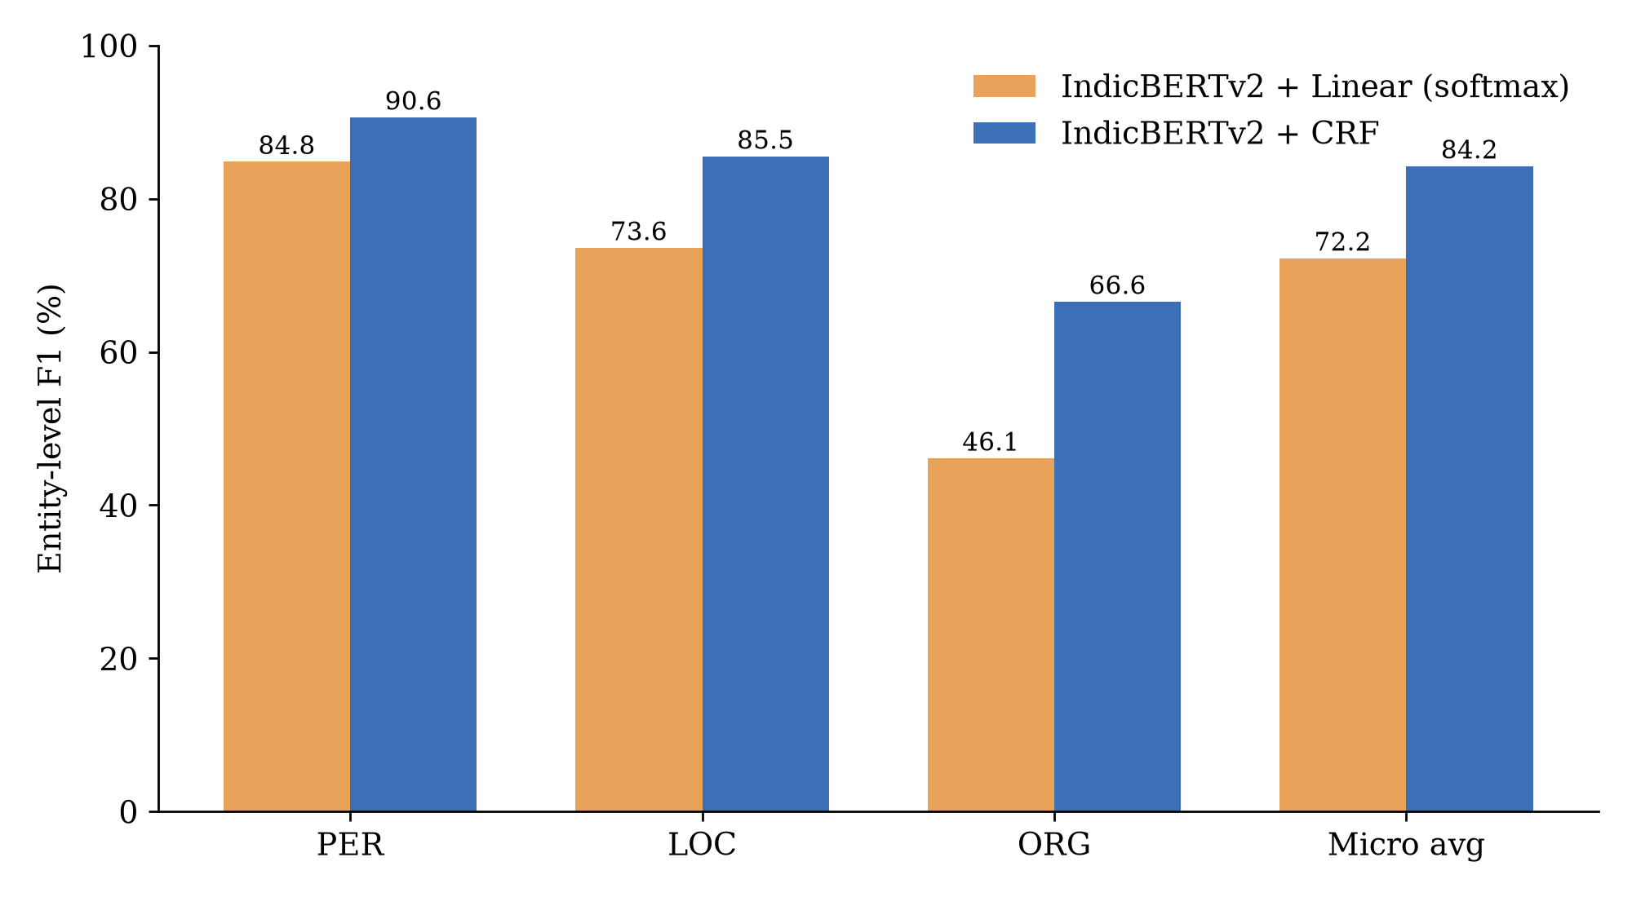
RESULTS
Where the gain comes from
11
Reading the numbers
• Softmax over-predicts: ~1,876 entities predicted for 1,505 real ones. Class weights (I-LOC ≈ 86× O) push doubtful words into entities.
• CRF predicts ~1,498, almost exactly the true count, so precision and recall are balanced.
• Biggest gain on ORG (+20.4): long spans have more transitions to get right.
• Ranking PER > LOC > ORG matches the base paper: ORG is hardest for everyone.
Note: the two models differ in decoder and in loss weighting, so +12 F1 is their combined effect. The drop in invalid transitions (98 → 20) is a direct effect of the CRF.
Malayalam NER using IndicBERTv2 + CRF | Final Evaluation
11
Notes:
Why does the CRF win? The softmax model, pushed by strong class weights, predicts about 1,876 entities when there are only 1,505, so precision suffers. The CRF predicts about 1,498, so it is balanced. To be transparent: the CRF is not class-weighted, so the twelve points combine the decoder and the weighting change. A two-by-two ablation is in our future work.

Slide 12
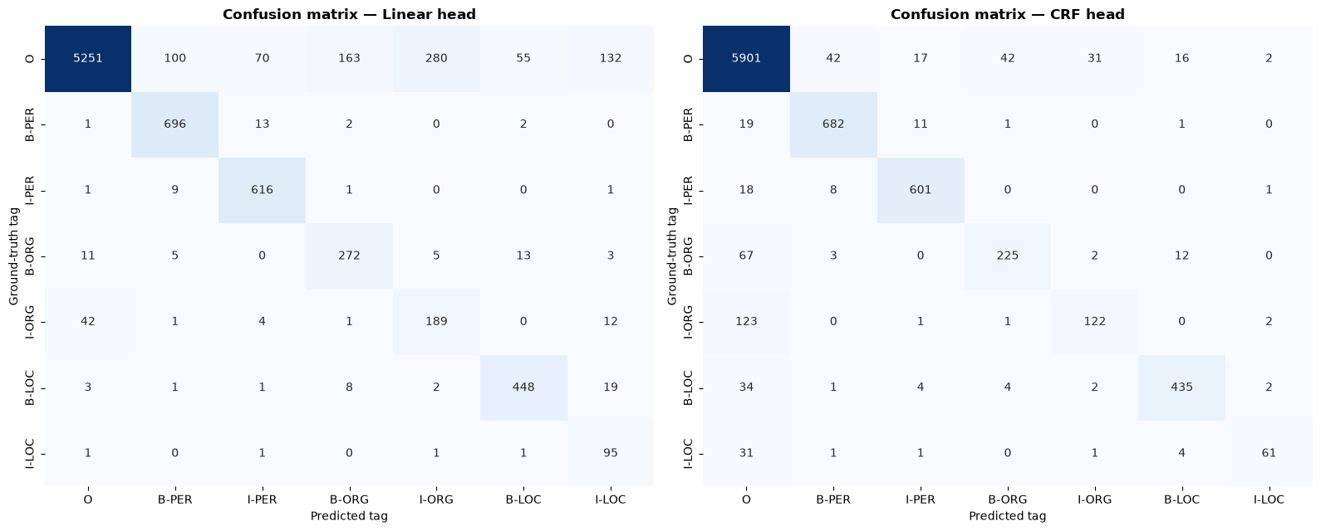
ANALYSIS
Error analysis: confusion matrices
12
Rows = true tag, columns = predicted tag. Left: softmax. Right: CRF.
Fewer false alarms
Detection > typing
ORG spans cut short
ORG / LOC ambiguity
O words tagged as entities: 800 → 150
292 entity words missed, only 35 typed wrong
123 of 249 I-ORG → O (“Kochi Metro” vs “Kochi Metro Rail Ltd”)
12 B-ORG → B-LOC: org names that start with a place
Malayalam NER using IndicBERTv2 + CRF | Final Evaluation
12
Notes:
The diagonal is correct predictions. In the softmax matrix the first row leaks: 800 non-entity words tagged as entities. The CRF cuts that to 150. The CRF's main error is the first column: entity words predicted as O, especially the tail of long organization names, 123 of 249 I-ORG words. Once the model finds an entity it almost always gets the type right. Under strict matching a truncated span counts as both a false positive and a false negative.

Slide 13
COMPARISON
Comparison with published work
13
System | Dataset | P | R | F1
Fuzzy SVM (Lakshmi 2016) | In-house, 500 sent. | — | — | 88.13
IndicNER (cited in base paper) | Naamapadam | — | — | 81.67
mBERT + softmax (base paper) | WikiAnn | 82.10 | 82.10 | 82.20
m-BERT (Gopalakrishnan 2025) | Unreleased | 95.37 | 96.55 | 96.45
Ours: IndicBERTv2 + softmax | Naamapadam | 65.09 | 81.13 | 72.23
Ours: IndicBERTv2 + CRF | Naamapadam | 84.45 | 84.05 | 84.25
How to read this
• Datasets and metrics differ, so the table is indicative only
• On the same benchmark as IndicNER we score higher: 84.25 vs 81.67
• We use only 7% of the training data and strict span matching
• Higher published numbers come from small or unreleased test sets
Malayalam NER using IndicBERTv2 + CRF | Final Evaluation
13
Notes:
Comparisons across papers must be read carefully, because datasets and metrics differ. The fair external comparison is IndicNER on the same Naamapadam benchmark: 81.67; we reach 84.25 with seven percent of the training data and strict matching. We also exceed the base paper's 82.2, though on a different dataset. The 96 and 88 figures come from unreleased or tiny private test sets.

Slide 14
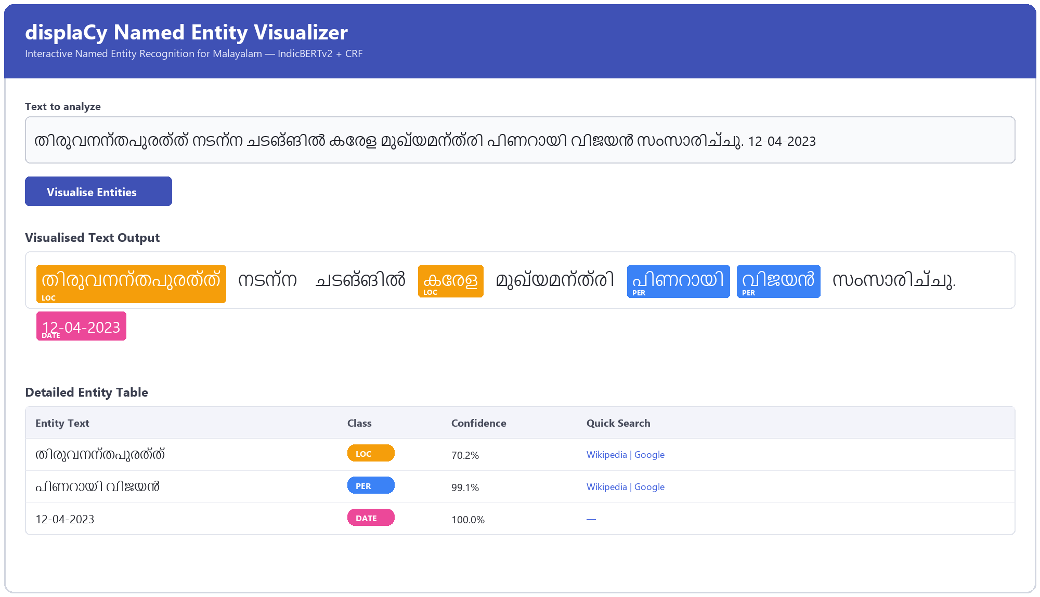
DEPLOYMENT
From model to product: web app + REST API
14
FastAPI (server.py)
POST /predict
{"type": "PER",
"text": "പിണറായി വിജയൻ",
"confidence": 0.99}
Pydantic validation, 400 on empty text, JSON spans + word tags, docs at /docs
Hybrid rule overlay
• Naamapadam has no DATE / numbers
• Regex adds DATE (month names, 12-04-2023) and CARDINAL (digits, രൂപ, കോടി)
• Only on words the model tagged O; not in any metric
Gradio app (app.py): colour-coded entities, confidence, Malayalam Wikipedia / Google links, class filters, bar charts, batch .txt upload with CSV export.
Malayalam NER using IndicBERTv2 + CRF | Final Evaluation
14
Notes:
We wrapped the CRF model in two front ends that share one predictor class. The Gradio app is for people: highlighting, confidence, Wikipedia links, and batch processing of documents. The FastAPI service is for programs: send text, get JSON. Since the dataset has no dates or numbers, a small rule layer adds DATE and CARDINAL, only where the model said O, and never in our reported metrics. If time allows, show the live demo here.

Slide 15
CRITICAL ANALYSIS
Strengths and limitations
15
Strengths
Limitations
• +12 F1 over the base-paper-style head with the same encoder
• Beats IndicNER on the same benchmark with 7% of the data
• No morphological analyser: agglutination handled by subwords
• Strict, reproducible evaluation (compare_models.py → eval_results.json)
• Deployable: web app + REST API
• 50k of 716k sentences, one run, no seed averaging or hyper-parameter search
• Decoder and class weighting changed together; effects not separated
• CRF mask skips subwords, but pytorch-crf expects a contiguous mask → 20 invalid transitions remain
• Noisy projected training labels, hurting ORG boundaries
• Confidence scores not calibrated; DATE/CARDINAL rules not evaluated
Malayalam NER using IndicBERTv2 + CRF | Final Evaluation
15
Notes:
Strengths are on the left. On the right, our honest limitations. The most technical one: our CRF runs over subword positions with a mask that skips continuation pieces, but the library assumes the mask is contiguous, so the learned transitions are approximate; that explains the 20 remaining invalid transitions. Moving the CRF to word-level emissions fixes it.

Slide 16
WRAP-UP
Future work and conclusion
16
Future work
Conclusion
• Word-level CRF with hard IOB2 constraints (always-valid output)
• 2×2 ablation over seeds: {softmax, CRF} × {weights, none}
• Encoder comparison: mBERT, MuRIL, XLM-R, IndicBERTv2
• Full 716k training set; gazetteers for ORG
• ONNX + INT8 for fast CPU deployment
• PDF/DOCX highlighting, entity linking to Malayalam Wikipedia
Fine-tuned IndicBERTv2 with first-subword alignment and a CRF decoder reaches 84.25 strict F1 on Malayalam NER.
Modelling tag transitions gives +12 F1 over independent softmax and removes 80% of invalid sequences.
Multi-word organization names remain the main open problem.
Packaged as a web app and REST API, it brings practical information extraction to Malayalam on modest hardware.
Malayalam NER using IndicBERTv2 + CRF | Final Evaluation
16
Notes:
To conclude: a fine-tuned Indic Transformer with careful subword alignment and a CRF gives 84.25 strict F1, twelve points over the softmax approach, and it runs on a laptop GPU. ORG remains the hard part. Next we would move the CRF to word level, run proper ablations, and compare encoders.

Slide 17
Thank you
നന്ദി
Questions welcome. Live demo: python app.py → http://127.0.0.1:7860
Key references: Bharathi Mohan et al., EASCT 2023 (base paper) · Mhaske et al., Naamapadam, ACL 2023 · Doddapaneni et al., IndicBERTv2, ACL 2023 · Devlin et al., BERT, NAACL 2019 · Lafferty et al., CRF, ICML 2001 · Khanuja et al., MuRIL, 2021 · Lakshmi et al., Fuzzy SVM, ICIS 2016 · Gopalakrishnan et al., IJIT 2025
Albin John • Adnan Soni • Aswin Paramesh S S | IIIT Kottayam
Notes:
Thank you. We are happy to take questions, and we can show the live demo.

