Slide 1
QuickDough: A Rapid FPGA Loop Accelerator Design Framework Using Soft CGRA Overlay
Cheng Liu, Ho-Cheung Ng, Hayden K. H. So
Department of Electrical and Electronic Engineering University of Hong Kong
FPT 2015 – 2015/12/07

Slide 2
Background: Hardware Accelerators
Numerous successful demonstrations using CPU + Hardware Accelerator.
CPU→ control intensive,
Hardware Accel.→ parallel compute intensive kernels
FPGA Accel. vs. PHI Accel. vs. GPU Accel.
FPGA Accel.: long history, energy efficient, low latency, many successful examples but limited adoption.
PHI & GPU Accel.: short history, 5 of the top10 super computers use PHI or GPU.

Slide 3
Background: Why not FPGA Accelerator?
Low design productivity of designers!
Low-level abstraction level
Lack of run-time and compilation-time support
Lack of efficient implementation and debugging
FPGA Accel. Development
HLL
HDL
Bitstream
Final Design
Up to hours
or days!
Edit
Debug
Compile-debug-edit cycle
Edit
Debug
Notes:
Explain what do you want to say with the animation. I guess you want to say users will do 2 levels of design iterations, one in HDL design and one in implementation. And you want to argue that implementation is part of the bottleneck for design iterations, correct?
Yes, I want to make it clear that this work helps to decrease the edit-compile-debug cycle. While debug may also happen in simulation stage where implementation is not needed at all. This work will particularly be useful in a in system debugging scenario where you need to download the FPGA bitstream and debug it in a run-time system. Also we agreed that this work focuses on the implementation instead of the rest two design productivity challenge.

Slide 4
Background: Overlay Architectures
User Application
Benefits
C/C++/Java/…
Netlist
Higher abstraction level
Virtualization → better portability
Improved debugging capability
Separation of HW/SW concern
HDL
Application Mapping
Overlay
Virtual FPGA
CGRA
GPU
Vector Processor
Overlay Mapping
Challenges
FPGA
Larger resource consumption
Possible performance degradation
RAM
DSPs
LUT
Processors
FFs
Notes:
Remove the confusing part and make this slide focusing on general overlay advantages and disadvanatges

Slide 5
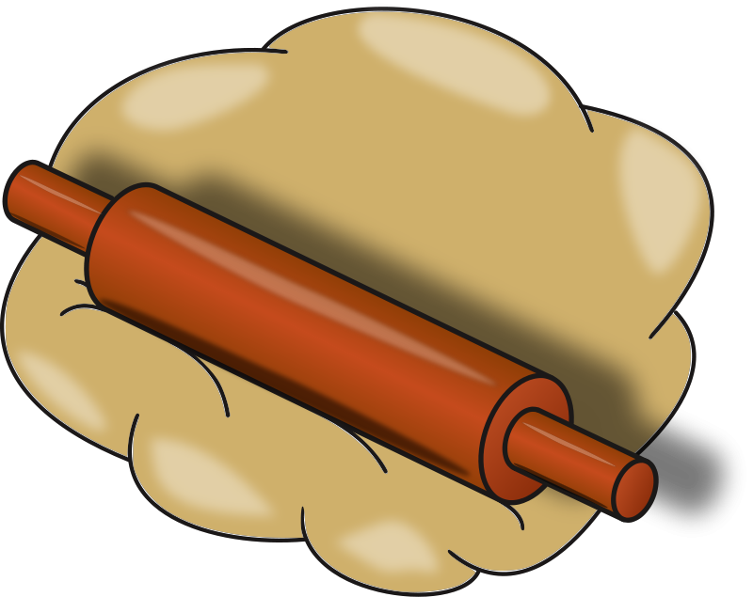
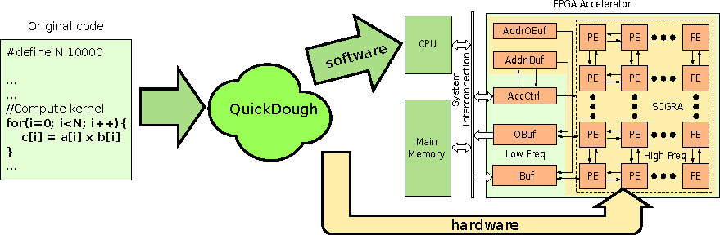
QuickDough Overview
A high productivity compilation framework for high-level applications on CPU-FPGA computers.
Compiles software and FPGA accelerator design within the same framework
Overall SW-like compile speed
Increase # of debug-cycle-per-day
Promising performance speedup

Slide 6
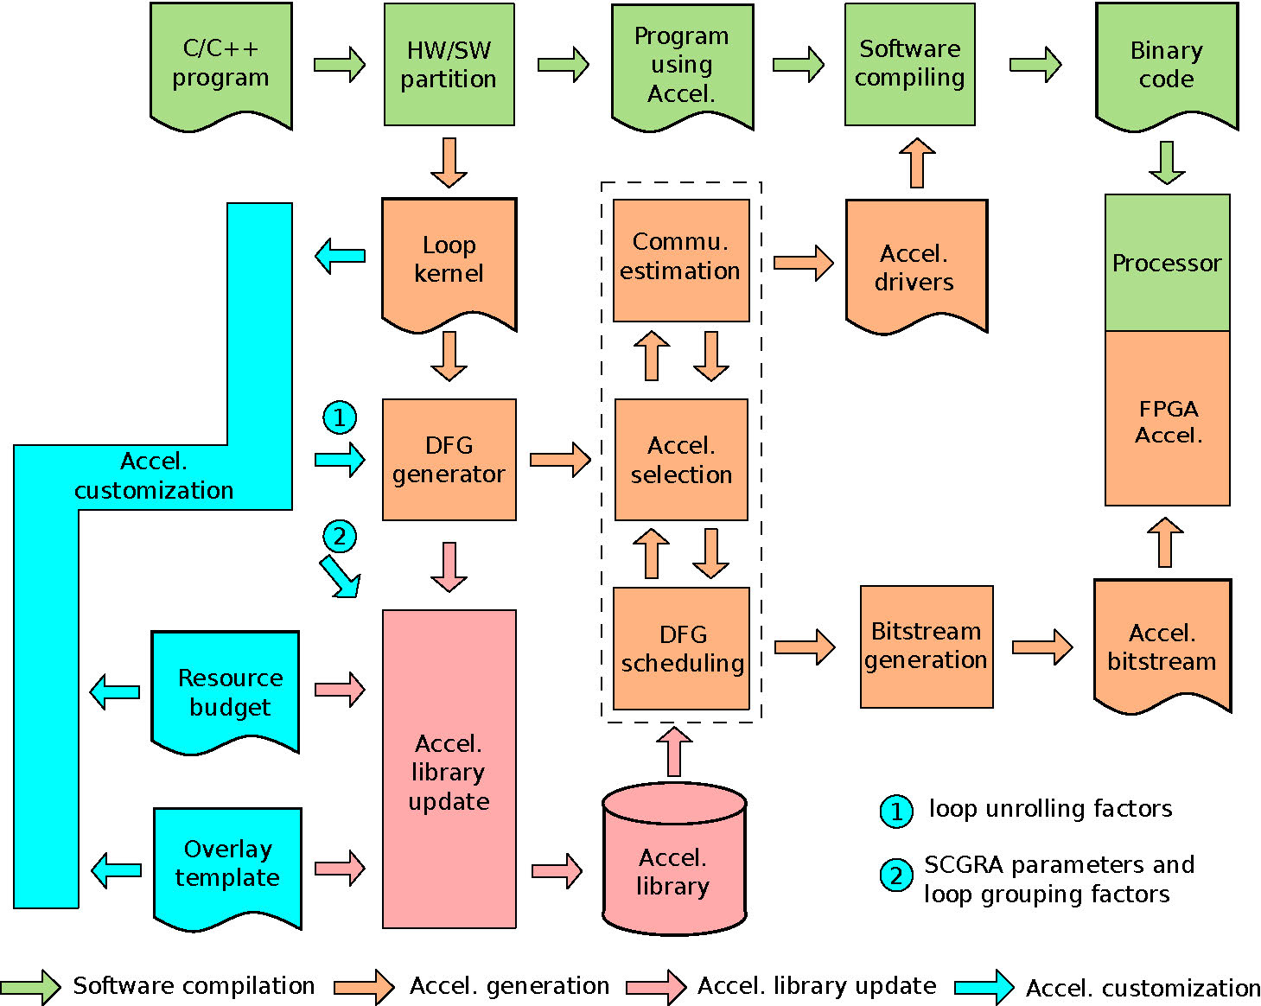
QuickDough Design Flow
Optimization for
performance/
power/
energy efficiency
Fast and common route
Slow yet less frequent route

Slide 7
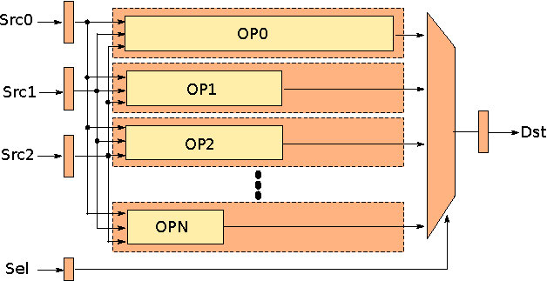
QuickDough Soft CGRA Overlay
Highly pipelined, good scalability, simple and easy to extend

Slide 8
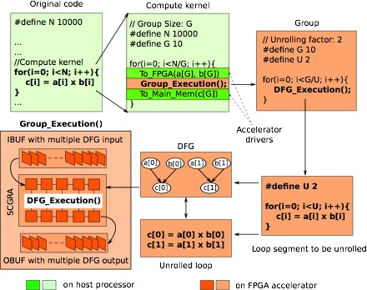
Loop Execution on the Accelerator

Slide 9
Accelerator Selection
Accel.
Config.
Data Mem
Inst. Mem
I/O Buffer
I/O Address Buffer
CGRA Size
Impl. Freq.
Loop
DFG
Most time-
consuming
Minimum data
mem, inst. mem
requirements.
Analyze
Group Size
Operation
Scheduling
Config.
filter
Communication
drivers
DMA
Model
# of cycles
Of DFG execution
Potential
Config.
Loop performance
Loop data
transmission time
Loop
computing time
Optimized
Config.
Notes:
It is somewhat too detailed in this slide, but it helps to explain the trick that operation scheduling can be reused for multiple accelerator configuration selection. Different parameters of the accelerator configuration are estimated in a different way. Basically, instead of evaluating each configuration sequentially, the selection process starts with the operation scheduling which requires DFG and CGRA size as input. With the operation scheduling, the performance of a group of accelerator configurations can be obtained with modeling. The rest of the design parameters can be evaluated.

Slide 10
Accelerator Selection
CGRA
Size
2x2
A single operation
scheduling can be reused
to evaluate a group of
accelerator configurations.
Accelerator library
CGRA
Size
5x5
Selection Strategy
-O0: accelerators with smallest CGRA size
-O1: target three groups of accelerators with different SCGRA size (small, medium, large)
-O2: full search

Slide 11
Accelerator Library Pre-build

Slide 12
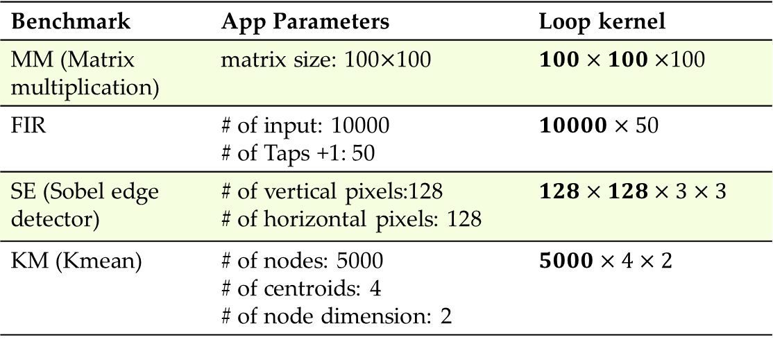
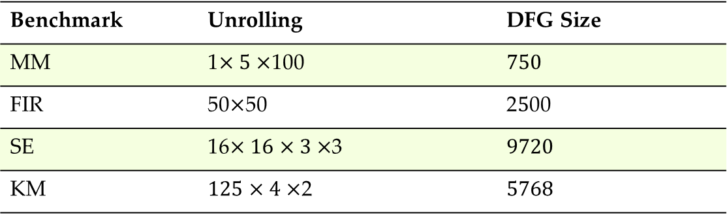
Benchmark
Benchmark | App Parameters | Loop kernel
MM (Matrix multiplication) | matrix size: 100100 | 100
FIR | # of input: 10000 # of Taps +1: 50 | 0
SE (Sobel edge detector) | # of vertical pixels:128 # of horizontal pixels: 128
KM (Kmean) | # of nodes: 5000 # of centroids: 4 # of node dimension: 2
Benchmark | Unrolling | DFG Size
MM | 1100
FIR | 5050 | 200
SE | 163
KM | 2

Slide 13
Common Operations of the Benchmark
Type | Opcode | Expression
MULADD | 0001 | Dst = Src0 x Src1 + Src2
MULSUB | 0010 | Dst = Src0 x Src1 - Src2
ADDADD | 0011 | Dst = Src0 + Src1 + Src2
ADDSUB | 0100 | Dst = Src0 + Src1 - Src2
SUBSUB | 0101 | Dst = Src0 - Src1 - Src2
PHI | 0110 | Dst = Src0 ? Src1 : Src2
RSFAND | 0111 | Dst = (Src0 >> Src1) & Src2
LSFADD | 1000 | Dst = (Src0 << Src1) + Src2
ABS | 1001 | Dst = ABS(Src0)
GT | 1010 | Dst = (Src0 > Src1) ? 1 : 0
LET | 1011 | Dst = (Src0 <= Src1)? 1 : 0
ANDAND | 1100 | Dst = (Src0 & Src1) & Src2

Slide 14
Experiment Setup
Basic SCGRA Configurations
SCGRA Topology | 2D Torus
Instruction Memory Data Width | 72 bits
Data Memory | 256 x 32 bits
I/O Buffer Data Width | 32 bits
I/O Addr Buffer Data Width | 18 bits
DMA Latency
DMA Size | ≥512 | 256 | 128 | 64 | 32 | 16 | ≤8
Latency/Word (ns) | 10.08 | 11.28 | 13.32 | 15.18 | 21.45 | 36.24 | 63.00
Notes:
DMA latency is needed to estimate the communication cost of the loop which are part of the loop performance

Slide 15
Accelerator Library Pre-build
Notes:
When the user provides the BRAM resource budget, we use it to decide the size of the pre-built accelerator library. Apparently, the larger budget is provided, the more accelerators need to be pre-built. And it will take longer time to pre-build the library. Thus this figure present the cost of the library pre-building process. The blue line shows how the number of accelerators increases with the BRAM budget. While the red line shows the how the library pre-building time changes with the BRAM budget.
There are 140 RAMB 36 on Zedboard and I want to use it as a reference of the BRAM Budget.

Slide 16
Resulting Accelerator Configurations
Opt. Option | Resulting Config | MM | FIR | SE | KM
O0 | SCGRA size | 2x2 | 2x2 | 2x2 | 2x2
 | Inst. Mem Depth | 4K | 4K | 4K | 4K
 | I/O Buffer Depth | 4K | 4K | 4K | 4K
 | Grouping Factor | 50x5x100 | 2500x50 | 128x64x3x3 | 1250x4x2
O1 | SCGRA Size | 3x3 | 3x3 | 3x3 | 5x5
 | Inst. Mem Depth | 2K | 2K | 4K | 1K
 | I/O Buffer Depth | 2K | 2K | 1K | 2K
 | Grouping Factor | 25x5x100 | 1250x50 | 64x32x3x3 | 1000x4x2
O2 | SCGRA size | 3x3 | 4x4 | 4x4 | 5x5
 | Inst. Mem Depth | 2K | 1K | 2K | 1K
 | I/O Buffer Depth | 2K | 8K | 1K | 2K
 | Grouping Factor | 25x5x100 | 5000x50 | 64x32x3x3 | 1000x4x2
Notes:
The table seems to be to large to put it here. Any suggestions for this one?

Slide 17
Accelerator Generation Time

Slide 18
Accelerator Performance

Slide 19
Accelerator Performance

Slide 20
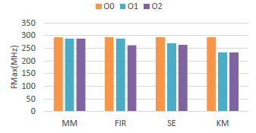
Accelerator Implementation
Notes:
Yes, as you mentioned, there is actually nothing significant to highlight in terms of implementation. I thought implementation is part of the experiment and completes this section. Anyway, one thing that may be worth mentioning is the fmax remains very good when the BRAM utilization is very high.

Slide 21
Conclusion
By using an SCGRA overlay, a rapid FPGA loop accelerator design framework is proposed.
With a pre-built SCGRA overlay based accelerator library, FPGA loop accelerator can be generated in seconds.
A highly pipelined CGRA overlay template is developed to ensure the performance of the resulting accelerators.
The accelerator communication interfaces are also generated forming a HW/SW co-design framework accessible to software designers.

Slide 22
Thank you very much!

