Slide 1
{project} Tech DD report
Disclaimer - This is a due diligence report ("CAST Report") on software health and risks based on the information provided to CAST by the Client. The CAST Report is not intended to replace the full due diligence to be performed by Client, its affiliates and any underwriters using the CAST Report. Any party is responsible for its own full due diligence and should not rely solely on the CAST Report for its decisions.
Chakra Yarlagadda, SVP, Tech Partnerships, M&A Manish Sharma, Senior Delivery Manager, Professional Services Matthieu Mabyre, Technology SME
DECEMBER 2020

Slide 2
Agenda
Executive Summary
Results for {all_apps}
Next Steps
Appendix: CAST Overview, Grading mechanism

Slide 3
We analyzed {app_count} application - {all_apps}. Health of {appl_name} is {grade_TQI} (out of 4) which is {risk_TQI} risk. 83 high priority health issues and 21 open-source components should be reviewed immediately, which can be addressed in ~30 person days.
{project} project has {app_count} applications i.e. {all_apps}, which are analyzed for overall health and open-source risks.
In terms of software health, applications are {quality_tqi} with respect to their overall quality, robustness, changeability & transferability, compared to peers of similar size and age. Immediate action should be taken to address {prob_inds}, following a reasonable action plan:
{each_app}
{app} – has {risk_tqi} risk with health score of {grade_tqi} out of 4. It is in the {apmark_quartile} quartile out of {apmark_total} (rank {apmark_rank}) when compared to peers.
Security is at {risk_security} with a grade of {grade_security}
Efficiency is at {risk_efficiency} with a grade of {grade_efficiency}
Robustness is at {risk_robustness} with a grade of {grade_robustness}
Changeability is at {risk_changeability} with a grade of {grade_changeability}
Transferability is at {risk_transferability} with a grade of {grade_transferability}
{hl_components} components with critical vulnerabilities in open source and {hl_priority_issues} priority issues from application health should be reviewed immediately, estimated to be ~xx person days.
{end_each_app}
Executive summary

Slide 4
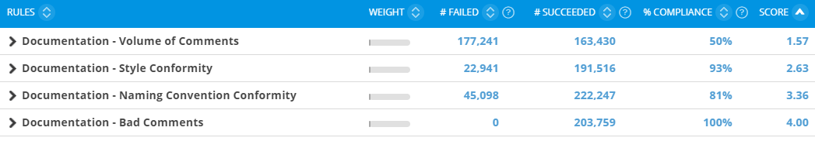
Application details: {appl_name} documentation insights
Explanation
Comments ratio ~10% is decent. They are not coming from commented code. 15-20% and evenly distributed documentation would be ideal, but this application is not very far from it.
Commented out code lines at 0% is very good.
Documentation
Update
2.89
Code | 0 | 0%
Comment Lines | 0 | 0%
Commented Out Code | 0 | 0%
Update
Documentation of ActionPlatform
1
2
3
4
1
Very high risk
2
High risk
3
Medium risk
4
Low risk

Slide 5
Application health: {appl_name} application has medium risk, needs remediation mostly in efficiency and security
Robustness
Efficiency
Security
Changeability
Transferability
{grade_Robustness}
{grade_Efficiency}
{grade_Security}
{grade_Changeability}
{grade_Transferability}
Likelihood of outage, data integrity or reliability issues
Resource consumption, scalability and performance issues
Security vulnerabilities and likelihood of breaches
Adaptability to changing regulations and business needs
Ramp up difficulties for newcomers
Summary
{appl_name} is a {size_category} application with {loc_short} and a {risk_TQI} risk (TQI of {grade_TQI} out of 4).
Application has ~83 priority violations which should be reviewed ASAP to reduce security risks. This will improve TQI to 2.71 and security to 2.17.
Efficiency is low mainly because of missing primary keys on ~2.2K tables which is ~20% of total tables. It is possible they are left on purpose and may not need. The list must be reviewed to ensure unexpected is not missed.
TQI
Technical size
{loc}
Lines of code
83
Top Priority
violations
1504
Medium risk
Violations
{grade_TQI}
Update
Update
Update
Total Quality Index, Aggregate score of all the quality rules
Size of the scope under analysis
Structural flaws that need immediate attention
Structural flaws that need attention in near term
TQI of {appl_name}
1
2
3
4
Update
1
Very high risk
2
High risk
3
Medium risk
4
Low risk

Slide 6
Application details: ActionPlatform application technical overview and key takeaways
ActionPlatform
Technical details
Modules by technology | LoC | TQI | Robustness | Efficiency | Security | Change- ability | Transfer-ability | Critical Violations | SEI
.NET | 1.64 MLOC | 2.56 | 2.72 | 1.58 | 2.07 | 2.66 | 3.39 | 6,567 | 3.37
HTML5/ Javascript | 1.02 MLOC | 3.16 | 3.27 | 2.83 | 2.65 | 3.55 | 3.39 | 345 | 3.23
Visual Basic | 265 LOC | 3.07 | 3.11 | 3.94 | 2.77 | 3.14 | 2.27 | 0 | 2.93
SQL | 2 MLOC | 2.54 | 2.71 | 1.51 | 2.31 | 3.00 | 2.74 | 7,277 | 2.49
Lines of code by technology
Technical size
Statistics on violations
Name | Value
kLoC | 4,671
Files | 55,614
Classes | 14,903
SQL Art. | 17,908
Tables | 15,176
Name | Value
Critical Violations | 14,159
per File | 0.25
per kLoC | 3.03
Complex Objects | 3,536
With Violations | 1,108
The overall application has medium risk, TQI 2.56 out of 4, and 14K critical violations. Efficiency and Security have a high risk so, the remediation plan should be focused on violations targeting these health factors. Both Changeability and Robustness have a medium risk factor and should be considered in the near-term remediation plan.
Looking at technology split, .NET and SQL both show lower efficiency and security grades hence start there first. The efficiency issues of the HTML5/JavaScript module should also be addressed.
Most of the critical violations are in the SQL code with .NET following closely behind. Both should be addressed in near term for improving application health significantly.
Top critical violations by count
Rule Name | # Violations
Avoid declaring public Fields | 4,799
Errors should be handled in stored procedures and functions | 4,647
Avoid Tables without Primary Key (SQL) | 2,230
Avoid directly throwing instance of Exception class | 879
Avoid cyclical calls and inheritances between namespaces content | 608
Avoid using SQL queries inside a loop | 330
Avoid empty catch blocks | 276
Avoid doing select on Datatable in loop | 80
Avoid using eval() (Javascript) | 63
Avoid SQL queries that no index can support for artifacts with high fan-in | 60

Slide 7
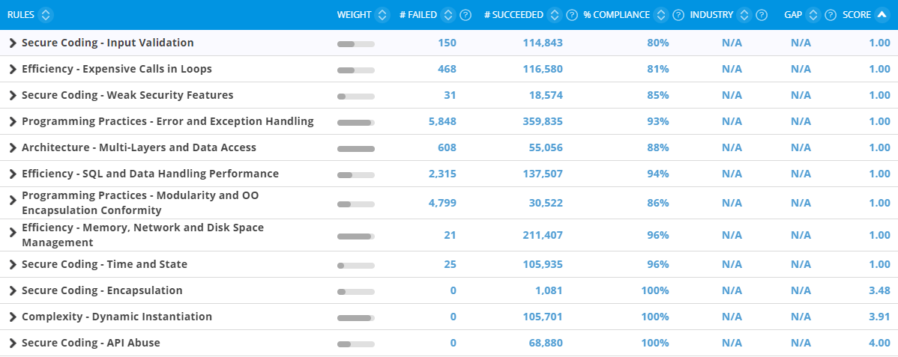
Application details: ActionPlatform technical strengths and improvement areas for Overall health (TQI)
TQI
Explanation
Strengths
No hardcoded passwords, count of violations across security technical criteria are limited hence can be fixed soon.
Improvement Areas
Efficiency issues mostly concern missing primary keys and SQL queries inside loops. Security issues are mostly related to input validation coming from react/angular application. There are also some architecture issues like cyclical calls between packages, as well as issues related to programming practices: exception handling – use of generic classes.
{grade_TQI}
Update
Update
TQI of ActionPlatform
1
2
3
4
1
Very high risk
2
High risk
3
Medium risk
4
Low risk

Slide 8
Fix now & Near term issue remediation of ActionPlatform health estimated at 100-150 person-days
Score improvement short term remediations
Criteria | Current score | New score | Gain
TQI | 2.56 | 2.89 | 13%
Robustness | 2.77 | 3.1 | 12%
Efficiency | 1.78 | 2.35 | 32%
Security | 2.01 | 3.09 | 54%
Changeability | 2.64 | 2.64 | 0%
Transferability | 3.21 | 3.21 | 0%
Fix now & Near-term plan
Near term plan estimates
Impact of quality
$60K-90K* implementation cost
Approx. 100-150 person-days implementation effort
Issue 1:
Ensure the X-Frame-Options header is setup (ASP.NET)
Mid term plan
Score improvement after mid term remediations
Mid term plan estimates
Criteria | Current score | New score | Gain
TQI | 2.56 | 3.42 | 34%
Robustness | 2.77 | 3.55 | 28%
Efficiency | 1.78 | 3.47 | 95%
Security | 2.01 | 3.76 | 87%
Changeability | 2.64 | 3.23 | 22%
Transferability | 3.21 | 3.21 | 0%
Issue 3:
Avoid Tables without Primary Key (SQL)
$90K-$120K* implementation cost
Approx. 150-200 person-days implementation effort
Issue 2:
Avoid directly throwing instance of Exception class
Complexity of implementation
Note –
*Day-rate used for cost calculation - $600/day
*Effort for open-source vulnerabilities is separate

