Slide 1
accela Tech DD report
Disclaimer - This is a due diligence report ("CAST Report") on software health and risks based on the information provided to CAST by the Client. The CAST Report is not intended to replace the full due diligence to be performed by Client, its affiliates and any underwriters using the CAST Report. Any party is responsible for its own full due diligence and should not rely solely on the CAST Report for its decisions.
Chakra Yarlagadda, SVP, Tech Partnerships, M&A Manish Sharma, Senior Delivery Manager, Professional Services Matthieu Mabyre, Technology SME
DECEMBER 2020

Slide 2
Agenda
Executive Summary
Results for Accela.
Next Steps
Appendix: CAST Overview, Grading mechanism

Slide 3
Target applications are in medium health. There are xx open-source vulnerabilities and xx health issues from application code that need immediate review.
Template content – replace appmarq and HL with actuals
accela project has two applications i.e. Accela, which are analyzed for overall health and open-source risks.
In terms of software health, applications are medium risk with respect to their overall quality, robustness, changeability & transferability, compared to peers of similar size and age. Immediate action should be taken to address Efficiency and Security, following a reasonable action plan :
Accela – has medium risk with health score of 2.50 out of 4. Application is in the xx quartile out of x,xxx (rank xx) when compared to peers. Application has high risk in Security (grade 1.63) , Efficiency (grade 1.86) health factors . xx components with critical vulnerabilities in open source and xx priority issues from application health should be reviewed immediately, estimated to be ~xx person days.
Executive summary
Next steps - recommended to sustain and solidify improvements
Assemble a team to implement the recommended action plan for APP1. In 3 months, re-scan to solidify trending of health measures
Establish a Continuous Improvement process and a structural quality gate to prevent health degradation.

Slide 4
Assessment Approach @ Vista
Automated, objective assessment of the structural and architectural quality of applications to be acquired.
Answers for today
What is the application’s current state of health according to CAST Software Intelligence Products?
Are there critical security risks including OWASP Top 10 and CWE Top 25 in the application?
Which areas of the application are critical to fix and which ones can be improved quickly? How large is the effort to fix identified issues?
What is the risk associated with the open-source components used in the applications?
What is the overall technical architecture of the application and are there any architectural risks?
How does the application compare to peer applications in the industry?
Application Scope
Accela – .NET, C++, HTML5, JEE, Objective-C, PHP, Python and SQL.
Assessment Scope
Database structure, all libraries & components, 3rd party artifacts including open-source components, and custom source code.
Products used are CAST Imaging for architecture blueprinting; CAST AppMarq for peer benchmarking; CAST AIP for deep system analysis; CAST Highlight for open-source risk analysis.

Slide 5
Agenda
Executive Summary
Results for Accela.
Next Steps
Appendix: CAST Overview, Grading mechanism

Slide 6
Summary of findings from the CAST analysis with focus on immediate actions
Template content – replace with actuals
Findings |  | Estimated Effort
Review and address critical security (and/or efficiency) vulnerabilities xxx immediate priority violations found in custom application components should be reviewed asap. See Panel XX. xxx open-source components (e.g. xxxx family components, xxxx, xxx, …) with critical vulnerabilities need review asap. See Panel XX. |  | ~$xxK-$xxK implementation cost (@ $600/day) Max. ~xx-xx person-days effort
Opportunities for strengthening security and efficiency of the application x,xxx violations added to the action plan for near term. xx cases of (rule name), xx cases of (rule name) and xx cases of (rule name). See Panel XX. Opportunities for securing open-source components xx components with High-risk security vulnerabilities and xx with Medium-risk security vulnerabilities detected leading to risk of (risk name) and (risk name). These should be reviewed for production risk. See Panel XX. |  | $xxK-$xxK implementation cost Max. xx-xx person-days implementation effort (~xx days effort to review open-source issues)
x,xxx items which will improve changeability, robustness and overall health of the application xxx violations from cyclical calls between packages would require design review. xxx empty catch blocks to handle. xxx violations where xxxxxxx. |  | $xxK-$xxK implementation cost Max. xx-xx person-days implementation effort
Review before closing
Near term
Mid term

Slide 7
Application health: Accela application has medium risk, needs remediation mostly in Security, Efficiency.
Robustness
Efficiency
Security
Changeability
Transferability
2.52
1.86
1.63
2.90
3.28
1
2
3
4
1
2
3
4
1
2
3
4
1
2
3
4
1
2
3
4
Likelihood of outage, data integrity or reliability issues
Resource consumption, scalability and performance issues
Security vulnerabilities and likelihood of breaches
Adaptability to changing regulations and business needs
Ramp up difficulties for newcomers
Summary
Accela application is a small (216,689) and has medium risk (TQI of 2.50 out of 4).
Accela has xx priority violations which should be reviewed ASAP to reduce risks. This will improve TQI to x.xx, efficiency to x.xx and security to x.xx
x,xxx violations should be reviewed in near term to strengthen health of application further. This will further the TQI score to x.xx, efficiency to x.xx and security to x.xx.
Efficiency can be improved further by reducing instantiations inside loops.
TQI
Technical size
216,689
Lines of code
XX
Top Priority
Violations
x,xxx
Next Priority
Violations
2.50
1
2
3
4
Total Quality Index, Aggregate score of all the quality rules
Size of the scope under analysis
Structural flaws that need immediate attention
Structural flaws that need attention in near term
Accela
1
2
3
4
High Risk
Medium Risk
Low Risk

Slide 8
Application details: Accela application technical overview and key takeaways
Accela Application
Split by Business Module or Technology Group
Module Name | LoC | TQI | Robustness | Efficiency | Security | Transfer-ability | Change- ability | SEI | Critical violations
.NET | 5,162 | 3.24 | 3.31 | 3.10 | 2.94 | 3.89 | 3.12 | 3.61 | 14
HTML5 | 166,592 | 3.15 | 3.26 | 2.61 | 2.64 | 3.40 | 3.59 | 3.25 | 72
JEE | 29,729 | 2.66 | 2.54 | 2.30 | 2.58 | 3.01 | 2.61 | 3.62 | 205
Objective-C | 5,822 | 3.83 | 3.54 | 4.00 | 4.00 | 3.88 | 3.54 | 3.51 | 21
PHP | 2,251 | 3.73 | 3.79 | 4.00 | 4.00 | 3.38 | 3.65 | 3.47 | 0
Python | 3,935 | 3.53 | 3.47 | 2.86 | 3.96 | 3.43 | 3.29 | 3.48 | 5
SQL | 3,121 | 3.42 | 3.62 | 2.88 | 4.00 | 3.18 | 3.28 | 3.60 | 11
Lines of code by technology
Technical size
Violations of Critical Rules
Name | Value
LoC | 217 K
Files | 3552
Classes | 763
SQL Artifacts | 47
Tables | 116
Name | Value
Violation Count | 328
per file | 0.09
per kLoC | 1.51
Complex objects | 81
With violations | 15
The overall application has medium risk, TQI 2.50 out of 4, with 328 critical violations. Security, Efficiency is high in risk. The remediation plan must be focused on violations targeting these areas of high risk. Also, critical violations for security should be addressed asap. Following in priority, remediating robustness and security violations in the code should be part of the near-term remediation plan.
Looking at technology split, JEE shows lower efficiency grade hence start there first. The efficiency issues of HTML5/JavaScript module must also be fixed, as well as JEE security.
Most violations are in JEE too (> 77%), hence can be addressed in near term for improving application health significantly.
Top critical rules violated (by number of violations)
Rule Name | # Violations
Avoid using '==' and '!=' to compare objects | 44
Avoid using Fields (non static final) from other Classes | 40
Avoid using incompatible mutation | 32
Avoid empty catch blocks | 27
Always implement the success/error/complete or done/fail/always callbacks when using jQuery ajax call | 17
Avoid using Ajax method without dataType with jQuery version older than 3.0.0 | 17
Avoid instantiations inside loops | 14
Avoid to use this within Constructor in multi-thread environment | 13
Avoid having suspicious similar method names or signatures in an inheritance tree | 12
Avoid cyclical calls and inheritances between packages | 12

Slide 9
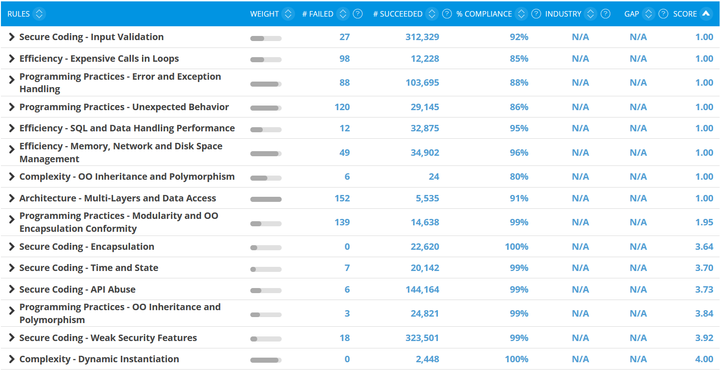
Application details: Accela technical strengths and improvement areas for Overall health (TQI)
Template content – replace with actuals
Explanation
TQI
Strengths
Secure coding showed 27 violations, but no hardcoded passwords, unsecured cookies or weak encryption algorithms detected which is good.
Improvement Areas
Efficiency issues mostly concern unreleased streams and expensive calls in loops. Security issues are mostly related to input validation. There are also some architecture issues like cyclical calls between packages, as well as issues related to programming practices: exception handling or encapsulation.
2.50
1
2
3
4
1
TQI of App1
2
3
4
Best Practices for Low Risk Applications
1
Very high risk
2
High risk
3
Medium risk
4
Low risk
http://technologies.castsoftware.com/rules

