Slide 1
CAST AIP – Out of the Box Presentation
Application :
ApplicationName
Version :
version
TodayDate

Slide 2
Agenda
CAST Overview
Application Overview
Context and Objectives
Executive Summary
Risk Drivers and potential Points of failures
Technical Debt, Maintainability costs and Compliance
Recommendations
Proposed Action Plan
Recommended metrics for Education and monitoring (watch list)
Notes:
This PPT Presentation needs to be presented during a one hour meeting with the Application Team (PM, SME, Architects).
There are 3 main parts :
CAST Overview :
5 slides describing CAST AIP Platform, it should be always the first topic to discuss and avoid to remove this part or to put it at the end because you will have almost everytime questions on how does it work and what is the main difference between CAST and the Competition
Application Overview :
This is the main part of the presentation with high level results, from context and objectives provided by the application team during the kick-off call to the identified areas at risk inside the application for each health factor and a focus on the module at higher risk.
Recommendations :
There are 2 parts :
General recommendations with watchlist rules (top rules to follow by the application team for ongoing)
Suggested action plan with action plan optimizer impact simulation

Slide 3
CAST OVERVIEW

Slide 4

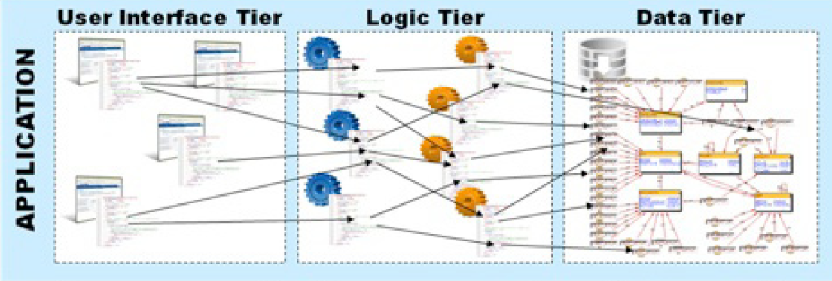


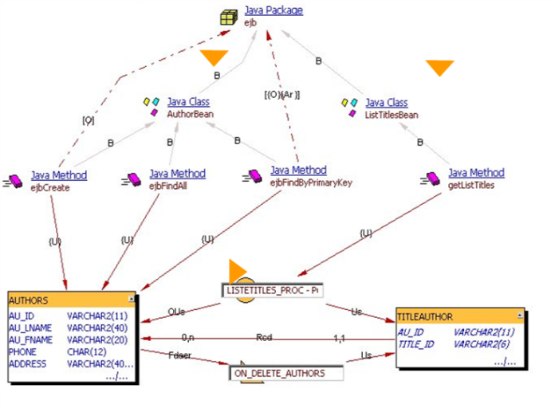



The Application Intelligence Platform: A $100m engine
The CAST Application Intelligence Center
Actionable visibility across the IT organization
Admin
Reports on application health, team performance, benchmarking
CAST AIP
CFOs, CIOs and VPs
Quality Measurement & Functional Sizing
Software characteristics, cost and risk drivers, ARB, architectural
governance, root cause analysis…
Compliance checks
Code, Architecture and Data Structure Analysis
PMs, QA, Architects
… and feedback & advice on software quality and engineering
Application Source Code
CICS, IMS, COBOL, DB2 z/OS
J2EE, .NET and all Major RDBMS
Web Apps, BI, EAI, C/C++, VB, PB
Siebel, SAP, PSFT, OBS, Amdocs
Development Teams
Notes:
Implementing CAST is pretty straightforward, as long as you can find your source code.
CAST plugs into all the major SCM or build management systems, or can take source code in whatever format it is maintained in the organization. Source code is then processed and stored in the CAST Knowledge Base as metadata. That metadata then forms the basis for all the analysis and information provided by the CAST AI Platform.
CAST looks at the entire application – even legacy components, packaged app customizations, and of course all the modern distributed technology environments. Data from third party code analyzers (like open source analyzers) can be integrated into CAST knowledge base and displayed in the AIP dash boards.
The resulting analysis gets distributed through the organization through a series of portals. Integration to other ALM products allow data to be pulled into other lifecycle tools as well.

Slide 5



CAST: Verification of CISQ’s Standards
CAST is the only SAM solution that inspects and verifies software in accordance to CISQ’s recommendations
CISQ Characteristic | System Level & Architecture Coding Practices | Component Level Coding Practices
RELIABILITY | Multi-layer design compliance Software manages data integrity and consistency Exception handling through transactions Class architecture compliance | Protecting state in multi-threaded environments Safe use of inheritance and polymorphism Patterns that lead to unexpected behaviors Resource bounds management, Complex code Managing allocated resources, Timeouts, Built-in remote addresses
PERFORMANCE EFFICIENCY | Appropriate interactions with expensive and/or remote resources Data access performance and data management Memory, network and disk space management Centralized handling of client requests Use of middle tier components versus stored procedures and database functions | Compliance with Object-Oriented best practices Compliance with SQL best practices Expensive computations in loops Static connections versus connection pools Compliance with garbage collection best practices
SECURITY | Input validation SQL injection Cross-site scripting Failure to use vetted libraries or frameworks Secure architecture design compliance | Error and exception handling Use of hard-coded credentials Buffer overflows Broken/risky cryptographic algorithms Missing initialization Improper validation of array index Improper locking References to released resources Uncontrolled format string
MAINTAINABILITY | Strict hierarchy of calling between architectural layers Excessive horizontal layers | Tightly coupled modules Unstructured and Duplicated code Cyclomatic complexity Controlled level of dynamic coding Encapsulated data access Over-parameterization of methods Hard coding of literals Commented out instructions Excessive component size Compliance with OO best practices
Notes:
Running a code quality program is very good, but if it has a specific business purpose, that’s even better. The industry has come together with thought leaders, IT executives and standards organizations in the CISQ consortium. The CISQ founders identified four business impacts of code quality: Reliability, Performance Efficiency, Security, and Maintainability. If your code quality program is not measuring & controlling these four factors, it probably lacks some element of purpose.

Slide 6
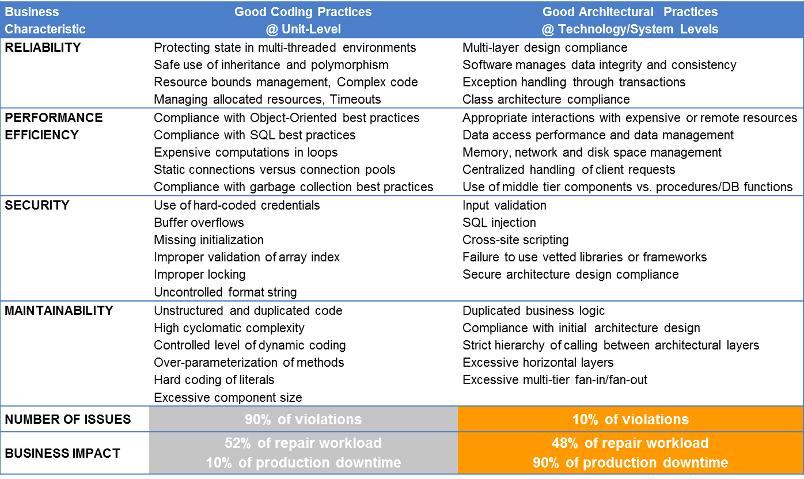
CISQ focuses on the software flaws that matter
Software Risk Prevention:
Focus on critical violations that matter
Focus resources on areas of highest impact not highest number of flags
SYSTEM LEVEL FLAWS
90%
8%
48%
Downtime caused by system-level flaws!
“Tracking programming practices at the Unit Level alone may not translate into the anticipated business impact,…most devastating defects can only be detected at the System Level.”
- OMG
92%
52%
Of all defects
Of total repair effort
10%
UNIT LEVEL FLAWS
Notes:
Further, the CISQ engineers have identified that the Unit level code quality checks, which account for 90% of the violations that would be flagged in analyzing code, account for a relatively small business impact. The System level code quality checks, however, account for 10% of all violations and represent the majority of business impact.

Slide 7
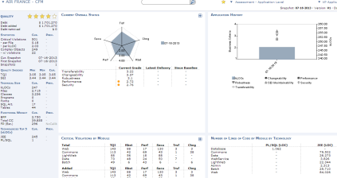
Overview of CAST Quality Model
Quality Metrics Subset
Technical Criteria
Business Criterial
Application Quality
Over 800+ architectural and language-specific code checks
SQL Complexity Distribution
Class complexity (Inh. depth)
Complexity
Performance
Class complexity (Inh. width)
Artifacts having recursive calls
Immediate Impact
Method complexity (control flow)
Robustness
Multiple artifacts inserting data on the same SQL table
Architecture
Coupling Distribution
Security
File conformity
Dead code
Application Quality
Structuredness
Programming Practices
Controled data access
Empty code
Modularity
Encapsulation conformity
Naming
Conventions
Inheritance
Package naming
Class naming
Transferability
Interface naming
Package comment
Documentation
Class comment
Changeability
On-Going Impact
Method comment
Package size
Size
Class size (methods)
Maintainability
Interface size
Notes:
A synthesis of Software Engineering for your business
The CAST health factors measure the quality risk in an application. CAST provides an out-of-the-box synthesis of the body of Software Engineering knowledge of Software Quality. The six health factors are generic quality indicators, following the ISO model of software quality definition (the same for every language) and specific quality metrics (unique by technology).
The only way to get a true measure of quality risk, and an early warning sign before serious problems occur with the application, is to measure quality metrics at the DNA level – directly from the application source code.
We automate the process of code review, providing 100% architectural and code checking via our Application Intelligence Platform.
Review of Health Factors:
1. Performance - Potential bottlenecks and scalability issues
2. Robustness - Risk of failure, difficulty to test
3. Security - Likelihood of breaches
4. Transferability - Ease of moving code among team members
5. Changeability - Ease of modifying, implementing new features
6. Maintainability - General measure of ease to maintain

Slide 8

Computation of score 1 to 4
Computed per rule, component, module and application
Below 3, risks and costs increase.
successful checks
Compliance Ratio =
(% of Successful checks)
X 100
successful checks + failed checks
Very high risk
High risk
Moderate risk
Low risk
Low risk
Moderate risk
4.00
High risk
3.00
Very high risk
2.00
1.00
Threshold #1
E.g.: 10%
Threshold #2
E.g.: 70%
Threshold #3
E.g.: 90%
Threshold #4
E.g.: 99%
Compliance Ratio
(% successful checks)

Slide 9
Application OVERVIEW

Slide 10
Context & Objectives
Context
Objectives
…
Application Name
Actual version number
Number of Release per Year
Number of End-users
Criticality
Domain
Size Application Category
Quality Application Category
ApplicationName
version
SizeType
qualityType
Notes:
Context
Application name : generated from CAST Dashboard and webservice
Actual version number : generated from CAST Dashboard and webservice (the information should be the same as the one provided inside the technical survey)
Number of Release per Year : (the information should be the same as the one provided inside the technical survey) →this information is important to identify the analysis frequency, when to schedule the next analysis.
Number of End-users : (the information should be the same as the one provided inside the technical survey) → this information gives an idea of the impact of the technical quality, the more end-users the more impact.
Criticality : (the information should be the same as the one provided inside the technical survey) → this information gives an idea of the impact of the technical quality, the more business critical the more impact.
Domain : (the information should be the same as the one provided inside the technical survey) → this information can be used to compare this application to CAST APPmarq database for benchmarking
Size Application Category : generated from CAST Dashboard and webservice (LOC)
Quality Application Category : generated from CAST Dashboard and webservice (TQI)
Objectives
Objectives should be taken from the technical survey and the Kick-off minutes call.

Slide 11
Executive Summary
Health Factors
Technical Inventory
 | TQI | Robu. | Perf. | Secu. | Trans. | Chang.
Current version | 0 | 0 | 0 | 0 | 0 | 0
Previous version | 0 | 0 | 0 | 0 | 0 | 0
Variation | 0,00 % | 0,00 % | 0,00 % | 0,00 % | 0,00 % | 0,00 %
Technical Size
Statistics on Violations
Name | Number
kLOCs | 0
Files | 0
Classes | 0
SQL Art. | 0
Tables | 0
Name | Number
Critical Violations | 0
per Files | 0
Per kLOC | 0
Complex Objects | 0
with violations | 0
Top 5 Technologies
Name | LOC
Techno 1 | 0
Techno 2 | 0
Techno 3 | 0
Techno 4 | 0
Techno 5 | 0
Best Practice Compliance
…
…
…
Comments
 | Prog. | Arch. | Doc.
Current version | 0.00 | 0.00 | 0.00
Previous version | 0.00 | 0.00 | 0.00
Variation | 0.00 % | 0.00 % | 0.00 %
Notes:
Health Factors
The current status is displayed as a Radar Chart that assess the application along the following five health factors: Robustness, Performance, Security, Transferability, and Changeability.
In a nutshell, these Health Factors respectively assess the ability of each application to perform well in operations, to withstand workload, to insure data integrity and confidentiality, to be understood by a developer, and to be evolved quickly.
This guides my assessment of the situation: how good – or bad – is the application likely to behave in operations? As this is a Web-facing application, is it robust and secure enough? As this is intended to serve all company employees, is it likely to withstand the workload during closing periods?
Technical Inventory
Technical Size - kLOCs/Classes/Files/Programs/Forms/SQL Artifacts/Tables
Various statistics for Current and Previous snapshots - Critical Violations/Critical Objects
Top 5 technos for kLOCs
Best Practice Compliance
The current status is displayed as a Radar Chart that assess my application along the following three rule compliance indexes: Documentation, Architectural Design, and Programming Practices.
In a nutshell, these respectively assess the compliance of the application with 100s of quality rules.
This gives further insight in the situation: am I making some progress these days? Have I improved the situation on the long run?
Comments
Provide a short comment about the overall Health Status :
Which Health Factor is at high risk (<3) or higher risk (lower than other health Factors)
Which Rule Compliance is at high risk (<3) or higher risk (lower than other rule compliance)
Provide a short comment on the trend (evolution of quantity and quality) if there are more than one version.
Provide information regarding the module at higher risk with the name of the module and the health factor at higher risk for this module.
Provide the name of the technical criteria at higher risk or with the higher increase if there is an evolution

Slide 12
Risk Drivers analysis
Performance:
qualityRuleGrade
Robustness:
qualityRuleGrade
Security:
qualityRuleGrade
Determines the risk of performance issues of an application
Determines the risk of failures or defects that could occur in production
Determines the risk of security breaches for an application
Technical Criteria | Grade | Evol.
Technical Criteria 1 | 0.0 | 0.0 %
Technical Criteria 2 | 0.0 | 0.0 %
Technical Criteria 3 | 0.0 | 0.0 %
Technical Criteria 4 | 0.0 | 0.0 %
Technical Criteria 5 | 0.0 | 0.0 %
Technical Criteria 6 | 0.0 | 0.0 %
Technical Criteria 7 | 0.0 | 0.0 %
Technical Criteria 8 | 0.0 | 0.0 %
Technical Criteria 9 | 0.0 | 0.0 %
Technical Criteria 10 | 0.0 | 0.0 %
Technical Criteria 11 | 0.0 | 0.0 %
Technical Criteria | Grade | Evol.
Technical Criteria 1 | 0.0 | 0.0 %
Technical Criteria 2 | 0.0 | 0.0 %
Technical Criteria 3 | 0.0 | 0.0 %
Technical Criteria 4 | 0.0 | 0.0 %
Technical Criteria 5 | 0.0 | 0.0 %
Technical Criteria 6 | 0.0 | 0.0 %
Technical Criteria 7 | 0.0 | 0.0 %
Technical Criteria 8 | 0.0 | 0.0 %
Technical Criteria 9 | 0.0 | 0.0 %
Technical Criteria 10 | 0.0 | 0.0 %
Technical Criteria 11 | 0.0 | 0.0 %
Technical Criteria | Grade | Evol.
Technical Criteria 1 | 0.0 | 0.0 %
Technical Criteria 2 | 0.0 | 0.0 %
Technical Criteria 3 | 0.0 | 0.0 %
Technical Criteria 4 | 0.0 | 0.0 %
Technical Criteria 5 | 0.0 | 0.0 %
Technical Criteria 6 | 0.0 | 0.0 %
Technical Criteria 7 | 0.0 | 0.0 %
Technical Criteria 8 | 0.0 | 0.0 %
Technical Criteria 9 | 0.0 | 0.0 %
Technical Criteria 10 | 0.0 | 0.0 %
Technical Criteria 11 | 0.0 | 0.0 %
Critical Rules | Violations
Rule 1 | 0
Rule 2 | 0
Rule 3 | 0
Rule 4 | 0
Rule 5 | 0
Rule 6 | 0
Rule 7 | 0
Rule 8 | 0
Critical Rules | Violations
Rule 1 | 0
Rule 2 | 0
Rule 3 | 0
Rule 4 | 0
Rule 5 | 0
Rule 6 | 0
Rule 7 | 0
Rule 8 | 0
Critical Rules | Violations
Rule 1 | 0
Rule 2 | 0
Rule 3 | 0
Rule 4 | 0
Rule 5 | 0
Rule 6 | 0
Rule 7 | 0
Rule 8 | 0

Slide 13
Technical Debt
Technical Debt :
DebtValue
The complexity has been converted into Technical Debt – the cost of fixing the structural quality violations that cause serious business disruption.
…
…
…
…
Definition
Comments
Notes:
Technical Debt Graph
• Left Y axis, debt evolution (added and removed) in euro
• Right Y axis total debt in euro
• X axis, snapshots date
Comments
Give the total technical Debt on the last snapshot.
Give the added and removed technical debt value from the last snapshot if evolution
Technical Debt Definition in details
• Principal is the cost of remediating should-fix violations in production code (hereafter referred to as “TD-principal”).
• Interest is the continuing costs attributable to should-fix violations in production code that haven’t been remediated, such as greater maintenance hours and inefficient resource usage.
• Technical debt is the future costs attributable to known violations in production code that should be fixed—a cost that includes both principal and interest.

Slide 14
Maintenability Cost
Transferability:
qualityRuleGrade
CAST Complexity Distribution
Evaluate how easily a new team or team member can be productive when assigned to work on the application
Technical Criteria Name | Grade | Evolution
Technical Criteria 1 | 0.0 | 0.0 %
Technical Criteria 2 | 0.0 | 0.0 %
Technical Criteria 3 | 0.0 | 0.0 %
Technical Criteria 4 | 0.0 | 0.0 %
Technical Criteria 5 | 0.0 | 0.0 %
Technical Criteria 6 | 0.0 | 0.0 %
Technical Criteria 7 | 0.0 | 0.0 %
Technical Criteria 8 | 0.0 | 0.0 %
Technical Criteria 9 | 0.0 | 0.0 %
Technical Criteria 10 | 0.0 | 0.0 %
Technical Criteria 11 | 0.0 | 0.0 %
CAST provides a distribution of objects based on several distributions:
-Algorithm Complexity (based on Cyclomatic complexity)
-SQL Complexity
-Coupling (Fan in, Fan out)
-Ratio of documentation
-Size of components
Changeability:
qualityRuleGrade
Evaluate how easily and quickly an application can be modified
Technical Criteria Name | Grade | Evolution
Technical Criteria 1 | 0.0 | 0.0 %
Technical Criteria 2 | 0.0 | 0.0 %
Technical Criteria 3 | 0.0 | 0.0 %
Technical Criteria 4 | 0.0 | 0.0 %
Technical Criteria 5 | 0.0 | 0.0 %
Technical Criteria 6 | 0.0 | 0.0 %
Technical Criteria 7 | 0.0 | 0.0 %
Technical Criteria 8 | 0.0 | 0.0 %
Technical Criteria 9 | 0.0 | 0.0 %
Technical Criteria 10 | 0.0 | 0.0 %
Technical Criteria 11 | 0.0 | 0.0 %
Cast complexity | Current total | Previous total | Evol. | Evol. % | % on total elements
Low Complexity | A2 | A1 | A2 – A1 | (A2-A1)/A1 | 100*A2/(A2+B2+C2+D2)
Average Complexity | B2 | B1 | B2 – B1 | (B2-B1)/B1 | 100*B2/(A2+B2+C2+D2)
High Complexity | C2 | C1 | C2 – C1 | (C2-C1)/C1 | 100*C2/(A2+B2+C2+D2)
Very High Complexity | D2 | D1 | D2 – D1 | (D2-D1)/D1 | 100*D2/(A2+B2+C2+D2)
Notes:
Best Practices
In all applications you should not have a high number (to be defined by the project) of high and very high complex objects (for example less than 5%)
On a recurring analysis the number should not increase more than the limit identified and if there is an increase it should be contained and justified
Cost Complexity Definition
Cost Complexity is calculated in a different way to other Complexity metrics. It takes into account complexity scores for other types of complexity (such as Cylcomatic Complexity) and aggregates them to provide a score for Cost Complexity.
The following items are taken into account:
Lack of Comment index
Artifacts are positioned based on their comment/code ratio using the following thresholds:
Average Comment/Code ratio: 15
High Comment/Code Ratio: 7
Very High Comment/Code Ratio: 3
Cyclomatic Complexity index
Artifacts are positioned based on their Cyclomatic Complexity score as follows:
Moderate Cyclomatic Complexity: for all artifacts having a result for the metric 65503 (Moderate Complexity Artifacts)
High Cyclomatic Complexity: for all artifacts having a result for the metric 65504 (High Complexity Artifacts)
Very High Cyclomatic Complexity: for all artifacts having a result for the metric 65505 (Very High Complexity Artifacts)
SQL Complexity index
Artifacts are positioned based on their SQL Complexity score as follows:
Moderate SQL Complexity: for all artifacts having a result for the metric 65803 (Moderate SQL Complexity Artifacts)
High SQL Complexity: for all artifacts having a result for the metric 65804 (High SQL Complexity Artifacts)
Very High SQL Complexity: for all artifacts having a result for the metric 65805 (Very High SQL Complexity Artifacts)
Artifact Granularity index
Artifacts are positioned based on their Size Distribution score as follows:
Average Granularity: for all artifacts having a result for the metric 65102 (Average Size Artifacts)
High Granularity: for all artifacts having a result for the metric 65103 (Large Size Artifacts)
Very High Granularity: for all artifacts having a result for the metric 65104 (Very Large Size Artifacts)
Artifact Coupling index
Artifacts are positioned based on their Coupling Distribution score as follows:
Average Coupling: for all artifacts having a result for the metric 65302 (Average Coupling Artifacts)
High Coupling: for all artifacts having a result for the metric 65303 (High Coupling Artifacts)
Very High Coupling: for all artifacts having a result for the metric 65304 (Very High Coupling Artifacts)
Calculation
Once the above scores are determined for an artifact, the Cost Complexity score is then calculated as follows:
Very High Cost Complexity
Cost Complexity will be Very High when ONE of the following is true:
Cyclomatic Complexity index is Very High
SQL Complexity index is Very High
Artifact Granularity index is Very High and Lack of Comment index is Very High and Artifact Coupling index is Very High
High Cost Complexity
Cost Complexity will be High when ONE of the following is true:
Cyclomatic Complexity index is Moderate and SQL Complexity index is Moderate and (Artifact Granularity index is Very High or Lack of Comment index is Very High or Artifact Coupling index is Very High)
Cyclomatic Complexity index is High
Artifact Granularity index is High and Lack of Comment index is High and Artifact Coupling Index is High
Moderate Cost Complexity
Cost Complexity will be Moderate when ONE of the following is true:
Cyclomatic Complexity index is Low and SQL Complexity index is Low and (Artifact Granularity index is High and Lack of Comment index is High and Artifact Coupling index is High)
Cyclomatic Complexity index is Moderate
SQL Complexity index is Moderate
Artifact Granularity index is Moderate and Lack of Comment index is Moderate and Artifact Coupling index is Moderate

Slide 15
Compliance
Compliance to Objectives
Topmost Complexity Increase
The list below shows the top 25 complexity increase of the most complex components between the 2 releases.
These components should be tested first and you should try to fix all important violations on this list first because they are certainly going to change in the future as well.
Object Name | CC evolution | Cyclomatic Complexity (CC) | Critical Violations
 | Objectives | Achievement | Achievement ratio
Entire Application (whole code) | - | - | -
Last Delivery (new and modified) | - | - | -
Topmost Violations
Critical Rule name | Latest Violations | All Violations | Objective | Observed
- | - | - | - | -
- | - | - | - | -
- | - | - | - | -
- | - | - | - | -
Notes:
Best Practices
You should define the Critical Rules (Objectives) with the Application Team As soon as possible
The topmost complexity increase will display all objects with functional changes that could lead to regressions if not tested in priority
Definition
Compliance to objectives (FRAME_PORTAL_SLA_VIEW - Vendors - Deliverables Acceptance)
Displays for the latest delivery (I.e., the new and modified code since the previous snapshot) and for the entire application the number of rules tagged as "critical contribution" in the Assessment Model with defects against the ones without, presented as a percentage values.
These rules are considered as the service level objectives: they are a subset of the whole rule set; they have been chosen for their importance to the user; with this specific focus, they should be adhered to. In other words:
The objectives are to have no critical violations in the delivery.
The number of objectives is therefore the number of critical rules that are applicable to the Application.
The number of objectives attained is the number of applicable critical rules that have no violations, in the latest delivery (new and modified source code) or in the entire application.
The percentage values that drive the gauges are the ratio of objectives attained on the total number of objectives.
Topmost violations
Displays the rules tagged as "critical contribution" in the Assessment Model with violations in the latest delivery (I.e., new and modified code alone since the previous snapshot) or in the entire application (this is, in fact, the detail of the top left-hand side section). It shows the compliance objective (in %), the effective compliance with the rule (in %), the gap (in % point) and the number of violations to translate the % into physical volume.
Topmost complexity increase
Displays the list of artifacts whose complexity (Cyclomatic complexity) has increased the most together with their number of violations (I.e., number of rules tagged as "critical contribution" in the Assessment Model they do not comply to). The panel is designed to help identify over-engineered artifacts that feature sources of risk.

Slide 16
Potential Points of failures: Propagated Risk Index
Top Riskiest Components
The PRI number reflects the cumulative risk of the object based on its relationships and interdependencies. The PRI is calculated as a function of the rules violated, their weight/criticality, and the frequency of the violation.
PERFORMANCE
Artefact Name | PRI
Artefact 1 | PRI 1
Artefact 2 | PRI 2
Artefact 3 | PRI 3
Artefact 4 | PRI 4
Artefact 5 | PRI 5
ROBUSTNESS
Artefact Name | PRI
Artefact 1 | PRI 1
Artefact 2 | PRI 2
Artefact 3 | PRI 3
Artefact 4 | PRI 4
Artefact 5 | PRI 5
SECURITY
Artefact Name | PRI
Artefact 1 | PRI 1
Artefact 2 | PRI 2
Artefact 3 | PRI 3
Artefact 4 | PRI 4
Artefact 5 | PRI 5
Notes:
Definition
Violation Index – VI
VI ranks an application objects (function, module, etc.) with respect to its structural quality risk an application object VI represents the impact of its detected violation on a given health factor/ business criteria
VI depends on the assessment model aggregation and computation weights of the detected violations
The higher the VI of an object the larger is the impact of its violations on a given health factor score
An object has different VI for different health factor
Risk Propagation Factor - RPF
The risk of a Violation depends on the hierarchical relationship of the affected object with other application components
The larger the number of call-path -- how many ways the affected object can be called by another object - the higher the risk
RPF counts the number of relevant call-paths of a given object
Propagated Risk Index - PRI
PRI combines VI and RPF
Identify violations related to object with the larger number of violations, as related to a concerned Health Factor, and which can impact the largest number of linked components

Slide 17
Potential Points of failures: Transaction Risk Index
Top Riskiest Transactions
Transaction Wide Risk Index (TwRI) is an indicator of the riskiest transactions of the application. The TwRI number reflects the cumulative risk of the transaction based on the risk in the individual objects contributing to the transaction. The TwRI is calculated as a function of the rules violated, their weight/criticality, and the frequency of the violation across all objects in the path of the transaction. TwRI is a powerful metric to identify, prioritize and ultimately remediate riskiest transactions and their objects
PERFORMANCE
Artefact Name | TRI
Artefact 1 | TRI 1
Artefact 2 | TRI 2
Artefact 3 | TRI 3
Artefact 4 | TRI 4
Artefact 5 | TRI 5
Comments
ROBUSTNESS
Artefact Name | TRI
Artefact 1 | TRI 1
Artefact 2 | TRI 2
Artefact 3 | TRI 3
Artefact 4 | TRI 4
Artefact 5 | TRI 5
SECURITY
Artefact Name | TRI
Artefact 1 | TRI 1
Artefact 2 | TRI 2
Artefact 3 | TRI 3
Artefact 4 | TRI 4
Artefact 5 | TRI 5
Notes:
Definition
Transaction-wide Risk Index - TwRI
Identify transactions with highest cumulated risk
To support “smart targeting” and Action Plan building Related to transactions that truly matter for end-users With high visibility on results
TwRI is the sum of Violation Indices (VIs) of the objects along the transaction, related to Robustness, Performance, and Security

Slide 18
recommendations
Notes:
For the Recommendations you will select no more than 3 rules from you recommendation slide before that are critical or with high weight on Robustness, Performance and Security
You should go back to the confluence website to have example of rules and slides :
https://confluence.castsoftware.com/display/PROS/S4.300+Technology+Focus

Slide 19
Proposed Action Plan
Rules selected for action
Recommendations
Rule | Still Violation (#) | New Violation (#)
Rule 1 | 1 | 1
Rule 2 | 2 | 2
Rule 3 | 3 | 3
Rule 4 | 4 | 4
Rule 5 | 5 | 5
Rule 6 | 6 | 6
Rule 7 | 7 | 7
Rule 8 | 8 | 8
Rule 9 | 9 | 9
Rule 10 | 10 | 10
Notes:
Best Practices
Action plans should not have more than 50 actions to be effective and usually 1 to 10 actions are enough.
Don’t select more than 5 rules (if possible critical rules)
Select always critical violations first or rules with weight higher than 6
Focus your action plan on Performance, Robustness or Security
Recommendations
Use the Action plan optimizer to provide an estimation of the impact on the TQI of the action plan based on the application if the impact is high at this level or usually on a specific module
Provide list of rules that should be part of new guidelines for developers to educate them without having to create an action plan
The list of rules selection for education will be on rules with high weight or critical and with lots of violations (developers usually don’t know about the rule if too many violations)

Slide 20
Rule name
Observation:
XXXX
CAST findings:
XXXX
Screen copy or picture
Business Value:
XXXX
Recommendation:
XXXX

Slide 21
Rule name
Observation:
XXXX
CAST findings:
XXXX
Screen copy or picture
Business Value:
XXXX
Recommendation:
XXXX

Slide 22
Rule name
Observation:
XXXX
CAST findings:
XXXX
Screen copy or picture
Business Value:
XXXX
Recommendation:
XXXX

