Slide 1

Oil and Gas Regulatory Record Digitizer (OGRRE)
Tool Guide

Slide 2
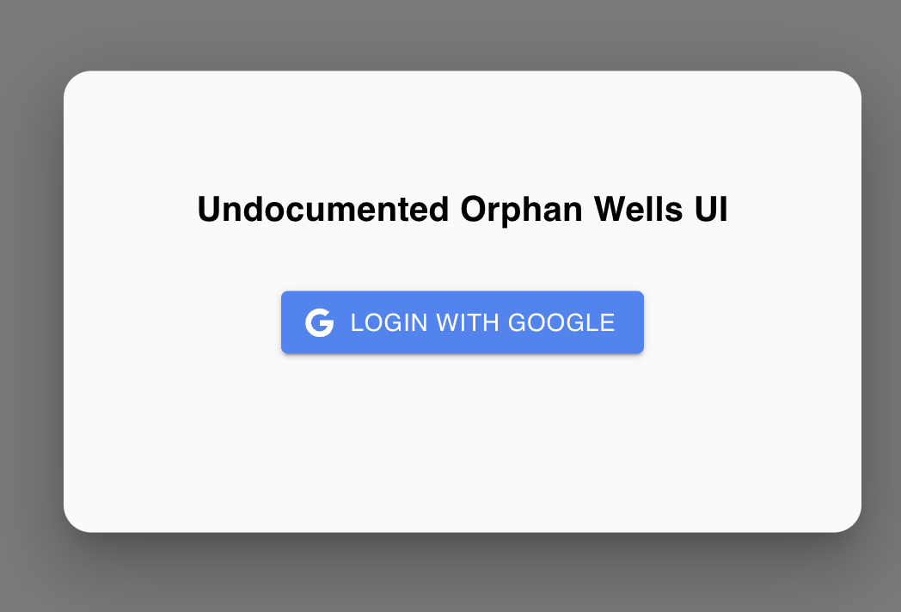
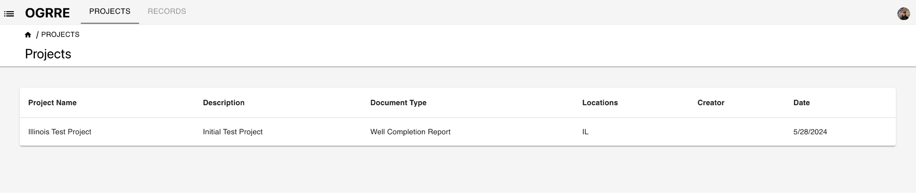
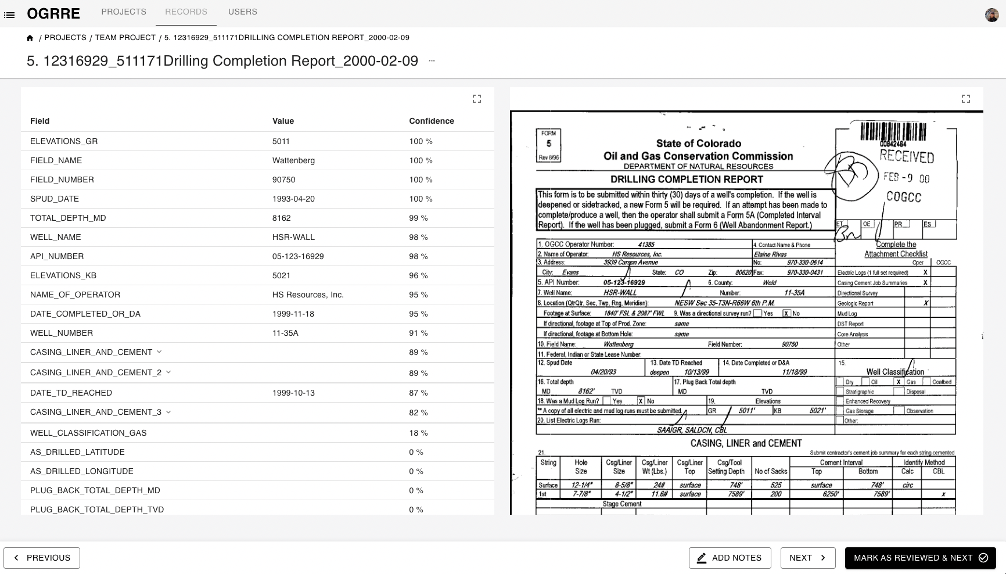

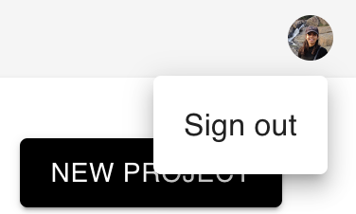
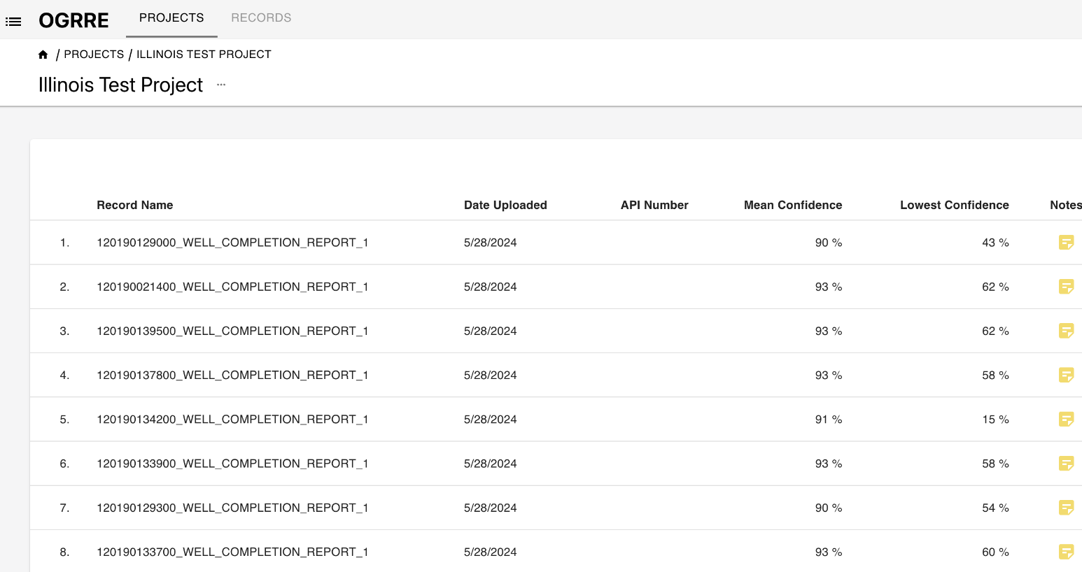
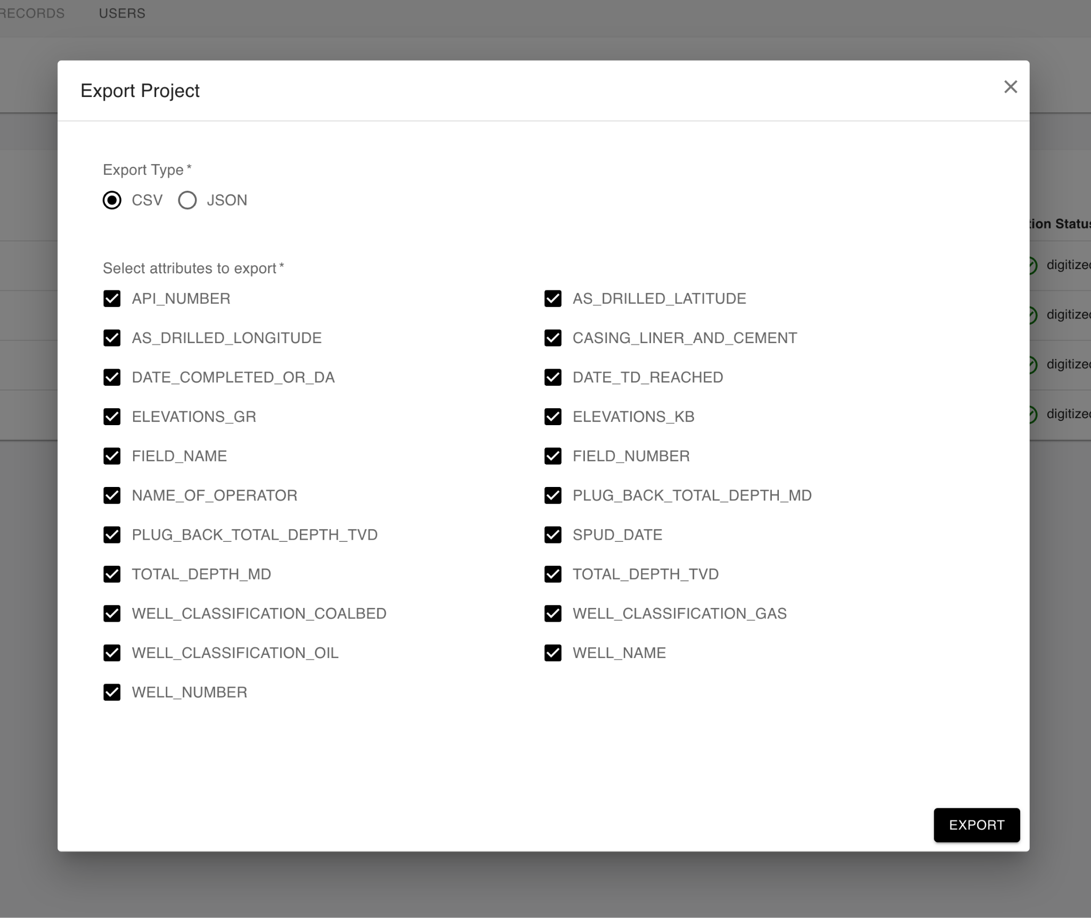
Overview of OGRRE UI Flow
Choose project
(Slides 4 - 6)
Review records
(Slides 8-15)
Log in
Sign out
Export records
(Slide 7)

Slide 3
Terminology
Project: Shared workspace for working on records
Document Type: Grouping of similar documents, e.g., "well completion report"
Digitize: Intelligently convert an image to corresponding text values
Processor: External tool that reads digitizes the supported types of scanned document images
Record: An uploaded document digitized by the processor
Attribute: One digitized name and value from the document
Confidence: The degree of certainty the tool (or human, if set manually) has in the predicted digitized field values

Slide 4
List of Projects
Start by clicking on the project in the list. Project will contain a set of records to review.
Illinois Test Project has been updated with preliminary 20 well completion records from ISGS submitted documents.
Notes:
Ask: Continue on the same project after testing period OR New project with transferring reviewed files

Slide 5
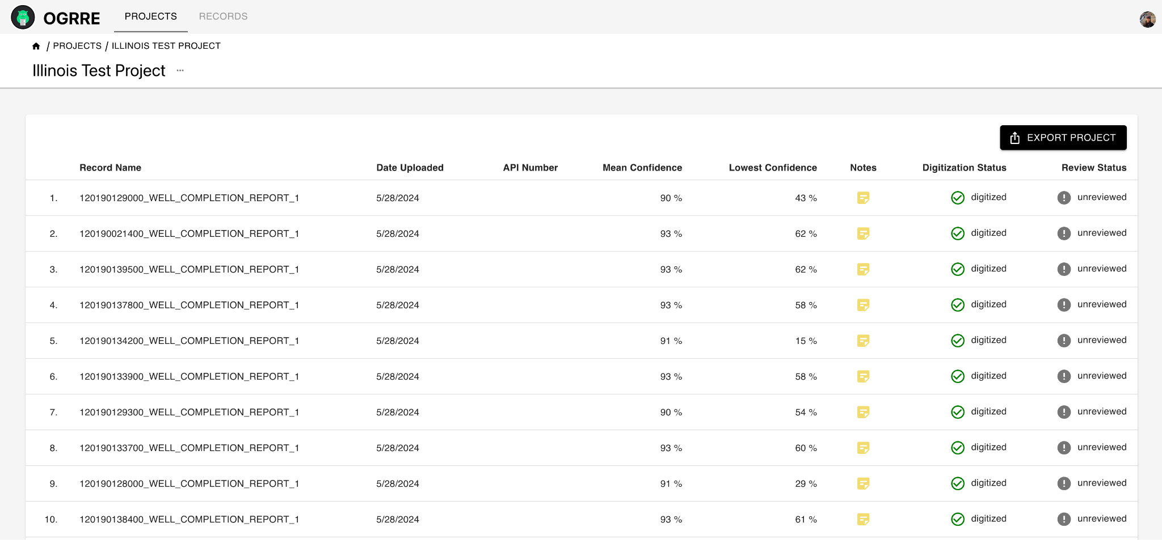
List of Records in the Project
Clicking on a row from the project list view will navigate to the view with a list of all the records uploaded as part of that project.
Clicking on a record row here will navigate you to record details page.

Slide 6
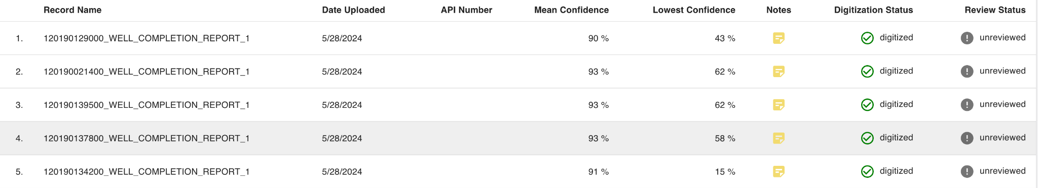
List of Records in the Project: Column descriptions
Record Name - Name of file uploaded
Date Uploaded - When the file was uploaded
API Number - Well API Number available from the uploaded file
Confidence - each attribute digitized will have associated confidence % given by processor
Mean Confidence - Mean of all digitized attributes’ confidence values in that record
Lowest Confidence - Lowest of all the confidence values in the record
Notes - Notes added to the record
Digitization Status - Status of record in tool: uploading/ processing/ digitized
Review Status - Status of review for the record: unreviewed/ reviewed

Slide 7
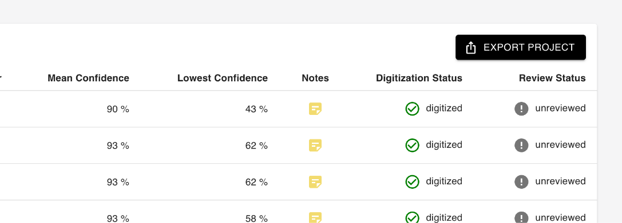
Project Details : Export Project
You could ‘export project’ to get a CSV or JSON format of all the digitized information from uploaded records.
You can select the attributes you want in the CSV or JSON export
Notes:
Csv screenshot

Slide 8
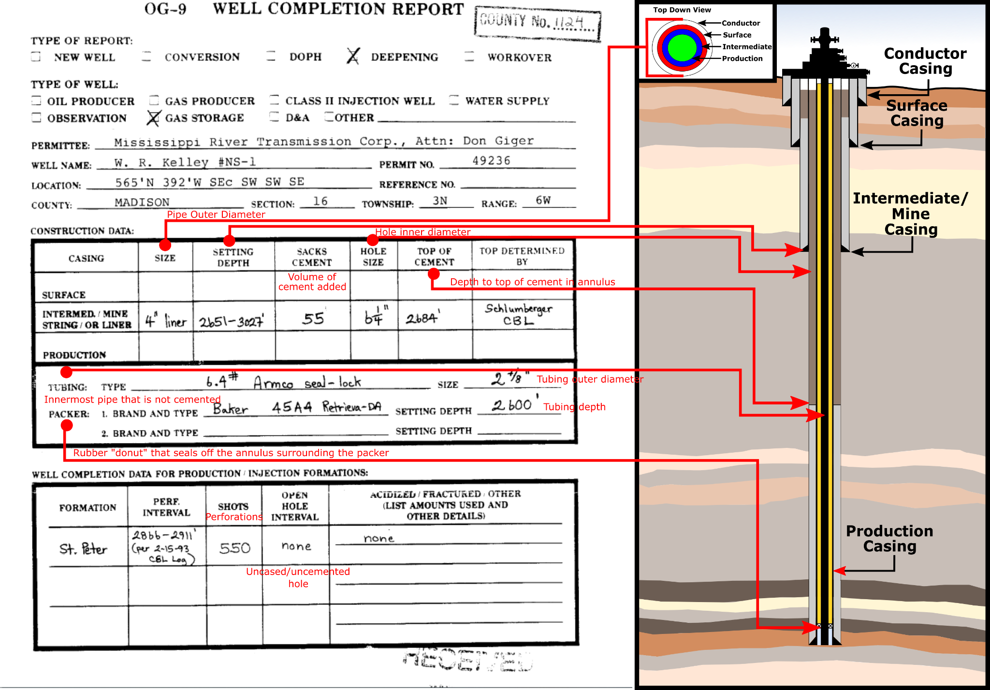
Notes:
Csv screenshot

Slide 9
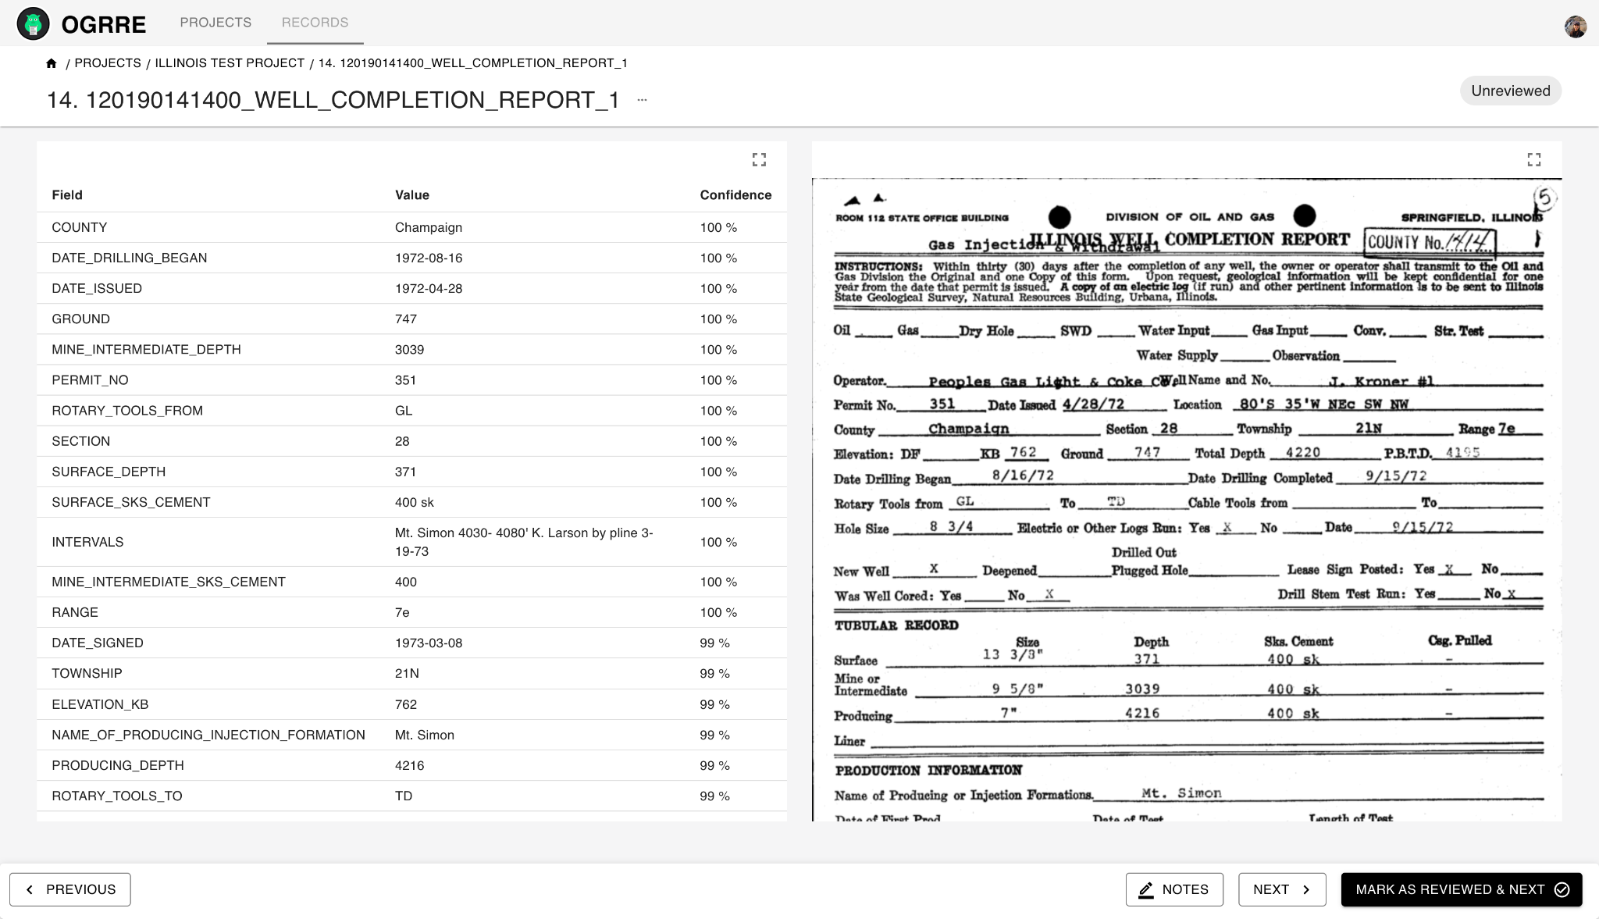

Record Details: Review & Edit Attributes
From the ‘Project details’ view, clicking a record row will open its ‘record details’ view.
The digitized values are on the left scrollable section and the uploaded document is on the right.
The two sides are linked: selecting fields on the left will highlight the place where it came from in the document on the right.
The attribute values are assigned a confidence by the processor. Some attributes digitized may have low or even 0 confidence values.
But attributes not found in the uploaded document will always have 0% confidence and show as:

Slide 10
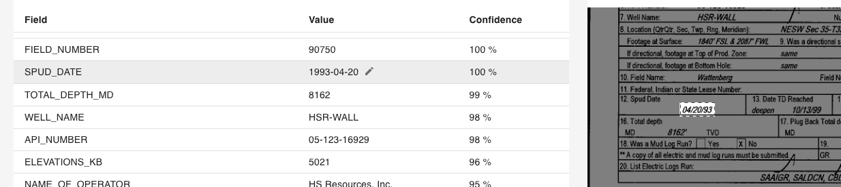


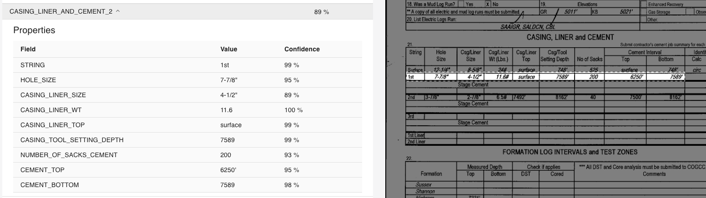
Record Details: Review & Edit Attributes
Clicking on attribute row will highlight that attribute value in the image on the right panel.
You could also use up and down keys as keyboard shortcuts to traverse through attributes
Clicking on button will let you edit the value. You could edit & correct any wrong values detected by processor, or add values for attributes not detected. These will be shown as
Enter key is the keyboard shortcut to edit the value of highlighted attribute. Enter or Esc to save and exit the edited value
Complex tabular attributes are collapsed by default, and expand on clicking the row
1.
2.
3.

Slide 11
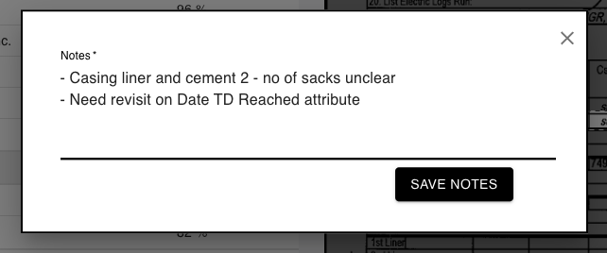
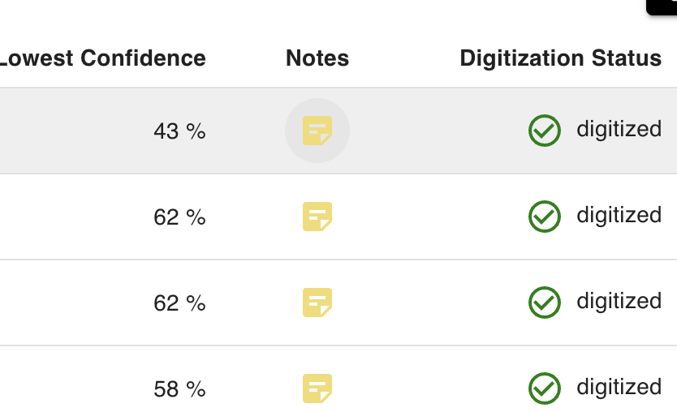
Record Details : Add Notes
For each record, you could add notes by clicking ‘Notes’ button in the toolbar at the bottom and saving them.
You could revisit the notes by clicking on same button again for the record.
These notes are also accessible from Records list view.
Notes:
Notes column in records table view.

Slide 12
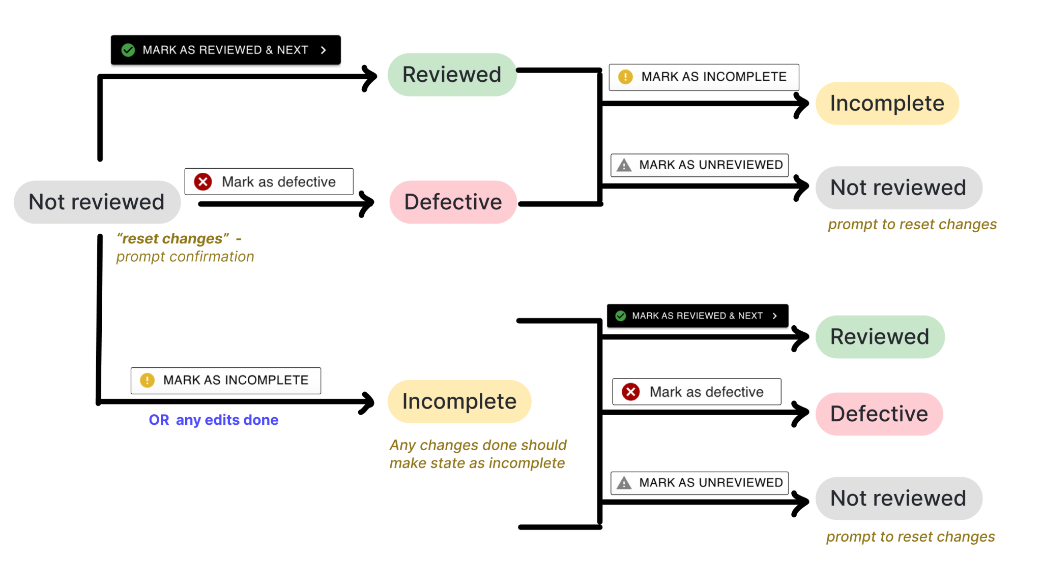
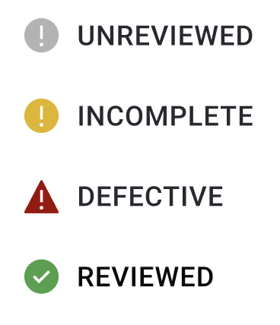
Record Review Status : Unreviewed, Incomplete, Reviewed, Defective
Each record can be in following states:
Each record by default is unreviewed, and can flow into other states as shown below:
Notes:
Notes column in records table view.

Slide 13




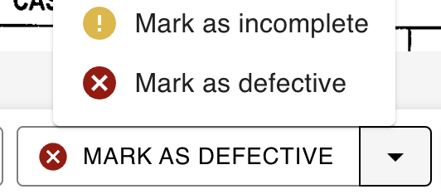
Record details : Mark as Reviewed, Unreviewed, Incomplete, Defective
The bottom toolbar on record details view include following action buttons:
Marks the record as reviewed and opens the next record details view
Marks a reviewed or defective record as unreviewed
Marks a record as incomplete
Marks a record as incomplete
The arrow opens additional options available for review status changes
Cmd(Mac) or Ctrl(Win) + Shift + Right arrow key
—
—
—
—
Notes:
Notes column in records table view.

Slide 14


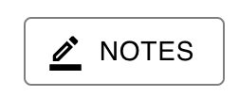
Record details : Next, Previous and Edit Notes
The bottom toolbar on record details view include following action buttons:
Opens the next record detail view without changing review state of current record
Opens the previous record detail view without changing review state of current record
Open notes to add/edit/review any notes for the record
Cmd(Mac) or Ctrl(Win) + Right arrow key
Cmd(Mac) or Ctrl(Win) + Left arrow key
—
Notes:
Notes column in records table view.

Slide 15
All Keyboard Shortcuts
Next attribute + highlight : up/ down arrow key
Edit value of current attribute : Enter key on current row
Save & exit edit mode : Enter or Esc
Mark as reviewed & next : Cmd(Mac) or Ctrl(Win) + Shift + Right arrow key
Next record : Cmd(Mac) or Ctrl(Win) + Right arrow key
Previous : Cmd(Mac) or Ctrl(Win) + Left arrow key
Notes:
These controls we can change with feedback

Slide 16
Feedback follow-ups
More Questions? Reach out to Gregory.Lackey@netl.doe.gov

