Slide 1

Chapter 5
Basic Graph Algorithms
Divesh Aggarwal
School of Computing
Department of Computer Science

Slide 2
Reachability
Given a graph G and a vertex s in G, the reachability question asks which vertices are reachable from s; that is, for which vertices v is there a path from s to v? For now, let’s consider only undirected graphs.

Slide 3
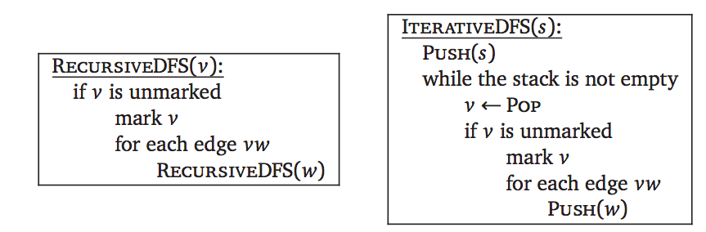
Depth-First Search
This algorithm can be written either recursively or iteratively. It’s exactly the same algorithm either way; the only difference is that we can actually see the “recursion” stack in the non-recursive version.

Slide 4
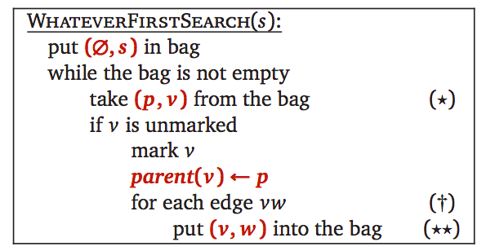
A generic graph searching algorithm!
The only important properties of a “bag” are that we can put stuff into it and then later take stuff back out. A stack is a particular type of bag, but certainly not the only one.

Slide 5
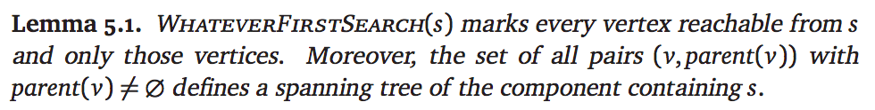
A generic graph searching algorithm!
Proof: By induction. Left as an exercise. (See textbook)

Slide 6
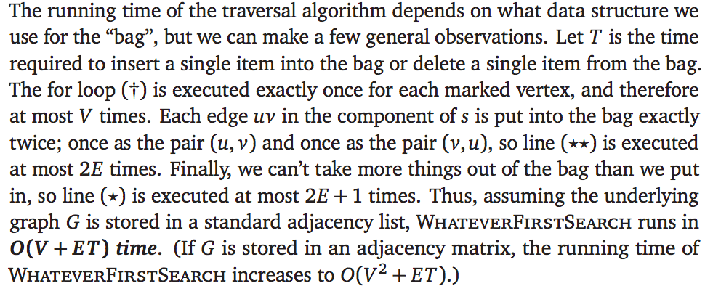
Analysis!

Slide 7
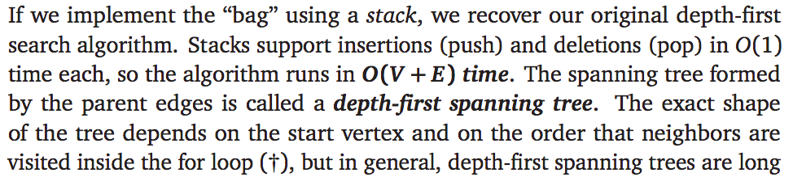
Important variants!
Depth-first search

Slide 8
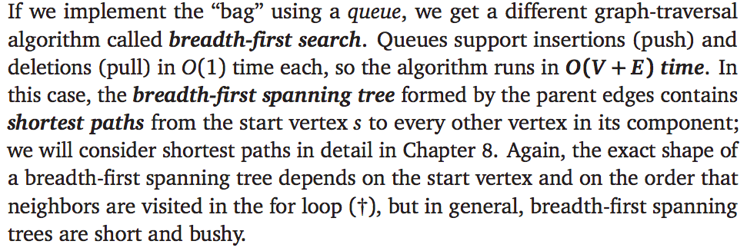
Important variants!
Breadth-first search

Slide 9
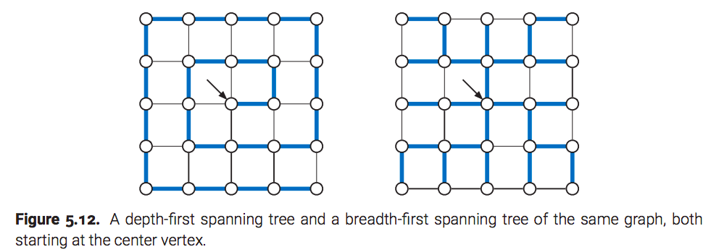
Comparison between BFS and DFS trees

Slide 10
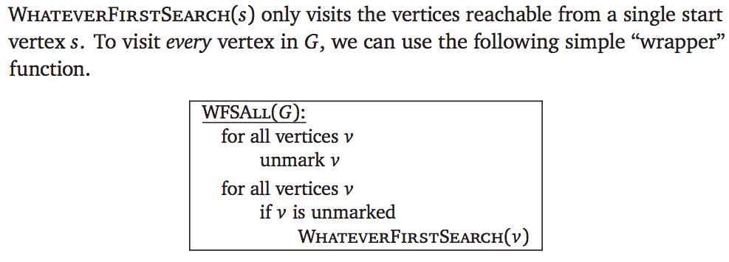
Disconnected graphs

Slide 11
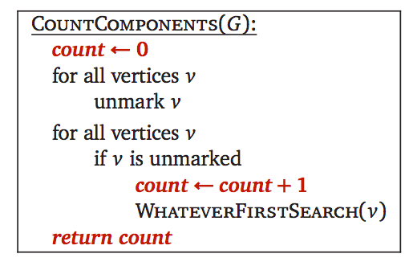
Count connected components

Slide 12
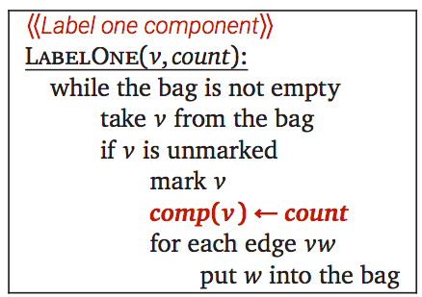
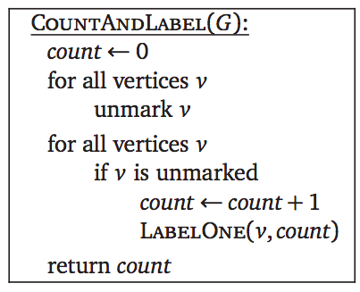
Count and label

Slide 13
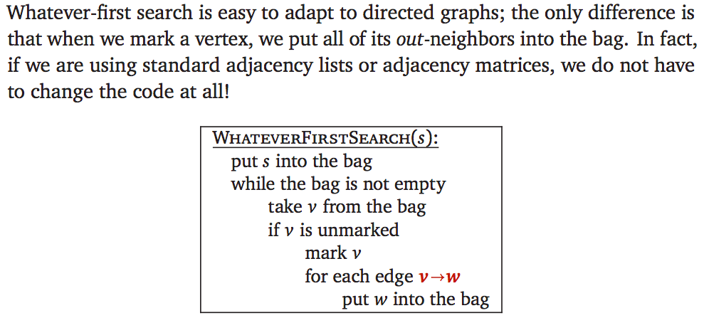
Directed graphs

Slide 14
Chapter 6
Depth-first search
Divesh Aggarwal
School of Computing
Department of Computer Science

Slide 15
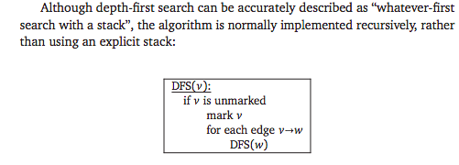
Depth-first search, revisited

Slide 16
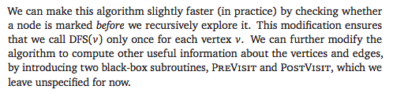
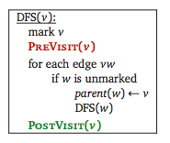
Depth-first search, modified slightly

Slide 17

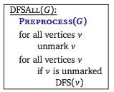
Preprocessing
In general, we can have a PREPROCESS function:

Slide 18

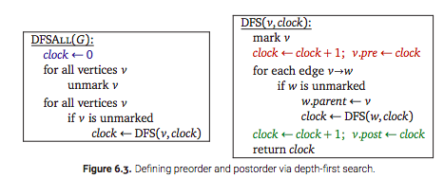
Tracking traversal order
We can use the following subroutines:

Slide 19
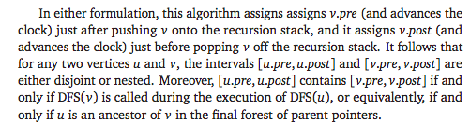
Tracking traversal order

Slide 20
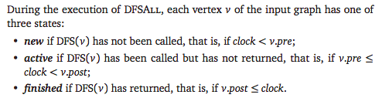
Classifying vertices w.r.t. the clock

Slide 21


Classifying edges w.r.t. the clock

Slide 22

Classifying edges w.r.t. the clock

Slide 23
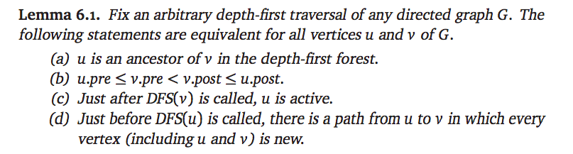
DFS tree ancestor lemma
Proof: Left as an exercise. (See textbook)

Slide 24
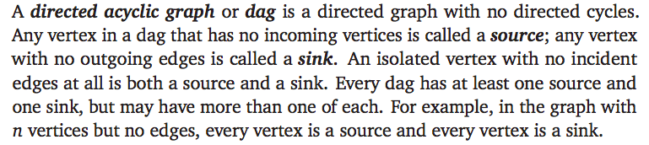
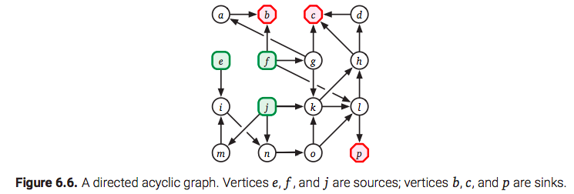
Directed acyclic graphs (DAGs)

Slide 25
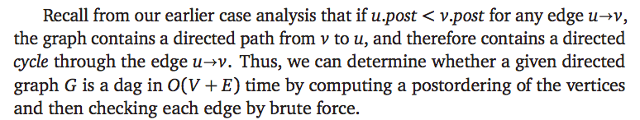
Detecting cycles
Why is this algorithm correct?
Proof: Suppose that there is a cycle v₁, v₂, …, v_{k}. Let v_{i} be the vertex visited last (i.e., v_{i}.pre is the largest) by the DFS algorithm. Then, v_{i} must be visited during the DFS visit of v_{i+1} which means v_{i}.post < v_{i}.post, and thus the algorithm finds this cycle.

Slide 26
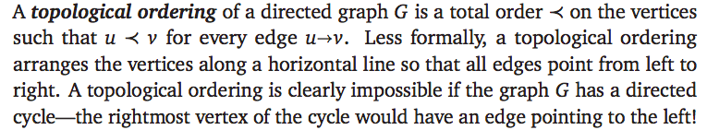
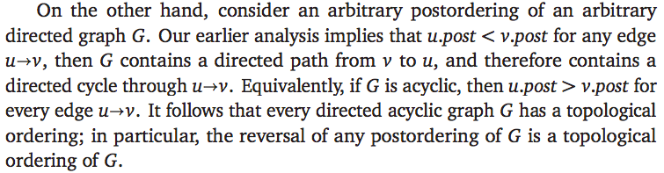
Topological sort

Slide 27
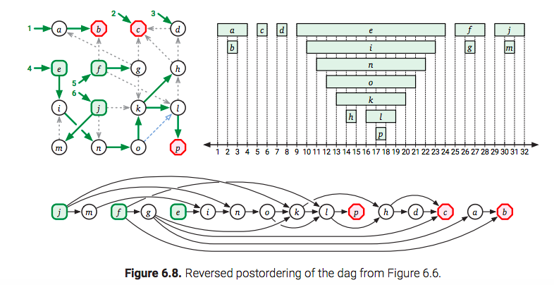
Topological sort

Slide 28
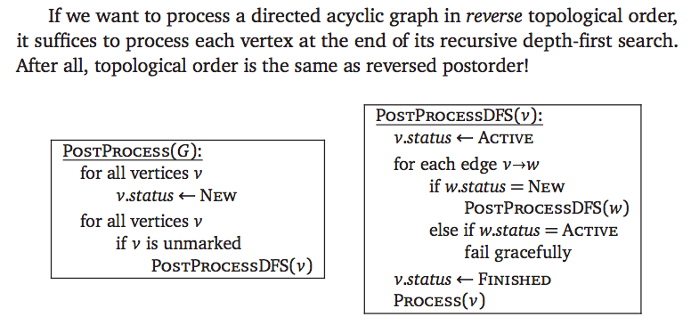
Processing in reverse topological order

Slide 29
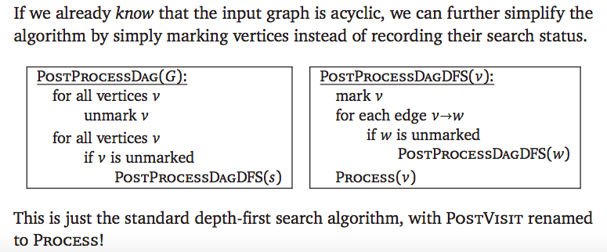
Processing in reverse topological order

Slide 30
Connection to Dynamic Programming and Memoization

Slide 31
Analogy between DFS and Dynamic Programming/Memoization
Our topological sort algorithm is arguably the model for a wide class of dynamic programming algorithms.
Recall that the dependency graph of a recurrence has a vertex for every recursive subproblem and an edge from one subproblem to another if evaluating the first subproblem requires a recursive evaluation of the second. The dependency graph must be acyclic, or the naïve recursive algorithm would never halt.
Evaluating any recurrence with memoization is exactly the same as performing a depth-first search of the dependency graph.

Slide 32
Analogy between DFS and Dynamic Programming/Memoization
Carrying this analogy further, evaluating a recurrence using dynamic programming is the same as evaluating all subproblems in the dependency graph of the recurrence in reverse topological order—every subproblem is considered after the subproblems it depends on. Thus, every dynamic programming algorithm is equivalent to a postorder traversal of the dependency graph of its underlying recurrence!
However, there are some minor differences between most dynamic programming algorithms and topological sort. First, in most dynamic programming algorithms, the dependency graph is implicit—the nodes and edges are not explicitly stored in memory, but rather are encoded by the underlying recurrence. But this difference really is minor; as long as we can enumerate recursive subproblems in constant time each, we can traverse the dependency graph exactly as if it were explicitly stored in an adjacency list.

Slide 33
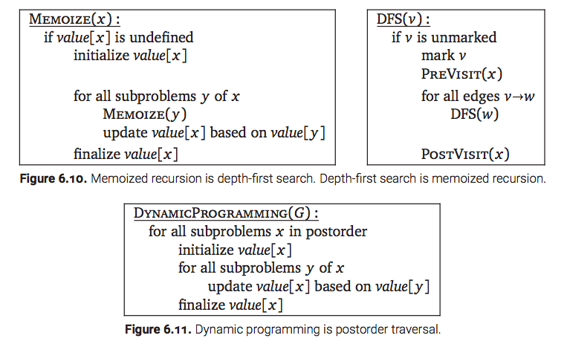
Analogy between DFS and Dynamic Programming/Memoization

Slide 34
Dynamic Programming via DFS
More significantly, most dynamic programming recurrences have highly structured dependency graphs. For example, as we discussed in Chapter , the dependency graph for the edit distance recurrence is a regular grid with diagonals, and the dependency graph for optimal binary search trees is an upper triangular grid with all possible rightward and upward edges.
Conversely, we can use depth-first search to build dynamic programming algorithms for problems with less structured dependency graphs.
For example, consider the longest path problem, which asks for the path of maximum total weight from one node s to another node t in a directed graph G with weighted edges. In general directed graphs, the longest path problem is hard, but there is an efficient algorithm for the special case when the graph is acyclic.

Slide 35
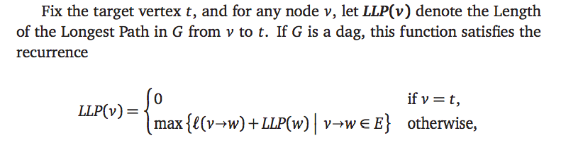
Longest path problem

Slide 36
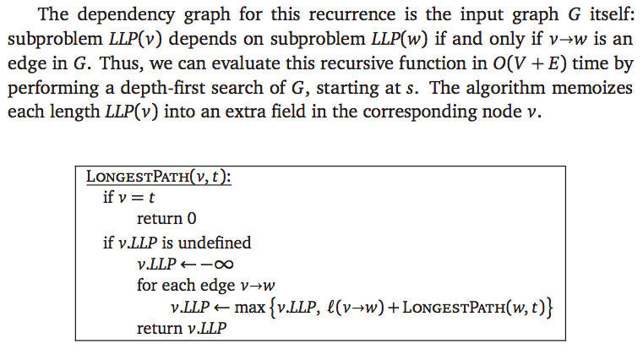
Longest path problem

Slide 37
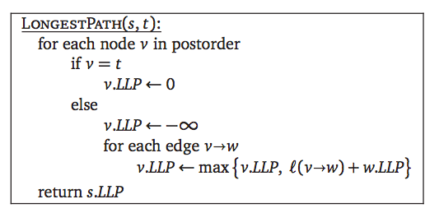
Longest path problem

