Slide 1
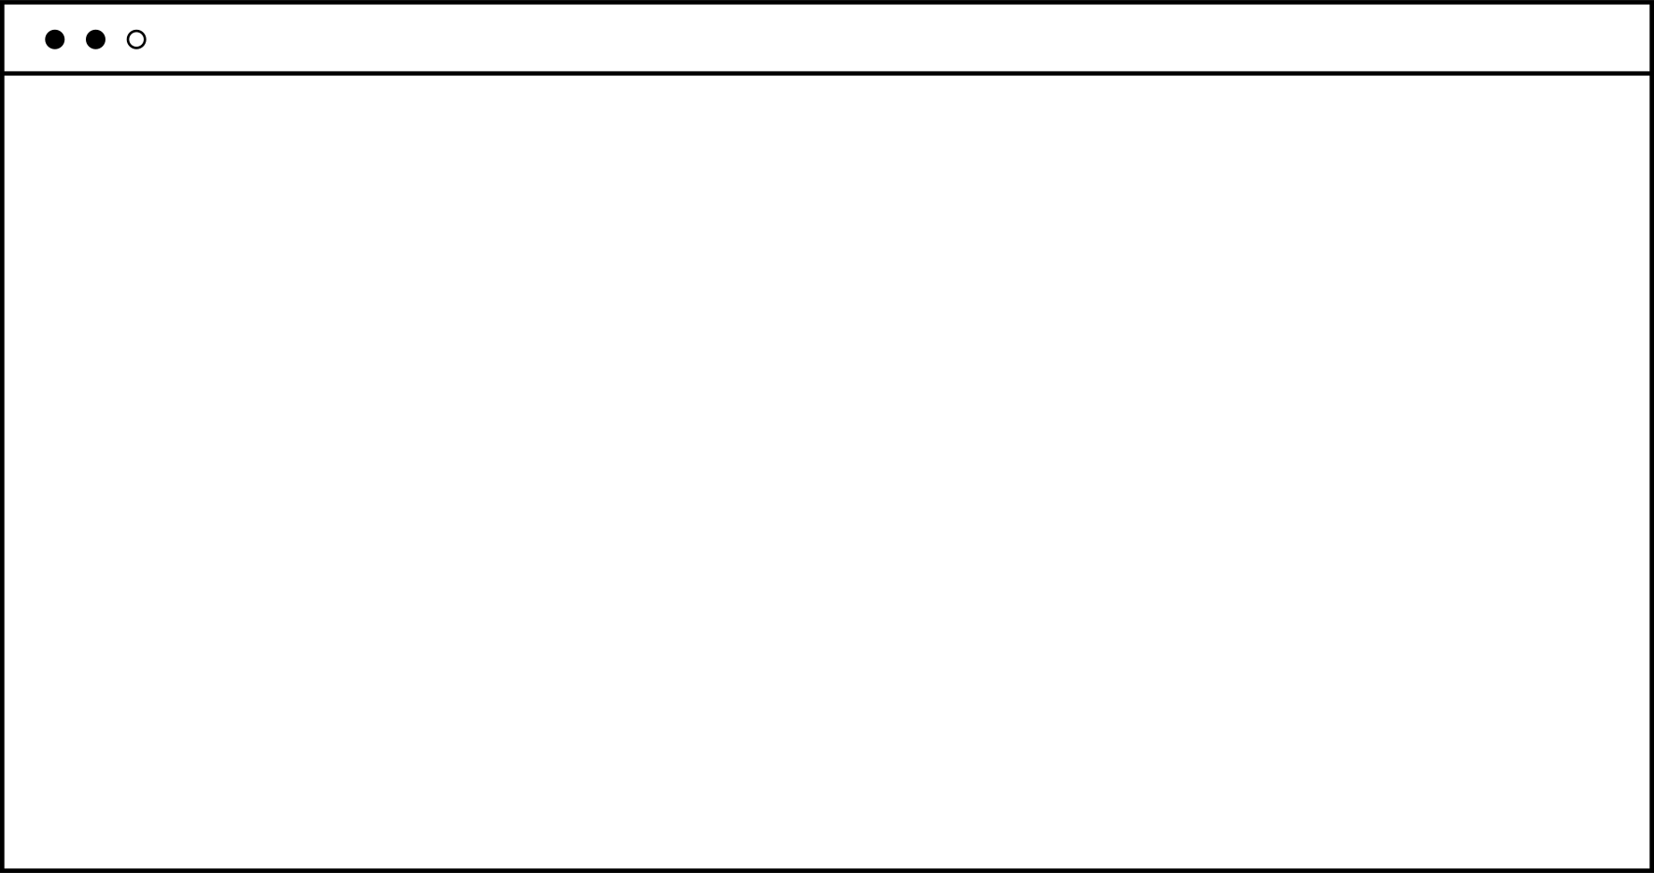


Hand Figuration
프레젠테이션
Team3
Start >
김동한,김재홍,박준하,이재욱,최우준
2021/12/21

Slide 2


Table of Contents
01
Project topic
And brief introduction
02
The roles of the
Team member
03
The open source library
04
Open source license
For team project
05
Demo videos
And lice demonstrations
06
Milestone and
Achievement level

Slide 3

Project theme & Introduction
01

Slide 4
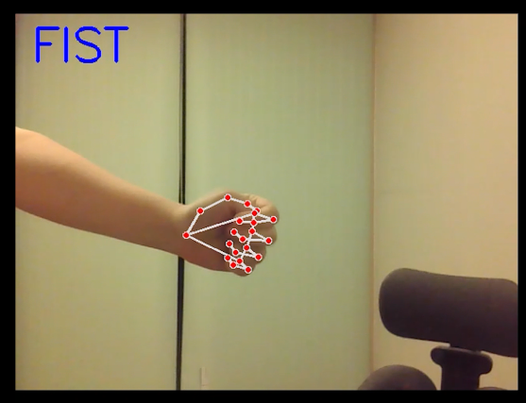

Our team made a game using hand recognition technology using Python.

Slide 5
목차를
02
The roles of the
team member

Slide 6





김동한
김재홍
박준하
이재욱
최우준
김민성
홍예주
박찬희
Hand gesture modeling
License research
GUI development
Making a hand recognition part
Finish game
Edit the video
GUI development
Finish game
PPT production
GUI development
Making a hand recognition part
Finish game
Next >

Slide 7

03
Open source Library

Slide 8





Open source library
사용자1
사용자2
사용자3
사용자4
OpenCV
TKINTER
NumPy
MediaPipe

Slide 9
04
Open source license

Slide 10

MIT Licenses
Among the licenses of the library used in our team project, MIT license and Apache 2 license are Permissive licenses that allow Re-licensing, so we decided to use MIT license for our project after Re-licensing.

Slide 11
05
Demo videos & Demo Live

Slide 12
데모 영상

Slide 13
Milestone & Achievement level
06

Slide 14
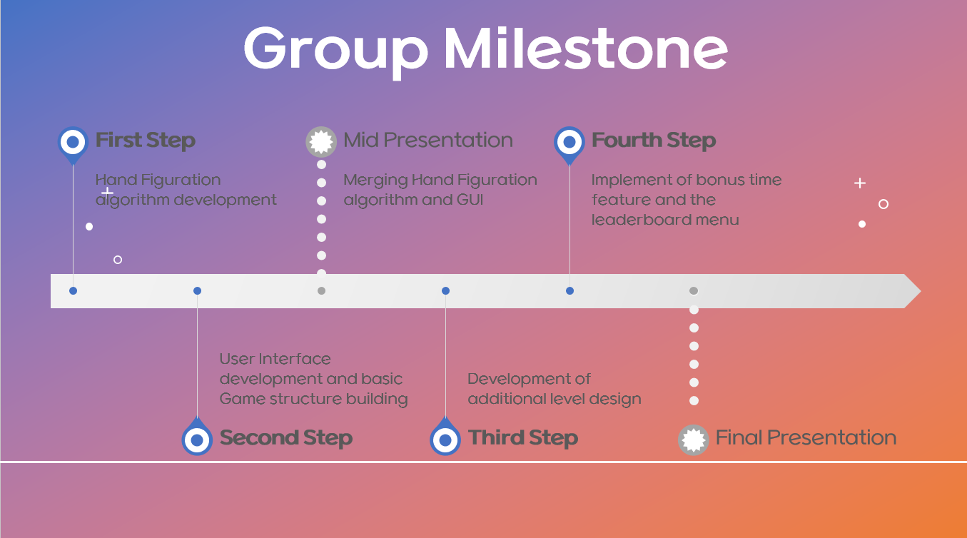
Milestone
01
Merging Hand Figuration
Algorithm and GUI
We spent a lot of time here
02
Development of
Additional level design
Failed
Implement of bonus time feature and the leaderboard menu
03
We only made leaderboard
01

Slide 15
Hand Figuration algorithm
UI development
Basic game structure building
Merging Hand
Figuration algorithm and GUI
Leaderboard menu
71%
Level design
Bonus time
01

Slide 16
Thank you for listening
Exit >
김동한,김재홍,박준하,이재욱,최우준
2021/12/21

