Slide 1
GOplan Instruction
Qianqian Huang
08/30/24

Slide 2
Introduction
  The design of breeding programs holds significant importance in achieving substantial economic gains. Simulation is the optimal approach because testing the effectiveness of a breeding program through trials is time-consuming and costly.
  GOplan is an R package tailored to help manage animal breeding programs of both single population and crossbreeding systems, as well as optimize breeding programs.
  GOplan has three wrapped functions, runCore() for evaluating breeding programs’ genetic progress and population diversity change, runWhole() for predicting crossbreed’s phenotype and evaluating the economic profit of crossbreeding systems, and runOpt() for optimizing breeding programs to get the greatest economic profit. Three demos were displayed to demonstrate its function.
  GOplan is a user-friendly and comprehensive R package with wrapped mainstream crossbreeding frameworks, which simplify the process of constructing crossbreeding systems. It also supports breeding program optimization by using the Bayesian optimization method.

Slide 3
Installation

Slide 4
How to install?
Install.packages(“remotes”)
library(remotes)
remotes::install_github(“https://github.com/CAU-TeamLiuJF/GOplan”)

Slide 5
Issues when installed on Mac
1. Install libomp using brew
Add below code in your ~/.R/Makevars
# you may change the path highlighted with your own path.
CXXFLAGS = -Xpreprocessor -fopenmp -I/opt/homebrew/opt/libomp/include
LDFLAGS = -L/opt/homebrew/opt/libomp/ lib -lomp
PKG_CPPFLAGS = -DARMA_64BIT_WORD=1
PKG_LIBS = $(LDFLAGS) $(LAPACK_LIBS) $(BLAS_LIBS) $(FLIBS) -L/ opt/homebrew/opt/libomp/ lib -lomp
In order to use OpenMP function, Mac users need to install libomp in their laptop.

Slide 6
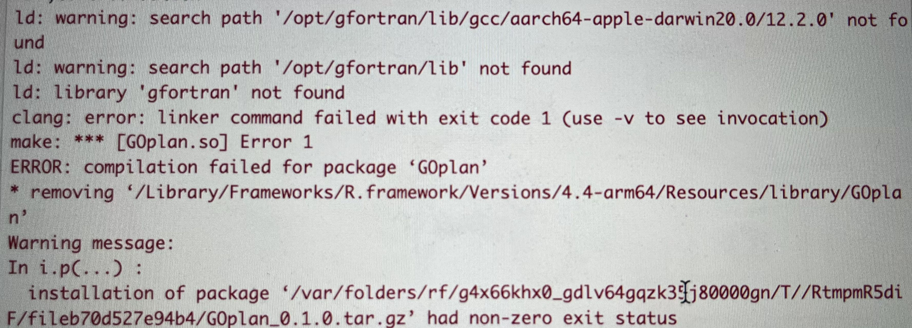
Issues when installed on Mac
2. library ‘gfortran’ not found

Slide 7
Issues when installed on Mac
2. library ‘gfortran’ not found
Run below code in your terminal:
# if do not have brew, install it first
/bin/bash -c "$(curl -fsSL https://raw.githubusercontent.com/Homebrew/install/HEAD/install.sh)“
echo 'eval "$(/opt/homebrew/bin/brew shellenv)"' >> ~/.zprofile
eval "$(/opt/homebrew/bin/brew shellenv)“
brew --version
# install gfortran using brew
brew install gcc

Slide 8
Issues when installed on Mac
2. library ‘gfortran’ not found
Run below code in your terminal:
# edit ~/.R.Makevars . Add follow information to it. If not exist, create one.
FC = /opt/homebrew/bin/gfortran # the path of your installed gfortran
F77 = /opt/homebrew/bin/gfortran
FLIBS = -L/opt/homebrew/lib/gcc/X.Y -lgfortran -lquadmath –lm
# X.Y is the version of your gcc, can also be X. (ex: 12.* or 12)

Slide 9
Functions

Slide 10
runCore( )
  The function designed to assess various breeding schemes for the nucleus herds, you can compare the genetic progress as well as the monetary profit under different key elements in constructing populations such as the productive lifetime of breeding stocks, mating ratio, mating methods, the number of dams, cull rate, the method of breeding value estimation, the number of individuals selected for phenotyping or genotyping, and so on.
  It returns five aspects of results, the realized genetic progress, the final population mean of traits, the decline of genetic variance, the inbreeding increment, and the economic profit.
  Widely used BV estimation methods including BLUP , GBLUP, and ssGBLUP (single-step GBLUP) are supported by this function, which can be executed through calling the DMU software.
  Additionally, to improve the flexibility of mating methods, users can invoke external mating programs to generate their own mating plans by specifying the program’s path.

Slide 11
runCore( )
realized genetic progress
Population structure
(Mating ratio, productive lifetime, etc )
population mean of traits
Aggregate selection index
Nucleus
Breeding program
decline of genetic variance
Breeding value estimation method
(BLUP, GBLUP, ss-GBLUP)
inbreeding increment,
Phenotype/genotype ratio
economic profit
variables
evaluation metrics

Slide 12
runCore( )
How to set variables?
Available variables for runCore(prm_path): Ys, Yd, Sor, nfam, nfam_F, nfam_M, ngeno, nGeno_F, nGeno_M. Using nfam or ngeno means adjust nfam_F and nfam_M or nGeno_F and nGeno_M simultaneously.
Setting variables in following parts in the parameter file.
example:
### VARIABLES ###
Ys 1 2 3 4
Yd 2 4 6
Note: Other parameters can also be modified, but you need to run them separately to compare them.

Slide 13
runCore( )
Demo 1:
Estimating the results of the nucleus breeding program with different productive lifetime of dams (the variable's symbol is "Yd").
setwd("./example_prm")
runCore(prm_path = "prm_Core.txt")

Slide 14
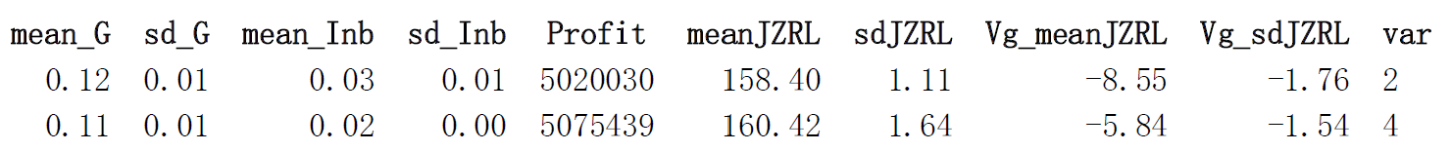
runCore( )
Results:
Mean value and stand error of inbreeding increase
Mean value and stand error of the predicted mean phenotype
name of variation combination
coreOut.xlsx:
Mean value and stand error of relative genetic progress
The economic profit
Mean value and stand error of population genetic variance
decrease of phenotype

Slide 15
runCore( )
Results:
coreOut_detail.xlsx:
records the information of each breeding season, and each type of information is saved in a separate sheet.
detailInfo.txt:
shows information about the population structure and breeding details under different
variation combinations

Slide 16
runWhole( )
  Designed to easily evaluate the performances of crossbred animals and the economic profit of complex crossbreeding programs with built-in frameworks.
  It allows the evaluation of different crossbreeding systems and can evaluate the effectiveness of crossbreeding program with different population structures by returning the predicted value of hybrids’ phenotype and economic profit.

Slide 17
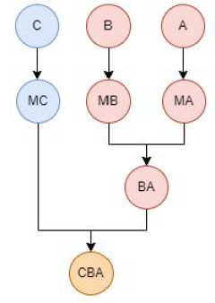
runWhole( )
Simulation three nucleus
Gene flow method predicts the genetic progress transmitted from three nucleus
Calculate the expected population mean of the final crossbreed and evaluate the economic profit

Slide 18
runWhole( )
How to set variables?
Available variables for runWhole(prm_path): Asec, Bsec, Csec, Dsec, YABd, YCDs, SorAB, SorCD, SorP
Setting variables in following parts in the parameter file.
example:
### VARIABLES ###
Asec 2 4 6
Note: Other parameters can also be modified, but you need to run them separately to compare them.

Slide 19
runWhole( )
Demo 2:
Estimating the results of three-way crossbreeding system breeding programs with different "SorP" (this variable means the male: female ratio of terminal cross).
setwd("./example_prm")
runWhole(prm_path = "prm_Whole.txt")

Slide 20
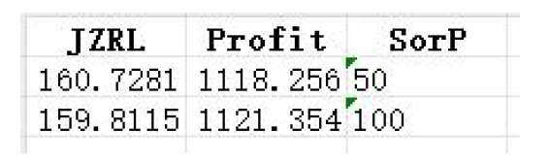
runWhole( )
Results:
Economic profit
wholeOut.xlsx:
Predicted population phenotype mean
The name of variation
*out.xlsx contains information about different subpopulations’ phenotype in each breeding season.
detailInfo.txt is the same as described before.
p.csv is the P matrix used in gene flow method.

Slide 21
runOpt( )
  Used to search for an optimal combination of parameter values which maximizes the economic profits of crossbreeding programs.
  By defining some uncertain parameters and giving reasonable variation ranges, it uses the Bayesian Optimization method to draw up a superior solution under fixed iteration times.

Slide 22
runOpt( )
How to set optimization parameters?
“Optimize Parameters” is used to modify each optimize parameter's range. If you don’t need some parameters, just delete the row of it. When use runCore(prm_path), runWhole(prm_path), ignore this section.
### Optimize Parameters ###
parameters value value explanation
Pars lower upper
Asec 2 6 #longevity of mutiplier A
Bsec 1 4 #longevity of mutiplier B
Csec 2 6 #longevity of mutiplier C
YABd 2 6 #longevity of hybrid dam AB
NAd 600 3000 #female size of nucleus A
NBd 300 1000 #female size of nucleus B
NCd 300 1000 #female size of nucleus C
Example of a three-way crossbreeding system optimization:

Slide 23
runOpt( )
Demo 3:
Running the breeding program optimization of a three-way crossbreeding system under a fixed number of final productions.
setwd("./example_prm")
res = runOpt(prm_path = "prm_Opt.txt")
getOptRes(res = res, out_path = out_path) # transfer the results to xlsx file

Slide 24
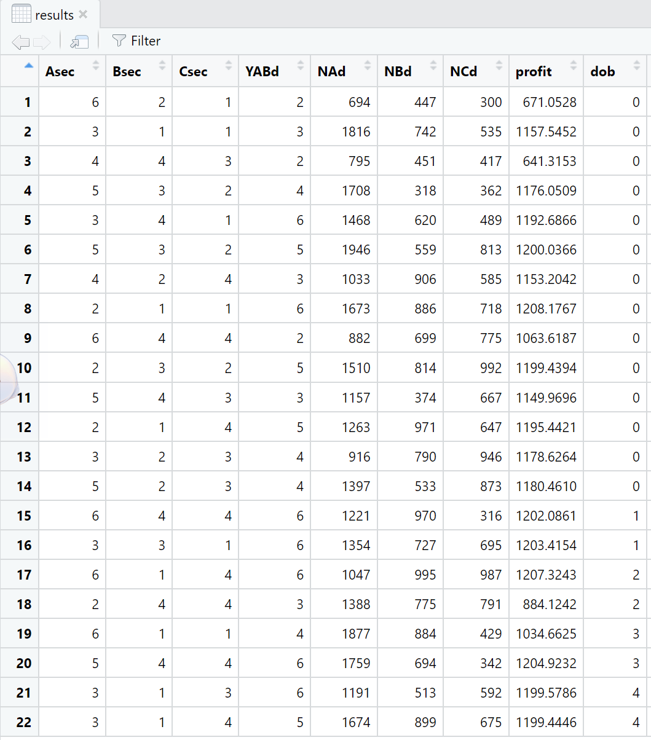
runOpt( )
Results stored in results.Rdata.
The parameter samples, the final profit and the iteration numbers(dob) are all listed, as well as some other information about the optimization.

