Slide 1

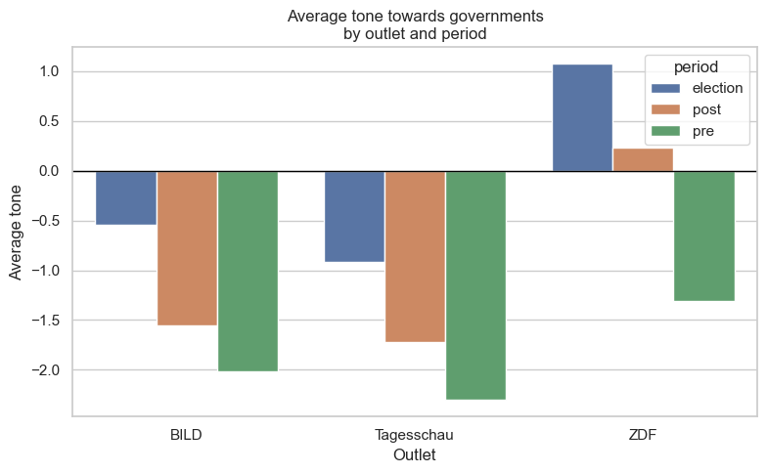
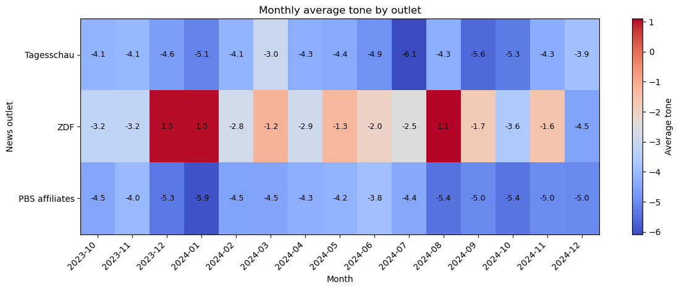
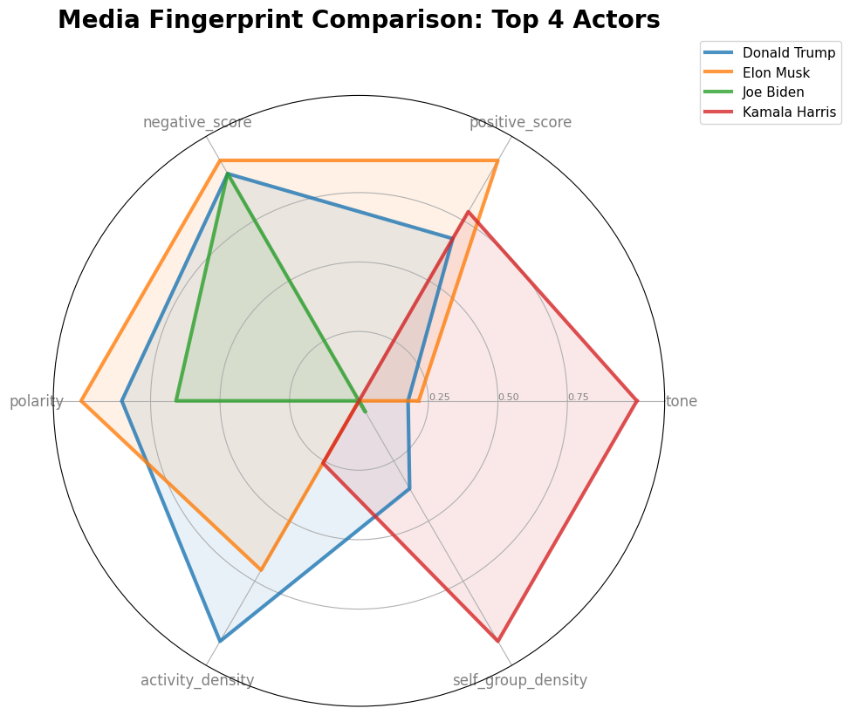
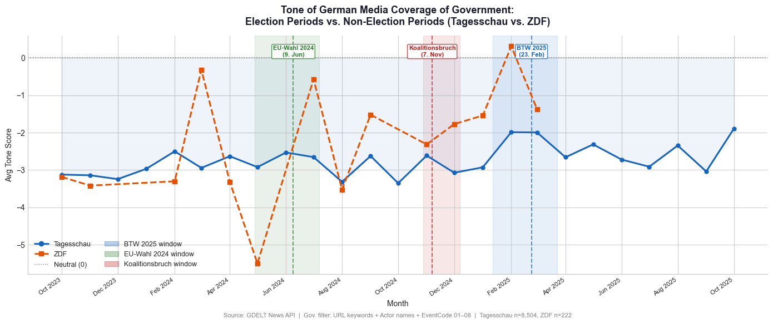
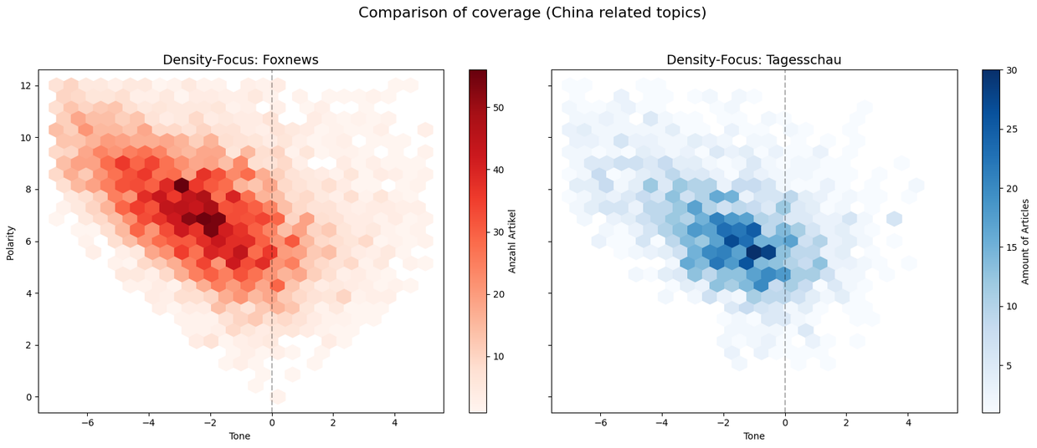
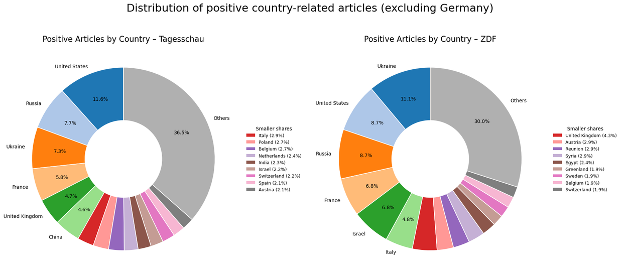
Project Title
Members (Name - Last Name)
Introduction
Details
Average monthly tone by Outlets regarding Israel and Palestine
Average
Details
Comparison of top 4 most mentioned Actors
Tone of german media coverage of Government: Election Periods vs. Non-election Periods (Tagesschau vs. ZDF)
Details
Comparison of China-related coverage between Foxnews and Tagesschau
Distribution of positive country-related articles (excluding Germany)
A hexbin plot shows the density of points for two continuous variables by dividing the plot into hexagonal bins colored according to how many points fall in each bin.
Details
Bibliography and References
Web page QR Code
should come here

