Slide 1
An introduction to R Day 2: Statistics in R

Slide 2
Recap
Assigning variables
x <- 1 INT
x <- “1” STRING
x <- c(1,2,3) VECTOR
x <- c(“1”,”2”,”3”)

Slide 3
Recap
Assigning variables
x <- merge(x=c(“1”,”2”,”3”), y=c(1,2,3)) DATAFRAME

Slide 4
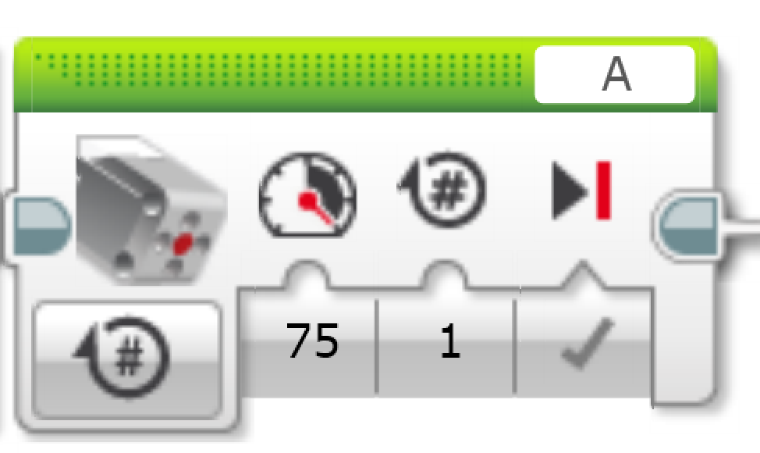
Recap
Functions and parameters
c(1,2,3)
cor(c(1,2,3), c(1,2,3))
rep(12345, time=66)
mean()

Slide 5
Recap
Variables and functions
x <- c(1,2,3)
y <- c(4,5,6)
correlation <- cor(x, y)

Slide 6
Recap
Set the 4th value of the testVector to NA.
testVector <- c(1,2,3)
testVector[2] <- “NA”
“1”,”NA”,”3”
testVector <- c(1,2,3)
testVector[2] <- NA
1, NA, 3

Slide 7
Recap
What is the sum of the vector
sum(testVector, na.rm=T)

Slide 8
Recap
Plot the gas milage on the x-axis and the price on the y-axis with different shapes for each car
gas <- c(5.7, 3.2, 4.5, 7.1)
price <- c(800, 120, 1200, 250)
plot(gas, price, pch=1:4)
legend("topright",
c(’A', ’M',’P',’J’), pch=1:4)

Slide 9
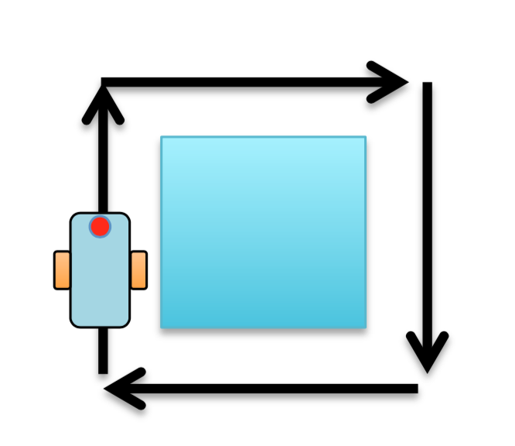
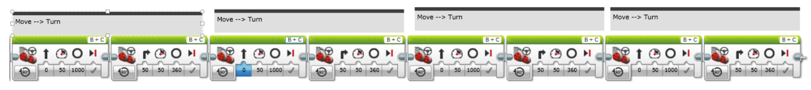
Recap

Slide 10
Recap
Plot the gas milage on the x-axis and the price on the y-axis with different shapes for each car
gas <- c(5.7, 3.2, 4.5, 7.1)
price <- c(80, 120, 1200, 250)
cars <- factor(c(’A', ’M',’P',’J'))
plot(gas, price, pch=1:length(levels(cars))
legend("topright", levels(cars), pch=1:length(levels(cars))

Slide 11
Recap
gas <- c(5.7, 3.2, 4.5, 7.1, 5.9, 6.3)
price <- c(80, 120, 1200, 250, 300, 45)
cars <-factor(c(’A’,’M',’P',’J’,‘A’,’P’))
Levels(cars)
”A” ”J” ”M” ”P"
as.integer(cars)
1 3 4 2 1 4

Slide 12
Recap
as.integer(cars)
1 3 4 2 1 4
Cars
A M P J A P
1 3 4 2 1 4
plot(gas, price, pch=1:length(levels(cars)))
legend("topright", levels(cars), pch=1:length(levels(cars)))

Slide 14
