Slide 1
PFAS Datathon
Facilitator: Scott Coffin, Ph.D.
Research Scientist III
California State Water Boards
Division of Drinking Water
December 4-5, 2019

Slide 2
Why We’re Here
Management Questions
Data
Solutions
How might we build the foundation for solutions?

Slide 3
Draft/Preliminary: CA PFAS Data Fingerprint Analysis
Matt Small and Shea Caspersen, U.S. EPA Region 9

Slide 4
Background
Question to be answered: “Can we visually discern any PFAS chemical occurrence trends from CA PFAS data.”
Note: this analysis is draft and preliminary. Trends are for discussion only and should be verified and investigated with additional data.
December 5, 2019

Slide 5
Process
Downloaded spreadsheet from CA Waterboard web site. https://www.waterboards.ca.gov/pfas/
Edited spreadsheet: removed non-detects, removed summed PFOA/PFAS, renamed compounds with short names.
Created analysis app using EPA Enterprise data analytics tool Qlik. https://www.qlik.com/us/
Soon to be released as a publicly available web app.
December 5, 2019

Slide 6
Results
Preliminary observations
December 5, 2019

Slide 7
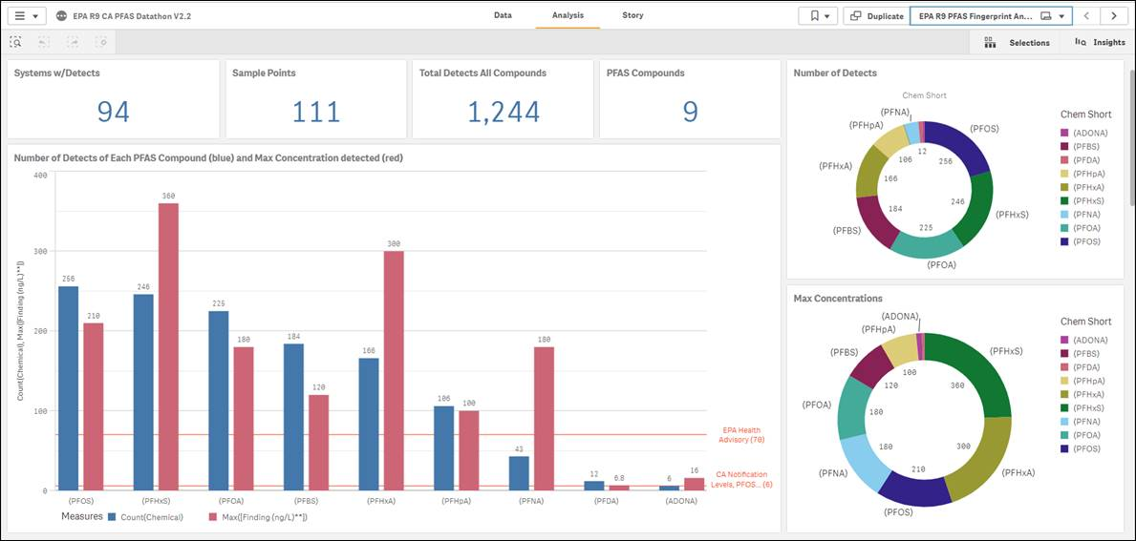
App Overview: Data view
December 5, 2019

Slide 8
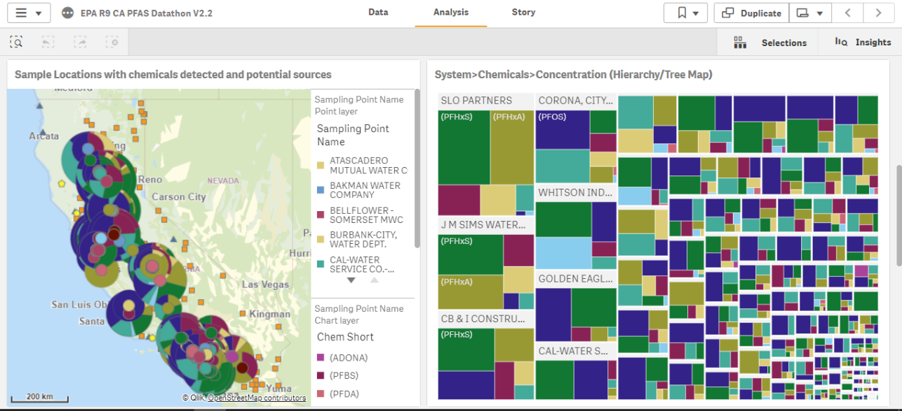
App Overview: Pie Chart Map and Tree Map
December 5, 2019

Slide 9
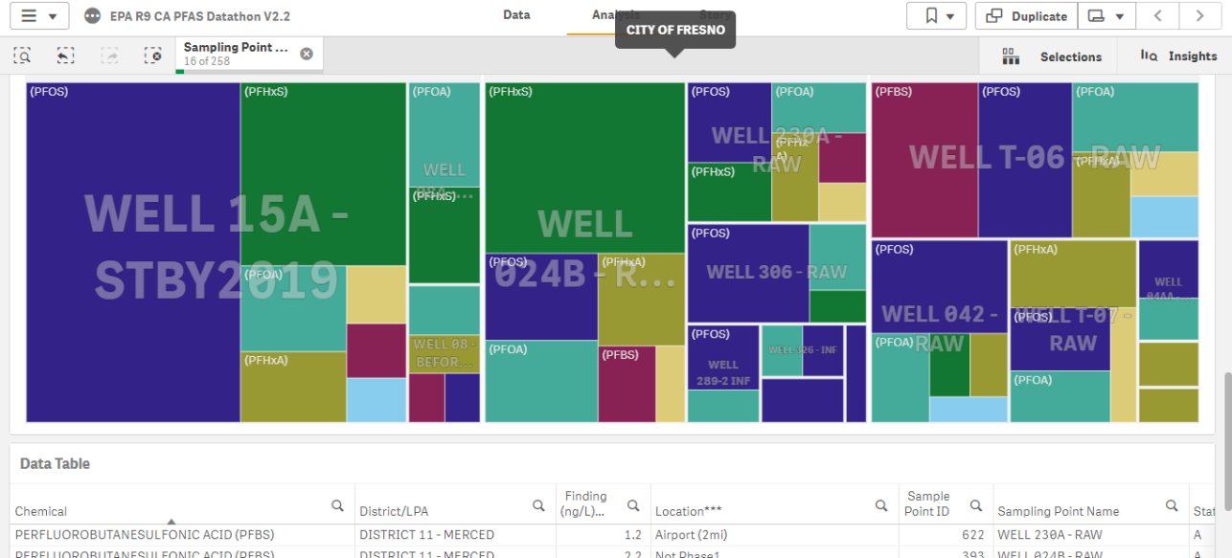
App Overview: Well Tree Map and Data Table
December 5, 2019

Slide 10
Preliminary Trend: Adona
December 5, 2019

Slide 11
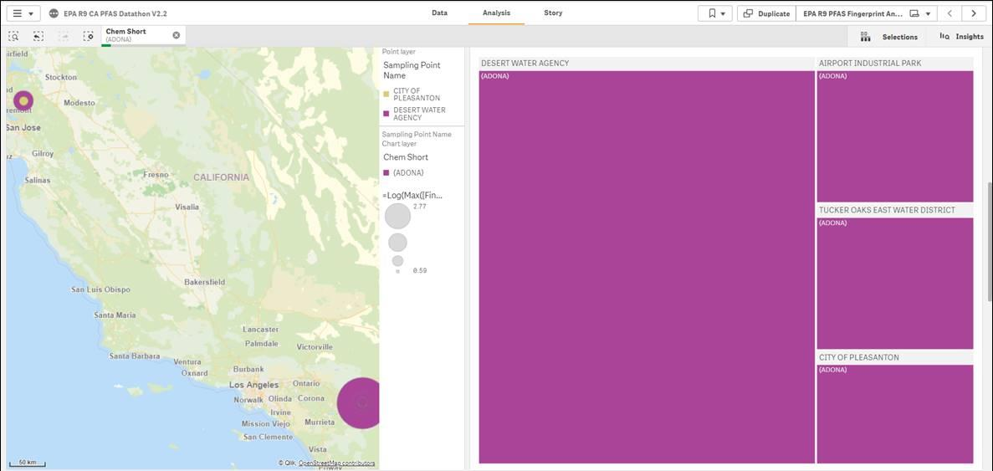
Preliminary Trend: Adona
December 5, 2019

Slide 12
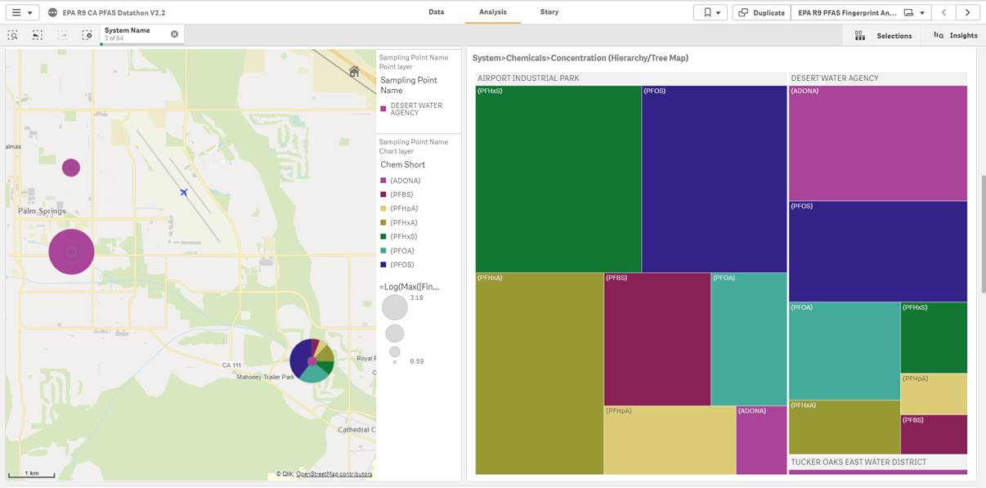
Preliminary Trend: Adona
December 5, 2019

Slide 13
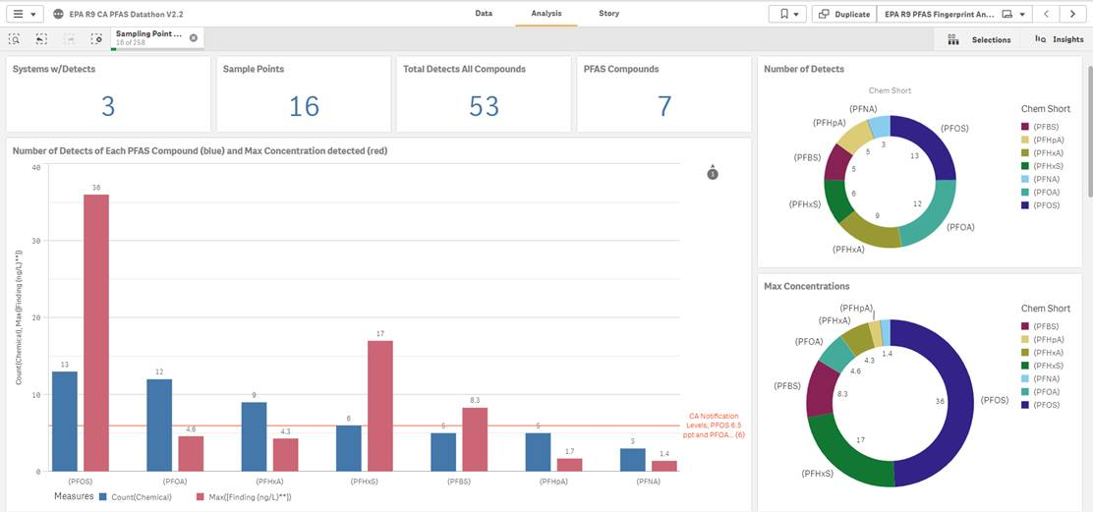
Preliminary Trend: Fresno Area
December 5, 2019

Slide 14
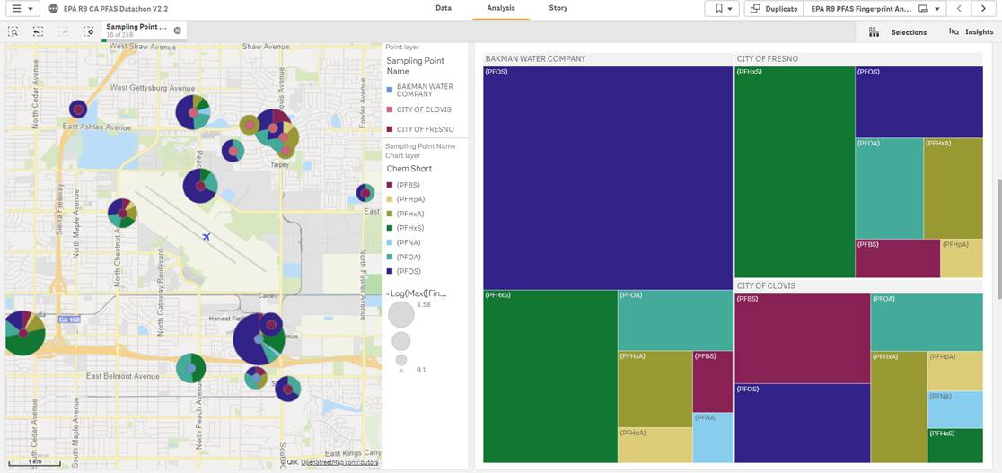
Preliminary Trend: Fresno Area
December 5, 2019

Slide 15
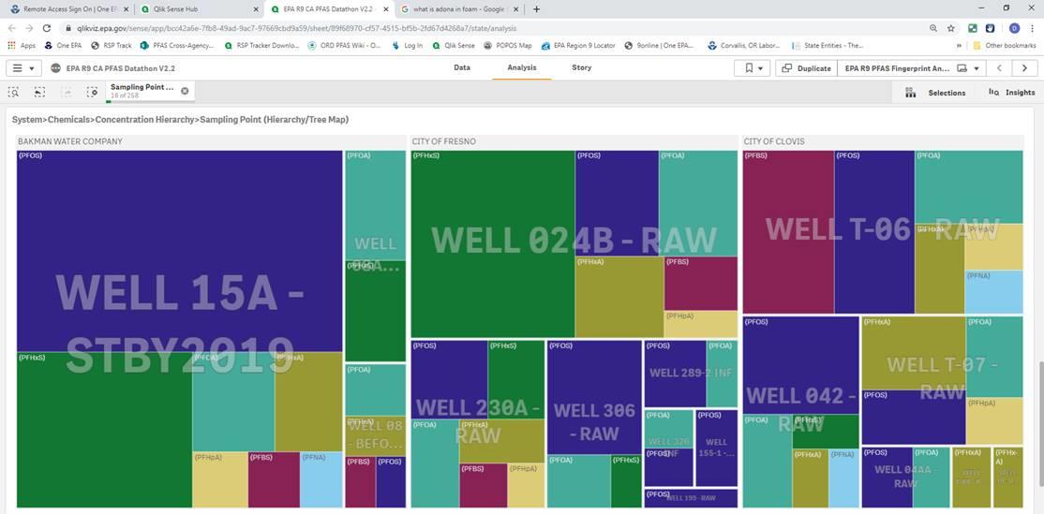
Preliminary Trend: Fresno Area
December 5, 2019

Slide 16
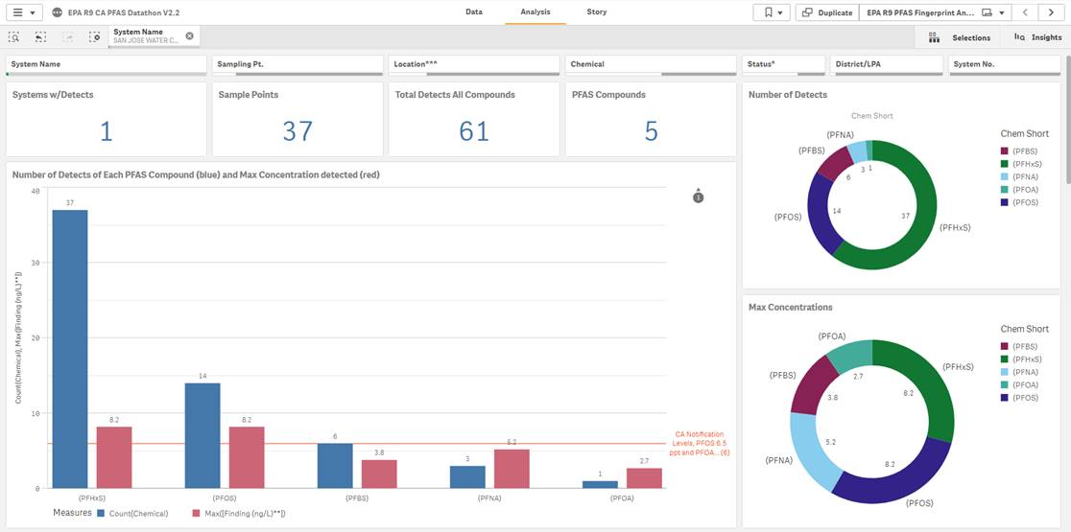
Preliminary Trend: San Jose Water Company
December 5, 2019

Slide 17
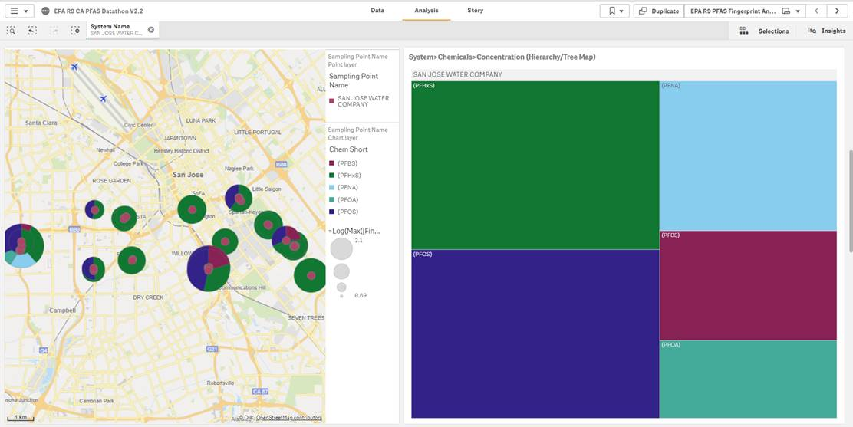
Preliminary Trend: San Jose Water Company
December 5, 2019

Slide 18
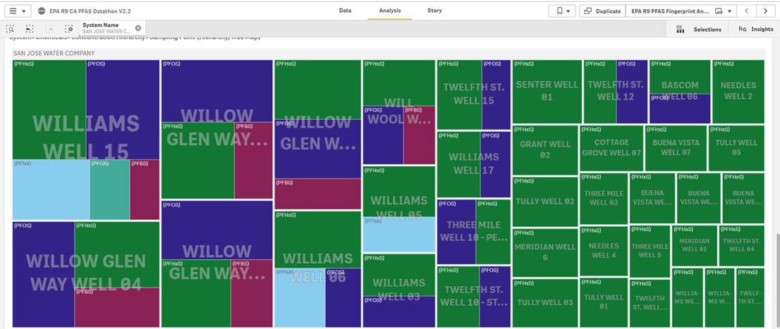
Preliminary Trend: San Jose Water Company
December 5, 2019

Slide 19
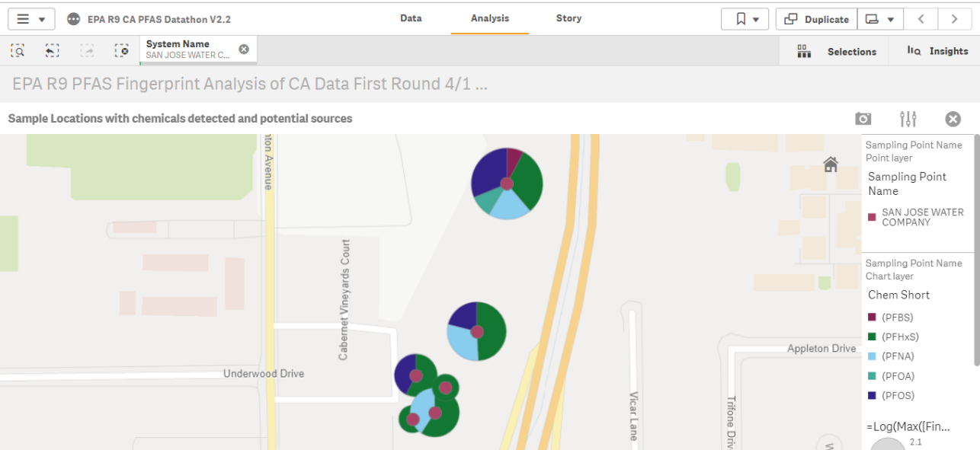
Preliminary Trend: Fate and Transport Trend?
December 5, 2019

Slide 20
Summary
YES, we can visually discern any PFAS chemical occurrence trends from CA PFAS data.
Multiple potential explanations exist for these trends.
Additional detailed data is needed to further evaluate these trends such as: well data, pumping rates, capture zones, screen lengths, ground water flow vectors, business types, PFAS use trends, etc.
Evaluate observed trends using additional data sources.
December 5, 2019

Slide 21
Thank you!
Draft/Preliminary: CA PFAS Data Fingerprint Analysis
Matt Small and Shea Caspersen, U.S. EPA Region 9

Slide 22
PFAS ANALYSIS AND INTERVENTION
Melissa Salazar
Andrew Cullen, Brittany Saleeby

Slide 23
Background
Web based application to analyze and possibly implement interventions to prevent further contamination.
Analysis may be time consuming or the personnel to do the analysis is non-existent
The initial dataset came from a test site along the Santa Ana River
December 5, 2019

Slide 24
Process
Sourcing existing resources: CA Water Boards
https://www.waterboards.ca.gov/drinking_water/certlic/drinkingwater/EDTlibrary.html
Wrangling data to provide appropriate format for analysis
Standardizing the process to create consistency
Developing pipelines for long term analysis and insight generation
December 5, 2019

Slide 25
December 5, 2019

Slide 26
Summary
Future work
Minor code changes to improve efficiencies
Implement a weather API to bring in historical data as well as forecasted
https://meldataaa.shinyapps.io/PFAS_Analysis_and_Intervention/
https://github.com/CAWaterBoardDataCenter/PFAS-Analysis-and-Intervention
December 5, 2019

Slide 27
Thank you!
PFAS ANALYSIS AND INTERVENTION
Melissa Salazar
Andrew Cullen, Brittany Saleeby

Slide 28
PFAS In Drinking Water: Correlations to PFAS in Blood Serum?
Team members:
Dori Bellan (DWQ), Emily Houlihan (DWQ),
Payman Alemi (DDW), Hung Bui (DDW), Rassam Zarghami (DDW),
Heidi Dieffenbach-Carle (Wood E&I, PLC)

Slide 29
THE RELATIVE CONTRIBUTION OF PFAS IN DRINKING WATER TO BODY LOAD IS UNKNOWN
Groundwater Quality
Blood Serum
State Water Board 13267 orders for groundwater quality in selective regions in the state
Of the seven PFAS chemicals analyzed in blood serum, 926 records of groundwater quality
CDPH conducted biomonitoring for PFAS in Los Angeles County
In LA County, 425 people were tested for seven PFAS chemicals in their blood serum
All data was scrambled- confidential issues
The goal of this project is to determine if drinking water PFAS levels are correlated measured exposure concentrations

Slide 30

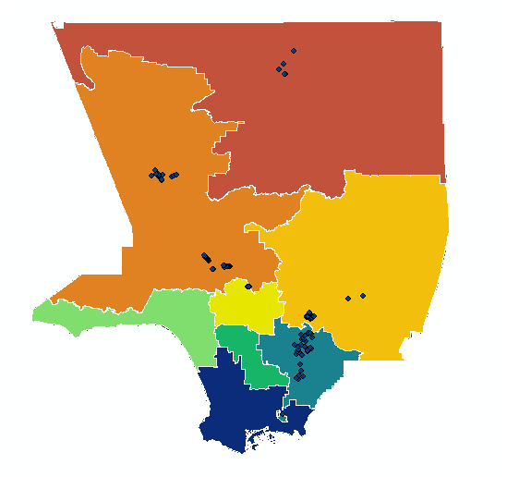

Slide 31
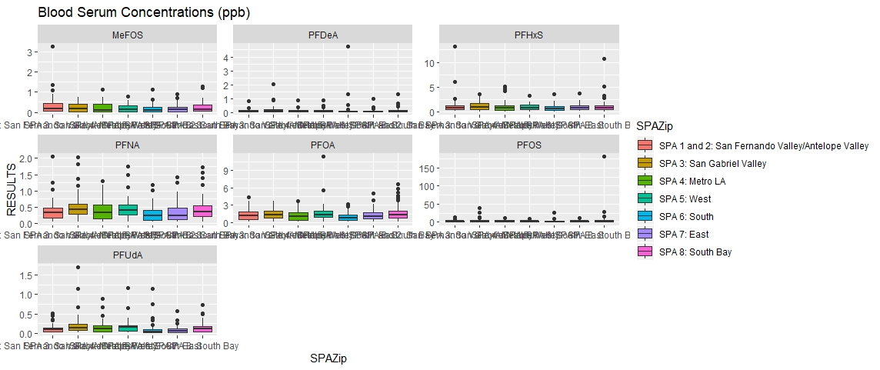
PFAS Levels in Blood Serum

Slide 32
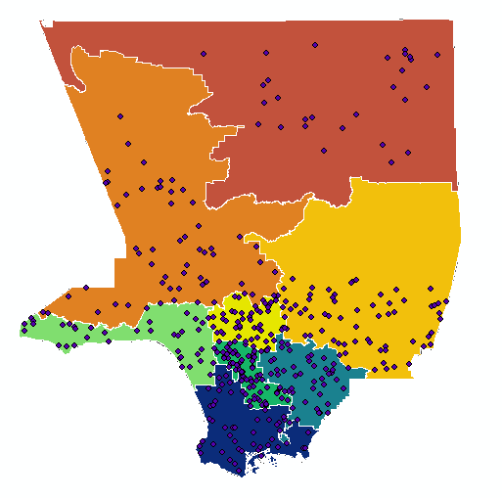
SPAs with Randomized Serum Points

Slide 33
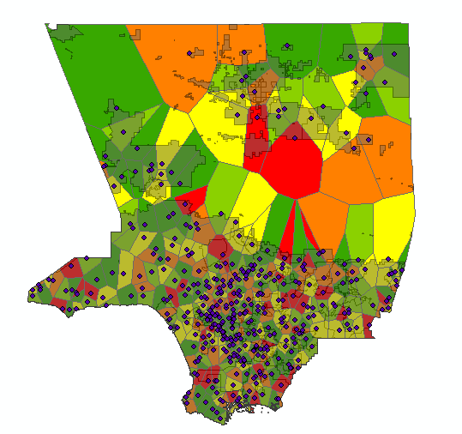
SPAs with Randomized Serum Points on Voronoi Plot of PFOS

Slide 34
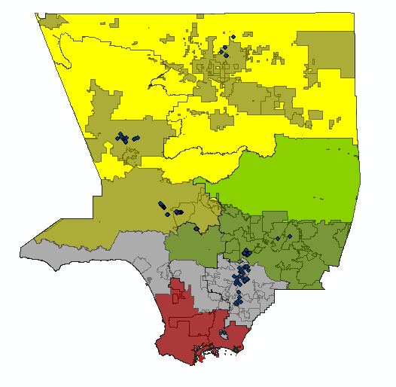
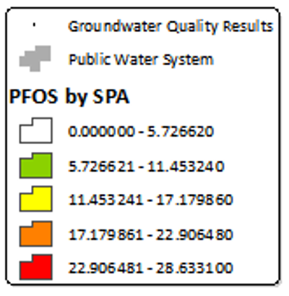

Slide 35
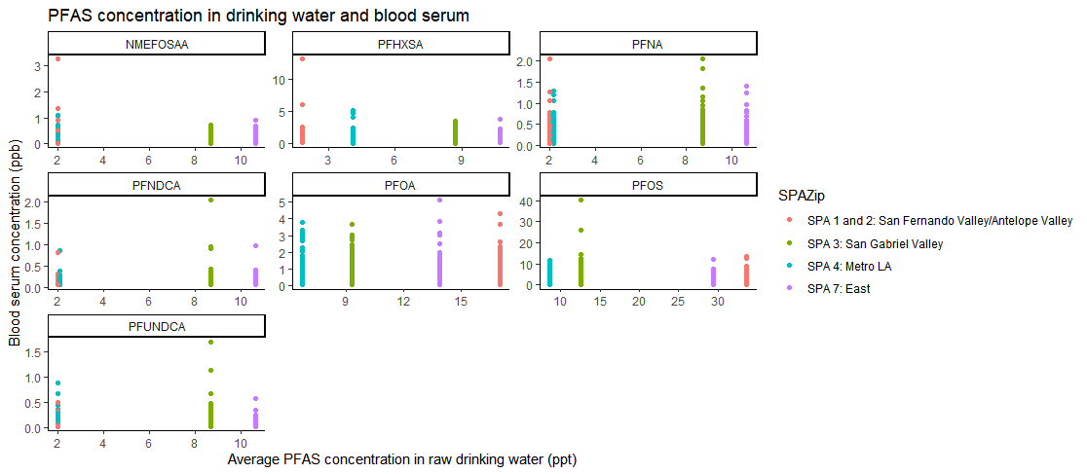
PFAS Levels in Raw Groundwater and Blood Serum

Slide 36
Future Work and Improvements
Receiving actual blood serum would allow actual comparisons with groundwater quality
Attaining the source of drinking water per person analyzed for serum levels would eliminate assumptions of source
Once DDW can specify source (surface vs ground vs purchased) within the system, we can remove assumption of source by location in system
December 5, 2019

Slide 37
Recommendations
Collect more demographics and lifestyle information about participants for a better understanding of all PFAS exposure
Find way to remove excessive confidentiality from serum data so more accurate analyses can be completed timely
December 5, 2019

Slide 38
Thank you!
Dori Bellan (DWQ), Emily Houlihan (DWQ),
Payman Alemi (DDW), Hung Bui (DDW), Rassam Zarghami (DDW),
Heidi Dieffenbach-Carle (Wood E&I, PLC)

Slide 39
PFAS Source Identification and Prediction Through Fingerprinting
Sarabeth George

Slide 40
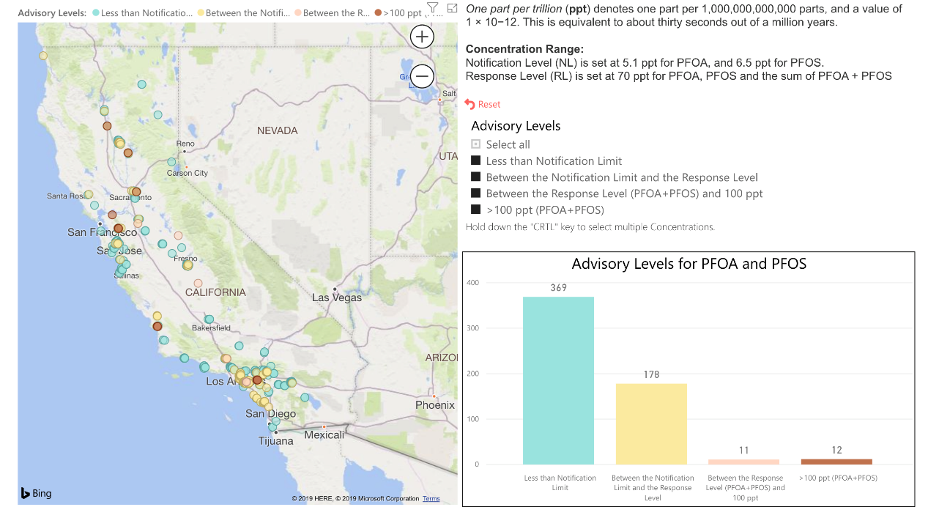
Background
[PROBLEM ADDRESSED]
[NOTE: KEEP BACKGROUND INFO LIMITED. ONLY INTRODUCE WHAT IS CRITICAL TO UNDERSTAND PROJECT, I.E. DATASETS USED, THEORETICAL BASIS, ETC.]
Notes:
It is everywhere—there is no part of the state (or world) that is unaffected.
But there is good news: there are locations where PFAS are non-detect and/or below regulatory thresholds.
Goal:
Protect these ‘clean’ sources
Stop contamination
Clean up contaminated areas

Slide 41
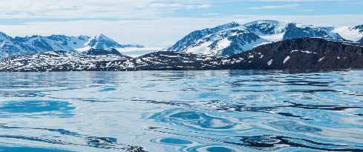

(Paleo)climatology
Notes:
alkenone molecule
background is in paleoclimatology, where we use these chromatographs to reconstruct past climate conditions
‘noise’ is data! noise gives us a lot of information in this data that would be otherwise missed
works for the past 120 million years

Slide 42
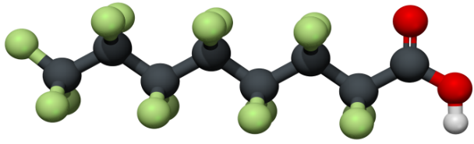
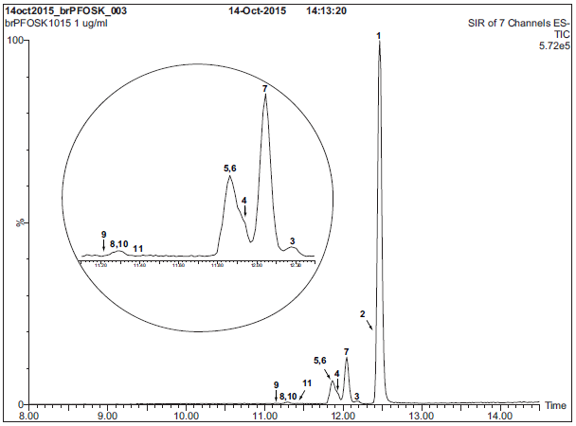
F
F
H
F
C
C
C
C
C
C
C
C
F
F
F
H
Taryn McKnight /Eurofins TestAmerica
Notes:
polyfluorinated chem structure
Noise is a problem for quantitation, but noise can also can be signal.
Can we use existing, noisy data to gain insights into the PFAS problem?
Overview of Existing PFAS Chemistry and Laboratory Analysis Methods Taryn McKnight

Slide 43
1. Dataset
Downloaded all PFAS sampling results for the state of California and associated monitoring data for other chemicals (GAMA, DDW, SDWIS, UCMR3)
Cleaned and normalized data to uniform scale
Integrated data into single file for downstream analysis

Slide 44
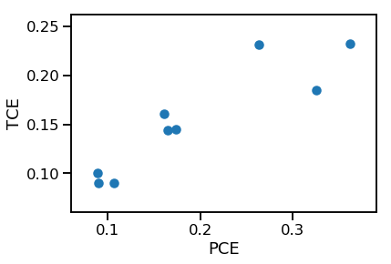
2. Correlation
correlation = 0.89
December 5, 2019
Notes:
This is the expected correlation between the concentration PCE and TCE that we see in our data is due to the breakdown of these chemicals in the environment. PCE is a precursor to TCE in the breakdown process. We expect similar relationships with PFAS.
THESE CORRELATIONS are useful for interpolating missing data. (Eg, only measured PCE, but want to model how much TCE)
On a local scale, PFAS concentrations vary and our limited data are already enough to start tentatively investigating source areas.
These variations are controlled by:
Natural processes (eg geology, precipitation, evaporation)
Anthropogenic effects (eg water recycling, wastewater release, other contamination)
Chemical interactions between water + environment and chems within the water mixture (eg biotic or abiotic degradation to daughter products)

Slide 45
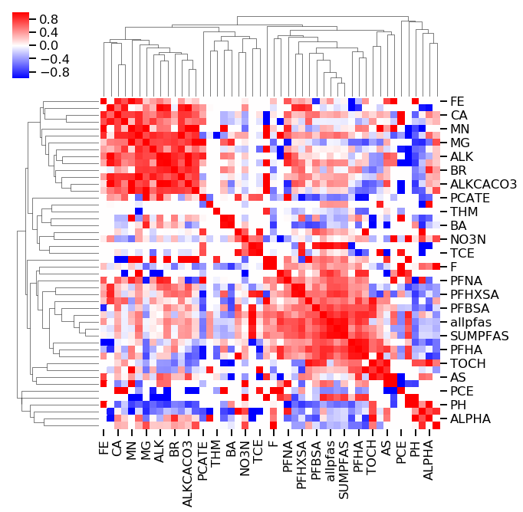
2. Correlation
correlation = 0.89
December 5, 2019
Notes:
If we make a figure colored by the pos/neg value of all chemical pairs in the dataset, we get a clustermap.

Slide 46
Notes:
Emphasize everything is 100% correlated with itself.
These variations are controlled by:
Natural processes (eg geology, precipitation, evaporation)
Anthropogenic effects (eg water recycling, wastewater release, other contamination)
Chemical interactions between water + environment and chems within the water mixture (eg biotic or abiotic degradation to daughter products)

Slide 47

3. Clustering &
Fingerprinting
December 5, 2019
Notes:
PCA and UMAP
PCA is Principal Component Analysis
UMAP is a Uniform Manifold Approximation and Projection
dimension reduction technique that can be used for visiualization similarly to t-SNE,but also for general non-linear dimension reduction.

Slide 48
3. Clustering &
Fingerprinting
Fingerprint 1
Fingerprint 2
Fingerprint 3
Fingerprint 4
Fingerprint 5
December 5, 2019
Notes:
On a local scale, PFAS concentrations vary and our limited data are already enough to start tentatively investigating source areas.
These variations are controlled by:
Natural processes (eg geology, precipitation, evaporation)
Anthropogenic effects (eg water recycling, wastewater release, other contamination)
Chemical interactions between water + environment and chems within the water mixture (eg biotic or abiotic degradation to daughter products)

Slide 49
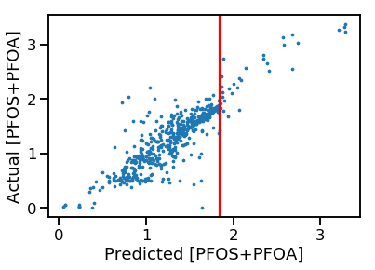
4. PFAS Prediction from non-PFAS monitoring data
EPA HAL = 70 ppt
December 5, 2019
Notes:
On a local scale, PFAS concentrations vary and our limited data are already enough to start predicting exceedances of the US EPA HAL.
HAL=health advisory level

Slide 50
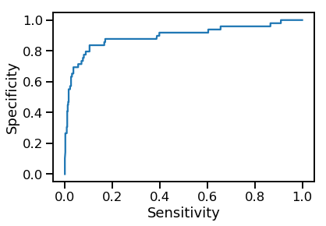
4. PFAS Prediction from non-PFAS monitoring data
(true pos rate)
EPA HAL = 70 ppt
(false pos rate)
December 5, 2019
Notes:
Model predicts continuously, but then we
Thresholded using EPA HAL: rate of false vs true positives for exceedances

Slide 51
4. PFAS Prediction from non-PFAS monitoring data
(true pos rate)
Good model ☺
EPA HAL = 70 ppt
(false pos rate)
December 5, 2019
Notes:
Model predicts continuously, but then we
Thresholded using EPA HAL: rate of false vs true positives for exceedances

Slide 52
Cross Section
Map View
W3
W1
W2
A’
A’
B
A
A
Water Bearing Zone 2
Water Bearing Zone 1
B’
Fault
5 miles
W6
W4
W5
B’
B
Water Bearing Zone 3
Notes:
Local level= uses other chemdata (pH, alk, metals, anthro chemicals) to ID connected water bearing zones

Slide 53
5. Source Identification
Fingerprint 1 = Source A
Fingerprint 2 = Source B
Fingerprint 3 = Source C
Fingerprint 4 = Source D
Fingerprint 5 = Source E
December 5, 2019
Notes:
Local level= uses other chemdata cluster similar-looking wells which may be useful for source area identification
We developed the dataset to do this during the datathon yesterday and today and will continue developing this tool.

Slide 54
Summary
Existing PFAS and other chemical monitoring data contain useful information for identifying areas of concern
This tool could be used to ‘fingerprint’ PFAS profiles, identify source areas, and expedite the cleanup process
This tool could also be used as guidance for future monitoring programs where groundwater is used as a source of drinking water
December 5, 2019

Slide 55
Thank you!
PFAS Source Identification Through Fingerprinting
Thank you ~wonderful~ Datathon collaborators!*
Priya Shivaani Chauhan, Jennifer Chen, Sara Huber, Erica Kalve, Brittany Saleeby, Susie Smith
*Collaborators listed in alphabetical order.

Slide 56



Upcoming Events!
Trash Datathon 2020 Event Series Kickoff
Water Data Science Symposium & Concurrent PFAS Hackathon
February 28, 2020
9:00 AM – 4:00 PM
CalEPA Building - Klamath Room
More Info and RSVP: http://bit.ly/TrashDatathonFeb28
June 29-30, 2020
CalEPA Building - Klamath Room
More details coming soon! https://www.waterboards.ca.gov/resources/ data_databases/wq_science_symposium.html

