Slide 1




Problem Solving
Knowledge Retention
Onboarding & Offboarding
Collaboration & Partnership
Accessibility
Accessibility
Transparency
Transparency
Reproducibility
Reproducibility
Benefits
Of
Documentation
Benefits
Of
Documentation

Slide 2
Project Documentation
Team
Documentation
Process
Documentation
Technical
Documentation
User
Documentation
Onboarding & Offboarding Resources
Useful Background Information
Values, Culture
Expectations, Codes of Conduct
Roles, Responsibilities
Administrative Resources
Where to find things (e.g. data, products)
Training Materials
Project Management
Meeting Agendas, Notes
Tracking Systems
Strategic Documents
Planning Documents
Data Management Plans
Engagement / Outreach Plans
Quality Assurance Project Plans (QAPPs)
Work Plans
Timelines
Budget and Contracts
Standard Operating Procedures (SOPs)
Product Review & Feedback Process
Data Life Cycle Workflow Diagrams
Data Architecture & Relationships
Metadata
Data Dictionaries
Data & Product Governance
Data Categorization
Security Checklists
Code / Repository Access Settings
GitHub Repositories
Source code with inline comments
ReadMe
Code outputs
Guides, Tutorials
Product Help, FAQs
Process Reporting
Updates
Responses to Feedback
Reasoning Behind Key Decisions
Fact Sheets
Reports, Publications
Event Materials
Agendas
Notes/Summaries
Recordings
Slides
Event Summaries

Slide 3
Problem Statement
Why?
Cause(s):
Why?
Cause(s):
Why?
Cause(s):
Why?
Cause(s):
Why?
Root Cause(s):
Priority Actions to Address Root Cause(s)

Slide 4
Problem Statement
Why?
Cause
Cause
Cause
Why?
Cause
Cause
Cause
Cause
Cause
Why?
Cause
Root Cause
Cause
Cause
Cause
Cause
Potential Actions
Why?
Cause
Root Cause
Cause
Root Cause
Cause
Potential Actions
Potential Actions
Why?
Root Cause
Root Cause
Root Cause
Root Cause
Root Cause
Potential Actions
Potential Actions
Potential Actions
Potential Actions
Potential Actions
Priority Actions to Address Root Cause(s)

Slide 5
Problem Statement
Why did this specific issue occur?
Why did this problem go unnoticed?
Why was the problem not prevented?
Why?
Why?
Why?
Why?
Why?
Root Cause(s)
Root Cause(s)
Root Cause(s)
Potential Actions
Potential Actions
Potential Actions
Priority Actions to Address Root Cause(s)

Slide 6
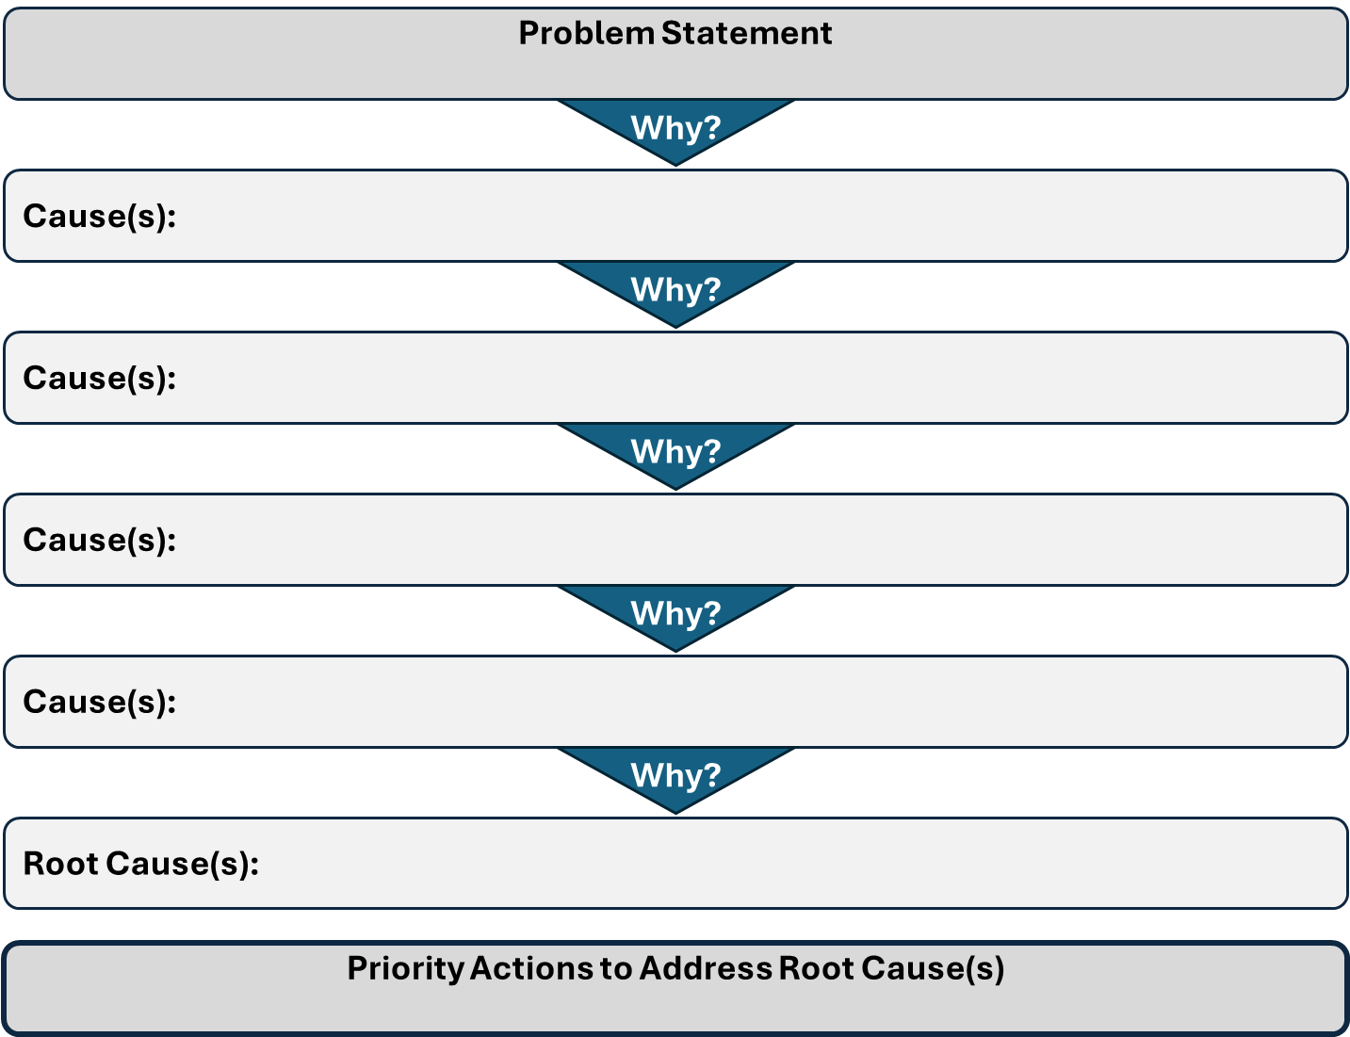
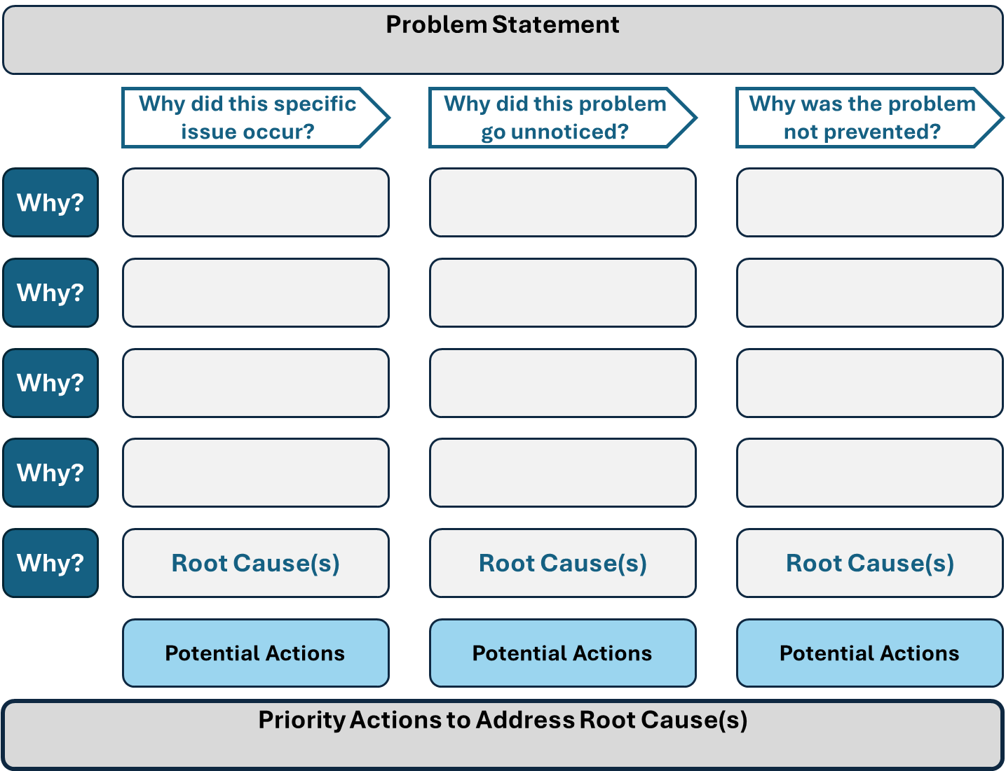
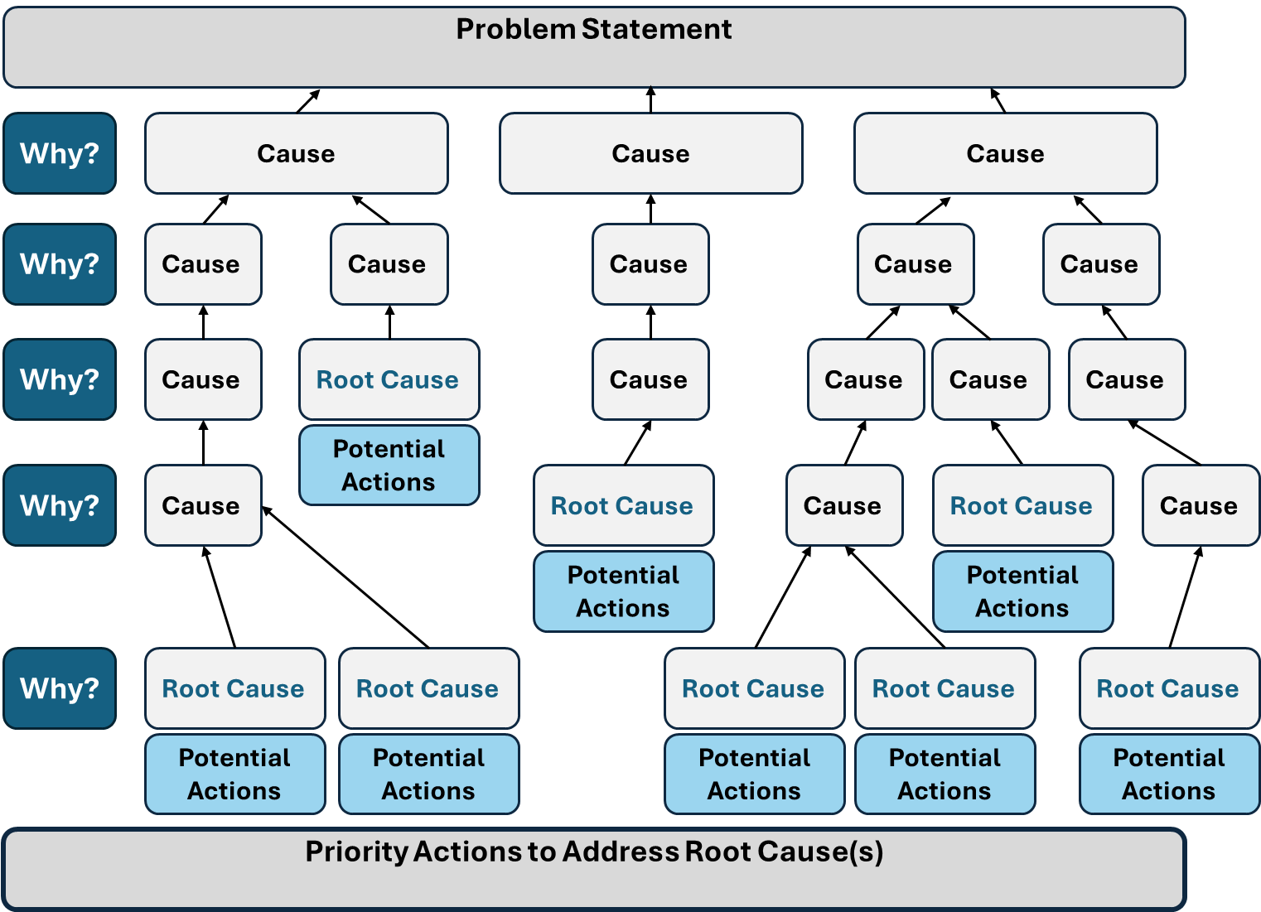
A
B
C

Slide 7
Priority Action
Who do we serve?
Who are our partners?
Is anyone better off?
#/% skills/knowledge improvement
How well did we do it?
% overall process measures (e.g., % people trained, turnover)
% activity-specific measures (e.g., % completed activities, timely)
How much did we do?
# people served
# activities completed
#/% attitude/opinion shifts
#/% behavior changes
#/% circumstance improvements
#/% cultural relevance
#/% language access
#/% participation and engagement
What is the quality of the action?
Next Steps

