Slide 1
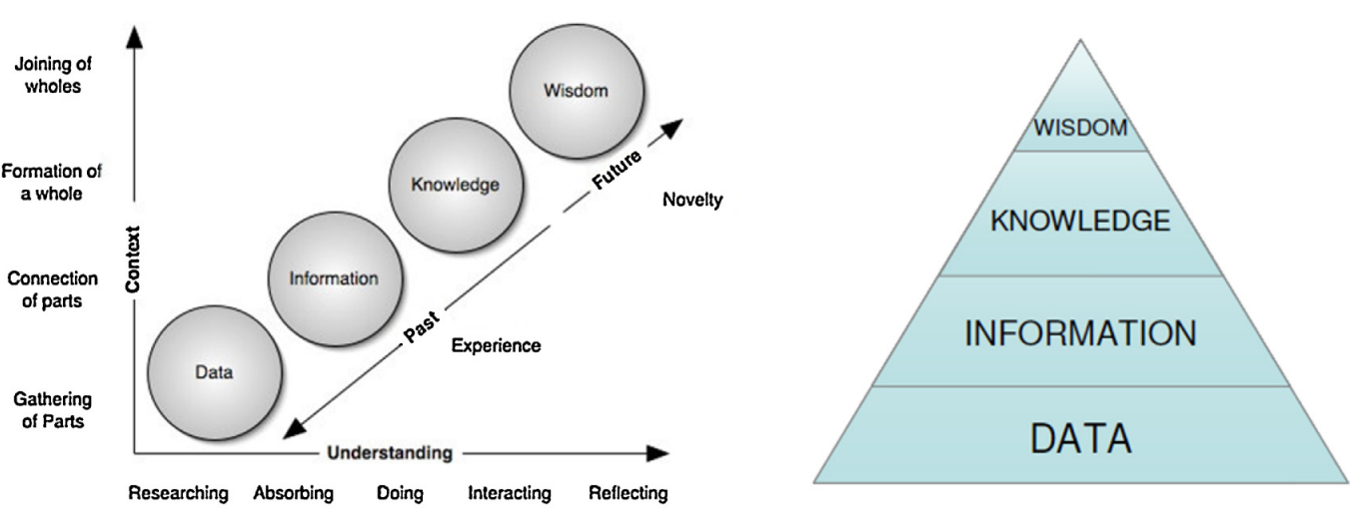

Progressing to Wisdom
Winnowing to Wisdom
+ insight
+ meaning
+ context

