Slide 1

Scott-Shasta Flow Monitoring Dashboard
Jeff Yeazell, P.E.
June 25, 2025

Slide 2
Dashboard Purpose
Provide real-time visibility into Scott and Shasta River streamflow conditions.
1
Compare recorded flows to regulatory minimum instream flow (MIF) thresholds.
2
Provide current curtailment status of PODs in the watersheds.
3

Slide 3
Data Sources
CDEC – California Data Exchange Center for 15-minute flow data.
Shapefiles – For watershed boundaries and stream networks.
POD Curtailment Status – Provided by Drought Unit

Slide 4
Key Features
Live gauges for SFJ and SRY with MIF thresholds.
Interactive map showing:
POD curtailment status
Clickable CDEC station links
Watershed and stream overlays
Desktop and mobile optimized

Slide 5
Technologies Used
R / Shiny / Leaflet for interactive web dashboard
flexdashboard for gauge rendering
Amazon S3 to store dynamic data

Slide 6


Access the Dashboard
https://cawaterdatadive.shinyapps.io/scott-shasta-flow-dashboard/

Slide 7

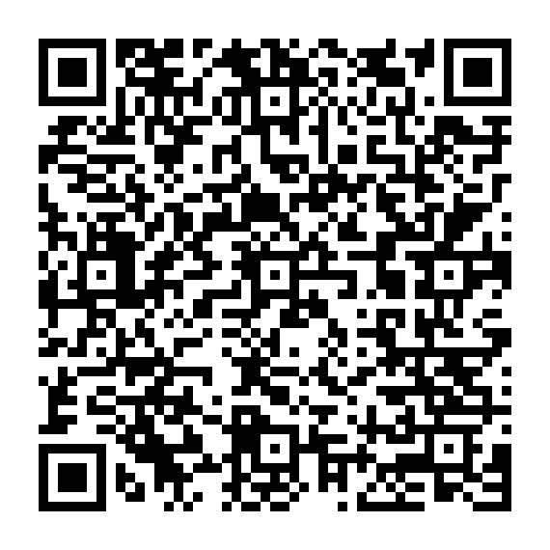
GitHub Repository
https://github.com/CAWaterBoardDataCenter/scott-shasta-flow-dashboard
Does not contain aws-data folder (PII)

