Slide 1


Slide 2
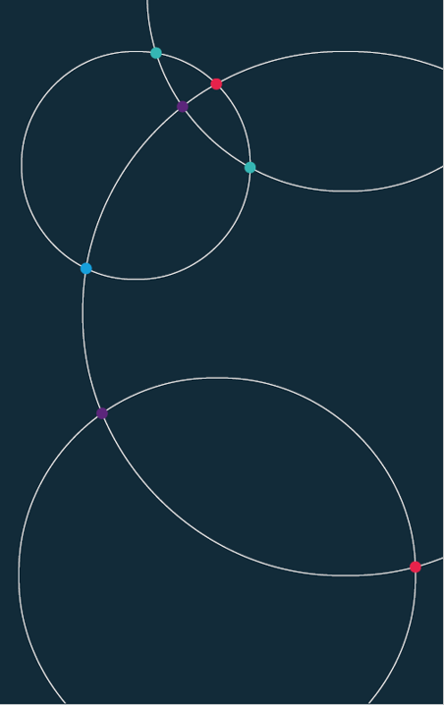
Automated Data Visualisation for Policymaking.
Session 5
Seminar

Slide 3
Week 5. Reminders
Reminder: Office hours.
RD: Thurs, 11:00-12:00 (SPP office)
FM: Friday, 14:30-15:30 (CBG 5.01 or lse.zoom.us/j/7930269151)
JH: Mon, 14:00-15:00 (CBG 5.01)
Reminder: Portfolio tasks
These are set each week and make up 20% of your grade. They can be found in the course DropBox. The file is here

Slide 4
Office hours
Finn McEvoy
f.l.mcevoy@lse.ac.uk
CBG 5.01 or lse.zoom.us/j/7930269151
Office hour: Friday
14:30-15:30
Josh Hellings
j.i.hellings@lse.ac.uk
CBG 5.01
Office hour: Monday
14:00-15:00

Slide 5
Office hours
Finn McEvoy
f.l.mcevoy@lse.ac.uk
CBG 5.01 or lse.zoom.us/j/7930269151
Office hour: Friday
14:30-15:30
Josh Hellings
j.i.hellings@lse.ac.uk
CBG 5.01
Office hour: Monday
14:00-15:00
You do not need to book!

Slide 6
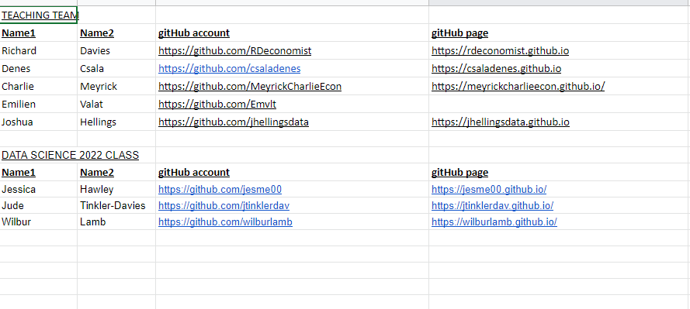
Week 5. Reminders
Reminder: Class Google Sheet
Please add your name, student ID, GitHub account details to the class spreadsheet. This is here

Slide 7
Today.
World Bank API
  Fetching, cleaning, merging data
Advanced charting
  Plotting out new dataset
  Transforms, filtering, formatting
Chart clinic
  Fixing any charts you’re working on
  A look at the portfolio tasks

Slide 8
World Bank API.
Colab link

