Slide 1
Sprint 3 Demo
Team Birds Are(n’t) Real
Zach Burgess, Grant Rainey,
David Schneidau, Carmen Accampo

Slide 2
Complete
In Progress
Sprint 3 Goals
Get Raspberry Pi capable of uploading data to GCP’s BigQuery Database
Explore most optimal remote access/software deployment methods for RPI
Integrate distance formula/positional data formatting into bird activity summaries
Heatmap for birds’ most visited areas
Total distance of bird movement
Swap to Aruco detection
Installation/positional optimization of the Raspberry Pi cameras.

Slide 3
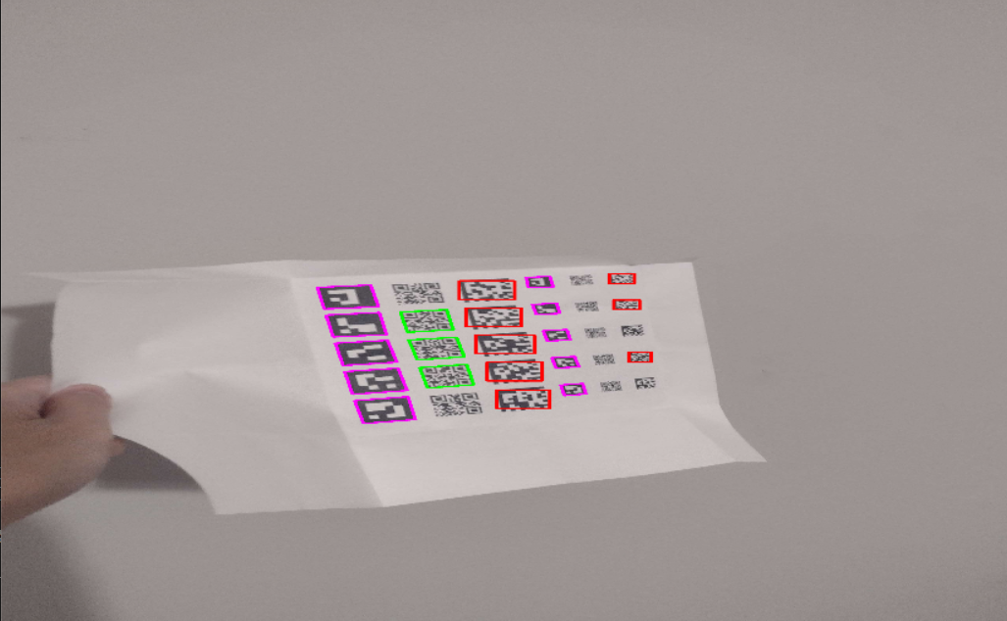
Aruco Markers
Improved detectability from a greater distance and with smaller codes (backpacks are 1x1cm)
ArUco - Purple
Data Matrix - Red
QR Code - Green

Slide 4
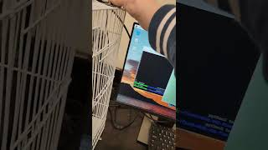

Slide 5
Client Feedback
Sprint 4 Goals
Overall very satisfied!
Recommendations:
Make installation easy to perform and reproduce
Implement a way to measure bird activity (frequently moving vs staying in one corner)
Finish Sprint 3 in-progress goals
Rework existing code to use natively supported libraries for RPI architecture

