Slide 1
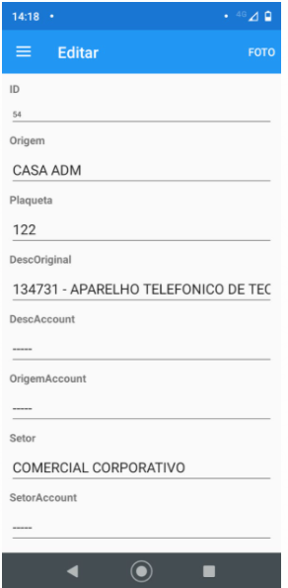
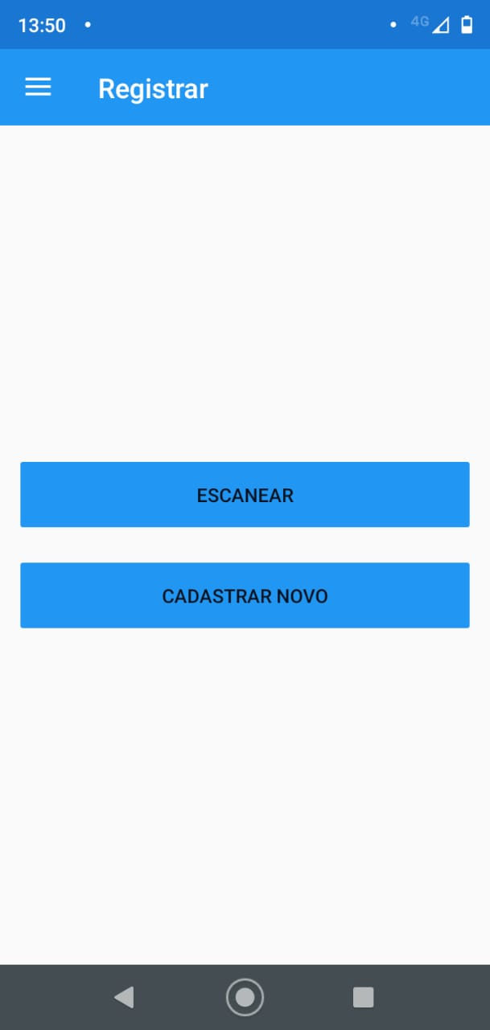

Read the barcode,
with your camera phone
Go to the registration screen
With the “Barcode”

Slide 2
WHAT I NEED
Scanner
Insert this new button, BUT, using the scanner function of the new device
Apenas trocar o texto para “ Leitor Câmera”
Just change the text to "Camera Reader"
Após fazer a leitura do código de barras,
Seguir o mesmo fluxo do botão que existe hoje.
After scanning the barcode,
Follow the same flow of the button that exists today.
https://i3.wp.com/ae01.alicdn.com/kf/HTB1mroNQVXXXXbeapXXq6xXFXXXF/LS350T-Industrial-Port%C3%A1til-Handheld-Leitor-RFID-M%C3%B3vel-de-Impressora-Scanner-De-Coletor-de-Dados-PDA-Terminal.jpg

