Slide 1

EduPath: FACTORS THAT INFLUENCE EDUCATION, SKILLS AND TRAINING CHOICES OF YOUNG PEOPLE

Slide 2

Problem Statement

Slide 3

Abstract

Slide 4
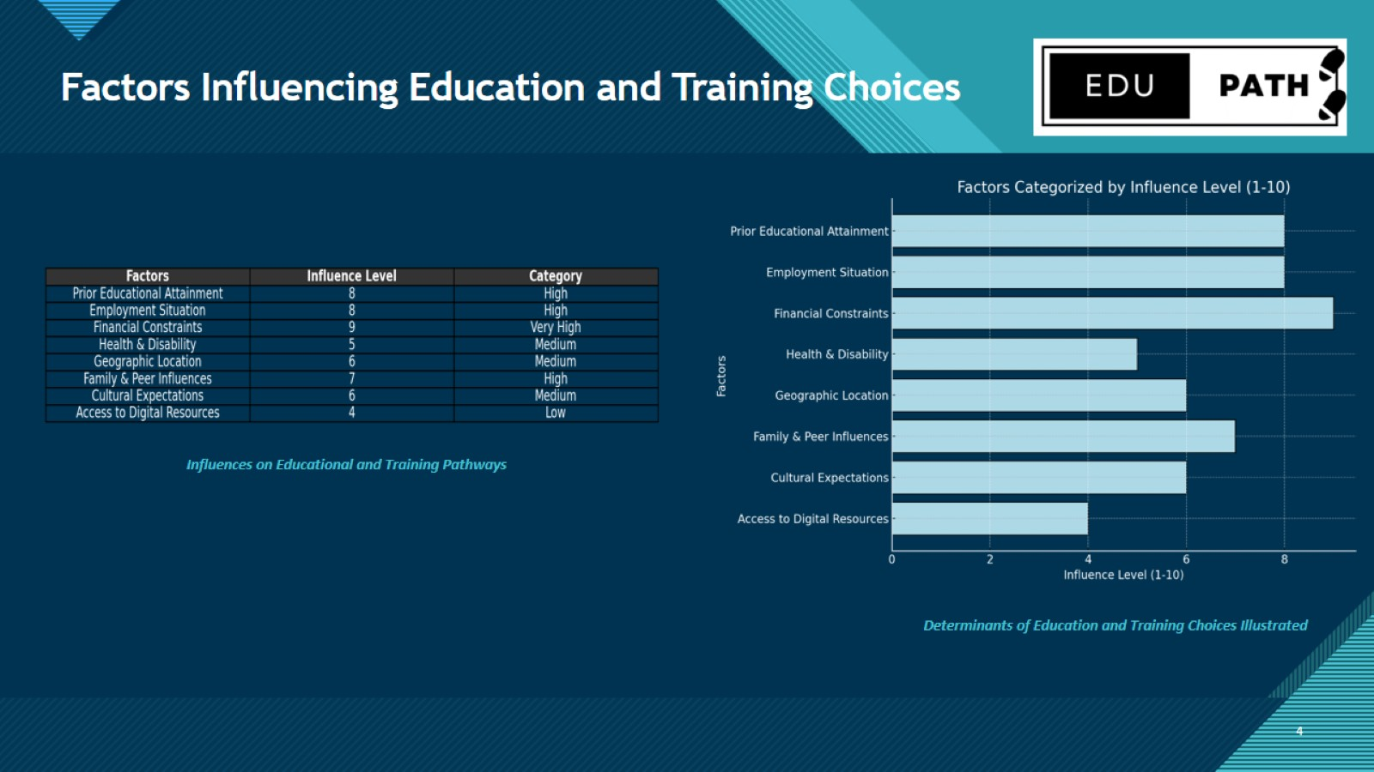
Factors Influencing Education and Training Choices

Slide 5
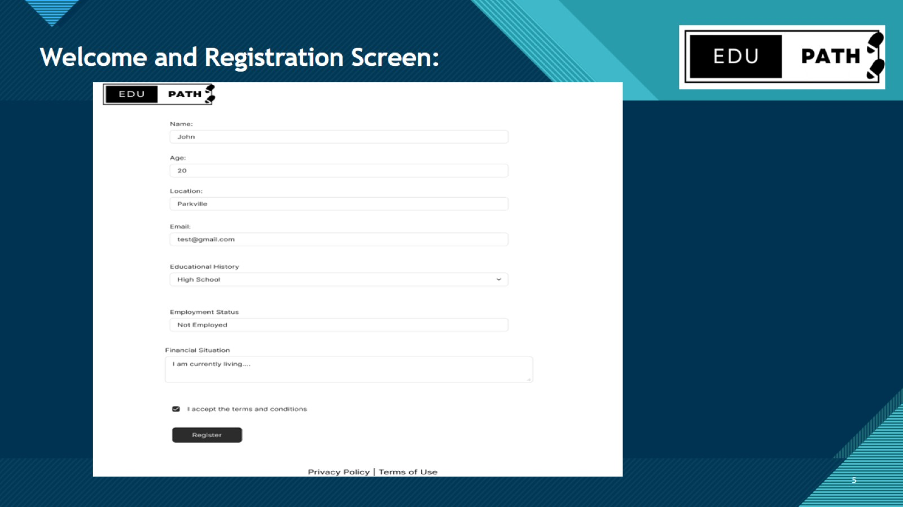
Welcome and Registration Screen:

Slide 6
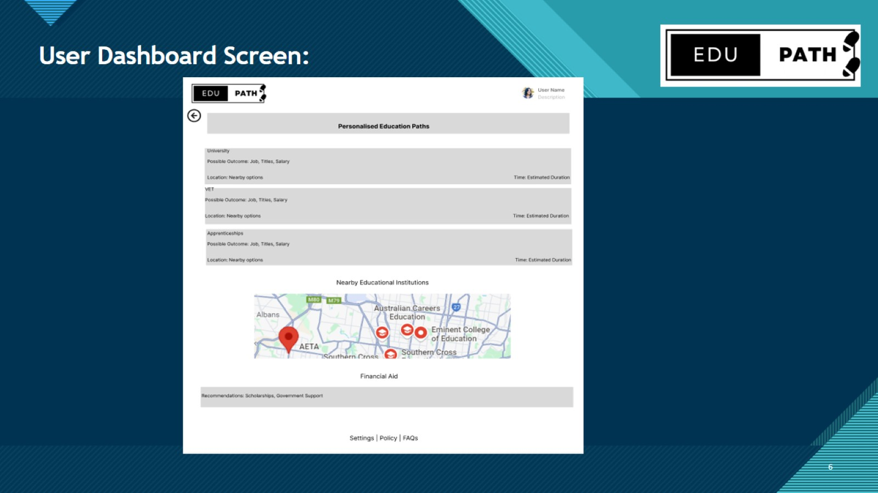
User Dashboard Screen:

Slide 7

Recommendation Screen:

Slide 8

Consistent Analysis:

