Slide 1
1.2 & 1.3
Geographic Data

Slide 2

Objectives and Essential Learning
1.2 Identify different methods of geographic data collection.
1.2.1 Data may be gathered in the field by organizations or by individuals.
1.2.2 Geospatial technologies include geographic information systems (GIS), satellite navigation systems, remote sensing, and online mapping and visualization.
1.2.3 Spatial information can come from written accounts in the form of field observations, media reports, travel narratives, policy documents, personal interviews, landscape analysis, and photographic interpretation.
1.3 Explain the geographic effects of decisions made using geographical information.
1.3.1 Geospatial and geographical data, including census data and satellite imagery, are used at all scales for personal, business and organizational, and governmental decision-making purposes.

Slide 3
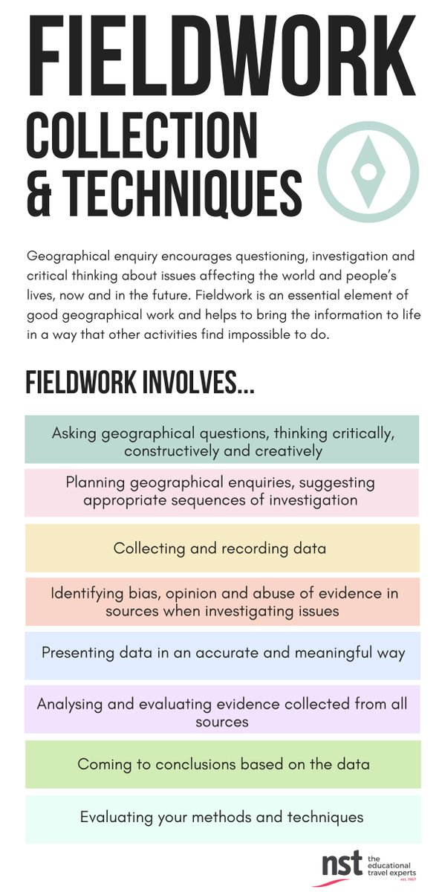

Identify different methods of geographic data collection.
How is data gathered?
  Fieldwork/Field Observations: The act of an individual physically visiting a location or place and recording, firsthand, information there.
    Examples: Written accounts, travel narratives, media reports, policy documents, interviews, photographs, landscape analysis

Slide 4

Identify different methods of geographic data collection.
Another example of fieldwork - The US Census
Mandated by the Constitution
Ex. of an organization (US government) doing fieldwork.
What is the point?
Representative Districts - voting & democracy
Distribution of public funding for:
  Schools
  Law Enforcement & Fire Department
  Highways & Infrastructure
Personal, government & business decision making.

Slide 5
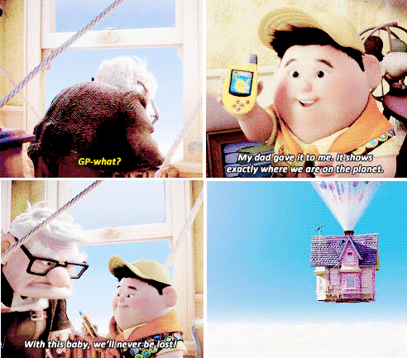
Identify different methods of geographic data collection.
b. Geospatial Technologies
Geographic information systems (GIS)
Satellite navigation systems (GPS)
Remote sensing
Online mapping + visualizations
Geospatial technologies are utilized by businesses, organizations, individuals and government agencies to make decisions.

Slide 6
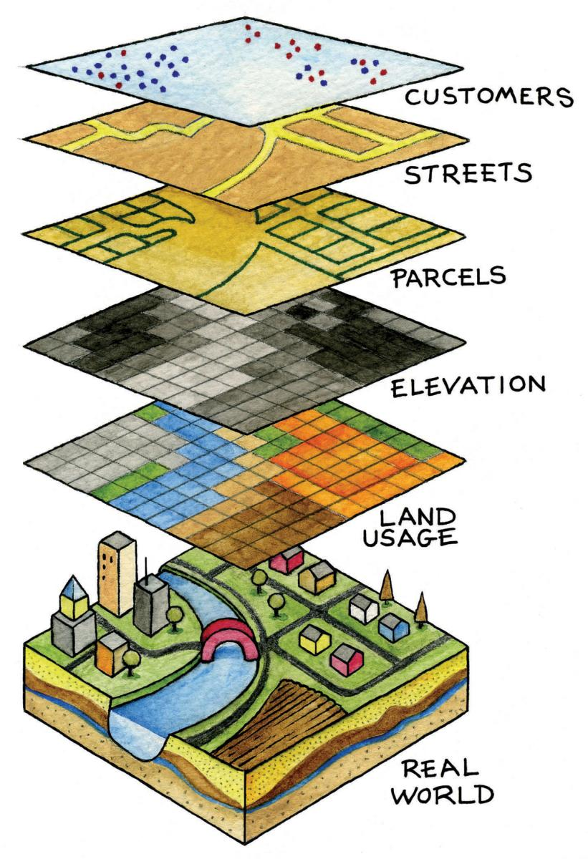
Identify different methods of geographic data collection.
Geographic Information Systems (GIS)
Computer system/software that stores, analyzes, and displays information from multiple digital maps or data sets.
Thematic and physical layers
Could be used for…
  Analysis of crime data
  Effects of pollution
  Urban planning

Slide 7
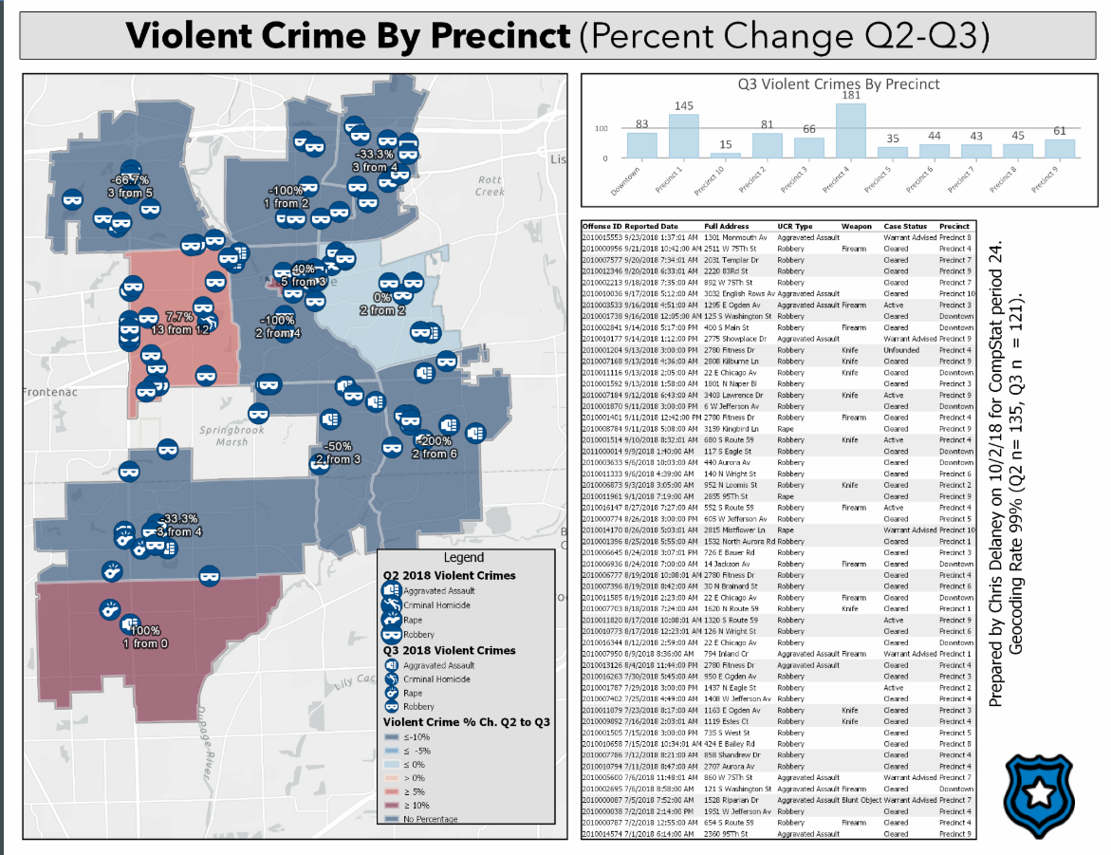

Slide 8

Identify different methods of geographic data collection.
Satellite Navigation Systems/Global Positioning System (GPS)
Satellites orbit the earth and communicate locational information to GPS receivers.
Absolute location
  Navigation -> ships, cars, aircraft
Aerial Photography
Professional images captured from planes or drones.

Slide 9
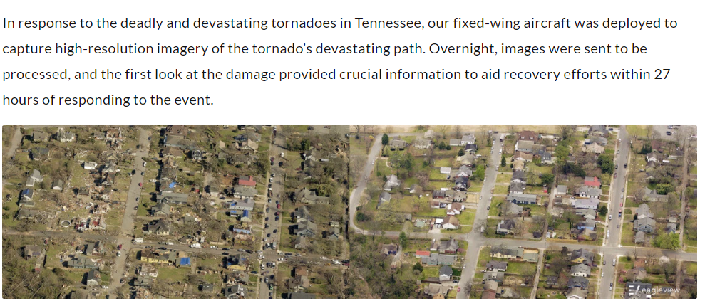
Notes:
https://www.eagleview.com/newsroom/2020/03/to-aid-in-nashville-tornado-recovery-eagleview-captures-and-donates-fixed-wing-aerial-imagery-to-davidson-county/

Slide 10
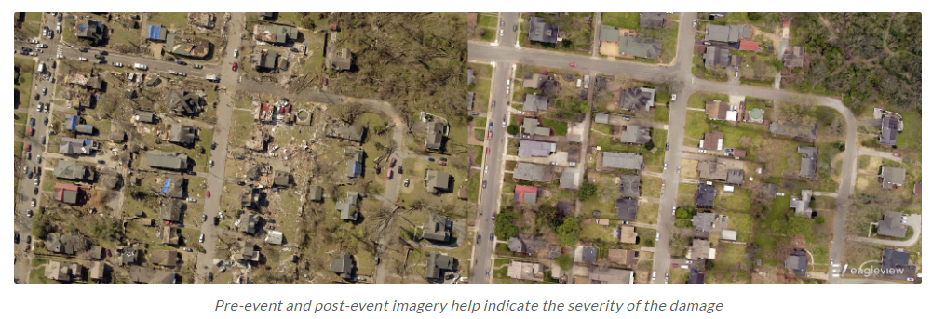

Slide 11
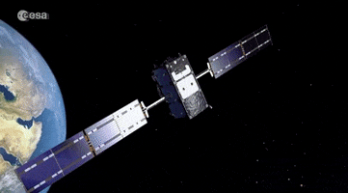
Identify different methods of geographic data collection.
Remote Sensing
The use of cameras or other sensors mounted on aircraft or satellites which orbit the earth above the atmosphere to collect digital images of the earth’s surface.
Examples:
  Monitoring environmental changes
  Weather

Slide 12
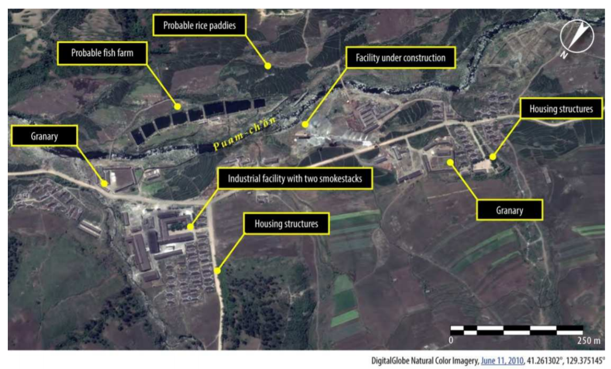
Example of Remote Sensing: North Korean Prison Camps
“We worked in the farms (at kwanliso 15) from 7am to 8pm. We cultivated corn. We were divided to work in units comprising 10-15 people each. We were given a daily production target that we had to meet. If the unit did not meet the daily target, the unit-members were punished collectively. During the course of our three-year detention, often we did not meet our targets because we were always hungry and weak. We were punished with beatings and also reductions in our food quota. In addition to that, in the Ideology Struggle Sessions that were held after work, those who did not meet the target were severely criticized and beaten by other inmates.”
In order to circumvent the unwillingness of the North Korean authorities to allow human rights investigators access, Amnesty International and others have used remote sensing tools, such as satellite imagery, to provide more information about the human rights situation in North Korea. Previous satellite image analysis released by Amnesty International suggests the use and expansion of North Korea’s notorious political prison camps, and the blurring of the boundary between kwanliso 14 and surrounding villages.
Notes:
https://www.amnestyusa.org/reports/north-korea-new-satellite-images-show-continued-investment-in-the-infrastructure-of-repression/

Slide 13
Objectives and Essential Learning
1.2 Identify different methods of geographic data collection.
1.3 Explain the geographic effects of decisions made using geographical information.

