Slide 1
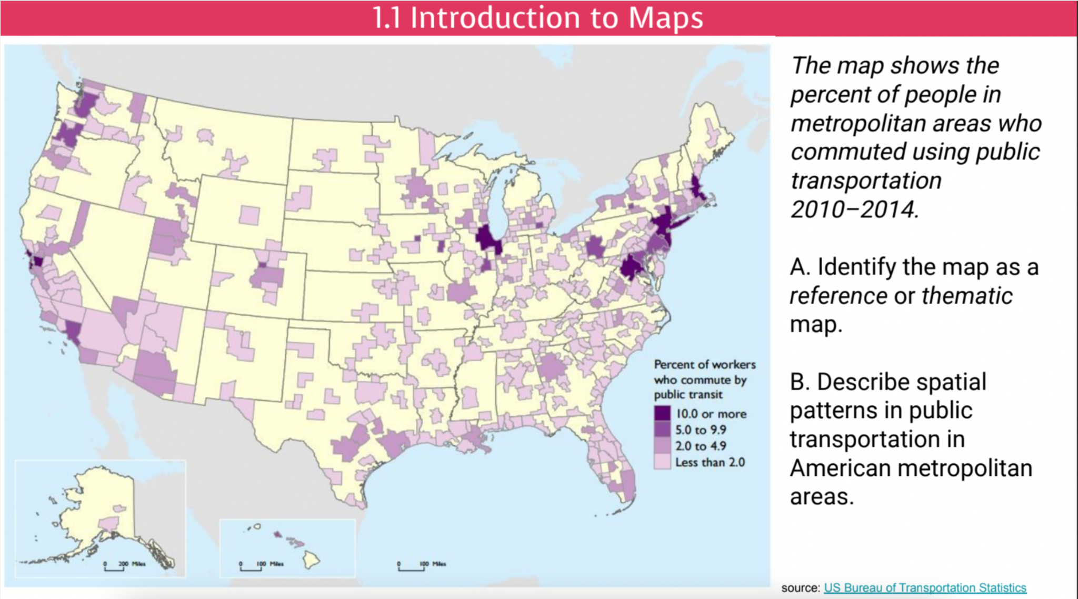

Slide 2
1.4
Spatial Concepts

Slide 3

Objectives and Essential Learning
1.4 Define major geographic concepts that illustrate spatial relationships.
1.4.1 Spatial concepts include absolute and relative location, space, place, flows, distance decay, time-space compression, and pattern.

Slide 4
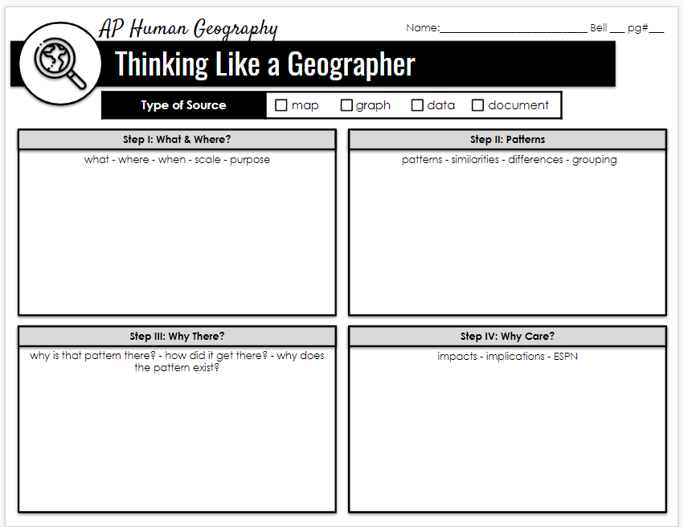
The Spatial Perspective
What?
Where?
Why There?
Why Care?
Patterns

Slide 5
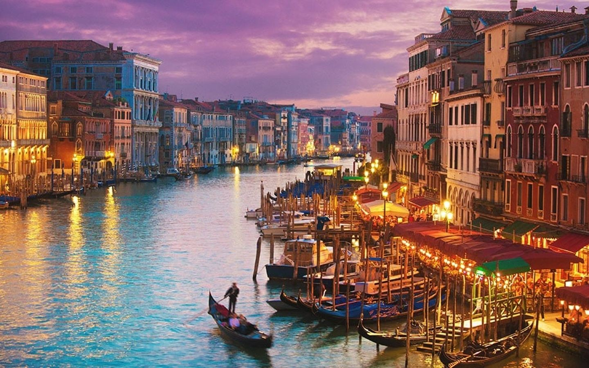

What = Place
How do we describe what a location is like?
Place
  Sense of Place: Factors that contribute to the uniqueness of a location.
  Cultural Landscape/Built Environment: Physical artifacts that humans created which make up the landscape. Human produced.
  Placelessness: A location without a
  sense of place. No distinct
  attributes.

Slide 6
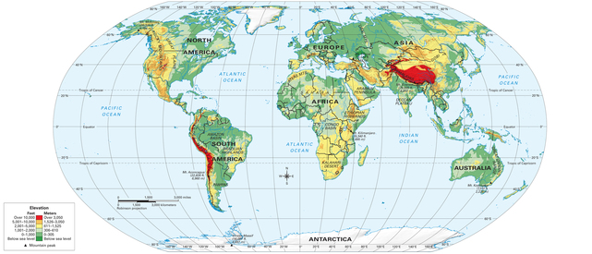

Where = Location
How do we describe where a place is located?
Location
  Absolute v. Relative
  Toponym -> Location’s name - usually reflective of the culture & history of a place. Ex: Georgetown, Washington, etc.
  Site/Physical Landscape: Environmental features of a location; includes climate, water sources, topography, soil, vegetation, elevation.

Slide 7
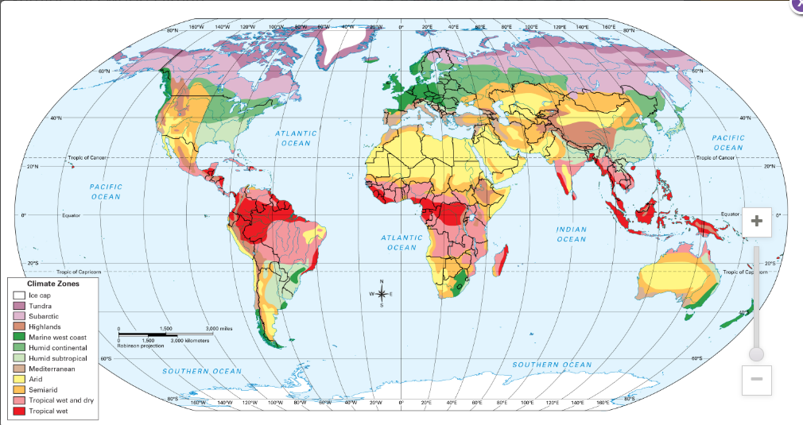
Places in tropical latitudes, near the equator, get the most direct rays from the sun all year, so these places have hot weather year-round. Places at high latitudes, close to the North and South poles, receive much less sunlight and remain quite cold all year. Elevation, or altitude, also affects climate. Places at high elevations have colder climates than those lower down.

Slide 8
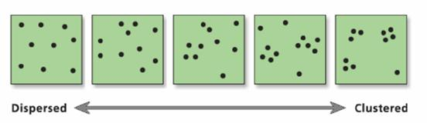
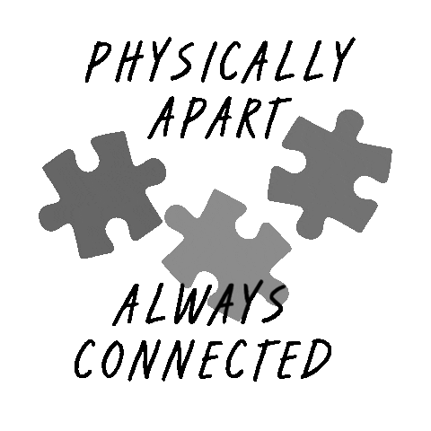
Patterns - Spatial Analysis
What patterns can be determined?
1. Clustering
Close together
Density - The # of something in a
defined area.
2. Dispersal/Distribution
Far apart
Distribution - The way something is
spread out over an area.
3. Patterns & Spatial Associations
Indication that two (or more) phenomena
may be related, associated, or correlated
with one another. RELATIONSHIPS.

Slide 9
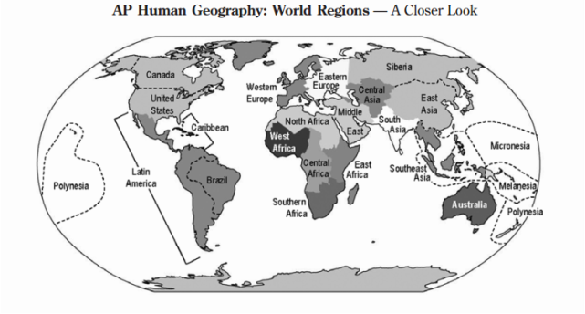
Patterns - Spatial Analysis
What patterns can be determined?
4. Regionalization
The process geographers use to divide and categorize space into smaller areas of analysis.

Slide 10

Why there? Why care? - Spatial Interactions
Spatial Interaction: Connections, contacts, movement, and flow of things between places.
What geographic concepts do we use to explain the connectedness (or lack thereof) of places, locations, phenomenon?
a. Distance Decay | b. Time-Space Compression
The interaction between two places declines as the distance between the two places increases. Physical Barriers-> Mtns./Rivers/ Oceans/Deserts Cultural Barriers -> Language/Religion | The increasing sense of accessibility and connectivity which seems to bring humans in distance places closer together. Globalization Increased technology & transportation
Notes:
Computers, the internet, email, Smartphones, Twitter, Youtube, Facebook, Snapchat etc. have facilitated both hierarchical and contagious diffusion
More accessible air travel

Slide 11
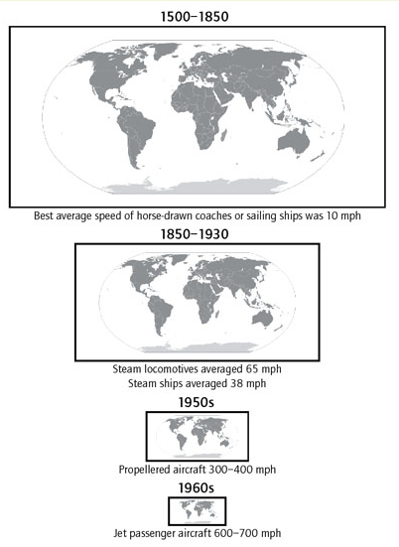
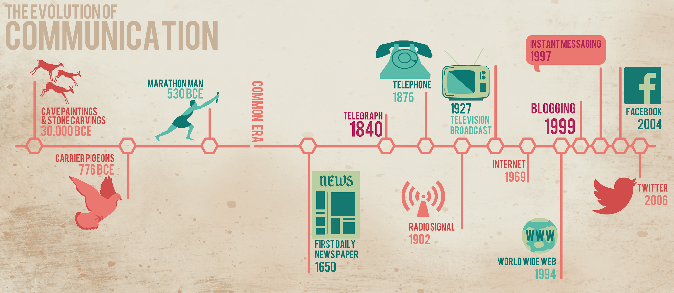
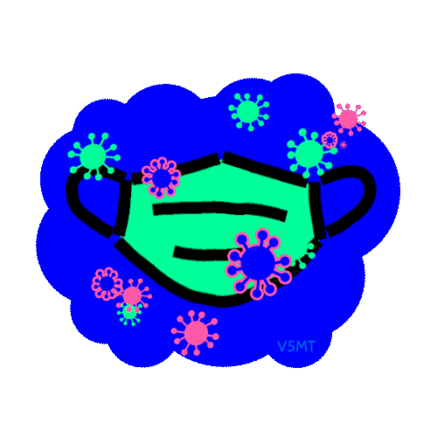


c. Diffusion: the process by which a characteristic spreads across space from one place to another.
i. Expansion Diffusion
ii. Relocation Diffusion

Slide 12
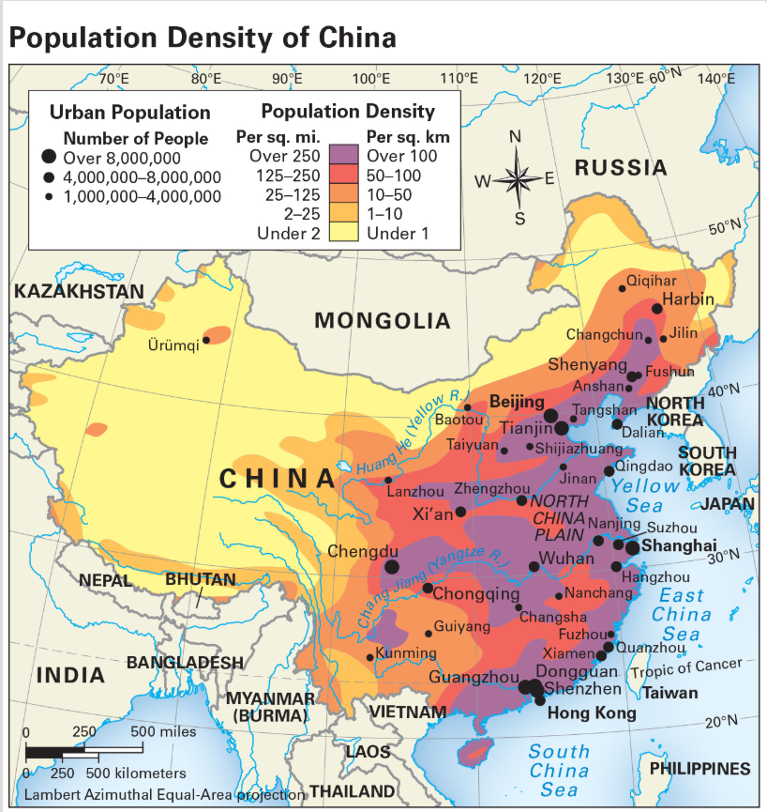
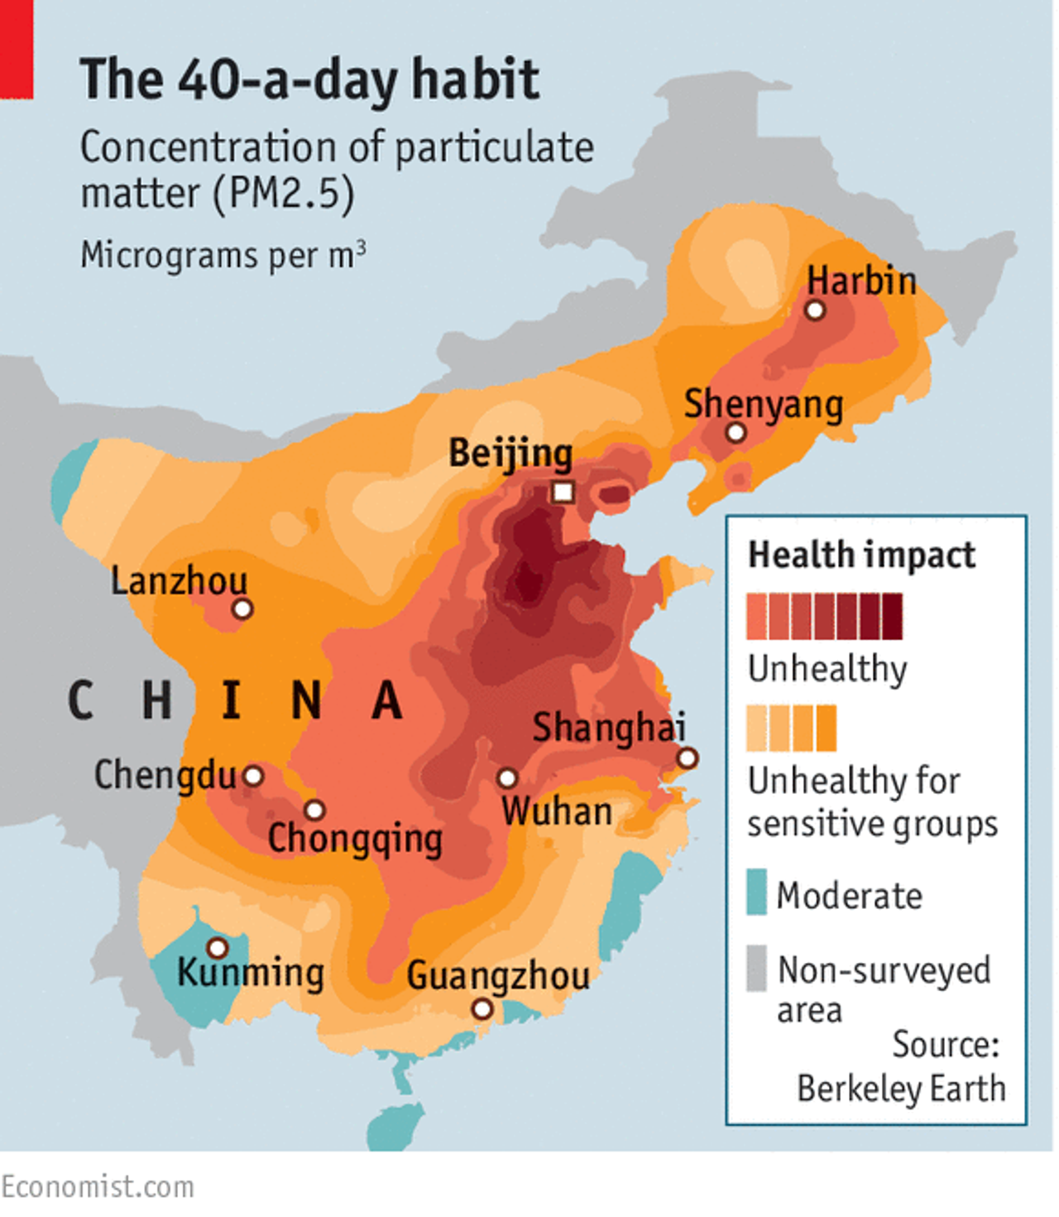
What? Where? Patterns? Why There? Why Care?

Slide 13
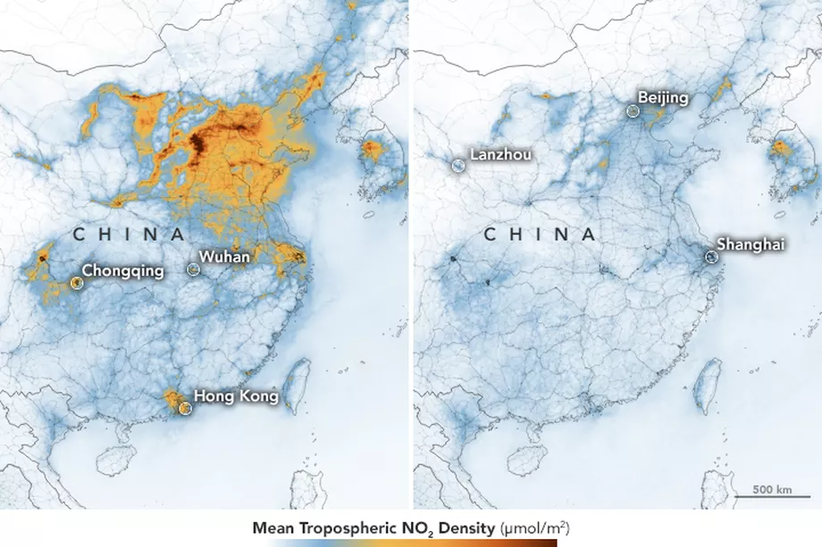
Maps show drastic drop in China’s air pollution after coronavirus quarantine

Slide 14
Objectives and Essential Learning
1.4 Define major geographic concepts that illustrate spatial relationships.

