Slide 1
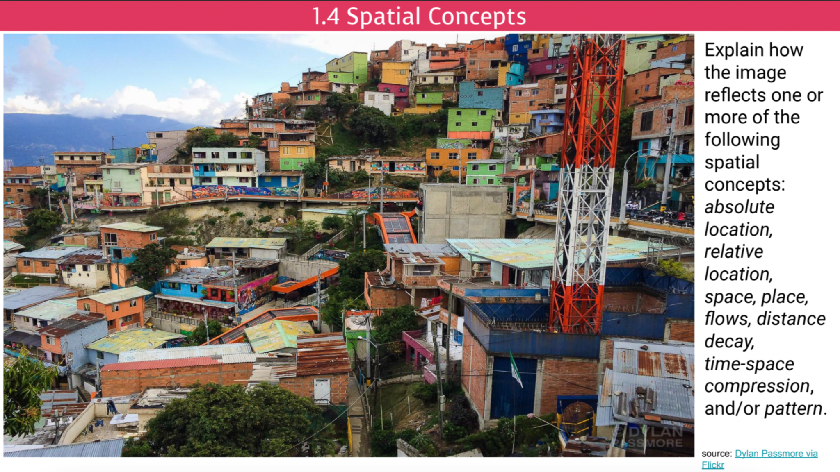
Notes:
🍐 This is a Pear Deck Text Slide
🍐 To edit the type of question, go back to the "Make Your Lessons Interactive" in the Pear Deck sidebar.

Slide 2
1.5
Human-Environmental Interaction

Slide 3

Objectives and Essential Learning
1.5 Explain how major geographic concepts illustrate spatial relationships.
1.5.2 Theories regarding the interaction of the natural environment with human societies have evolved from environmental determinism to possibilism.

Slide 4

Cultural Ecology
The study of how humans interact or adapt to the environment.
Theories have evolved over time due to developments in technology.
Environmental Determinism
v.
Possibilism

Slide 5
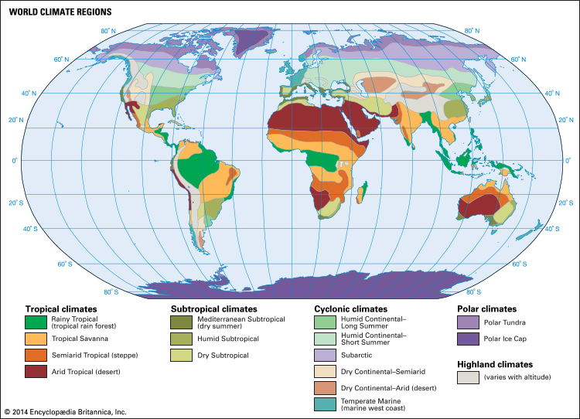
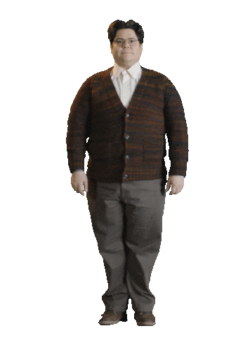
Environmental Determinism
18th Century
The belief that climate and landforms are the most powerful forces shaping human behavior and societal/cultural development.
  Used to justify racism.
    Concludes that warmer climates tend to cause inhabitants to have a more relaxed attitude toward work and progress. This led some ppl to believe that Europeans and those from more temperate climates were more motivated, intelligent and culturally advanced than those of warmer climates.

Slide 6
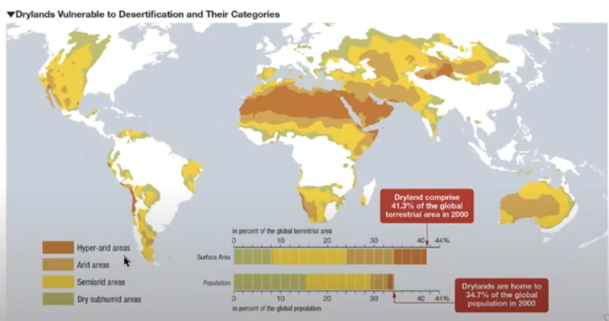
The environment (climate/precipitation) DETERMINES or controls what can happen in these areas! What do you know about what happens in these areas? Farming? Clothing? Etc?
Notes:
🍐 This is a Pear Deck Text Slide
🍐 To edit the type of question, go back to the "Make Your Lessons Interactive" in the Pear Deck sidebar.

Slide 7

Possibilism
More modern interpretation.
Acknowledges the limitations imposed by the natural environment, but focuses on the role of human culture to modify and respond to the environment to better fit human needs.

Slide 8
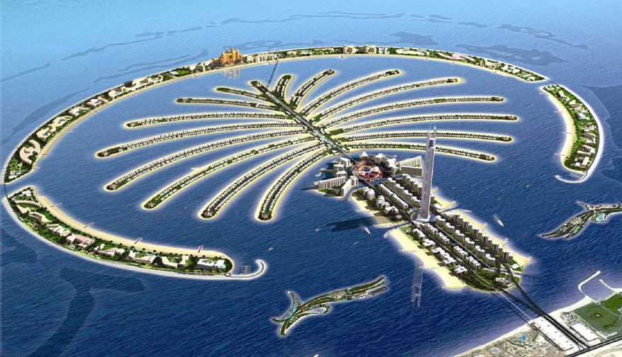
The Palm Islands were completed in only four years, with each island using over 53 million pounds of sand and 12 million pounds of rock to be created. Located in Dubai, UAE. How does this demonstrate possibilism?
Notes:
🍐 This is a Pear Deck Text Slide
🍐 To edit the type of question, go back to the "Make Your Lessons Interactive" in the Pear Deck sidebar.

Slide 9

The Hoover Dam, which finished construction in 1936, is utilized to supply power and water to the nearby town of Las Vegas, Nevada which is located in the middle of a desert. How does this demonstrate possibilism?
Notes:
🍐 This is a Pear Deck Text Slide
🍐 To edit the type of question, go back to the "Make Your Lessons Interactive" in the Pear Deck sidebar.

Slide 10
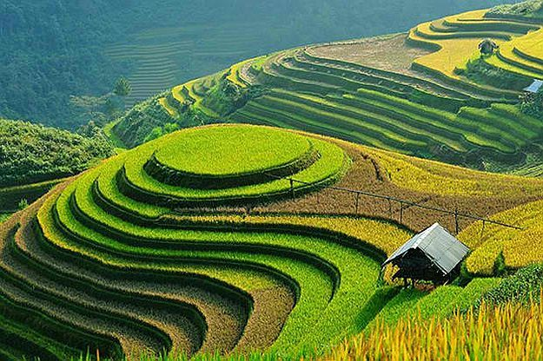
Invented by the Inca people who lived in the South American mountains. This farming method has made cultivation of crops in hilly or mountainous regions possible. It is commonly used in Asia by rice-growing countries such as Vietnam, Philippines, and Indonesia.How does this demonstrate Possibilism?

Slide 11
Objectives and Essential Learning
1.5 Explain how major geographic concepts illustrate spatial relationships.

Slide 12
1.6
Scales of Analysis

Slide 13
Objectives and Essential Learning
1.6 Define scales of analysis used by geographers.
1.6.1 Scales of analysis include global, regional, national, and local.
1.6 Explain what scales of analysis reveal.
1.6.2 Patterns and processes at different scales reveal variations in, and different interpretations of data.

Slide 14
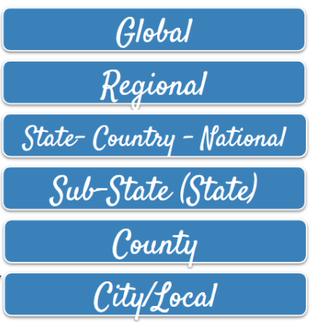
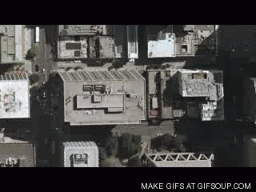
Scales of Analysis
Zooming In & Zooming Out
to tell a story.
Census Tract

Slide 15
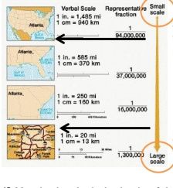
Scales of Analysis
Small scale maps: show LARGE area with SMALL amounts of data. Zoomed OUT. BIG # on map.
Large scale maps: show SMALL area with LARGE amounts of data. Zoomed IN. Small # on map.

Slide 16
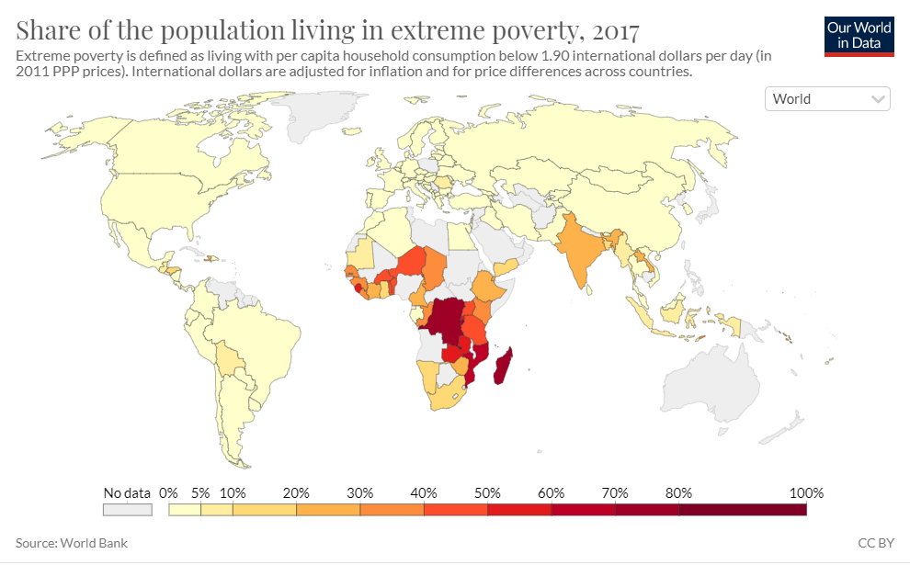
Global Scale Map - National Level of Analysis
Comparing & contrasting countries of the world.

Slide 17
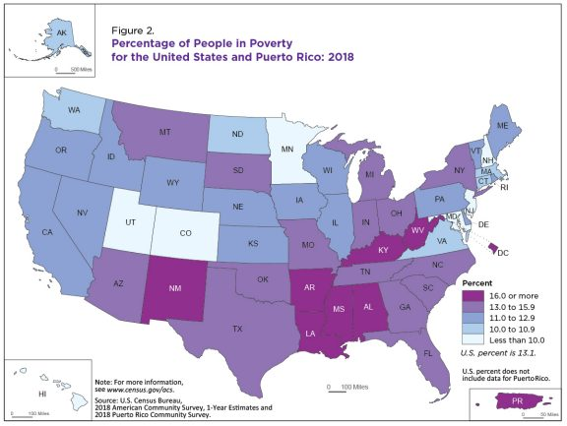
National Scale Map - Substate Level of Analysis

Slide 18
Different scales reveal variations in spatial patterns.
Notes:
🍐 This is a Pear Deck Text Slide
🍐 To edit the type of question, go back to the "Make Your Lessons Interactive" in the Pear Deck sidebar.

Slide 19
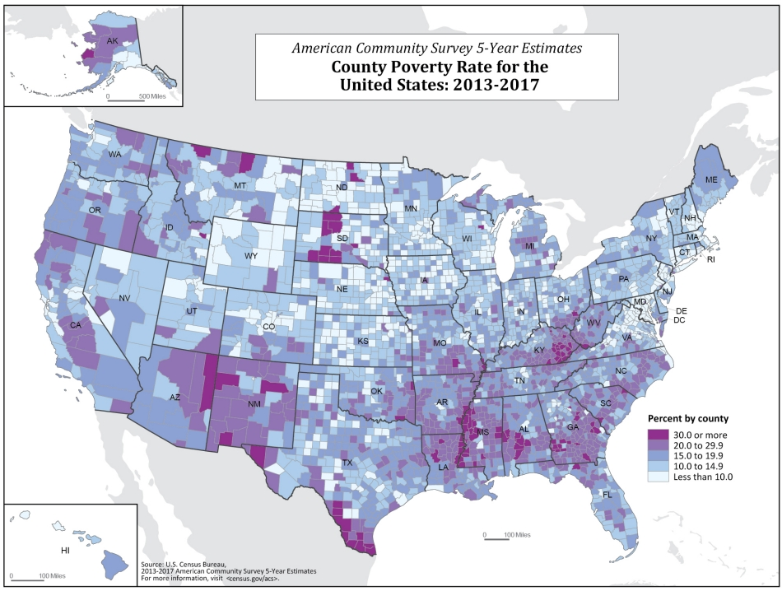
National Scale Map - County Level of Analysis

Slide 20
Different scales reveal variations in spatial patterns.

Slide 21
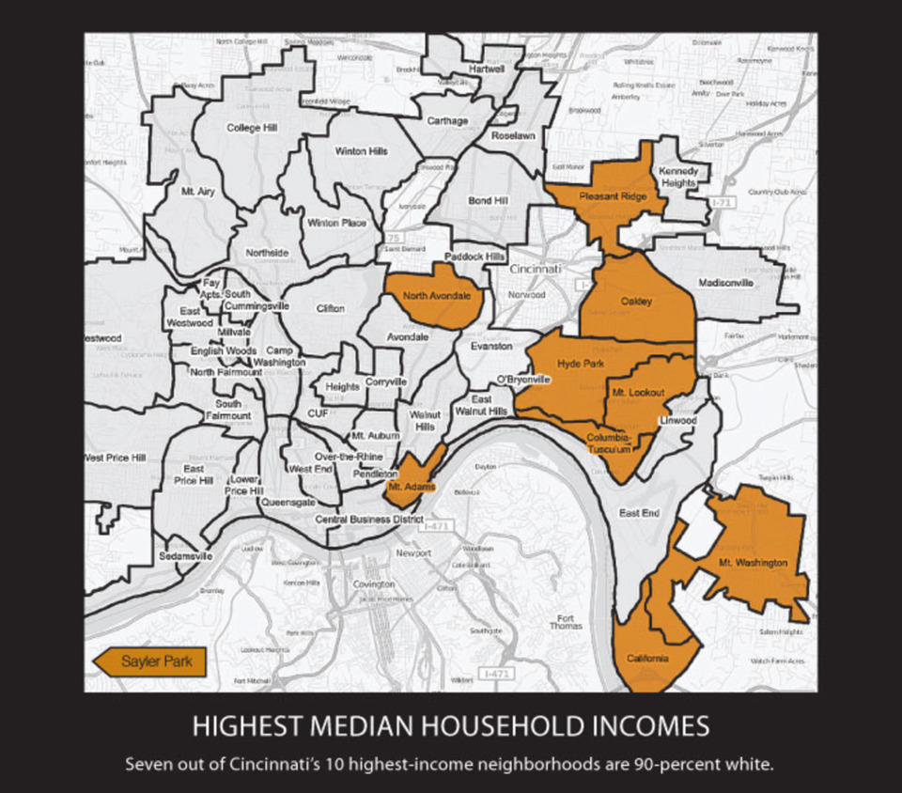
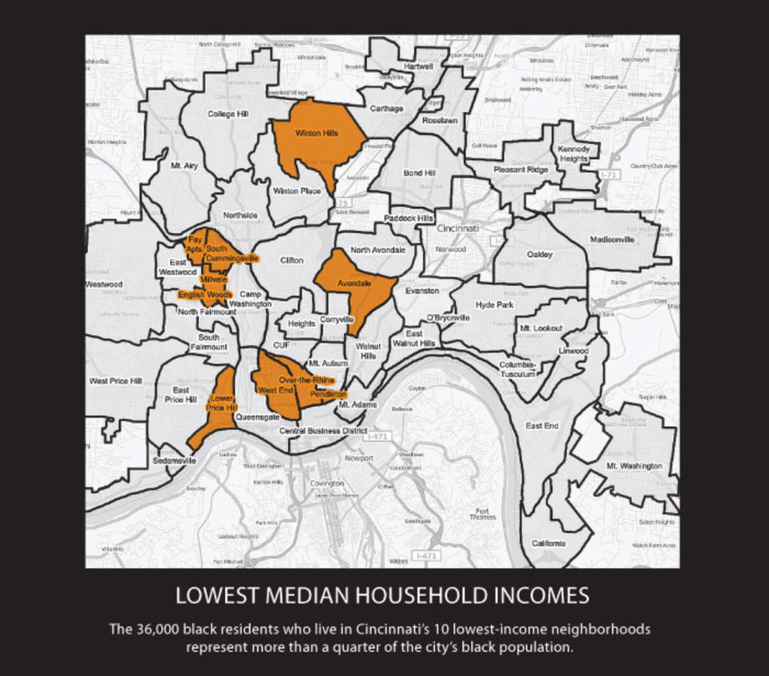
Local Scale Map & Level of Analysis
Census Tract: Smallest scale of analysis - comprise about 1,000-8,000 ppl
Closest to the size of an actual neighborhood.

Slide 22
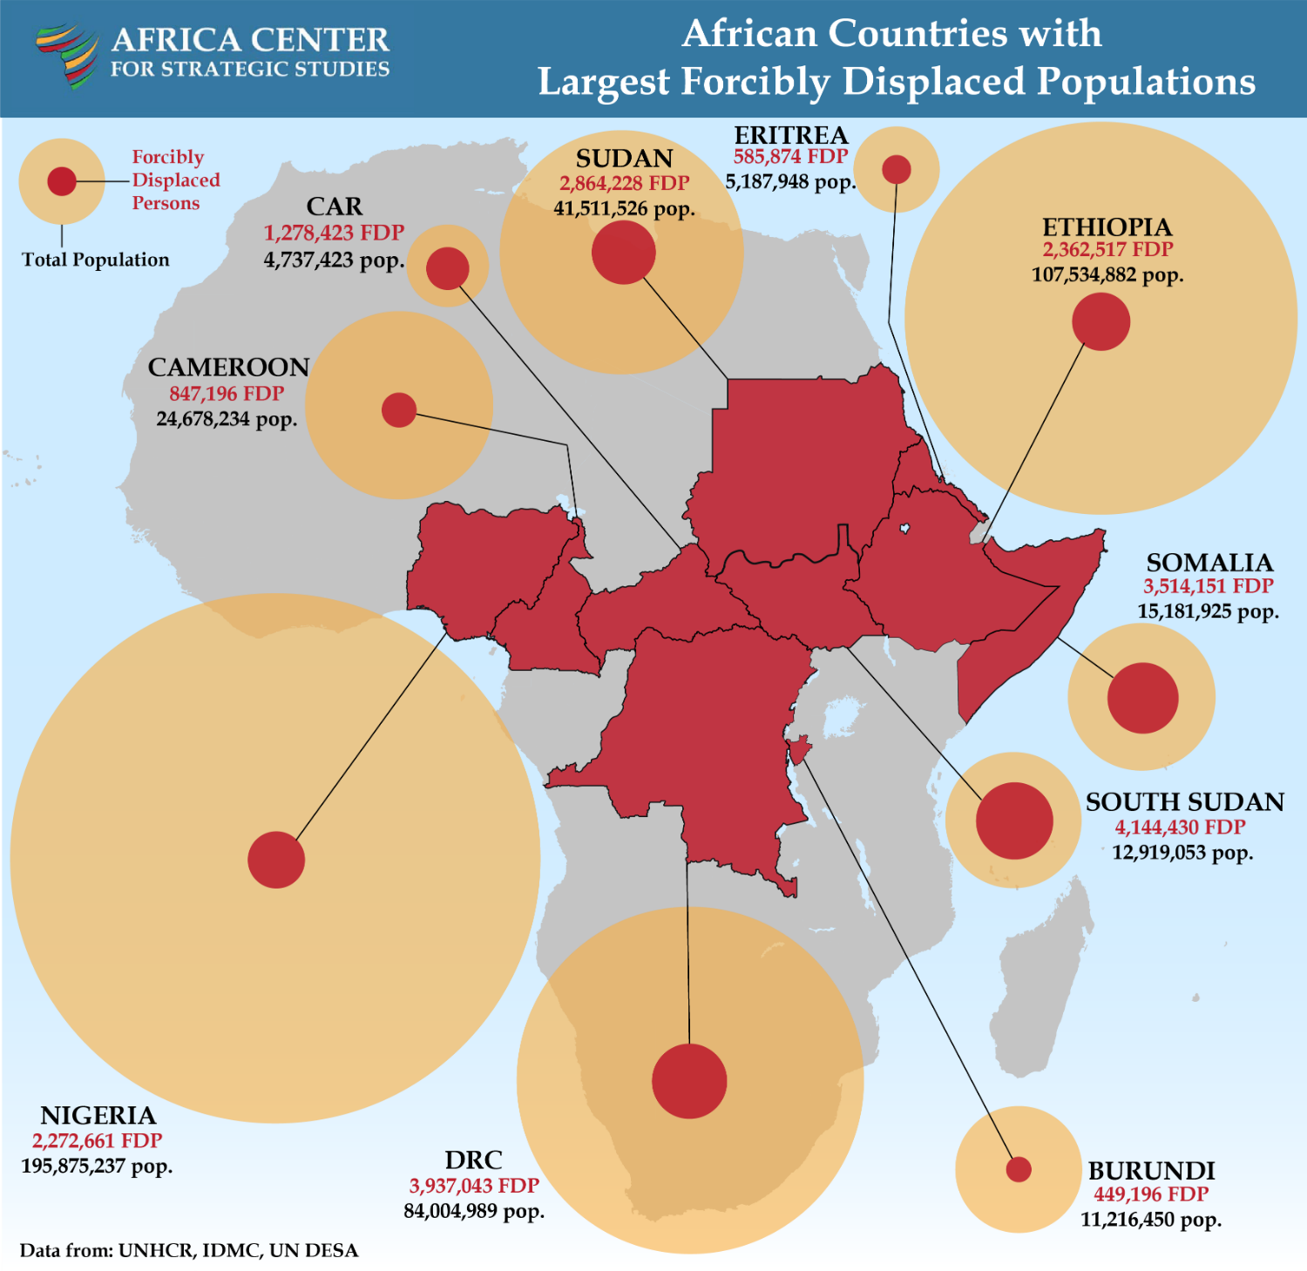
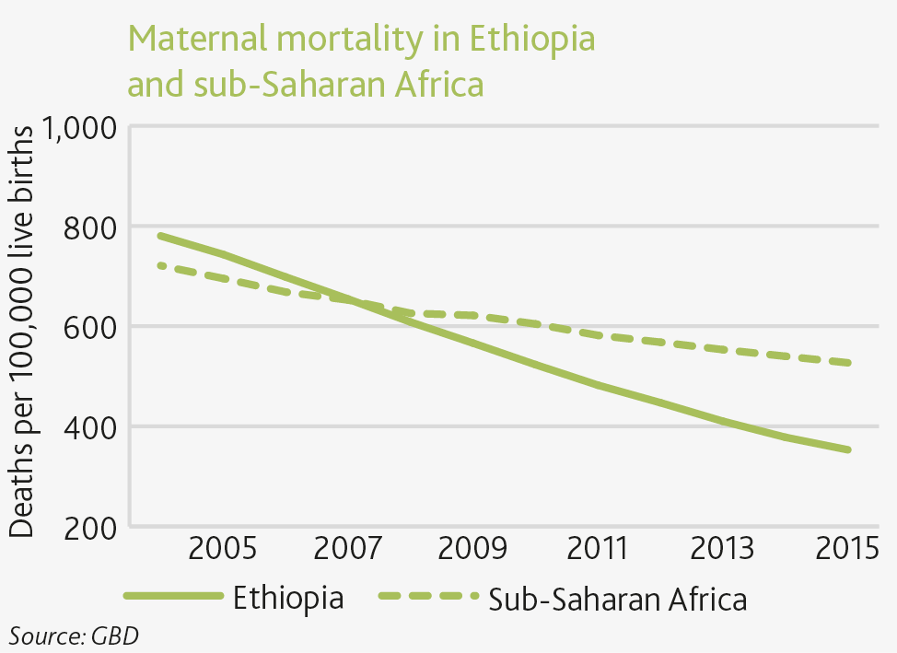
Regional Scale of Analysis

Slide 23
Objectives and Essential Learning
1.6 Define scales of analysis used by geographers.
1.6 Explain what scales of analysis reveal.

