Slide 1
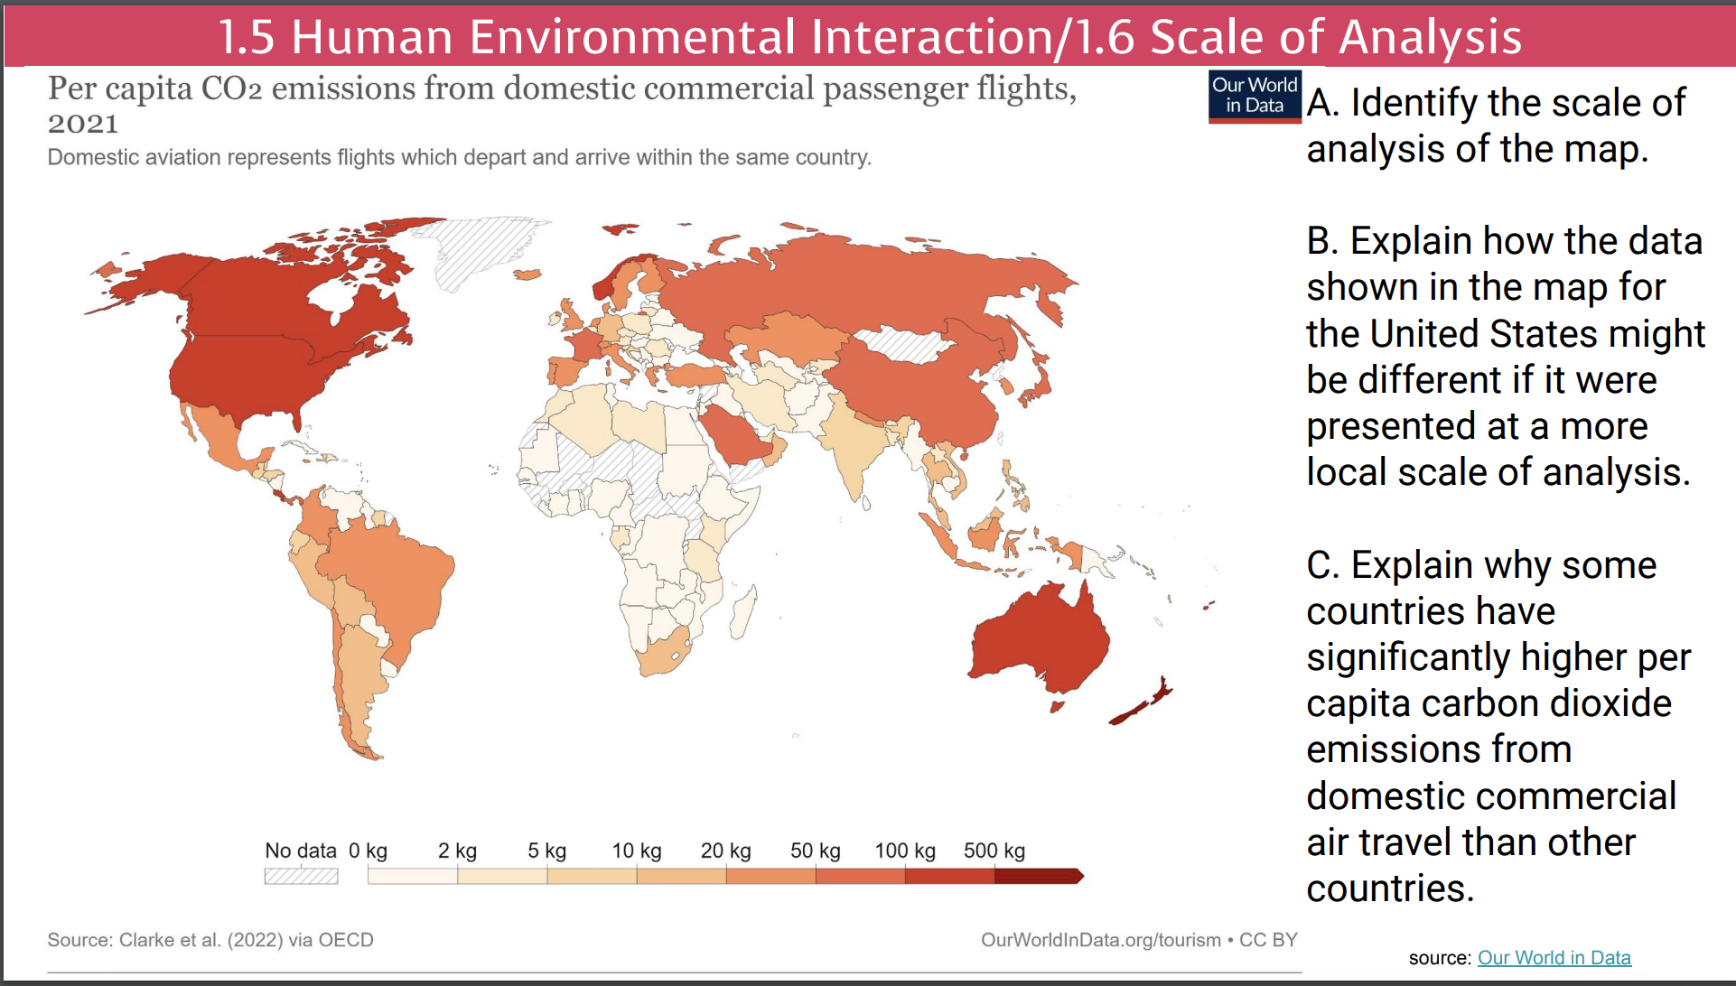

Slide 2
1.7
Regional Analysis

Slide 3

Objectives and Essential Learning
1.7 Describe different ways that geographers define regions.
1.7.1 Regions are defined on the basis of one or more unifying characteristics or on patterns of activity.
1.7.2 Types of regions include formal, functional, and perceptual/vernacular.
1.7.3 Regional boundaries are transitional and often contested and overlapping.
1.7.4 Geographers apply regional analysis at local, national, and global scales.

Slide 4
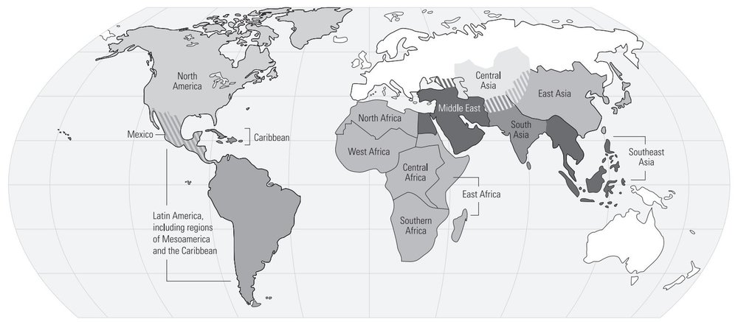
College Board - AP Human Geography Regions

Slide 5
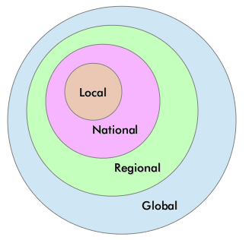
Geographers apply regional analysis...

Slide 6
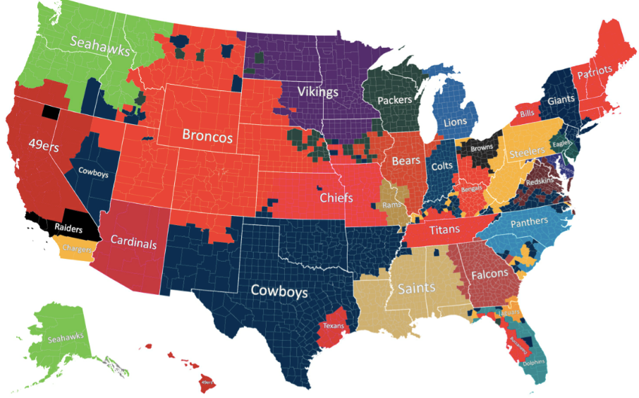
Regions are defined as...
one or more unifying characteristics (human or physical) or patterns of activity.
Formal
Functional
Vernacular/perceptual

Slide 7




A formal region is...
united by one or more specific traits.
Economic
Social
Political
ENvironmental

Slide 8
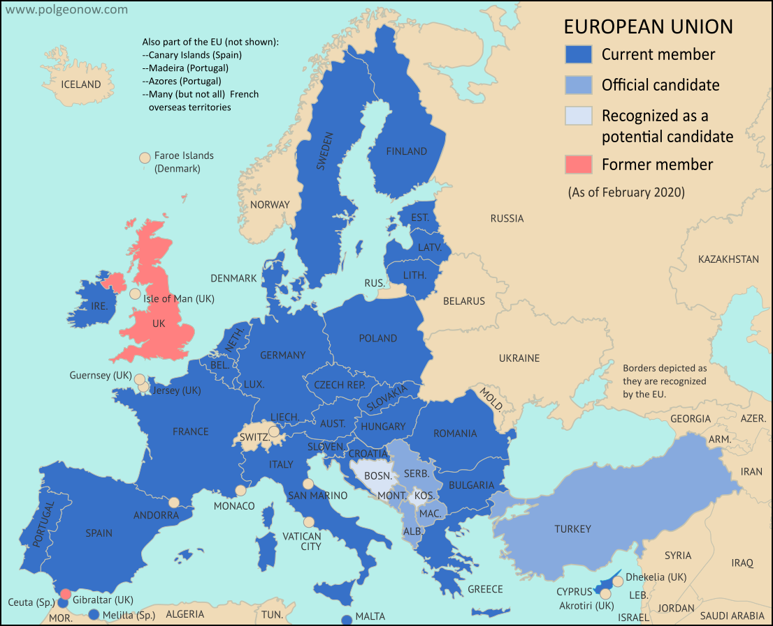
Economic Region
Free Trade. Common currency (the Euro).

Slide 9
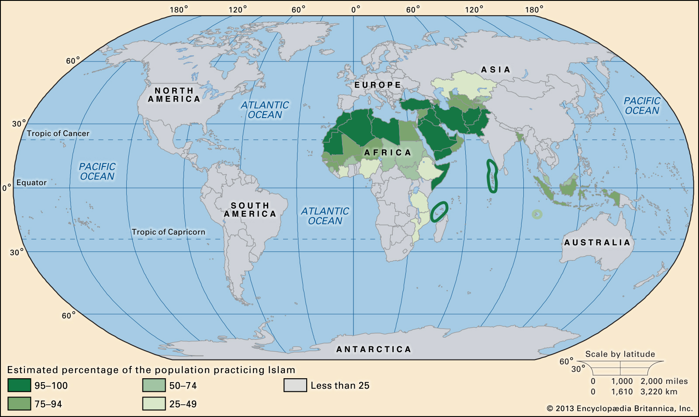
Social/Cultural Region
Islamic World: Distribution of Muslim adherents is primarily clustered in SW and C Asia and N Africa.

Slide 10
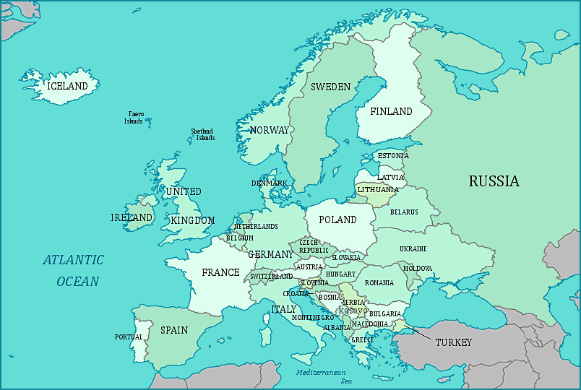
Political Region
Europe. The states & capitals in Europe.

Slide 11
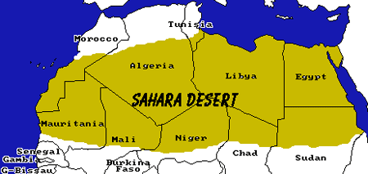
Environmental (Physical)
The Sahara Desert: Desert region which separates N Africa and Sub-Saharan Africa.

Slide 12
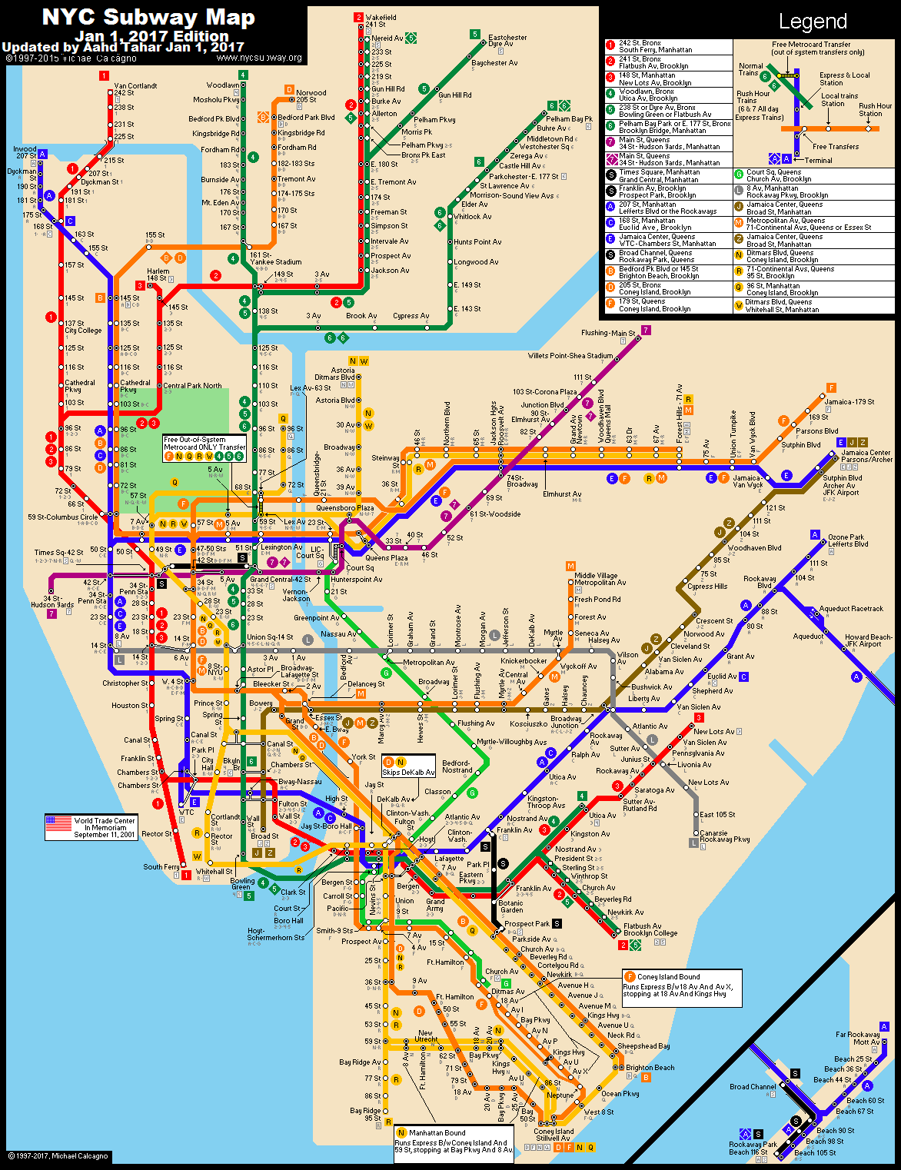
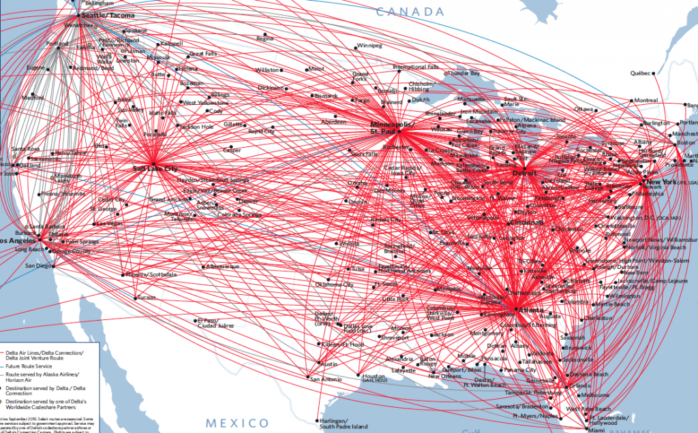
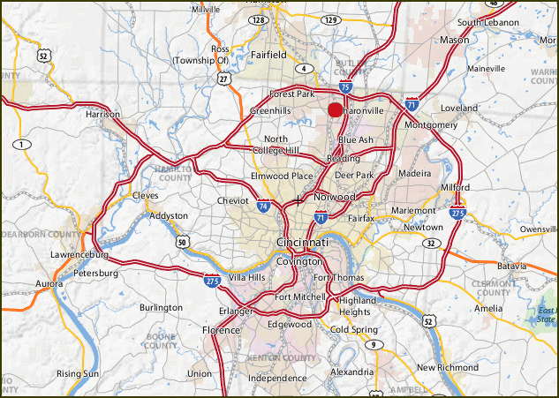
A functional region is...
organized around a central node (focal point) and the relationship is typically based around economics, travel or communication.

Slide 13
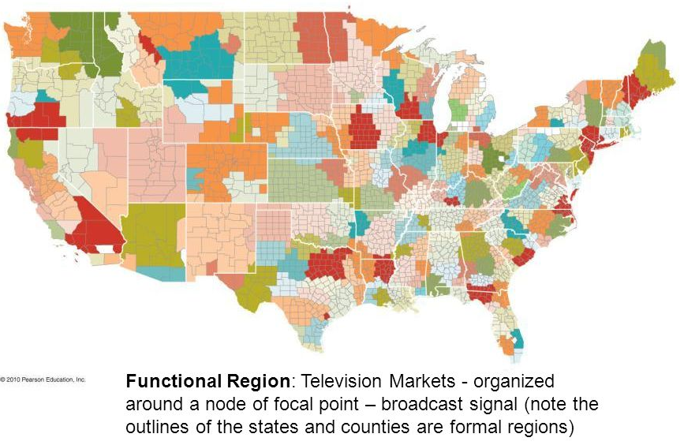
A functional region is...

Slide 14

A perceptual/vernacular region is...
based on a person’s perspective or perception of a certain location.
Informal
Sense of place & cultural identity.
Boundaries often vary widely because people have a different sense of what defines and unites these regions

Slide 15
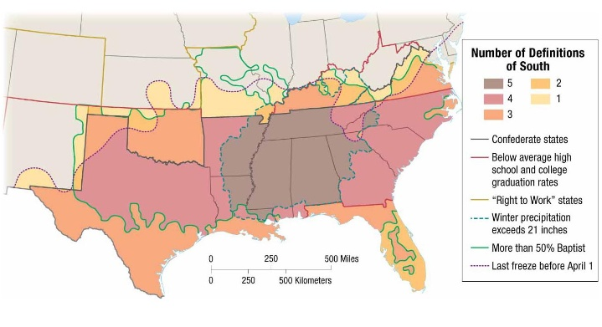
A perceptual/vernacular region is...
The South?

Slide 16
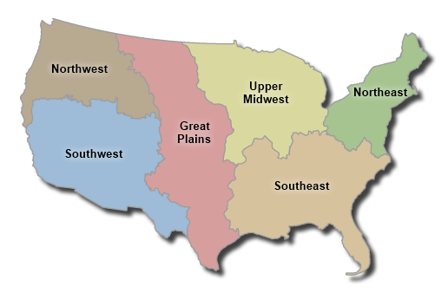
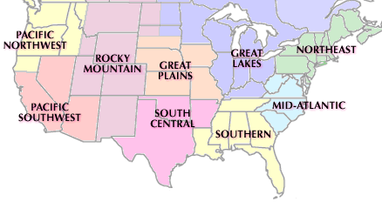
Regional boundaries are...
Transitional, Contested, Overlapping

Slide 17
Regional boundaries are...
Transitional, Contested, Overlapping

Slide 18
Objectives and Essential Learning
1.7 Describe different ways that geographers define regions.
1.7.1 Regions are defined on the basis of one or more unifying characteristics or on patterns of activity.
1.7.2 Types of regions include formal, functional, and perceptual/vernacular.
1.7.3 Regional boundaries are transitional and often contested and overlapping.
1.7.4 Geographers apply regional analysis at local, national, and global scales.

