Slide 1
2.1
Population Distribution & Density

Slide 2

Objective and Essential Learning
2.1.1 Identify the factors that influence the distribution of population at different scales.
A1. Physical features (e.g. climate, landforms, water bodies) and human factors (e.g. culture, economics, history, politics) influence the distribution of population.
A2. Factors that illustrate patterns of population distribution vary according to the scale of analysis.
2.1.2 Define and explain the differences between the methods geographers use to calculate population density.
B. The three methods for calculating population density are arithmetic, physiological, and agricultural.
C. The method used to calculate population density reveals different information about the pressure the population exerts on the land.

Slide 3
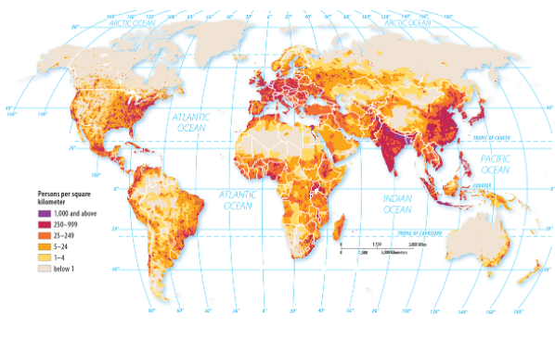
Where is population distributed?
7.8 BILLION
EAST ASIA
SOUTH ASIA
SOUTHEAST ASIA
WESTERN EUROPE

Slide 4

What factors influence the distribution of population?
NATURAL / ENVIRONMENTAL / PHYSICAL
People do not settle in the “5 toos”
  Too hot, cold, wet, hilly, or dry
People are likely to settle in…
  Low elevation
  Fertile soil
  Temperate climates
  Near a body of water
Ecumene: The habitable areas of the world.

Slide 5
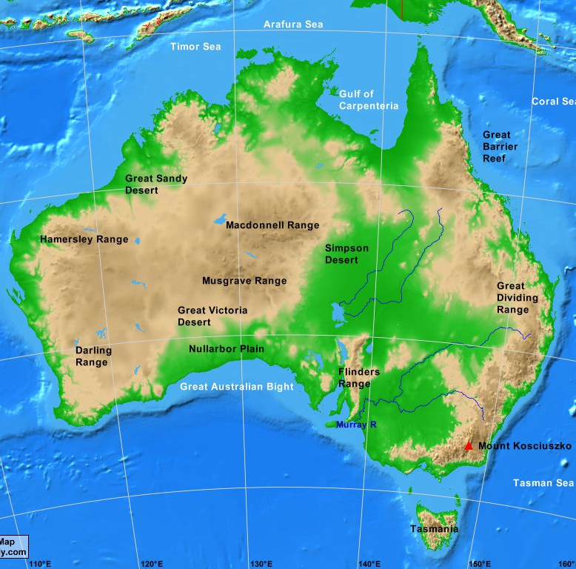
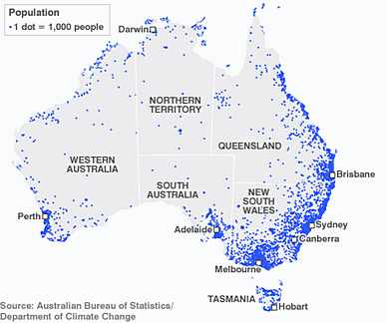
What factors influence the distribution of population?
NATURAL / ENVIRONMENTAL / PHYSICAL

Slide 6



What OTHER factors influence the distribution of population?
ECONOMIC
SOCIAL / CULTURAL
POLITICAL

Slide 7
How do geographers calculate population density?
Total population
Arithmetic
Land area (sq. mi)
Physiological
Total population
Arable Land (sq. mi)
Agricultural
Farmers
Arable Land (sq. mi)

Slide 8

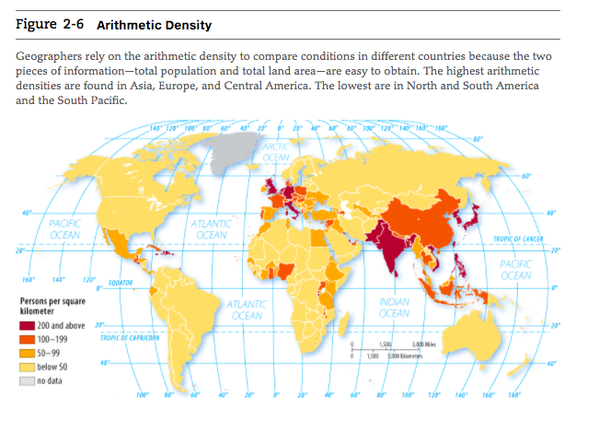
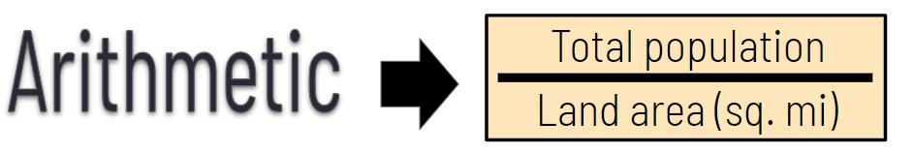
How do geographers calculate population density?
Does not account for the uneven distribution of population within each country. No information about clustering or dispersal.

Slide 9
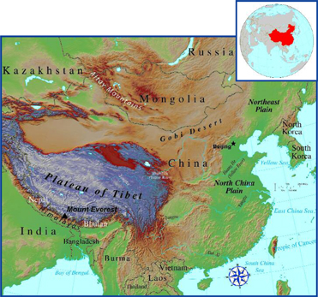
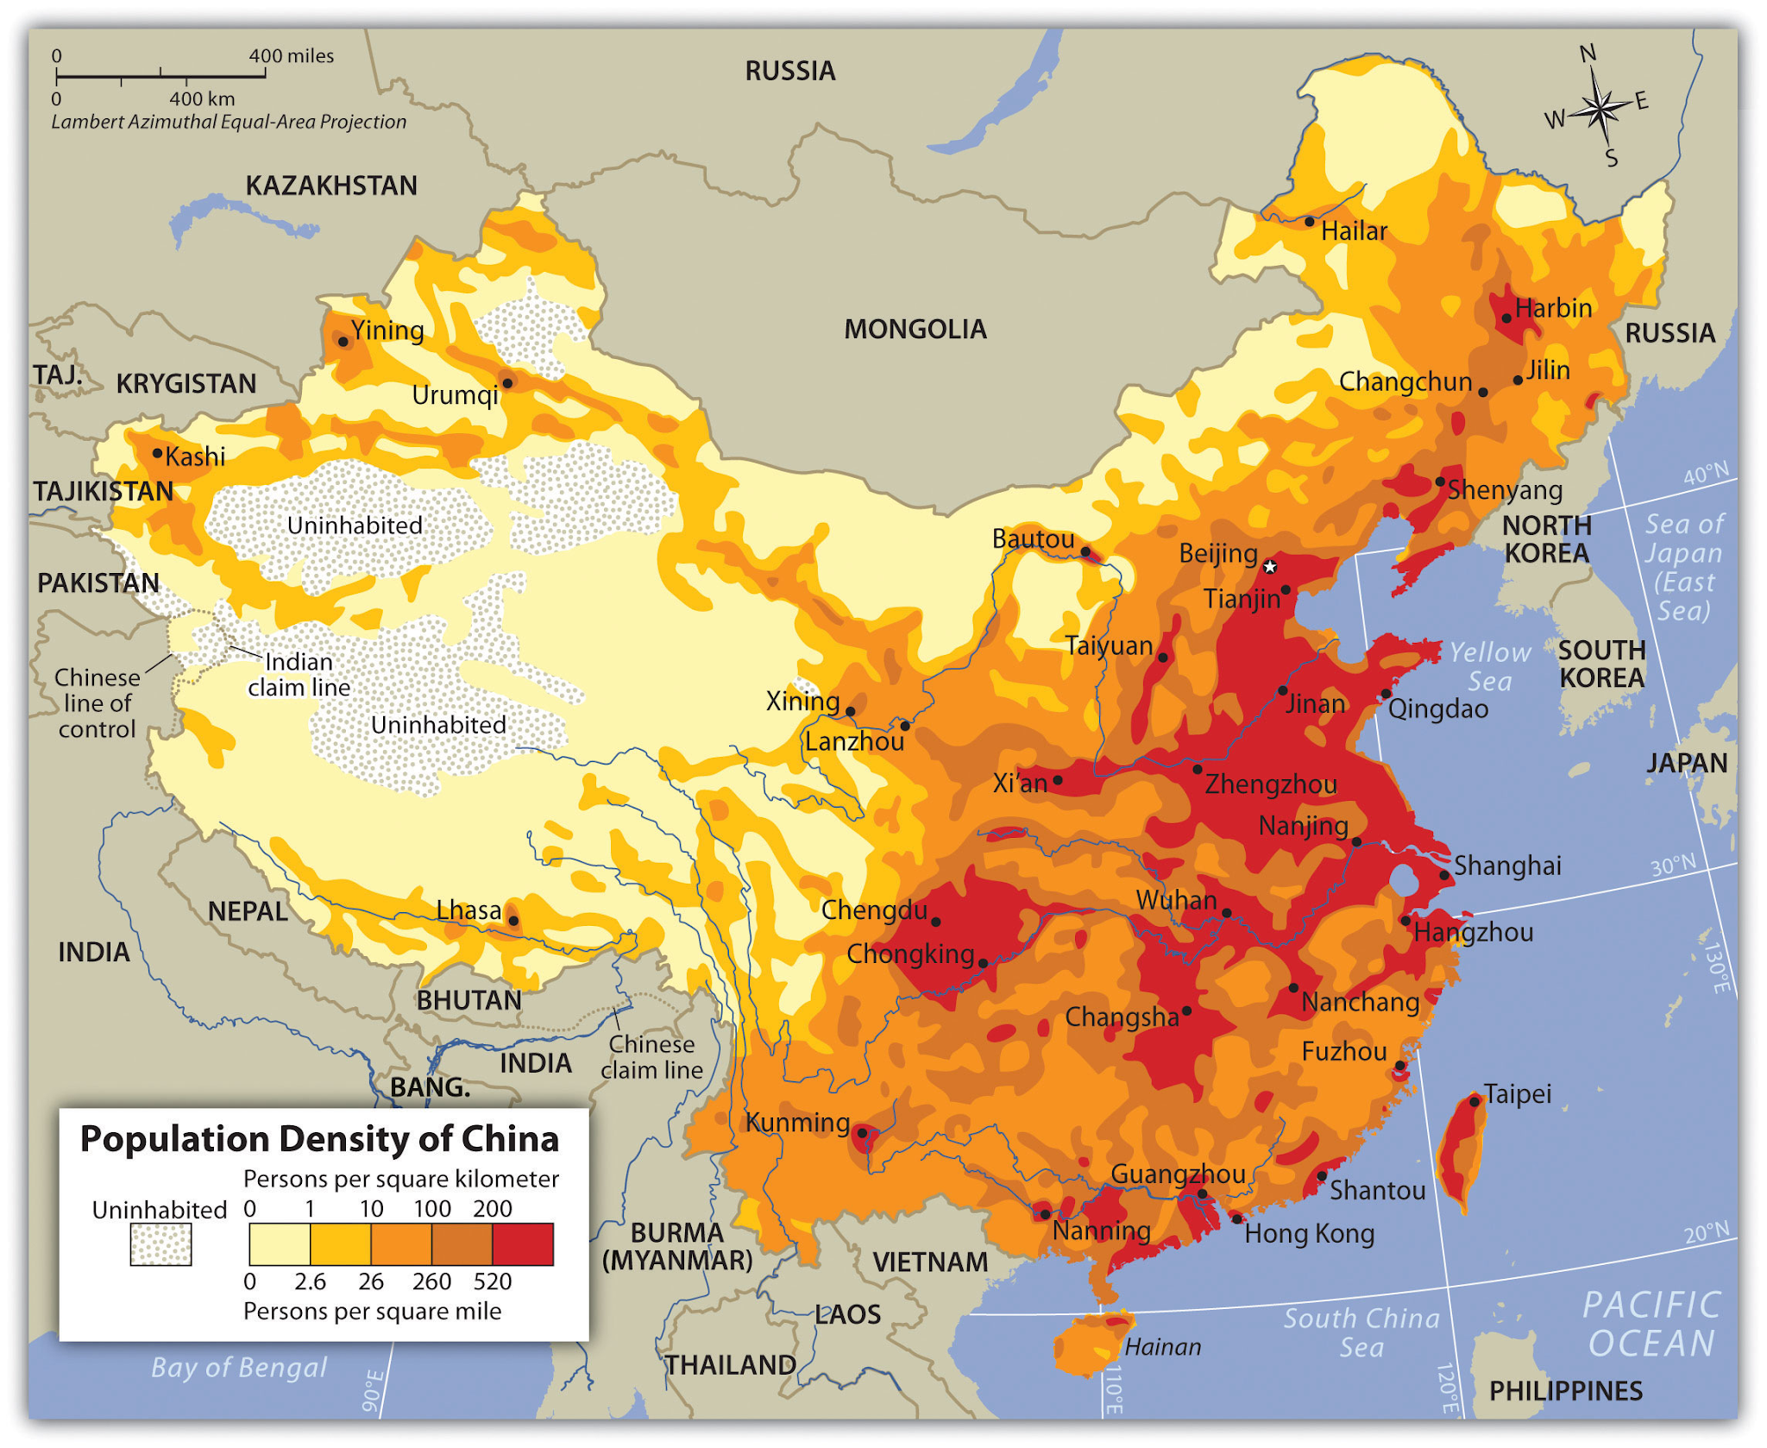

How do geographers calculate population density?
How does our understanding of population distribution and density change when we change the scale of analysis?
94% of China’s population lives in the Eastern region.

Slide 10

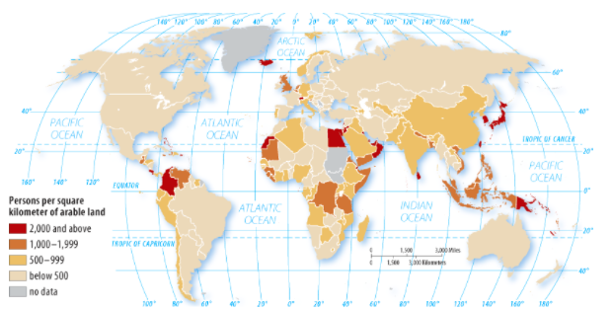
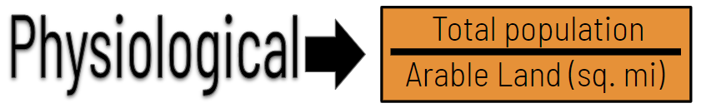
How do geographers calculate population density?
Carrying Capacity: The maximum population size that can be supported by the available resources without damaging the environment or using natural resources unsustainably.

Slide 11
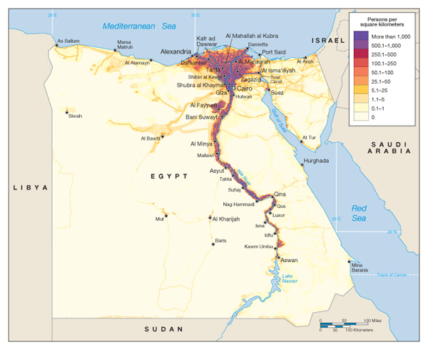
How do geographers calculate population density?
How does our understanding of population distribution and density change when use physiological density?
ARITHMETIC (2020) - 257
PHYSIOLOGICAL (2020) - 9,182
95% of the population of Egypt live on just 3% of land - along the Nile River.
What is the physical environment of Egypt?

Slide 12
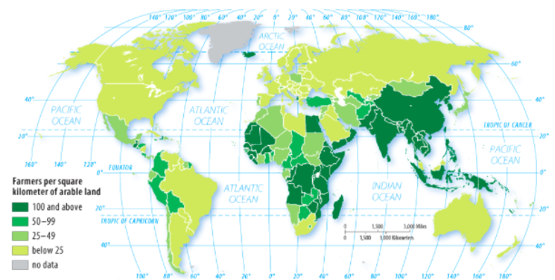
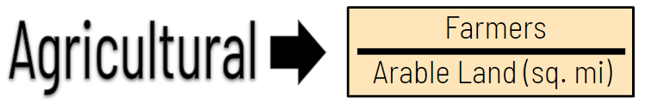
How do geographers calculate population density?
Better indicator of a country's level of economic development rather than population distribution.
High: LDCs
Low level of technology
Farming by hand = more farmers
Low output
Low: MDCs
High levels of mechanization
Less farmers but more output.

Slide 13


How do geographers calculate population density?

Slide 14
Objective and Essential Learning
2.1.1 Identify the factors that influence the distribution of population at different scales.
2.1.2 Define and explain the differences between the methods geographers use to calculate population density.

Slide 15
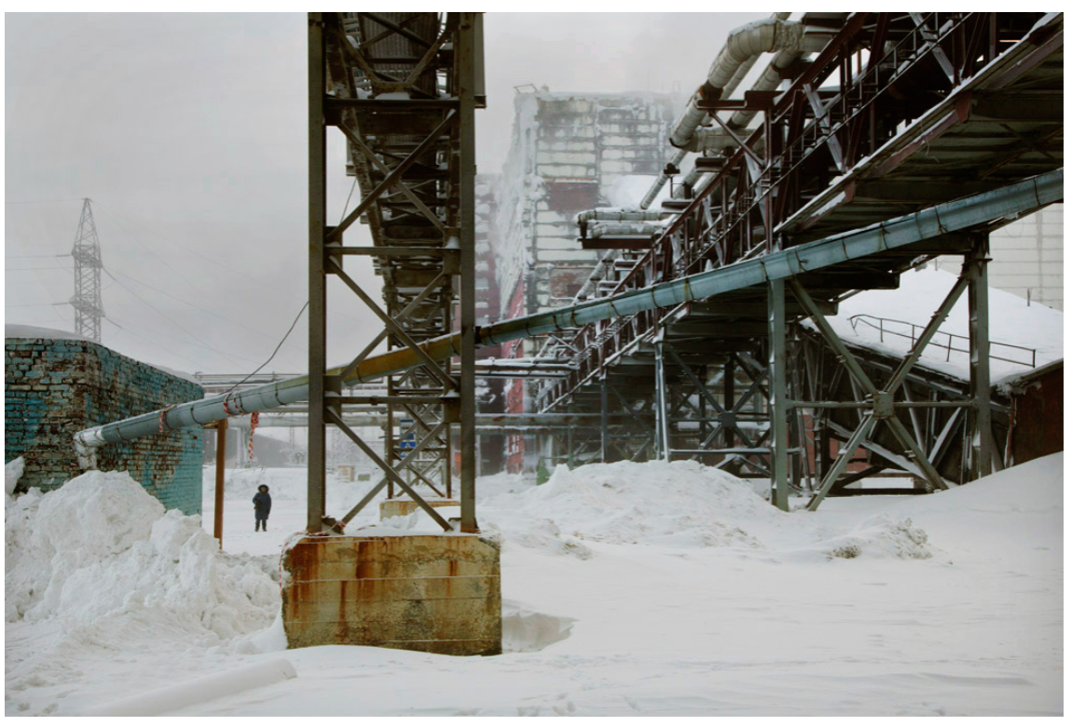
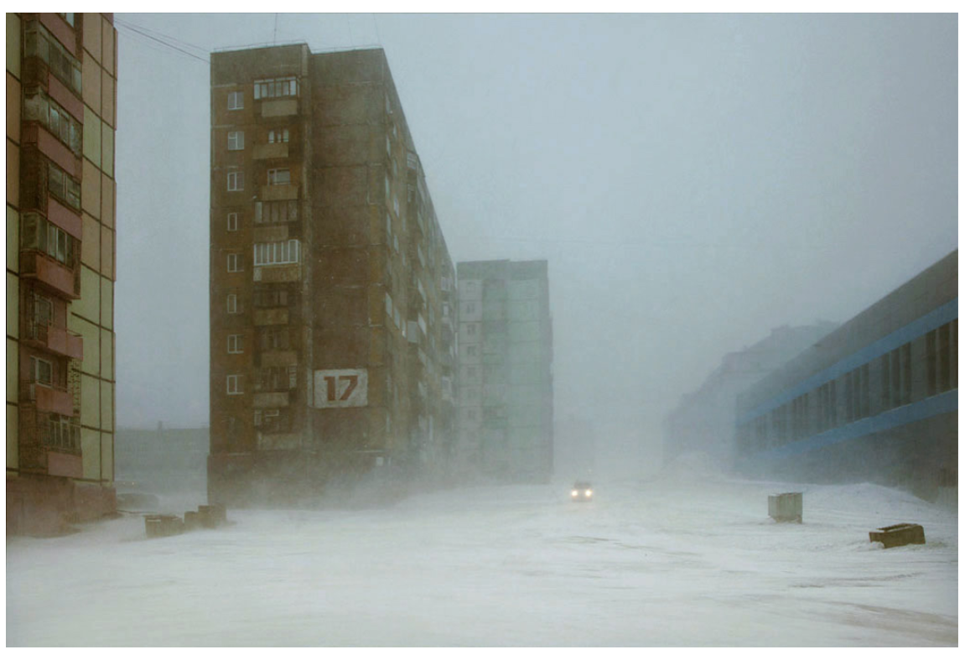

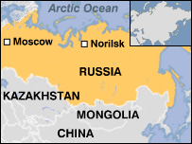
What factors influence the distribution of population?
ECONOMIC
Job Opportunities
Access to Natural Resources
Case Study: Norilsk, Siberia
“One example of how economic conditions prevail over environmental limitations is Norilsk, Siberia. Nearly 200,000 people in this city, which is located north of the Arctic Circle, brave extremely harsh weather conditions ever winter. Why...The region has the world’s largest known deposits of nickel, an industrially important metal.”
Source: Human Geography - A Spatial Perspective, Bednarz, Bockenhauer & Hiebert

Slide 16
What factors influence the distribution of population?
SOCIAL / CULTURAL
POLITICAL
Housing availability
Safety
Access to transportation
A feeling of belonging
Community
Housing availability
Safety
Access to transportation
A feeling of belonging
Community

