Slide 1
2.2
Consequences of Population Distribution

Slide 2

Objective and Essential Learning
2.2 Explain how population distribution and density affect society and the environment.
Population distribution and density affect political, economic, and social processes, including the provision of services such as medical care.
Population distribution and density affect the environment and natural resources; this is known as carrying capacity.

Slide 3
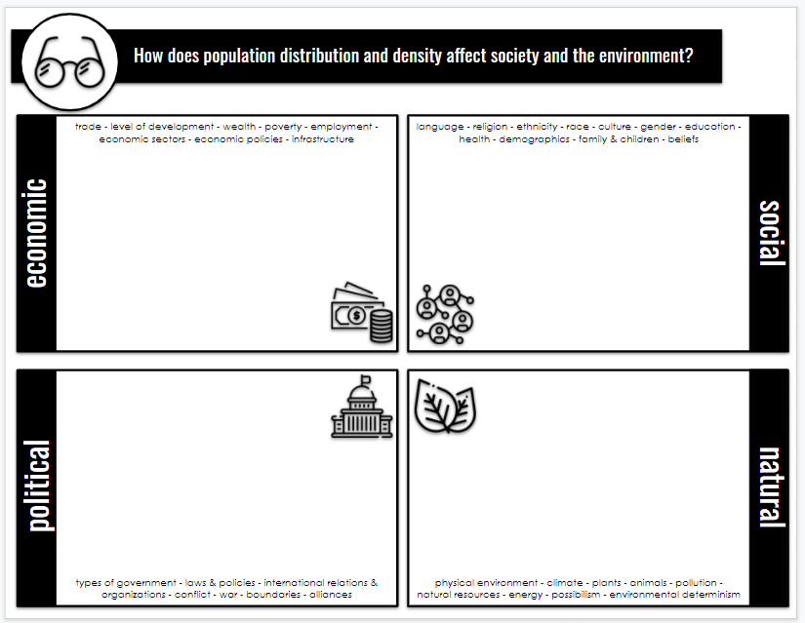
How does population distribution and density affect society and the environment?
E
S
P
N

Slide 4

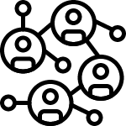



How does population distribution and density affect society and the environment?
ECONOMIC / POLITICAL /SOCIAL
Social Services & Infrastructure: High population density impacts access to housing, jobs, water, and services like sanitation, medical care, fire, police, public transportation and waste collection.
  Actually easier and cheaper to provide support to clustered populations - less distance & travel. Rural areas have a dispersed population, but fewer facilities.
  Yet, it is still extensive to provide services for large amounts of people.

Slide 5
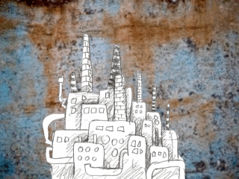
How does population distribution and density affect society and the environment?
ECONOMIC
Competition for jobs.
Urbanization due to manufacturing and industrialization.
  Today, more tertiary activities are located in cities.
Uneven population distribution results in uneven development.
  Scattered/dispersed populations
    Lower wages -> Less access to services-> Overall, less developed

Slide 6



How does population distribution and density affect society and the environment?
POLITICAL
Representation in Government
  Electoral Districts which have to be roughly equal in population size.
  Determines how many representatives in Congress.
  Redistricting -> process of redrawing electoral district boundaries after the Census every 10 years.

Slide 7

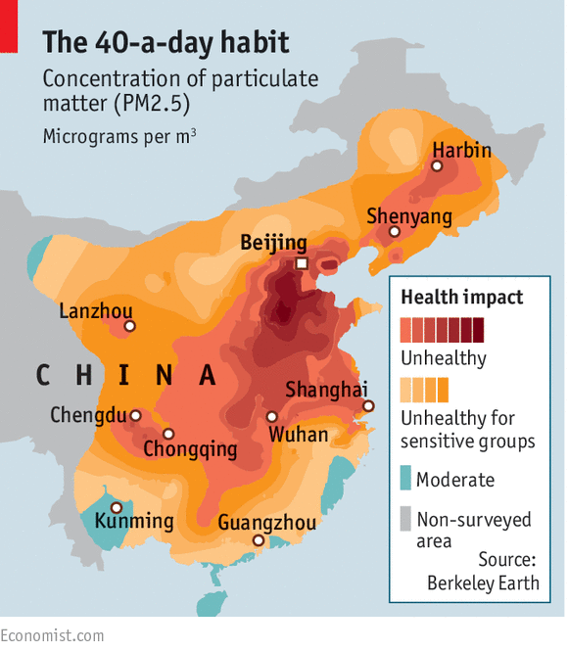
How does population distribution and density affect society and the environment?
NATURAL / ENVIRONMENTAL / PHYSICAL
Carrying Capacity: The maximum population size an environment can sustain.
  High population density = pressures on the arable land, water, resources, and food supply.
  Air and water pollution, depletion of natural resources, use of large amounts of energy, excessive waste

Slide 8
Objective and Essential Learning
2.2 Explain how population distribution and density affect society and the environment.
Population distribution and density affect political, economic, and social processes, including the provision of services such as medical care.
Population distribution and density affect the environment and natural resources; this is known as carrying capacity.

