Slide 1
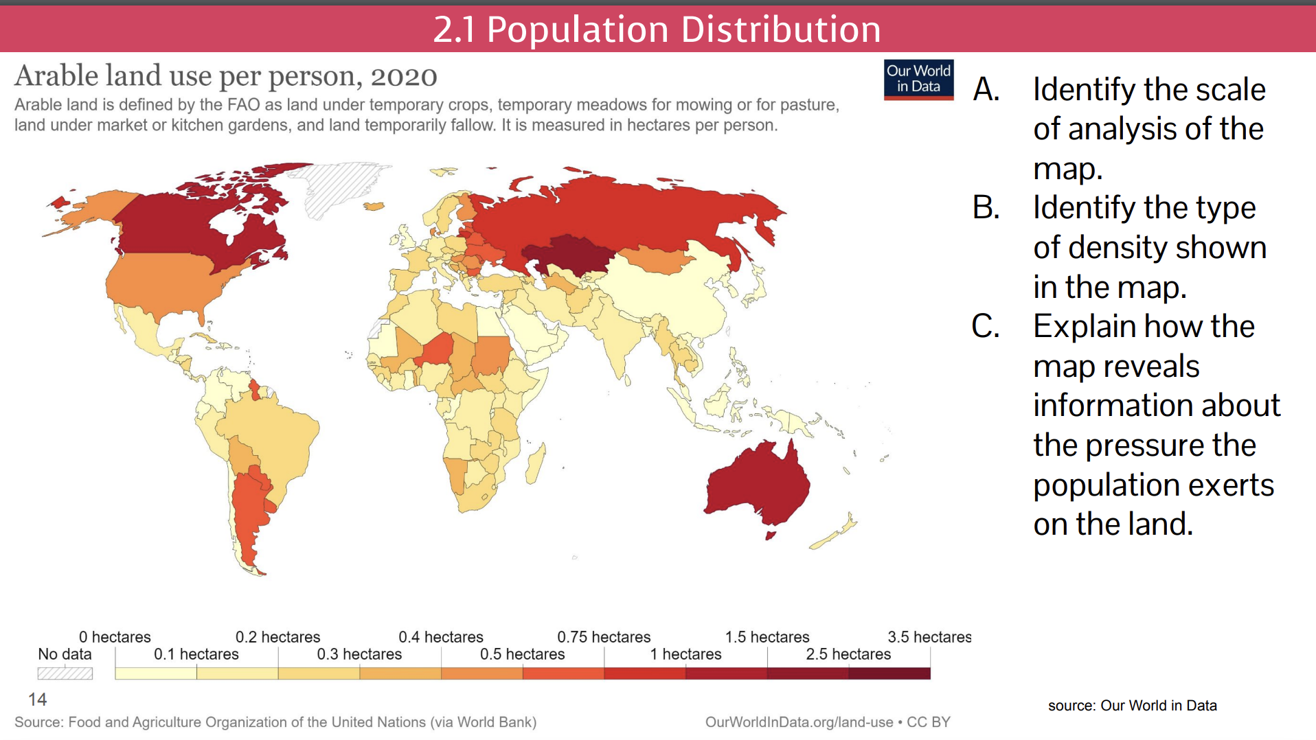

Slide 2
2.4.1
Population Dynamics

Slide 3

Objective and Essential Learning
2.4 Explain factors that account for contemporary and historical trends in population growth & decline.
Demographic factors that determine a population’s growth and decline are fertility, mortality and migration.
Geographers use the rate of natural increase and population doubling time to explain population growth and decline.

Slide 4
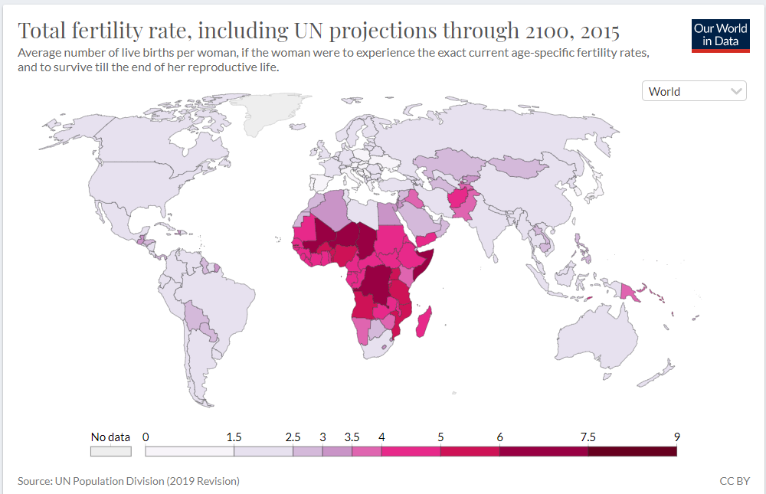
What factors determine a population’s growth & decline?
Fertility
  Crude Birth Rate (CBR)
  Total Fertility Rate (TFR)
Mortality
  Life Expectancy
  Crude Death Rate (CDR)
  Infant Mortality Rate (IMR)
Migration

Slide 5
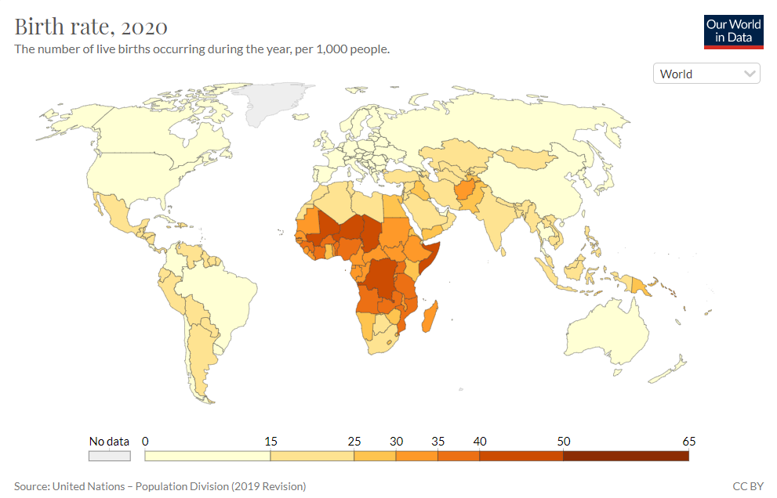
Fertility
Crude Birth Rate (CBR)
  The number of live births occurring in one year per 1,000 people.
Total Fertility Rate (TFR)
  Average number of children who would be born per woman during her childbearing years.
  Globally TFR has been significantly decreasing over time.

Slide 6
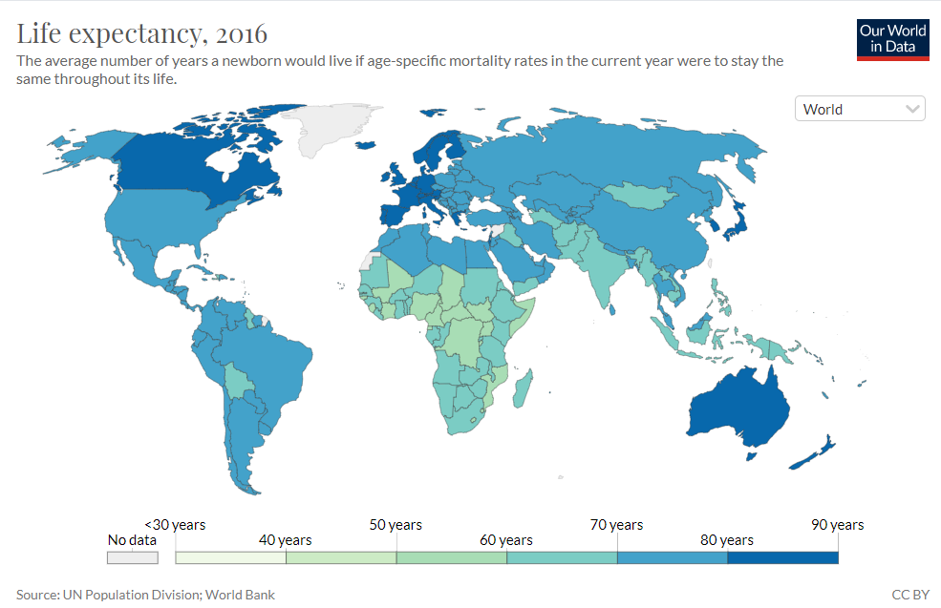
Mortality
Life Expectancy
  The number of years the average person will live.
  This has been steady increasing over time, which has contributed to population growth.
Crude Death Rate (CDR)
  The number of deaths occuring in one year per 1,000 people.

Slide 7
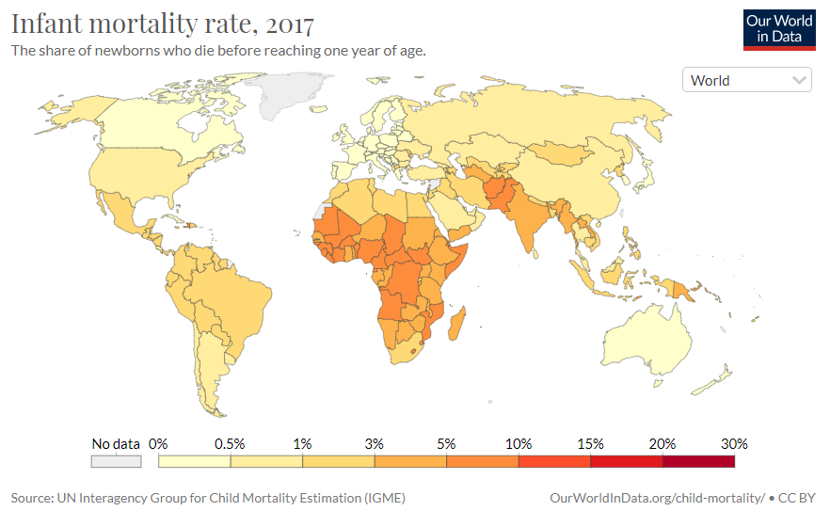
Mortality
c. Infant Mortality Rate (IMR)
  The number of children who die before one year of age.
  Typically when IMR goes down, life expectancy goes up which leads to higher population growth.

Slide 8
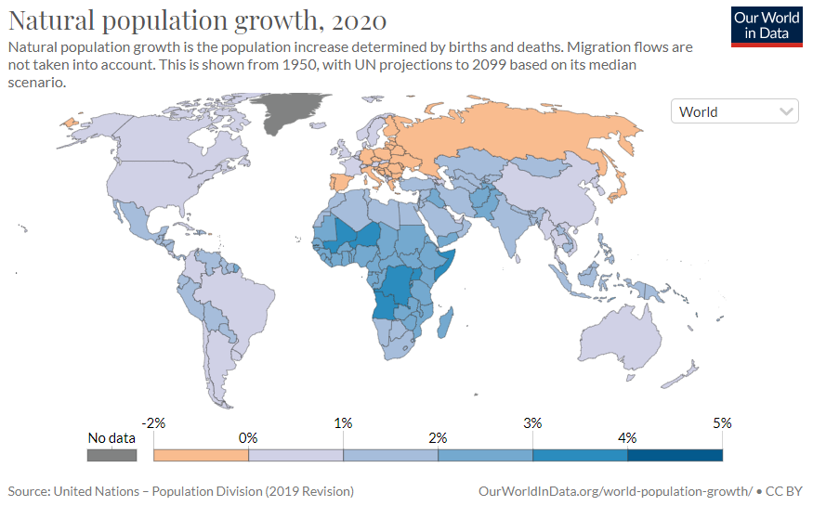
How do geographers calculate population growth & decline?
Natural Increase Rate (NIR) or Rate of Natural Increase (RNI)
  Does not account for migration.
  Can be a negative number, indicating population decrease.
  Usually expressed in a percentage
CBR - CDR
___________________
10

Slide 9
How do geographers calculate population growth & decline?
Natural Increase Rate (NIR) or Rate of Natural Increase (RNI)
  NIR - United States
  CBR - 12.4
  CDR - 8.3
12.4-8.3
0.41%
=
___________________
10

Slide 10
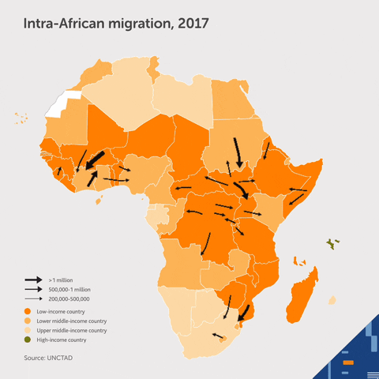
How do geographers calculate population growth & decline?
b. Population Growth Rate
  More accurate measure because it accounts for migration.
  Immigrants - people who moved into a country
  Emigrants - people that move out of the country.
  United States - 0.72%
Births - Deaths + Immigrants - Emigrants

Slide 11
How do geographers calculate population growth & decline?
c. Doubling Time: The number of years in which a population will double assuming the growth rate remains stable.
70
70
175 years
=
___________________
___________________
NIR
0.41%

Slide 12
Objective and Essential Learning
2.4 Explain factors that account for contemporary and historical trends in population growth & decline.
Demographic factors that determine a population’s growth and decline are fertility, mortality and migration.
Geographers use the rate of natural increase and population doubling time to explain population growth and decline.

Slide 13
2.4.2
Population Dynamics

Slide 14
Objective and Essential Learning
2.4 Explain factors that account for contemporary and historical trends in population growth & decline.
Social, cultural, political, and economic factors influence fertility, mortality and migration rates.
2.8 Explain how the changing role of females has demographic consequences in different parts of the world.
Changing social values and access to education, employment, health care, and contraception have reduced fertility rates in most parts of the world.
Changing social, economic, and political roles for females have influenced patterns of fertility, mortality….

Slide 15
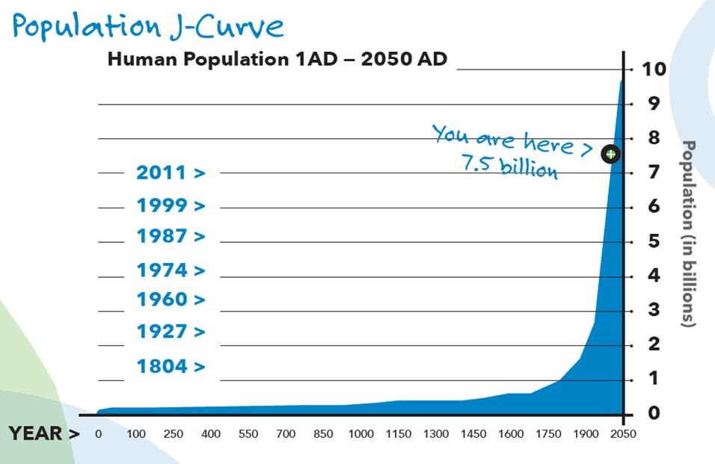
Historical Trends in Population Growth & Decline
Throughout most of history, population growth was very low.
Starting around 1750
  Agricultural Revolution
  Industrial Revolution
  Rapid urbanization
  Advances in healthcare & sanitation
First 1 billion in 1804
  Since then, doubling time has decreased as population growth increased rapidly
Source: https://www.populationconnection.org/talking-about-population-growth/

Slide 16
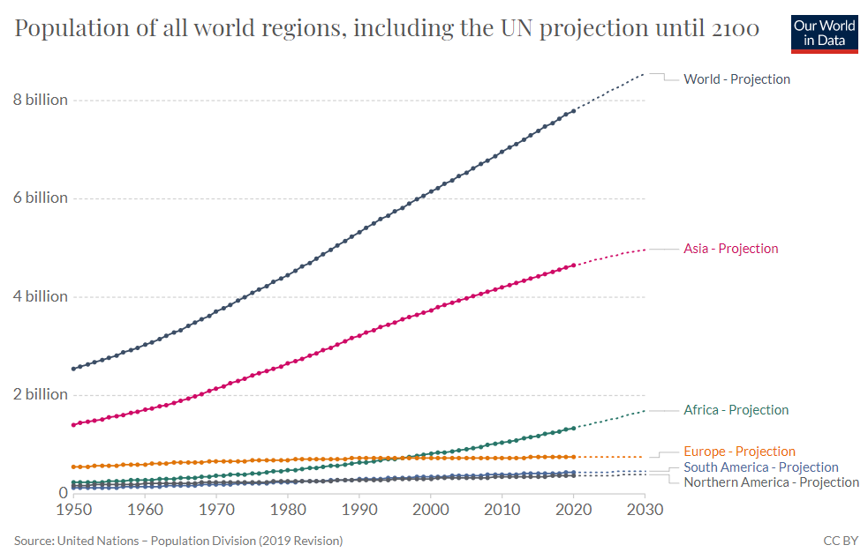
Contemporary Trends in Population Growth & Decline
Today, most population growth is happening in LDCs - specifically in Asia and Africa.
  NIR in Niger = 3.8%
  NIR in Spain = -0.11%

Slide 17

What causes population to grow & decline?
 | Population Growth - High TFR, CBR or life expectancy // Low CDR & IMR Agricultural societies Need children to labor on the farm Advancements in food production & nutrition Mechanization of agriculture Farming efficiency Advancements in sanitation Less water contamination & disease Water treatment plants Garbage pickup Economic prosperity Access to healthcare Core countries provide better healthcare services Prevention & cure of disease. Women have access to pre & post-natal care
ECONOMIC

Slide 18
What causes population to grow & decline?
 | Population Decline - High CDR & IMR // Low TFR, CBR, or life expectancy Industrial & post-industrial society Women more involved in the workforce Urbanization -> small living quarters Economic hardship Children are expensive, provision of food & resources Access to healthcare Women have access to contraceptives
ECONOMIC

Slide 19

What causes population to grow & decline?
 | Population Growth - High TFR, CBR or life expectancy // Low CDR & IMR Religion Traditional cultures encourage big families Restriction of contraceptive use and abortion. Earlier marriages = more children
 | Population Decline - High CDR & IMR // Low TFR, CBR, or life expectancy Role of Women - Education & Workforce Cultural expectations have changed in many MDCs -> more women in the workforce/education -> postpone having children -> reduction in child bearing years -> less children. Healthcare How to care for babies -> lower IMR, CDR, higher life expectancy Access & understanding of contraception -> lower TFR
SOCIAL

Slide 20

What causes population to grow & decline?
 | Population Growth - High TFR, CBR or life expectancy // Low CDR & IMR Pro-Natalist Population Policies Government encourages families through propaganda and incentives to have children. Shift from war to peace -> Baby Boom
 | Population Decline - High CDR & IMR // Low TFR, CBR, or life expectancy Anti-Natalist Population Policies Government discourages families through propaganda, disincentives, and policies. War Higher mortality rate, increase in migration shortages of supplies
POLITICAL

Slide 21
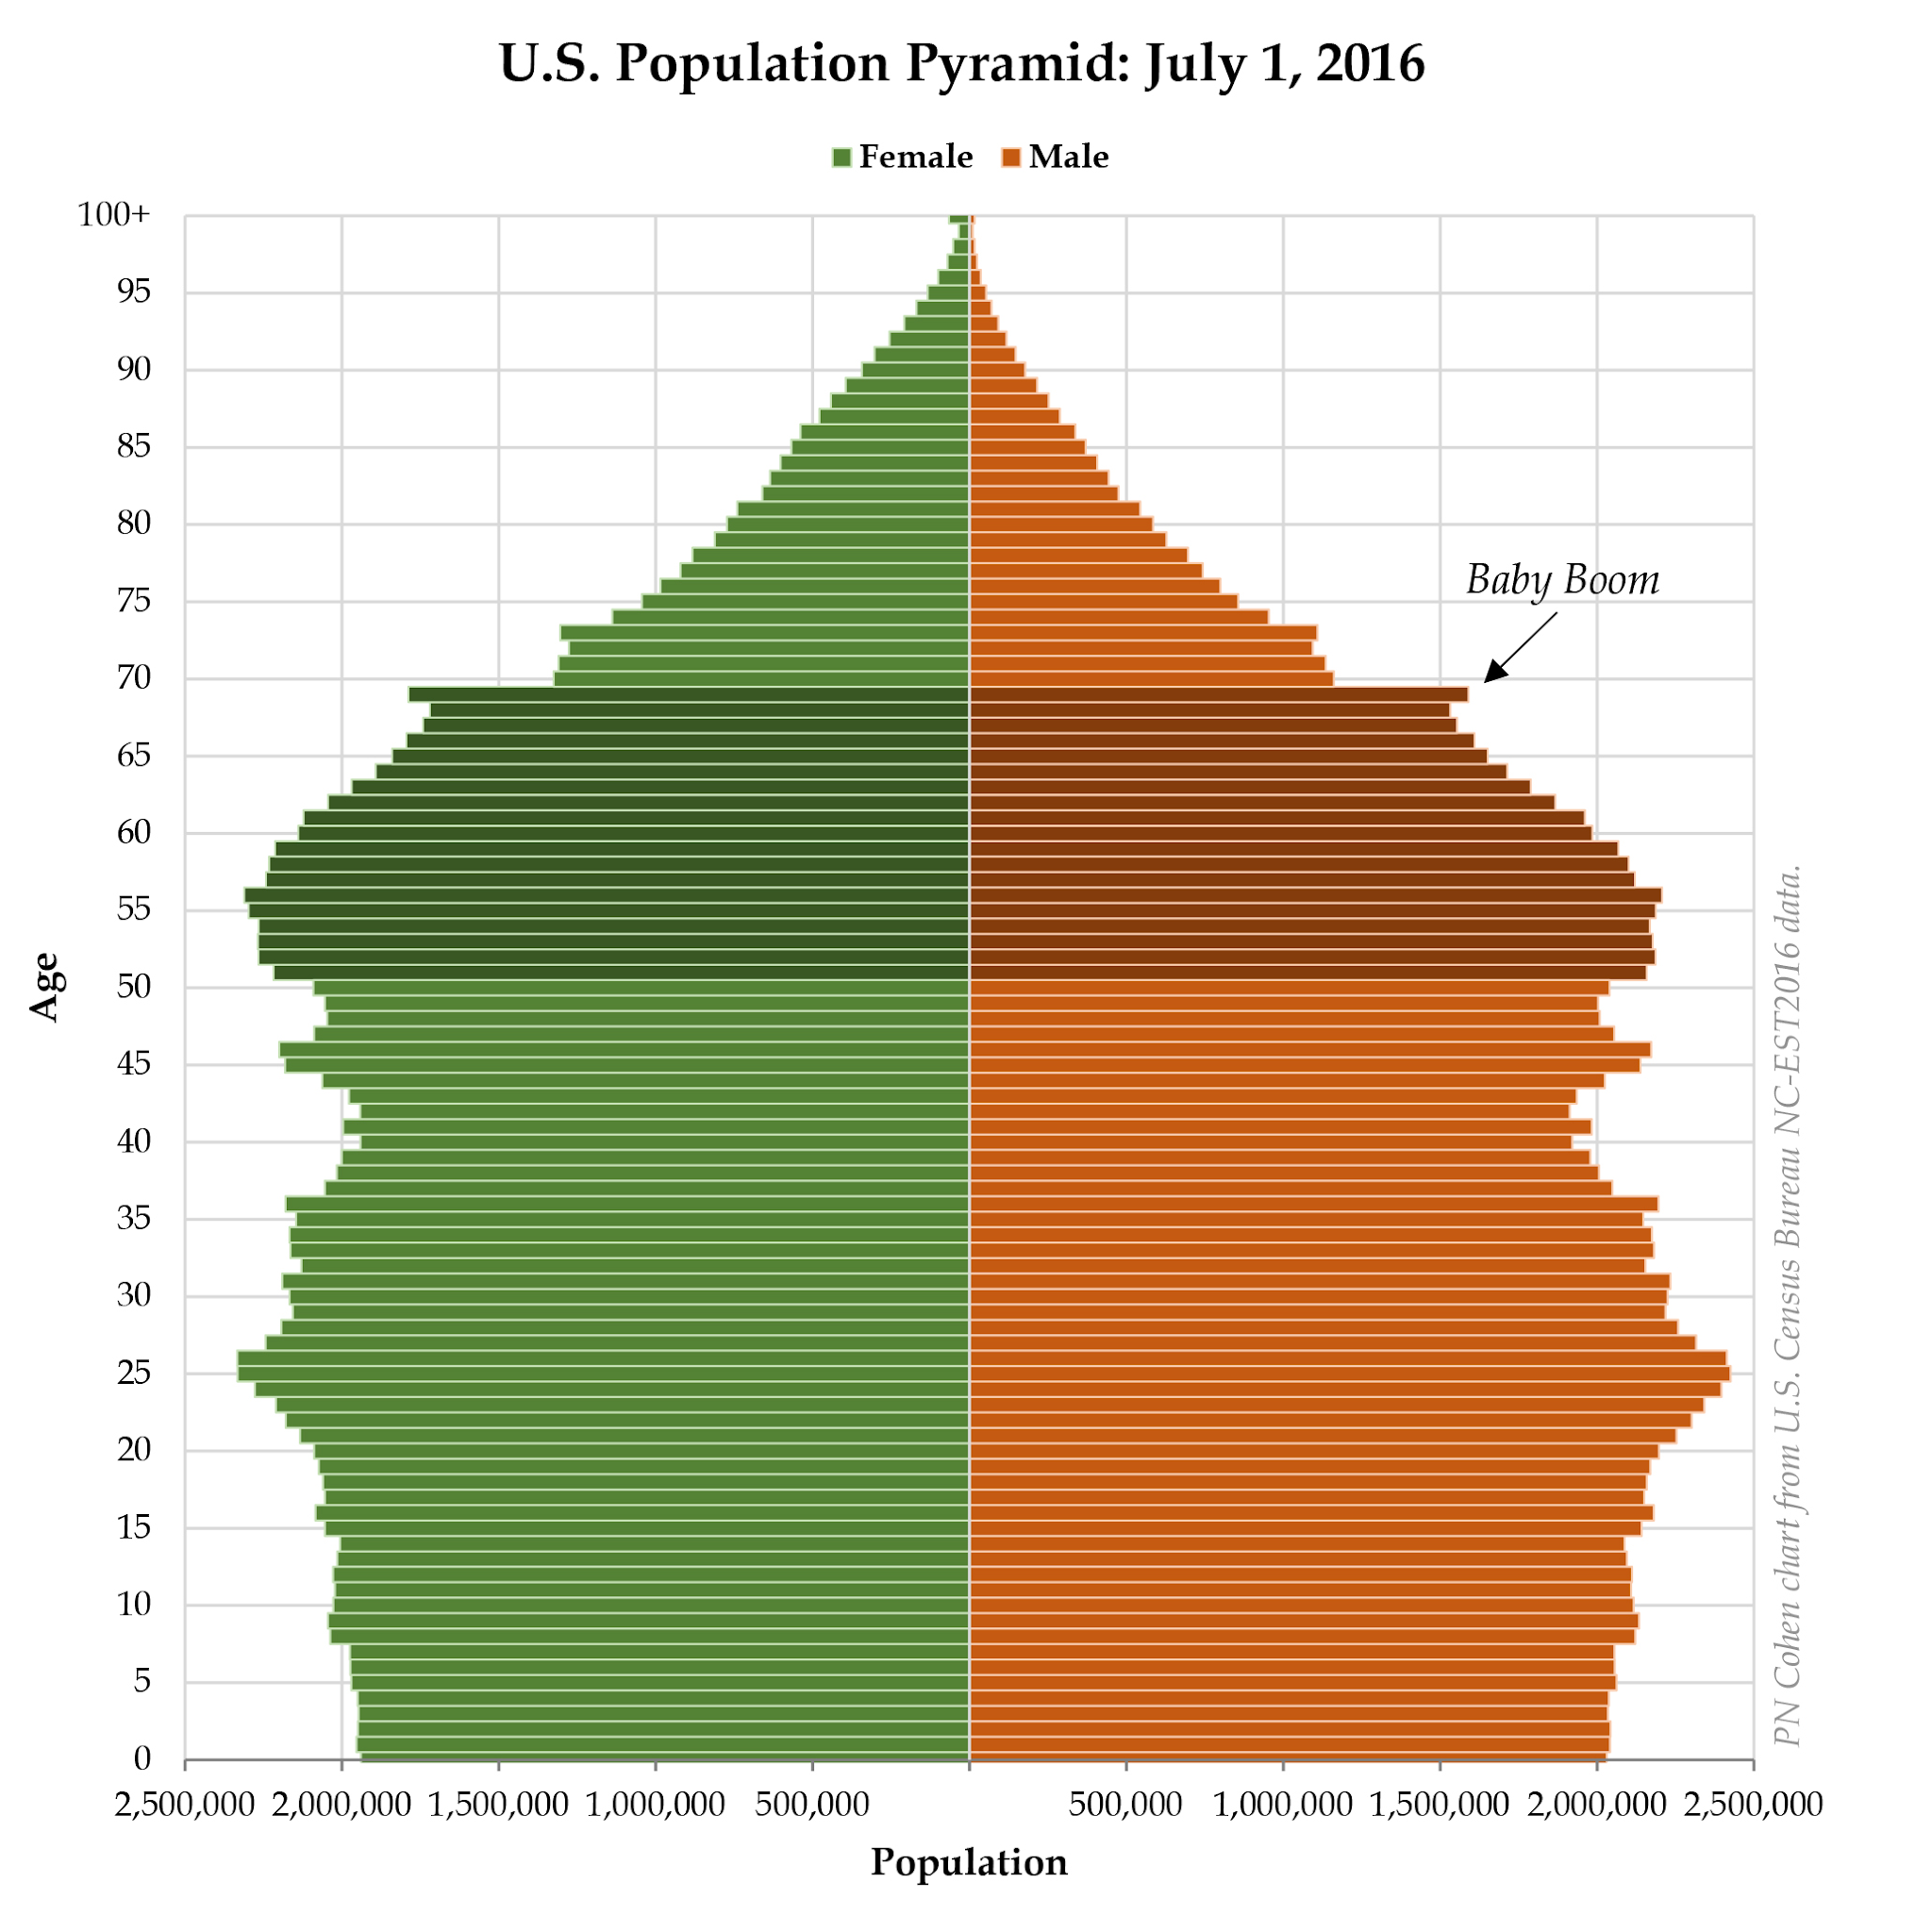

United States “Baby Boom” after World War II (1946-1965)
End of WWII
Economic Prosperity
Cultural Expectations of Women

Slide 22

What causes population to grow & decline?
 | Population Growth - High TFR, CBR or life expectancy // Low CDR & IMR
 | Population Decline - High CDR & IMR // Low TFR, CBR, or life expectancy Natural disasters (earthquakes, flooding, tsunamis, hurricanes) Famine & Drought Spread of disease 60% of Europe died in the 1300s due to Bubonic Plague
NATURAL

Slide 23
Objective and Essential Learning
2.4 Explain factors that account for contemporary and historical trends in population growth & decline.
Demographic factors that determine a population’s growth and decline are fertility, mortality and migration.
Geographers use the rate of natural increase and population doubling time to explain population growth and decline.
Social, cultural, political, and economic factors influence fertility, mortality and migration rates.

