Slide 1


APHG FRQ Workshop
Ms. Anderson

Slide 2

What is the FRQ
What does it stand for?
How many do I do?
How much time do I have?
There will be 3 FRQ Questions on your exam
Free
Response
Question
  75 minutes total, suggested 25 minutes per question
CLASS 2024

Slide 3
Yes!
Are there multiple parts per question?
A.
Question demands will start easy
B..
May ask you to do something simple to start
C.
But will get progressively more demanding
D.
As you go, the questions will ask you to analyze
E.
Draw conclusions about multiple sources of data
F.
And recall information you have learned.

Slide 4
What is Stimuli?
FRQ’s can include no stimuli, 1 stimuli, or 2 stimuli.
Maps
Graphs
Charts
Photographs
etc.

Slide 5





What will questions ask me to do?
Identify
Define
Describe
Compare
Explain
  1 sentence.
  2 sentences
  2-3 sentences
  5-6 sentences
  2-3 sentences

Slide 6
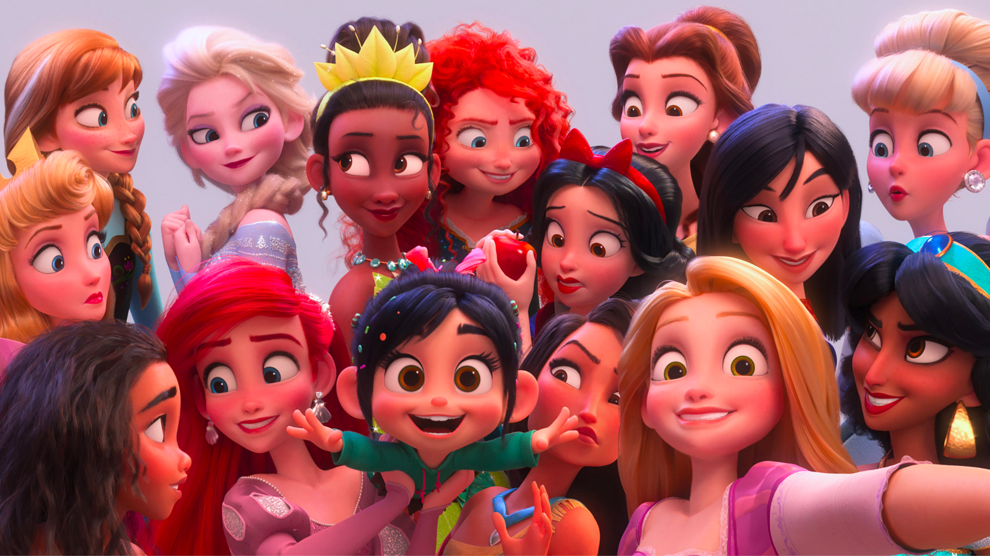
Examples: Identify
Identify two Disney Princesses:
Two Disney Princesses are Ariel and Elsa.

Slide 7
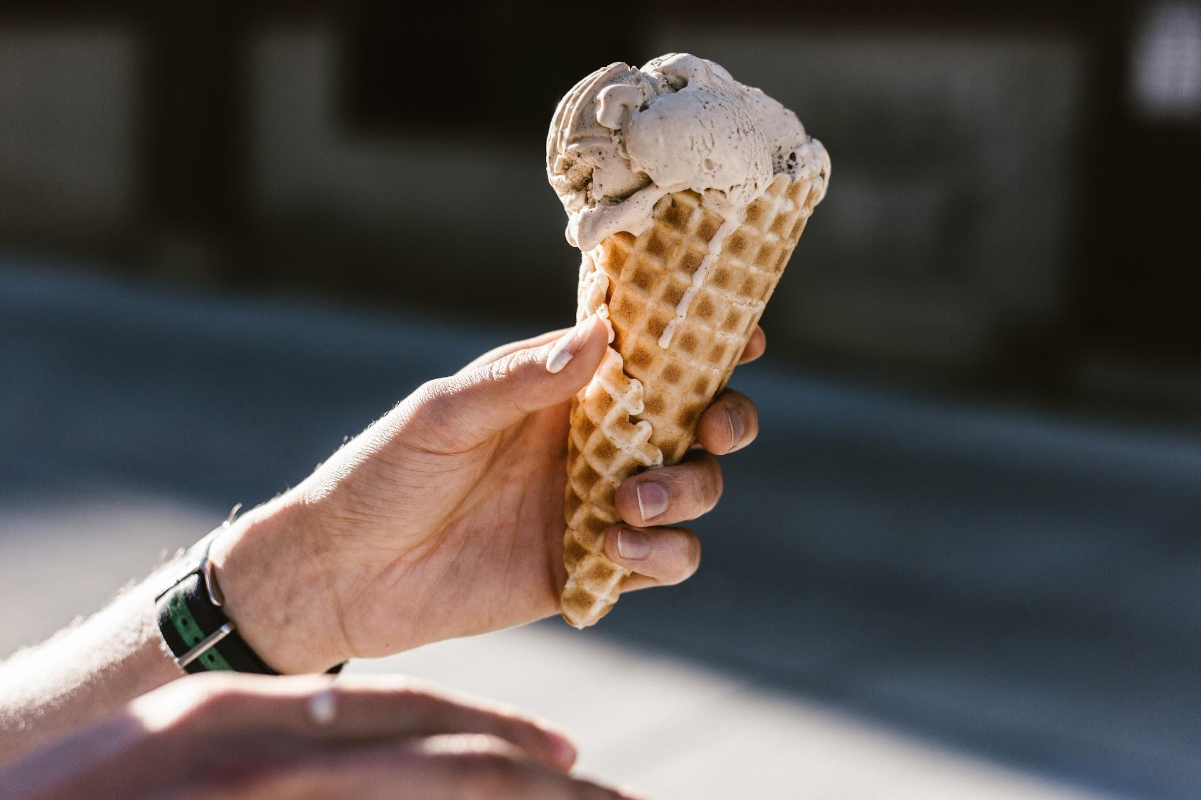
Examples: Identify
Identify two types ice cream.
1 sentence.
CLASS 2023
Notes:
🍐 This is a Pear Deck Text Slide
🍐 To edit the type of question, go back to the "Ask Students a Question" in the Pear Deck sidebar.

Slide 8
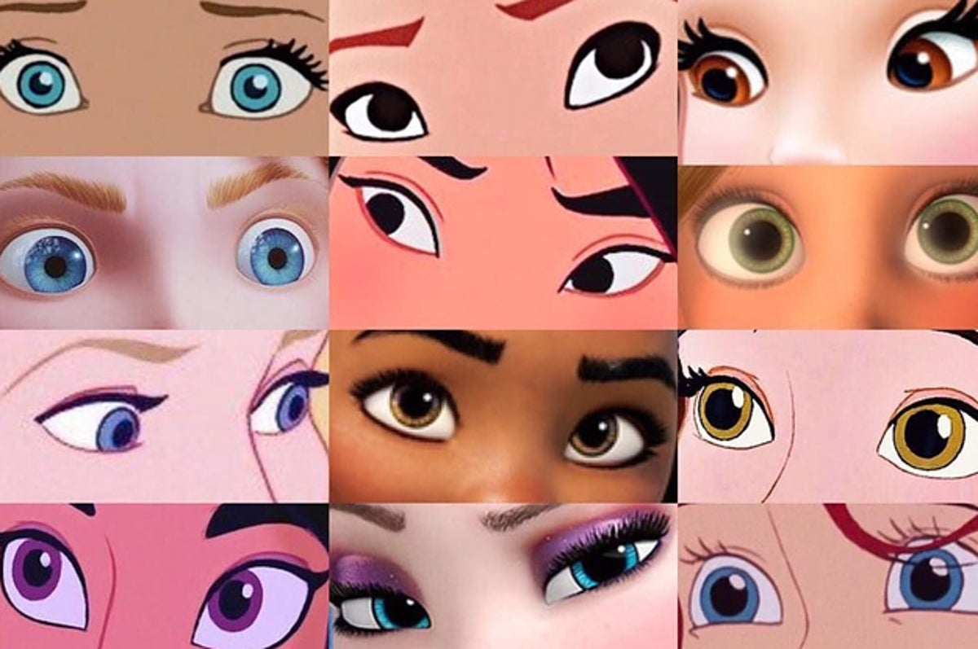
Examples: Describe
Describe common characteristics of Disney Princesses.
Disney Princesses typically are shown in pastel, bright, or soft colors. They usually have long, thick hair and large eyes.
CLASS 2023

Slide 9
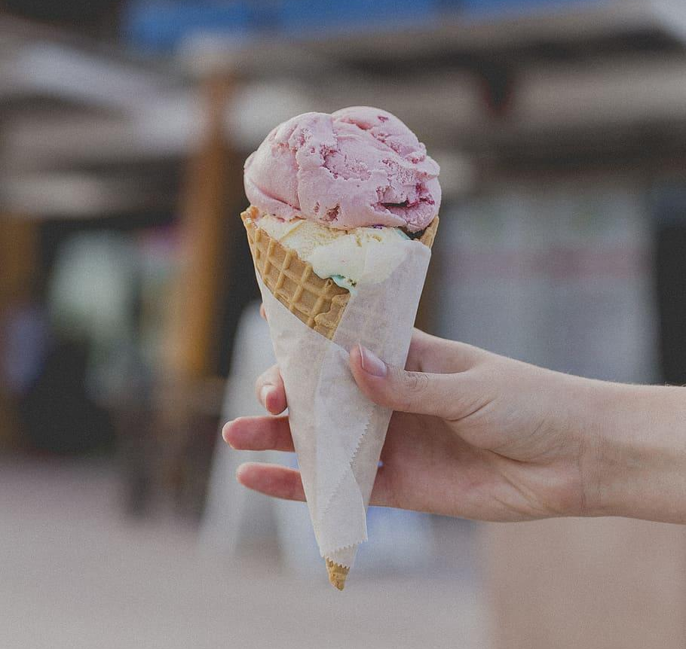
Examples: Describe
Describe common characteristics of ice cream.
2-3 sentences
CLASS 2023
Notes:
🍐 This is a Pear Deck Text Slide
🍐 To edit the type of question, go back to the "Ask Students a Question" in the Pear Deck sidebar.

Slide 10
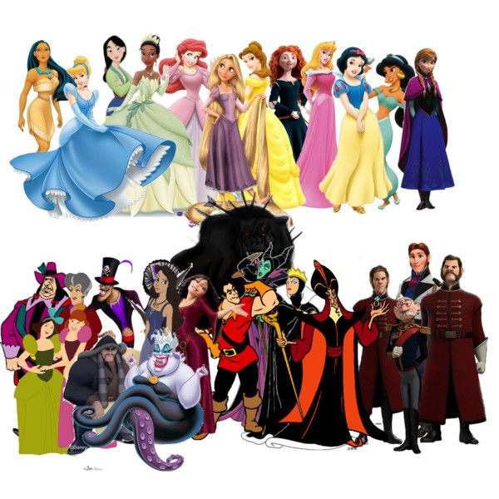
Examples: Explain
Explain why Disney Princesses are commonly shown in pastel colors.
Answer: Because colors red, black, and purple are the most memorable psychologically because they imply danger. Disney wants viewers to remember the actions of villains so that they won't repeat them. Therefore, characters like Scar and Jafar are usually shown in red, black, and purple. Princesses are shown in pastel colors in order to contrast their "good" with the villains "evil" in the story
CLASS 2023

Slide 11
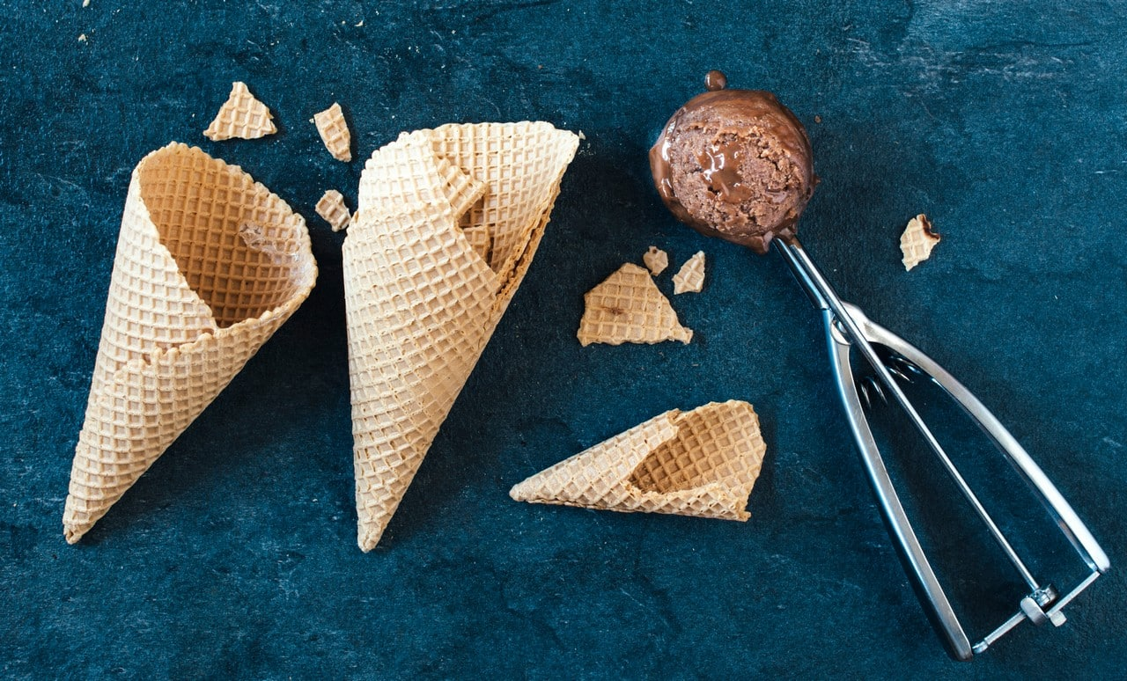
Examples: Explain
Explain why ice cream is more popular than other types of dessert.
2-3 sentences
CLASS 2023
Notes:
🍐 This is a Pear Deck Text Slide
🍐 To edit the type of question, go back to the "Ask Students a Question" in the Pear Deck sidebar.

Slide 12
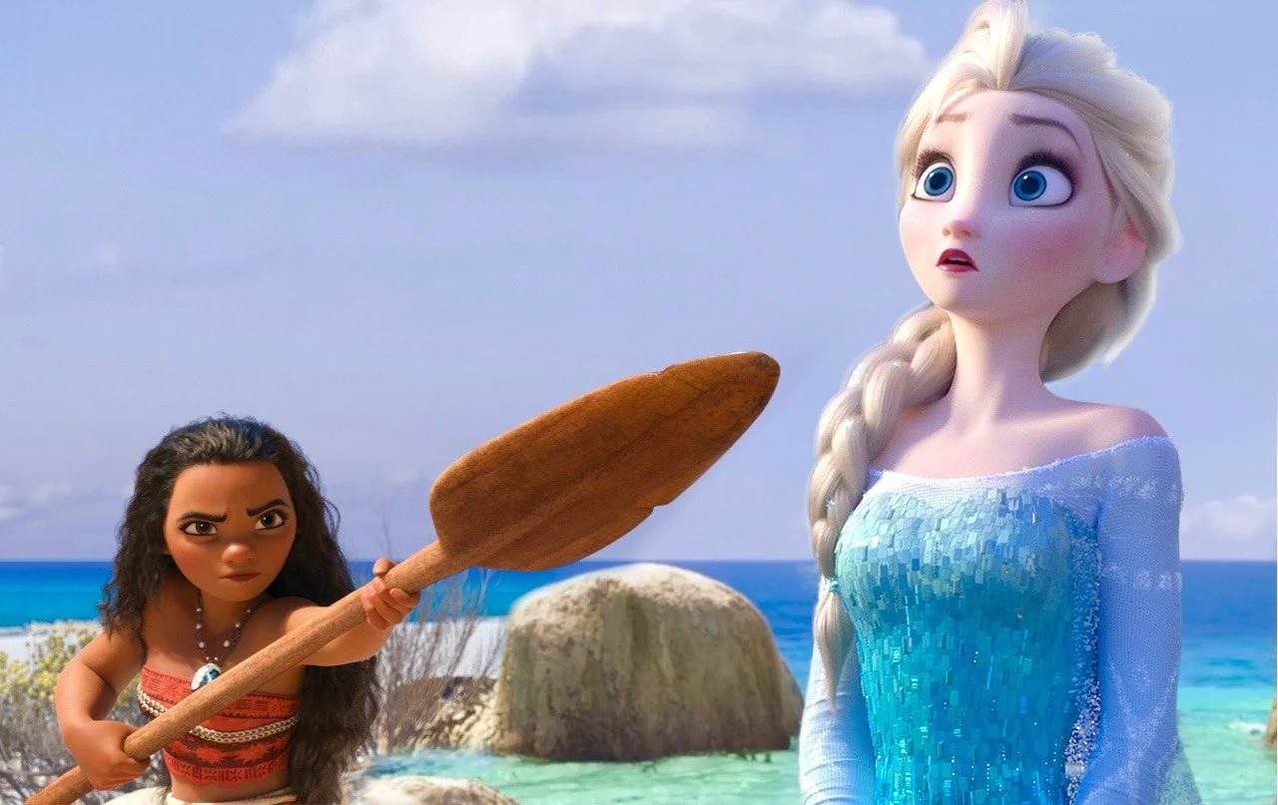
Examples: Compare
Question: Compare two Disney Princesses.
Answer: Elsa and Moana are both in leadership positions in their societies. Elsa is set to become the Queen of Arendelle while Moana is set to become to Queen of Motunui. Additionally, both Princesses flee their kingdoms before eventually returning home to rule. Water is a central aspect of both of the princesses stories. The geography of both princesses are different. While Elsa rules Arendelle, a kingdom set in Scandinavia, Moana rules Motunui, an island in the Pacific Ocean. Finally, Moana's parents are still alive to support here, while Elsa's parents died in a shipwreck when she was young.
CLASS 2023

Slide 13
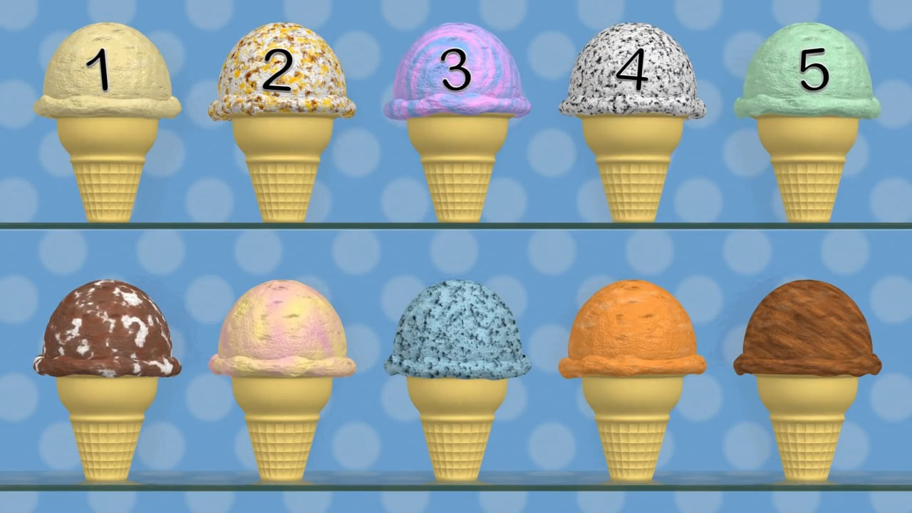
Examples: Compare
Compare (and Contrast) two different ice cream flavors
5-6 Sentences
CLASS 2023
Notes:
🍐 This is a Pear Deck Text Slide
🍐 To edit the type of question, go back to the "Ask Students a Question" in the Pear Deck sidebar.

Slide 14
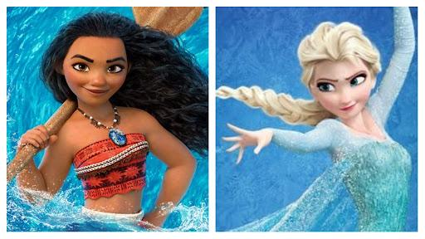
Examples: To what Degree
Question: Explain to what degree Disney Princesses affect children’s confidence development.
Answer: Seeing Disney Princesses and their stories can have a LARGE IMPACT on children and their confidence. Children can watch stories like Moana where she saves her home, or Elsa who learns to love herself and her powers. These uplifting stories can be positive examples to children on ways to deal with struggles in their own lives because they have good role models.
CLASS 2023

Slide 15
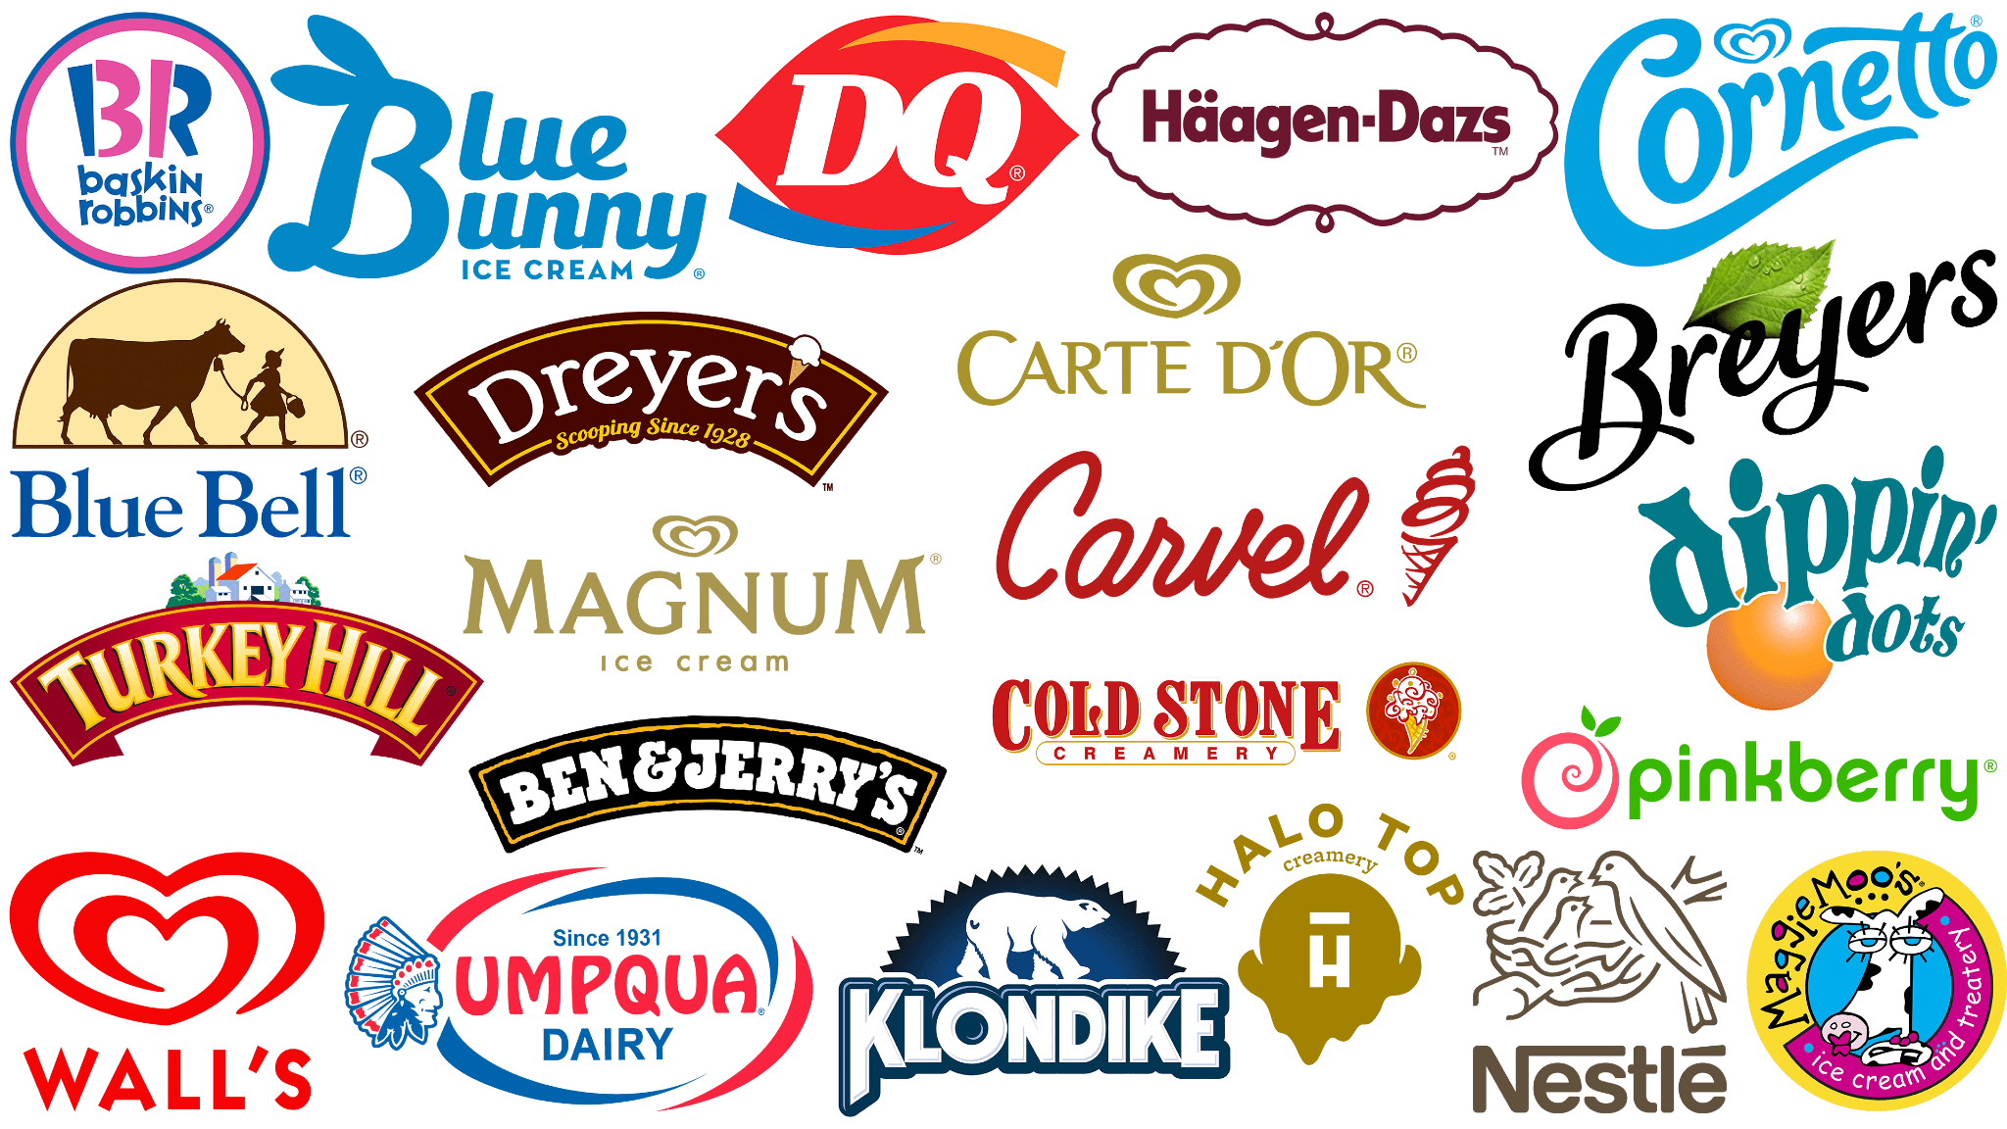
Examples: To what Degree
Explain to what degree the brand reputation influences the perceived taste and satisfaction of ice cream.
3-4 Sentences
CLASS 2023
Notes:
🍐 This is a Pear Deck Text Slide
🍐 To edit the type of question, go back to the "Ask Students a Question" in the Pear Deck sidebar.

Slide 16
Reminders
Identify topic, timeframe, key concepts, and command words.
Give space between answers.
Do not restate prompt.
No anti-examples.
Short answers are risky.
Always review answers
WRITE LEGIBLY!
Skim your FRQs, then make an outline.
In order to pass, need 12/21 points.
Label A. B. C. D. E. F. G.
Each strand is one point.
No double dipping
Give examples frequently
Use Vocab in context
CLASS 2023

Slide 17
Does it meet the length requirement?
For compare Questions: Does it close the loop
Checklist for FRQ’s
Does it use the expected vocabulary words?
Does it FULLY answer the question?
CLASS 2023

Slide 18
Time to write!

Slide 19
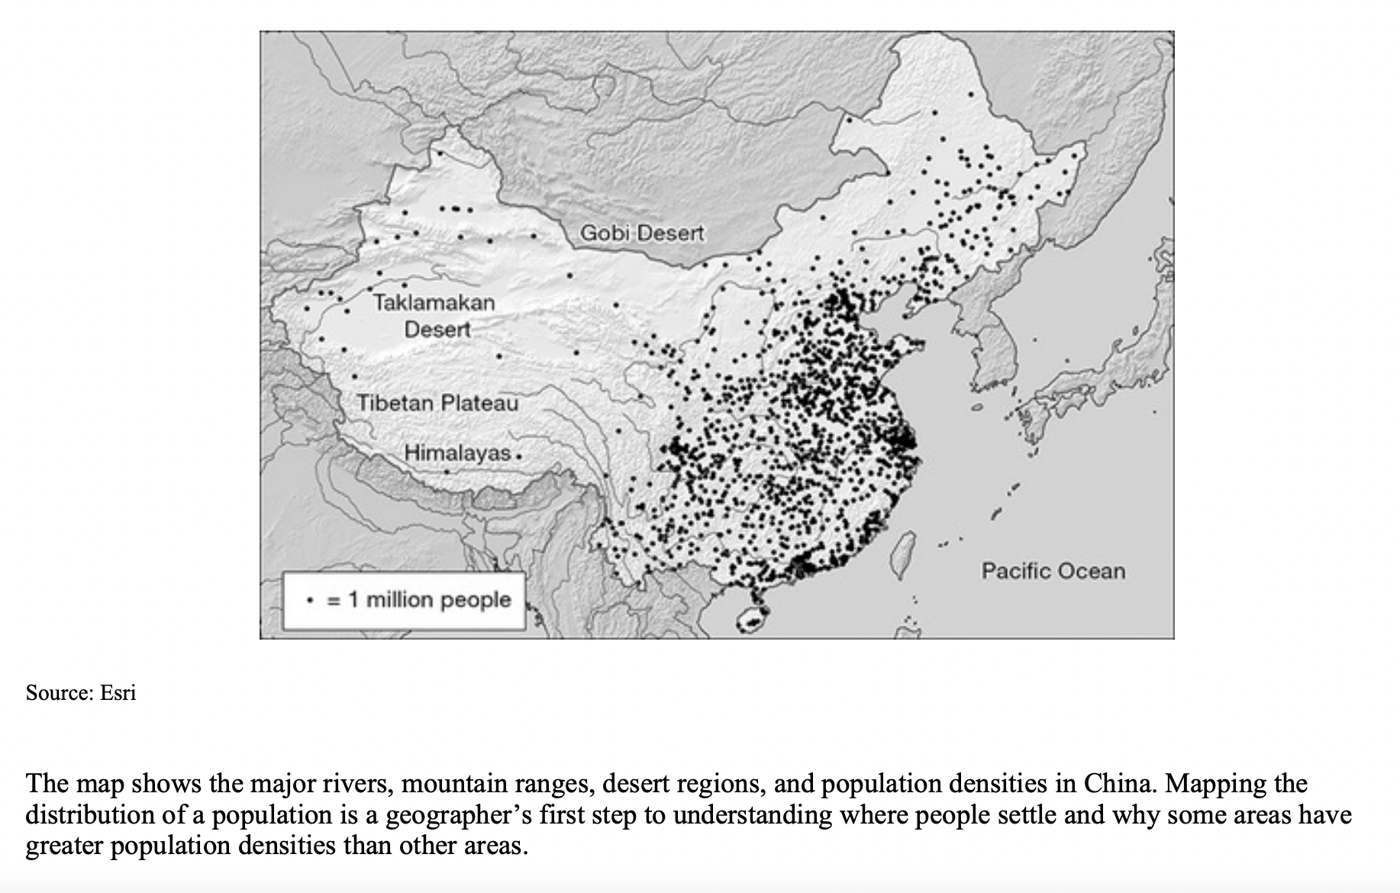
A. Identify what each point symbol on the map represents.
B. Identify TWO topographic features shown on the map.
C. Describe TWO ways that topography affects the spatial pattern of population distribution shown on the map.
D. Describe ONE way that the availability of natural resources may affect population distribution.
CLASS 2023
Notes:
🍐 This is a Pear Deck Text Slide
🍐 To edit the type of question, go back to the "Ask Students a Question" in the Pear Deck sidebar.

