Slide 1
Cryptocurrency price prediction
TEAM: THE MAVERICKS
C B Ananya, Ayshwarya B, Sathvika V S

Slide 2
Problem Statement
To predict the price of a given cryptocurrency at the end of the day by using historical data and a sentimental analysis on current global scenario.

Slide 3
Tech Stack
The entire backend was done using python
Since instantaneous data plays a major role in the algorithm, there is no necessity for a permanent storage space of data
Machine learning algorithm used - Ensemble model to improve accuracy
Sentimental analysis using TextBlob library

Slide 4
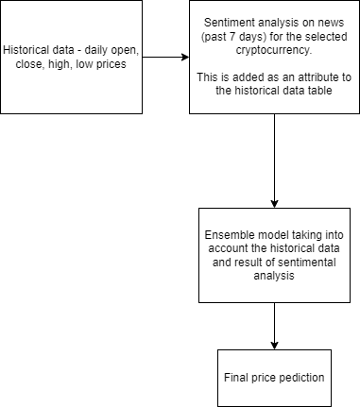
Flow diagram

Slide 5
THANK YOU

