Slide 1
Homework Assignment 0
Due Thursday (Midnight Baltimore Time)

Slide 2
Add yourself to the course website on Github Due Thursday (Midnight Baltimore Time)
0. Download these slides at
1. If you do not already have a Github account, create one at https://github.com/
2. Fork the class repo https://github.com/JEFworks-Lab/genomic-data-visualization
3. Clone the repo to your computer
4. Add a profile picture under the /assets/images/profiles as firstnamelastinitial.jpg
5. Create a profile for yourself under the _authors/ folder as firstnamelastinitial.md
6. Commit and push your local changes to your Github
7. Make a pull request to submit this assignment and merge your changes back to the class repo

Slide 3
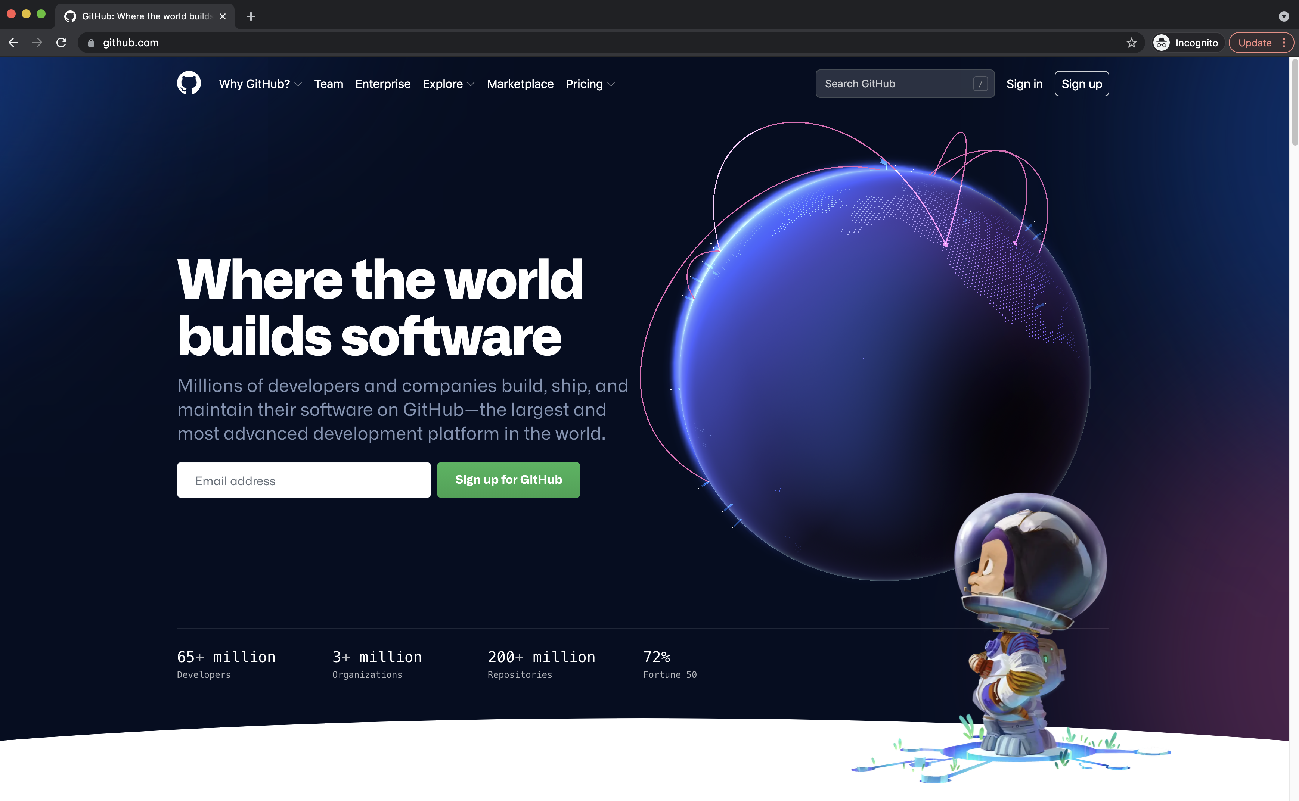
1. If you do not already have a Github account, create one at https://github.com/

Slide 4
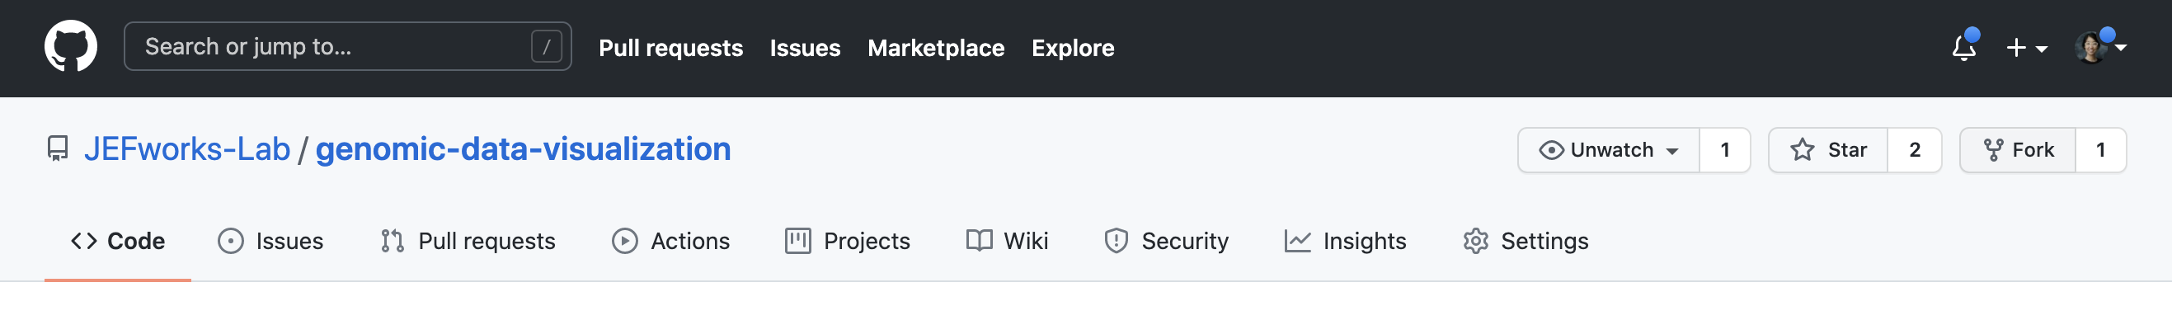
2. Fork the class repo https://github.com/JEFworks-Lab/genomic-data-visualization

Slide 5
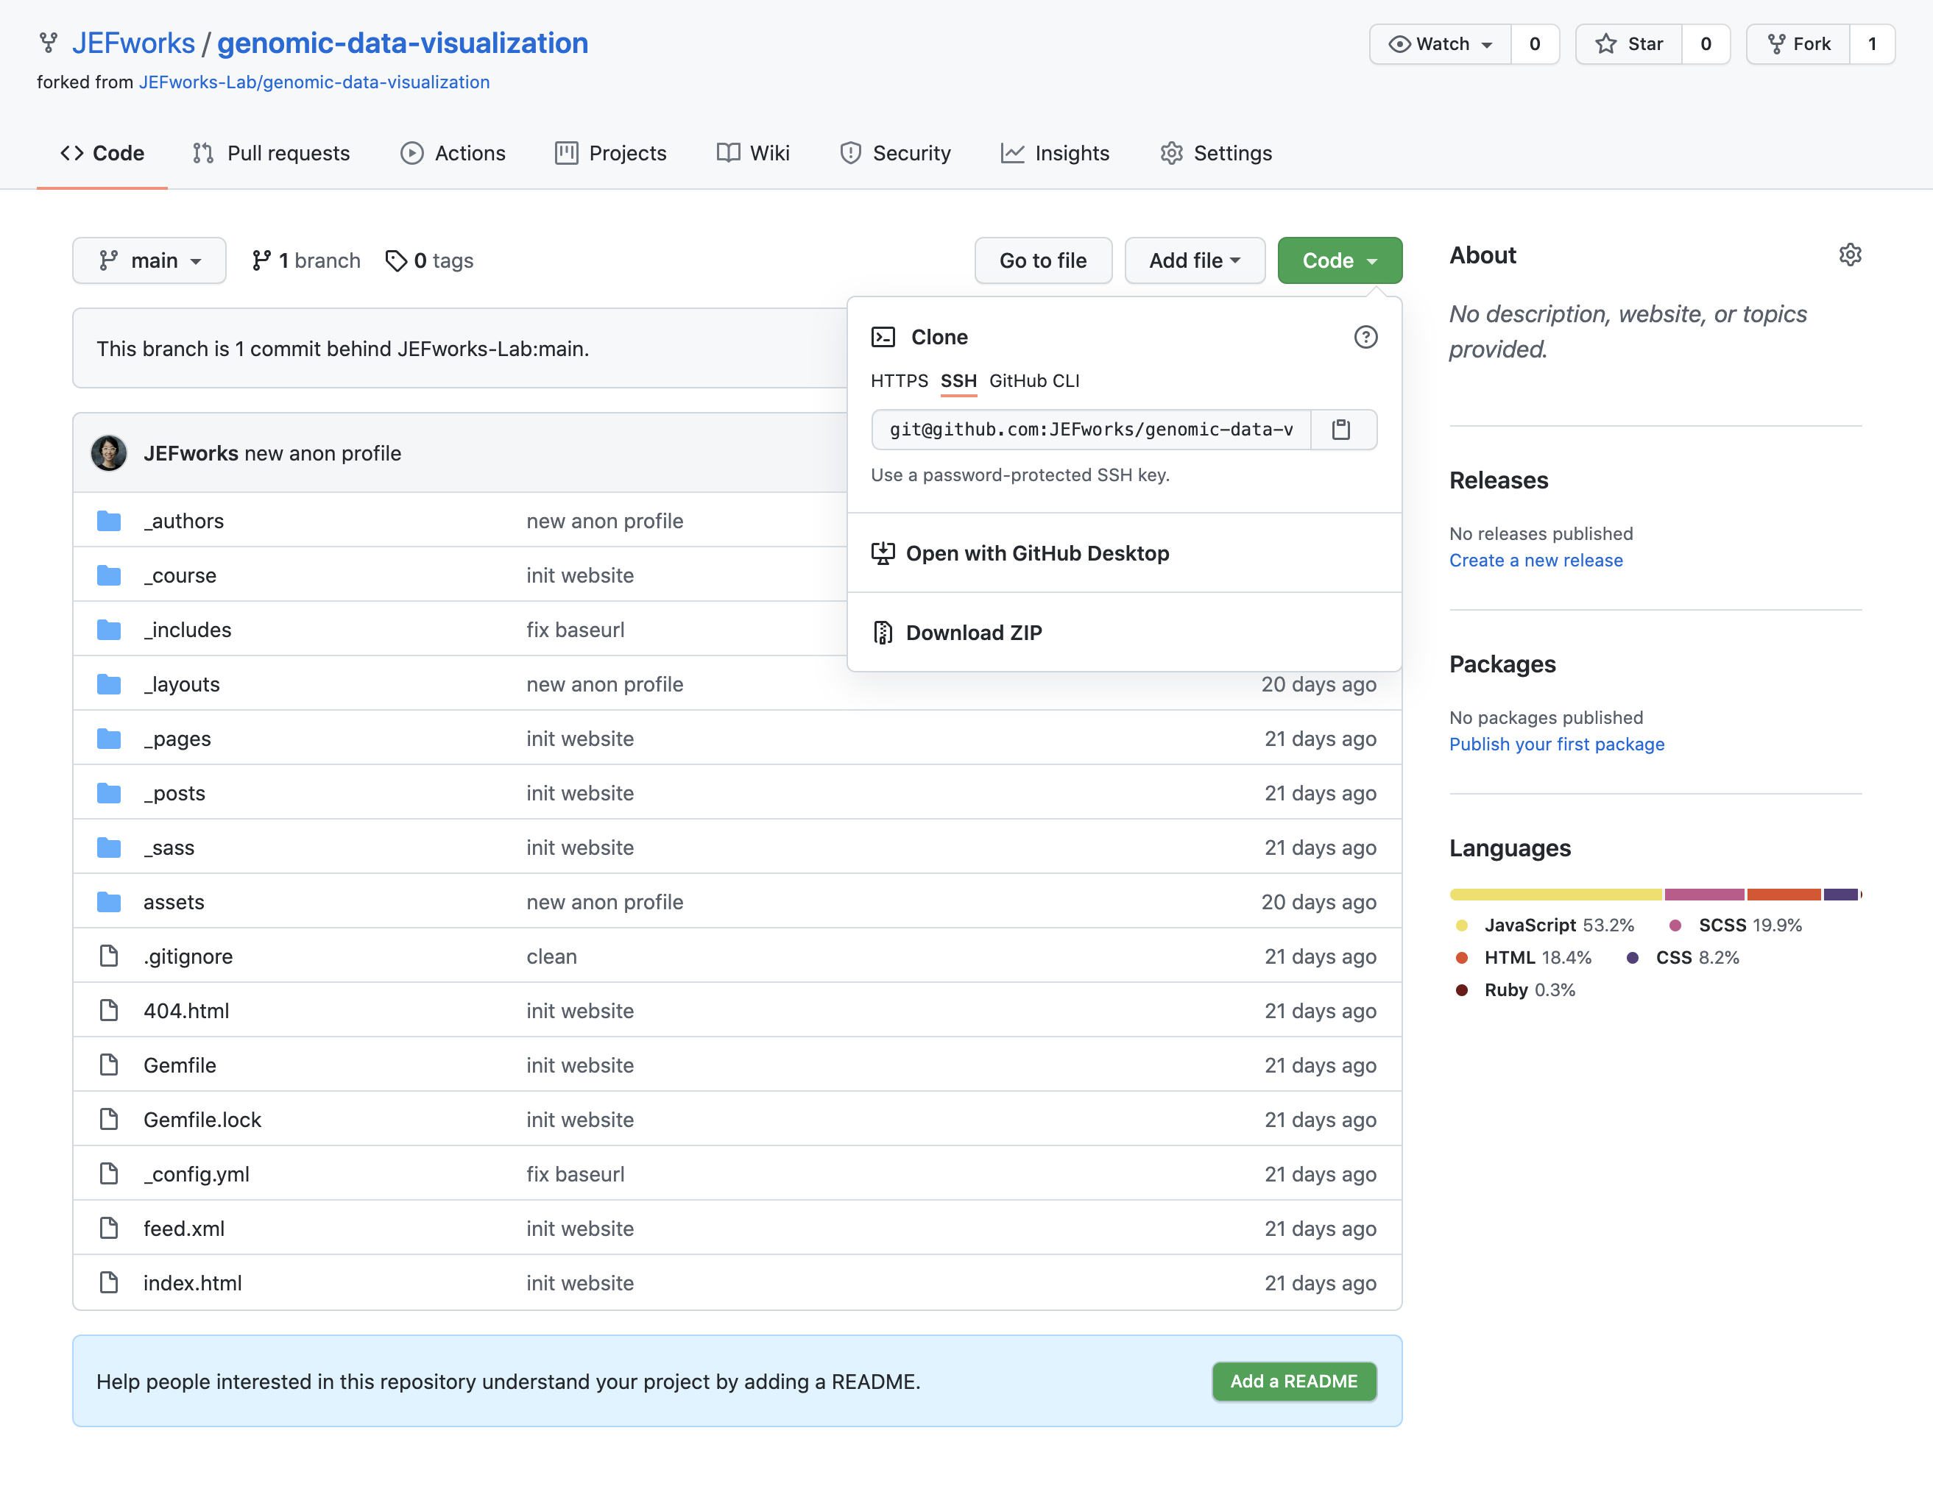
3. Clone the repo to your computer

Slide 6
4. Add a profile picture under the /assets/images/profiles as firstnamelastinitial.jpg
On your computer, add a 600x600 pixel photo of yourself under the /assets/images/profiles/ folder as firstnamelastinitial.jpg
You can use a real photo of yourself, an avatar, or any fun (appropriate) picture.

Slide 7
5. Create a profile for yourself under the _authors/ folder as firstnamelastinitial.md
under the _authors/ folder, copy the samplestudent.md markdown file to be firstnamelastinitial.md
edit the name to your first name and last initial
change the avatar URL to the image you added under the /assets/images/profiles/ folder

Slide 8
6. Commit and push your local changes to your Github.
Please double check that your changes are indeed on Github

Slide 9
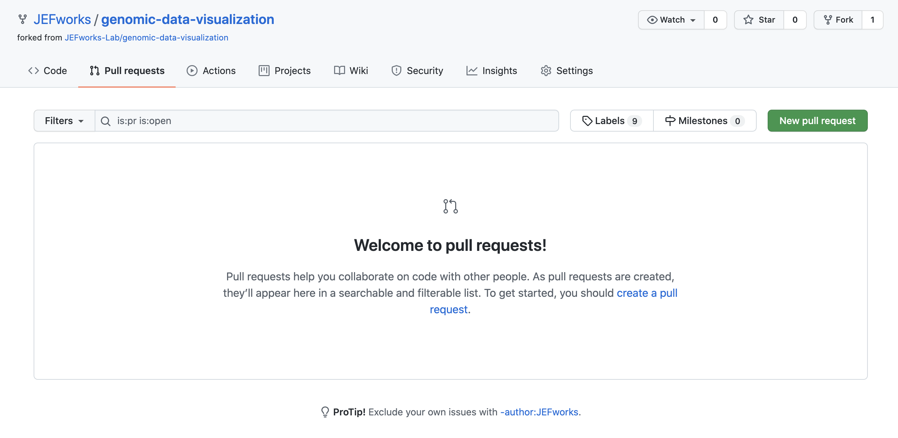
7. Make a pull request to submit this assignment and merge your changes back to the class repo.

