Slide 1
Lesson 0: Welcome and Introductions
Prof. Jean Fan

Slide 2
0.0 Lesson learning objectives
By the end of this lesson, you should understand what to expect from the course and what is expected of you.

Slide 3
0.1.0. Course descriptions
Spring 2022, 1st half Semester: Jan. 25 to Mar. 19 (MWF, 8-9:50 am) Location: TBD
As the primary mode through which analysts and audience members alike consume data, data visualization remains an important hypothesis generating and analytical technique in data-driven research to facilitate new discoveries. However, if done poorly, data visualization can also mislead, bias, and slow down progress. This hands-on course will cover the principles of perception and cognition relevant for data visualization and apply these principles to genomic data, including large-scale single-cell and spatially-resolved omics datasets, using the R statistical programming language. Students will be expected to complete class readings, create weekly data visualizations as homework assignments, and make a major class presentation.
Notes:
Who here is in the right class?

Slide 4
0.1.1 Course learning objectives
By the end of this course, you will be able to:
Critique a data visualization, distinguish a good from a bad data visualization, and devise techniques to improve bad data visualizations
Design and produce data visualizations for large multi-omic datasets
Become more comfortable with programming in R, version control using Github, and other programming basics

Slide 5
Survey: Why are you interested in taking this course?
Raise your hand if you…
Want to gain more experience in programming?
Want to gain more experience in genomics?
Want to gain more experience in visual communication?
Other?

Slide 6
0.1.2 Pre-requisites
You have access to a laptop that you can bring to class where you are able to download data and install software (required for in-class participation)
You know basic biology
DNA, RNA, protein
Cells, tissues, organisms
You know basic statistics
Estimates, standard errors, distributions

Slide 7
0.2. Course staff
Prof. Jean Fan Office Hours: Mondays and Wednesdays after class, and by appointment. Location: Wyman Park S253.
TA: TBD Office Hours: TBD

Slide 8
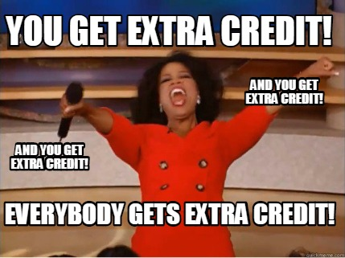
0.3. Course logistics
8 week course, 3 classes per week, 1 to 2 homework assignments per week, 2 quizzes, 1 final presentation, 2 extra credit assignments.

Slide 9
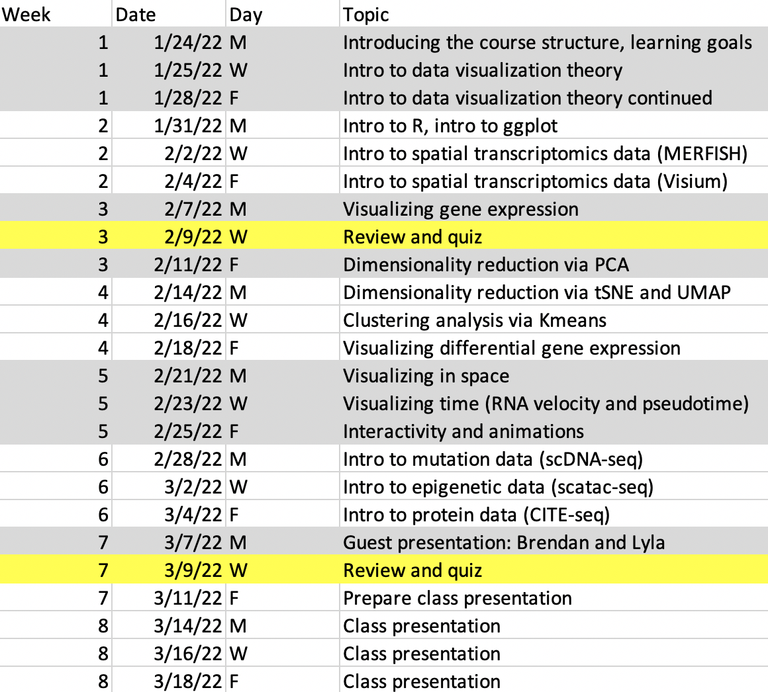

Slide 10
0.3.0. Grading
We aim to give you a grade that best reflects our assessment of your effort and learning with:
A == Excellent == 90%+
B == Passing == 80%+
C == Needs improvement == 70%+
We rarely give out grades below a C and if you consistently submit work, participate in discussions, and do your best you are very likely to get an A or a B in the course.

Slide 11
0.3.0. Grading (continued)
Homework: 40%
Quizzes: 10%
Preparedness/attendance: 30%
Final presentation: 20%
2 extra credit assignment opportunities to boost your grade up to 2%

Slide 12
0.3.1. Homework Assignments
If you submit each assignment, it is your own work, and it meets a basic level of completeness and effort you will receive up to 100% for that assignment. If you submit an assignment but it doesn’t meet basic completeness and effort you will receive 50%. If you do not submit an assignment at all you will receive 0%. A 30% deduction will be made for every day an assignment is submitted late up to 3 days, after which the assignment will be no longer accepted and you will receive a 0%.
We will be turning in all assignments electronically through Github. Assignments must be submitted by midnight (electronic timestamp) on the due date for full credit.

Slide 13
0.3.1.0. Data Visualization Homework Assignments
A part of this course will involve creating and describing data visualizations. For data visualization homework assignments, grades will be broken down according to the following characterization of your data visualization:
Did you address the question? (30%)
Did you use appropriate visualization techniques? (30%)
Was your description clear and precise? (30%)
Was your code reproducible? (10%)

Slide 14
0.3.1.1. Written Review Homework Assignments
A part of this course will involve reviewing public data visualizations as well as each others’ data visualizations both in written and oral form. For such written review homework assignments, grades will be broken down according to the following characterization of your review:
Was your review clear and precise? (50%)
Was your review polite and constructive? (50%)

Slide 15
0.3.2. Quizzes
There will be 2 quizzes in this class. Quizzes will be a combination of multiple choice with free form writing. Quizzes will also have at least 1 optional bonus question to boost your quiz grade up to 5%.

Slide 16
0.3.3. Final
The final for this course will be in the form of a presentation. The presentation grade will be determined based on peer evaluation.

Slide 17
0.4. Code of Conduct
Be considerate in speech and actions, and actively seek to acknowledge and respect the boundaries of other members.
Be respectful.
Refrain from demeaning, discriminatory, or harassing behavior and speech.
Take care of each other.

Slide 18
0.5. Policy on Plagiarism
Plagiarism is defined as taking the words or ideas of another and representing them as one’s own.
We welcome the sharing of ideas between students as well as consultation of online materials. We find both are important resources that can greatly aid your independent learning.
However, if you use the code, words, and/or ideas of another person, be it an online resource or fellow classmate, please provide a statement of attribution (e.g. give credit) such as in the form of a link to the online resource or a mention by name of the collaborating student.

Slide 19
0.6.0. Disability Services
The Disability Services program within the Office of Institutional Equity oversees the coordination of reasonable accommodations for students and employees with disabilities, and serves as the central point of contact for information on physical and programmatic access at the University. More information on this policy may be found at https://oie.jhu.edu/ or by contacting (410) 516-8075.

Slide 20
0.6.1. Health-related absences
If you are ill or suspect you have been exposed to a contagious illness, please contact Student Health and Wellness. Please do not come to class.
Please reach out to the course staff to inform them of your health-related absence as soon as possible so that we can best accommodate your absence.

Slide 21

Questions? Comments? Feedback?
Wyman Park S253

Slide 22
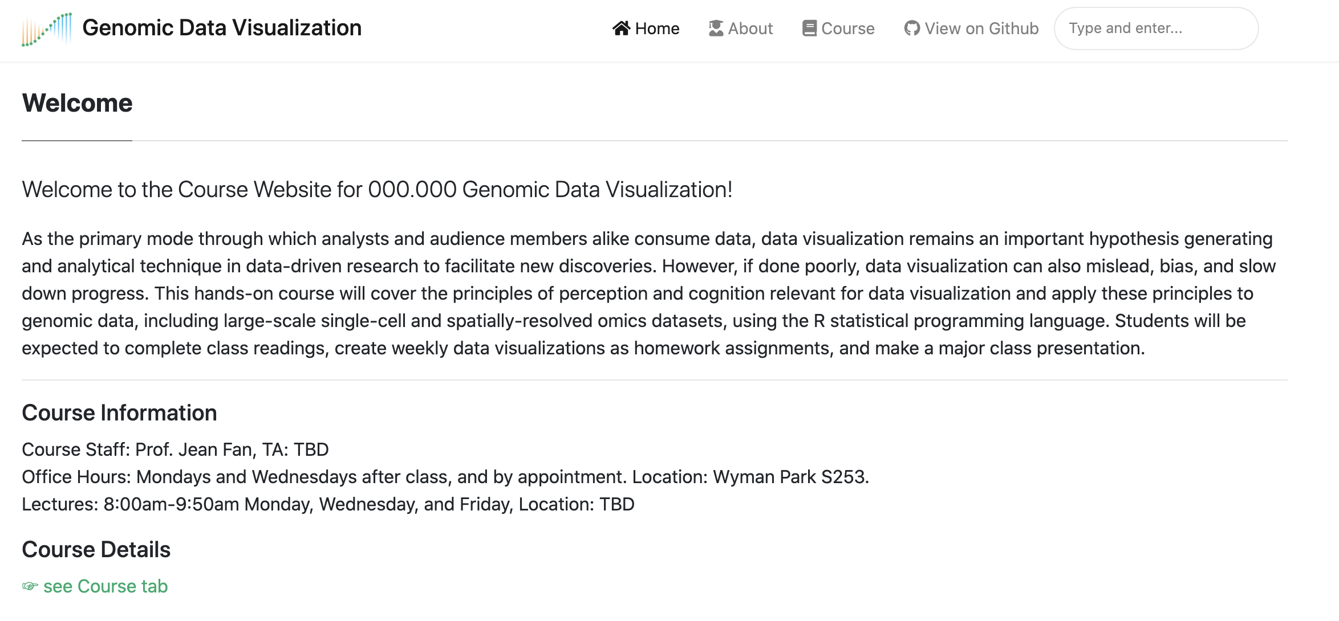
Course Website: https://jef.works/genomic-data-visualization/

