Slide 1

Part 1.1 Comparative Analysis of Personal Genomes
James Diao, Dingjue Ji, and Nir Neumark
Yale University
9 May 2017

Slide 2
overview
introduction to genomic databases
retrieving annotations for variants
retrieving population frequencies for variants

Slide 3
1 | introduction to genomic databases

Slide 4
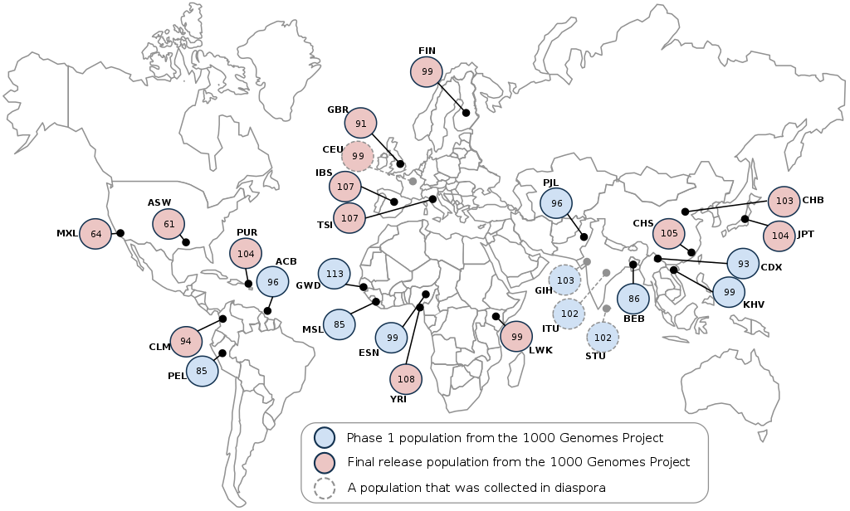
human genetic variation
Reference genetic variation: catalogues the “normal” range of variation in human genomes
Populations: ancestral groups cluster together
Notes:
Much can be learned from collections of variants in large populations. Newer datasets have additionally enabled the identification of novel variants, accurate estimation of allele frequencies, and stratification by ancestral population groups.
The clinical utility of carefully cataloging genetic diversity is clear. Analysis of a personal genome involves evaluating its differences from the normal range of genetic variation. This normal range is inferred by comparison to many other genomes in some database. A variant identified as disease-causing or protein-knockout can be searched up in such a database to find how common it is. Variants that are very common (relative to disease prevalence) may be dismissed as uninformative. Rare variants, on the other hand, are often considered to be highly penetrant.

Slide 5
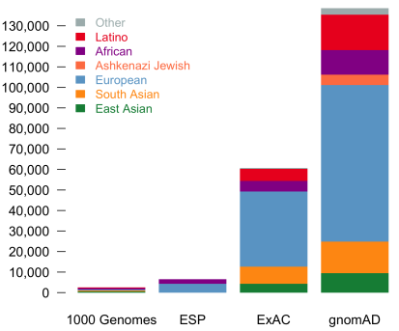
genomic databases
1000 Genomes Project (1KGP): individual-level genomes (2,504)
Exome Sequencing Project: aggregated population-level exomes (6,515)
Exome Aggregation Consortium (ExAC): more aggregated population-level exomes (60,706)
Genome Aggregation Database (gnomAD): update to ExAC; even more population-level exomes and genomes (138,632)
Notes:
Sample size: The rise of next-generation sequencing has enabled the collection of massive amounts of data. Rapid improvements to efficiency, speed, and cost have increased the number of sequenced genomes and exomes documented in public databases. This has allowed unprecedented resolution for estimating allele frequencies, as well as identifying new variants.
Data aggregation: Combining data across a large number of studies is an efficient way to increase the sample size of a genomic database. However, uniform processing and other corrections are needed to account for issues like variable coverage and reference bias. Groups like the MacArthur Lab, which assembled the ExAC and gnomAD databases, have developed a number of techniques for effectively managing and processing exome data in the past few years. In the future, efforts of similar methods and scale could be performed for genomes as well.

Slide 6
2 | retrieving annotations for variants

Slide 7
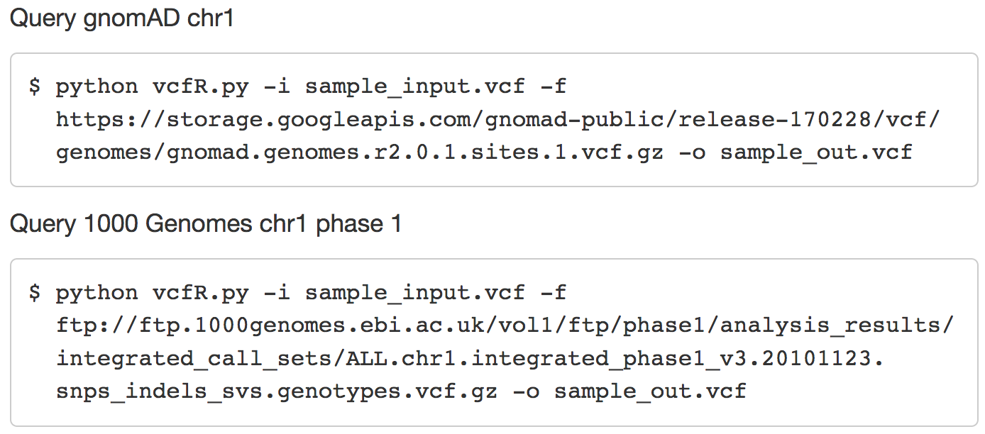
vcfR: query tool
Notes:
Online browser and API access are not straightforward for users interested in using their own variant call files (VCFs) to retrieve a slice from a very large database. We propose a tool, vcfR, to help users to use VCFs to query certain variants within a reference dataset. The reference can be a standalone file or a link. The reference can be customized and the searching process is fast given proper reference and sorted order of query by genome position. The usage of vcfR is as follows: python vcfR.py -i <input.vcf> -f <ref.vcf.gz> -o <output.vcf> The matched terms in input file will be output to a file named input_matched.file in case of the comparison between matches and output. As mentioned earlier, vcfR can also deal with online reference, e.g., to query chr1 variants in 1000 Genomes and gnomAD:

Slide 8
results from vcfR
Directly compared with reference VCF
No need to download
--anno option
Calling myvariant database
Matched terms in reference
Annotation in JSON format
Easier for further analysis
Sample_input:
190 variants in coding regions
Different variants:
chr1:g.12783G>A : intron_variant
chr1:g.14464A>T : non_coding_transcript_exon_variant
…
Notes:
All the annotations will be saved into a js on file named “sample_input_matched.json”. It would be easy to use tools or simple codes dealing with JSON files to get annotations. In this case, 854 variants are matched in gnomAD. Users are able to retrieve information after simple processing of the JSON file, for example, 190 variants in coding region are identified and the type of sequence variants is recorded, for example, chr1:g.12783G>A : intron_variant, chr1:g.14464A>T : non_coding_transcript_exon_variant…

Slide 9
3 | retrieving population frequencies for variants

Slide 10
ANNOVAR
Pinpointing a small subset of functionally important variants
Mutation prediction approach for annotation
Identify subsets of variants based on comparison to other variant databases:
dbSNP
1000 Genome Project
gnomAD - Genome Aggregation Database
Pipeline: Download -> Convert -> Analyze

Slide 11
Download
annotate_variation.pl -downdb 1000g2015aug humandb -buildver hg19
annotate_variation.pl -buildver hg19 -downdb -webfrom annovar gnomad_genome humandb/

Slide 12
VCF conversion
convert2annovar.pl -format vcf4 -withfreq data/indel.vcf > data/indel.avinput
convert2annovar.pl -format vcf4 -withfreq data/snp.vcf > data/snp.avinput

Slide 13
Analysis
annotate_variation.pl -filter -dbtype 1000g2015aug_all -buildver hg19 -out indel data/indel.avinput humandb/
annotate_variation.pl -filter -dbtype hg19_gnomad_genome -buildver hg19 -out snp.gad data/snp.avinput humandb/

Slide 14
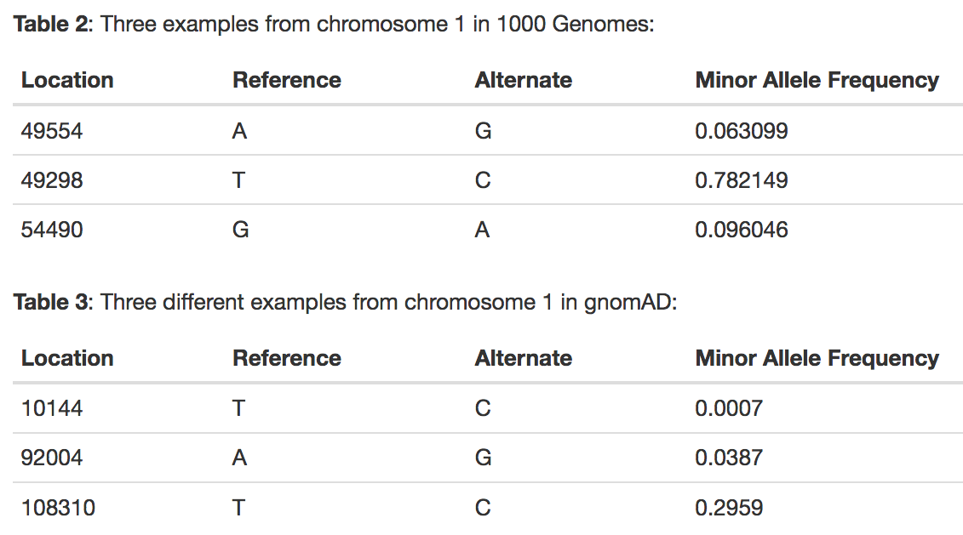
sample allele frequencies
Notes:
llele frequencies were collected variants in both 1000 Genomes and in gnomAD using ANNOVAR.

Slide 15
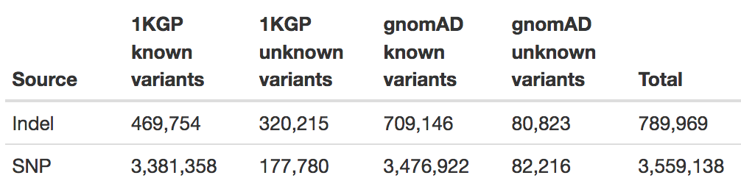
sample allele frequencies
Proportion of private variants is different by 2.5% and 30% for SNPs and indels, respectively, when comparing 1000genome to gnomAD.
gnomAD contains much more variants, as we expect, since it comes from a much larger cohort.
Notes:
A comparison of subjectZ (Carl) with all individuals in 1000 Genomes: 95% of the SNPs (~3.4M) and 60% of the indels (469K) were found in at least 1 other individual. This leaves 5% of the SNPs (~178K) and 40% of the indels (320K) as private variants.
A comparison of subjectZ with all individuals in gnomAD: 97.5% of the SNPs (~3.5M) and 90% of the indels (709K) were found in at least 1 other individual. This leaves 2.5% of the SNPs (~82K) and 10% of the indels (81K) as private variants.

Slide 16
summary
genomic databases are important for understanding the “normal” range of genetic variation
vcfR retrieves online references
ANNOVAR retrieves genome frequencies and annotations
Notes:
A comparative analysis of Carl’s personal genome is useful for finding which variants are functionally important, and how common those variants are. Here, we have developed tools and a pipeline for retrieving information on Carl’s personal variants. Although the variants were too numerous to collect annotations on all of them in our time frame, we demonstrate that, based on the gnomAD dataset, 2.5% of Carl’s SNPs and 10% of his indels are private variants. Additionally, our pipeline is able to collect allele frequency data for non-private variants. From here, it would not be a difficult next step to identify pathogenic annotations of shared variants as candidates for clinical reporting.

