Slide 1
CRISPR and personal genomics: The impact of SNPs on sgRNA sets and off target mutations
CBB752 final project 2-2
May 18, 2017
Jay Stanley, Acer Xu and Jiawei Wang

Slide 2
Introduction
Cas9 activity depends on both sgRNA sequence and experimental conditions.
While obviously conditions inside the human body are difficult to control, knowledge of sgRNA sequence will greatly impact the effect of CRISPR/Cas9 efficiency.
The many SNPs in Carl’s genome may lead to a variety of different off-target effects, which can be alleviated via well thought out application of CRISPR guide RNA selection rules.
Overall, introduction of SNPs will generate novel NGG sites relative to any guide genome, leading to poor effects from any “generalized” CRISPR therapeutic strategies.
Any CRISPR therapeutics will therefore require an initial genome sequencing to ensure that a full knowledge of potential S. pyogenes CRISPR sites is known.

Slide 3
Introduction
Additionally, any SNPs in guide sequence areas would lead to lower Cas9 cleavage rates at those loci.
Base-pair mismatches will lead to decreased affinity in on-target sites, but may also lead to increased affinity in off-target sites.
Using techniques such as tru-gRNA (truncated guide RNA) or a gRNA extension could also lead to more specific cleavage, but this again would be affected by SNP changes.

Slide 4
Introduction (cont.)
Overall, the best way to avoid SNPs causing both undesired off-target effects or decreased therapeutic efficiency is probably through thorough sequencing and screening of the patient-genome prior to construction of CRISPR gRNA sequences.

Slide 5
Writing
How might SNPs in Carl’s genome impact the use of CRISPR as a treatment? Discuss how individual SNPs would impact the off-target effects in the presence of the SNP.

Slide 6
Coding
Propose a tool that finds PAM sites in the human reference genome as well as Carl’s genome and compares the similarity of the two sets.

Slide 7
Coding idea
Take the commonly used CRISPR/Cas9 PAM sites: NGG as example
Find all the NGG (GG) sites on the reference genome (GRCh37)
Replace the reference genome with Zimmrome SNPs
Find all the NGG (GG) sites on the altered genome (Zimmerome)
Compare the NGG distribution on the two genomes

Slide 8
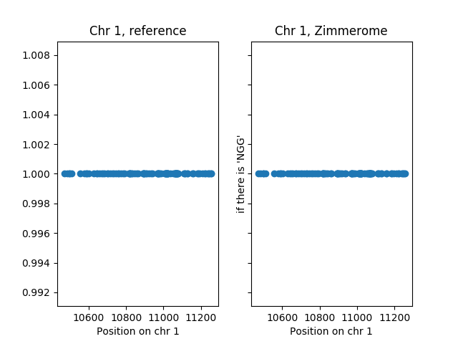
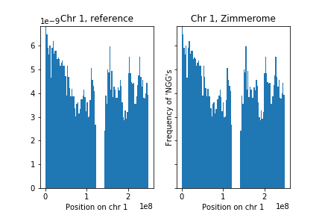
NGG sites on chromosomes

Slide 9
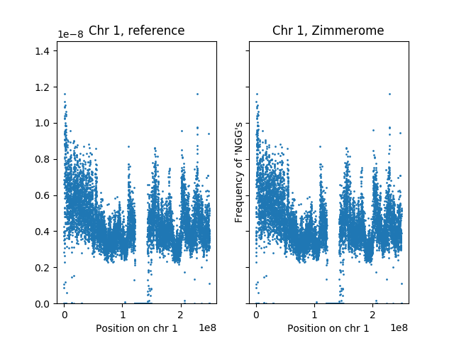
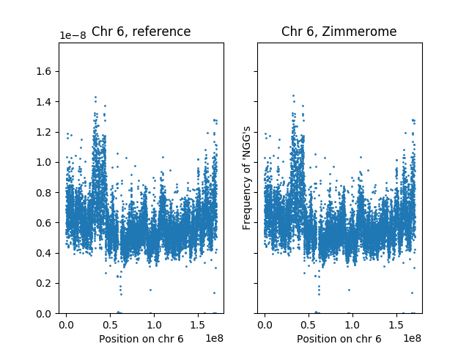
The uneven distribution of NGGs

Slide 10
Gained and lost PAM sites due to SNPs
#chrom | pos | change | #chrom | pos | change
1 | 58209 | gained | 1 | 79049 | lost
1 | 65743 | gained | 1 | 88176 | lost
1 | 74553 | gained | 1 | 91473 | lost
1 | 122813 | gained | 1 | 91474 | lost
1 | 127489 | gained | 1 | 101266 | lost
1 | 230057 | gained | 1 | 133482 | lost
1 | 250232 | gained | 1 | 239162 | lost
1 | 537535 | gained | 1 | 239163 | lost
1 | 537536 | gained | 1 | 242424 | lost

Slide 11
Influence of SNPs on PAM sites

Slide 12
Pipeline
Calculate the sgRNA libraries for the reference genome and Carl’s genome. How different are these two sets?

Slide 13
References
Doench, John G., et al. "Optimized sgRNA design to maximize activity and minimize off-target effects of CRISPR-Cas9." Nature biotechnology (2016).
Perez, Alexendar R., et al. "GuideScan software for improved single and paired CRISPR guide RNA design." Nature Biotechnology 35.4 (2017): 347-349.

Slide 16
Summary statistics
chr | reference | Zimmerome | gained | %gained | lost | %lost
1 | 12264104 | 12261798 | 27176 | 0.221589771 | 29482 | 0.240392612
2 | 11987524 | 11985172 | 27521 | 0.229580354 | 29873 | 0.249200752
3 | 9540307 | 9538887 | 23103 | 0.242162018 | 24523 | 0.257046236
4 | 8480633 | 8478943 | 23941 | 0.28230204 | 25631 | 0.302229798
5 | 8601743 | 8600170 | 20683 | 0.240451267 | 22256 | 0.258738258
6 | 8148515 | 8147001 | 21947 | 0.269337419 | 23461 | 0.287917492
7 | 8004650 | 8003284 | 19381 | 0.242121767 | 20747 | 0.259186848
8 | 7132394 | 7130922 | 18268 | 0.256127185 | 19740 | 0.276765417
9 | 6395239 | 6394260 | 14755 | 0.230718508 | 15734 | 0.246026771
10 | 7046754 | 7045331 | 18080 | 0.256572033 | 19503 | 0.276765728
11 | 7091678 | 7090700 | 18156 | 0.256018392 | 19134 | 0.269809205
12 | 6762794 | 6761892 | 16542 | 0.244603044 | 17444 | 0.257940727

Slide 17
Summary statistics
chr | reference | Zimmerome | gained | %gained | lost | %lost
13 | 4370828 | 4370107 | 12652 | 0.289464605 | 13373 | 0.305960335
14 | 4609762 | 4609181 | 11214 | 0.243266355 | 11795 | 0.255870043
15 | 4528515 | 4527322 | 10647 | 0.235110185 | 11840 | 0.261454362
16 | 4915413 | 4914933 | 11686 | 0.237741976 | 12166 | 0.247507178
17 | 5022588 | 5021820 | 10011 | 0.199319554 | 10779 | 0.214610476
18 | 3647641 | 3646846 | 9958 | 0.272998357 | 10753 | 0.294793265
19 | 4057174 | 4056403 | 8753 | 0.215741302 | 9524 | 0.234744677
20 | 3611014 | 3610301 | 7553 | 0.209165625 | 8266 | 0.228910771
21 | 1824254 | 1823997 | 4967 | 0.272275681 | 5224 | 0.286363631
22 | 2482215 | 2481813 | 4891 | 0.197041755 | 5293 | 0.213236968
X | 7355128 | 7355146 | 8185 | 0.111282904 | 8167 | 0.111038176
Y | 1268519 | 1268488 | 294 | 0.023176634 | 325 | 0.025620428

